Slide 1
BCSE301L - Software Engineering | Fall Semester 2026-27
Campus Lost & Found
Team
1
[Student 1 name]
Requirement Gathering & Analysis
A web platform to report, search for and safely claim items lost on campus
[Student 2 name]
2
System Design (UML)
MERN stack web application | Software Engineering Digital Assignment
3
[Student 3 name]
Development
4
[Student 4 name]
Testing
5
[Student 5 name]
Documentation (SRS)
Faculty: [Faculty name]
Notes:
Opening (any team member, ~20 seconds): Good morning. We are presenting Campus Lost & Found, a web application that helps students report, search for and safely claim items lost on campus. Each of us will present the phase of the software development life cycle we were responsible for: requirements, design, development, testing and documentation.

Slide 2
Agenda - 20 minutes, 5 presenters
1
2
3
4
5
Student 1
Student 2
Student 3
Student 4
Student 5
Requirements
System Design
Development
Testing
Documentation
Problem, stakeholders, FR / NFR, feasibility
Five UML diagrams
Architecture, stack, live demo
Test plan, results, defects
SRS overview, conclusion
0:00 - 4:00
4:00 - 8:00
8:00 - 13:00
13:00 - 16:00
16:00 - 18:00
Questions from the instructor and classmates: 18:00 - 20:00
Notes:
Student 1 introduces the agenda (~20 seconds). Keep to the times shown - the demo is the longest part, so the requirements and design parts must stay within 4 minutes each. Hand over to the next presenter by name.

Slide 3
Student 1 | Requirements Analysis
The problem
1
Scattered channels
Problem statement
Lost items are posted in many WhatsApp groups and notice boards; posts are buried within hours and cannot be searched.
Students who lose or find belongings on campus have no single, searchable, trustworthy place to connect. Many items are never returned, some go to the wrong person, and contact details are over-shared.
2
No proof of ownership
Anyone who says "that's mine" can take an item - there is no check before hand-over.
3
Privacy risk
Goal: finders post, owners search and claim with proof, finders approve - contact details only for logged-in members.
Finders share their phone numbers with hundreds of strangers in large groups.
Notes:
Student 1 (about 1 minute). Explain the three pain points from left to right, using a real example - for instance a lost ID card posted in a class WhatsApp group that nobody outside the class sees. Then read the problem statement on the right. Emphasise three words: searchable, trustworthy (ownership is checked), and private (contact details are not exposed).

Slide 4
Student 1 | Requirements Analysis
Stakeholders
Students (finders)
Students (owners)
Security / lost-and-found desk
Primary user | Influence: High
Primary user | Influence: High
Admin user | Influence: Medium
Post an item quickly, hand it to the real owner, avoid sharing their number with strangers
Search all found items in one place, prove ownership, track their claim
Fewer walk-in enquiries, ability to remove spam or wrong posts
College administration
Faculty / course instructor
Development team (5 students)
Sponsor | Influence: Medium
Evaluator | Influence: High
Builder | Influence: High
A safer campus with less loss; low cost; protection of student data
Correct application of SE principles across the SDLC, working demo
Clear requirements, a feasible scope within one semester, maintainable code
Notes:
Student 1 (about 45 seconds). Walk through the stakeholders: the two kinds of students are the primary users and have high influence; the security desk acts as admin; the college administration is the sponsor; the faculty evaluates; the team builds. Mention that requirements were gathered by informal interviews with classmates, observing WhatsApp groups and notice boards, and talking to the security desk.

Slide 5
Student 1 | Requirements Analysis
Requirements: 16 functional, 10 non-functional
Accounts
Register with validated email & password, log in / out with a 7-day session
Key non-functional requirements
FR-01 - FR-02
Security - bcrypt-hashed passwords, JWT sessions, ownership check on every change
Privacy - email & phone visible only to logged-in users
Validation - clear messages and correct status codes, never a crash
Upload safety - images only, max 5 MB, random file names
Integrity - an item can be returned to only one person
Usability - claim an item in 3 screens; works on phones
Items
Post found / lost items with optional photo, edit, delete, "My posts"
FR-08 - FR-11
Search
Browse, keyword search, filters, pagination, contact privacy, stats
FR-03 - FR-07, FR-16
Claims
Claim with proof, one per item; poster approves; item marked returned
FR-12 - FR-15
Notes:
Student 1 (about 1 minute). Left: the 16 functional requirements fall into four groups - read one example from each group. Every requirement has a MoSCoW priority and is linked to the test cases that verify it, which Student 4 will show. Right: the most important non-functional requirements are security (bcrypt hashing, ownership checks), privacy (contact details hidden from visitors), and clear validation and error messages.

Slide 6
Student 1 | Requirements Analysis
Feasibility analysis
Technical
Economic
Operational
Schedule
Legal / ethical
Free, mature MERN stack and libraries for auth, upload and search.
All open source; runs on a student laptop. Licence cost: Rs. 0.
Familiar post -> search -> claim flow; no training needed.
Scope cut to fit one semester; extras moved to future work.
Minimal personal data, hashed passwords, contacts hidden.
Feasible
Feasible
Feasible
Feasible
Feasible
Schedule (12 weeks)
Requirements
Design
Development
Testing
Docs & slides
Wk 1-2
Wk 3-4
Wk 5-8
Wk 9-10
Wk 11-12
Notes:
Student 1 (about 45 seconds). The project is feasible on all five dimensions. Technical: the MERN stack is free and well supported. Economic: zero licence cost. Operational: no training needed because the flow mirrors how items are returned today. Schedule: we cut notifications and image matching to fit one semester - see the timeline. Legal: we store minimal personal data. Then hand over to Student 2.

Slide 7
Student 2 | System Design
Design overview: four viewpoints, five diagrams
Functional
Who uses it, for what?
Use Case
Three-tier architecture
Presentation
Structural
What data, how related?
Class
React SPA (Vite)
HTTP / JSON
Application
Behavioural
How do parts interact, step by step?
Sequence + Activity
Express REST API + middleware
HTTP / JSON
Physical
Where does each part run?
Deployment
Data
MongoDB + uploads folder
Notes:
Student 2 (about 30 seconds). We chose five UML diagrams that together cover four viewpoints: functional (use case), structural (class), behavioural (sequence and activity) and physical (deployment). The system has a three-tier architecture: React in the browser, an Express REST API, and MongoDB.

Slide 8
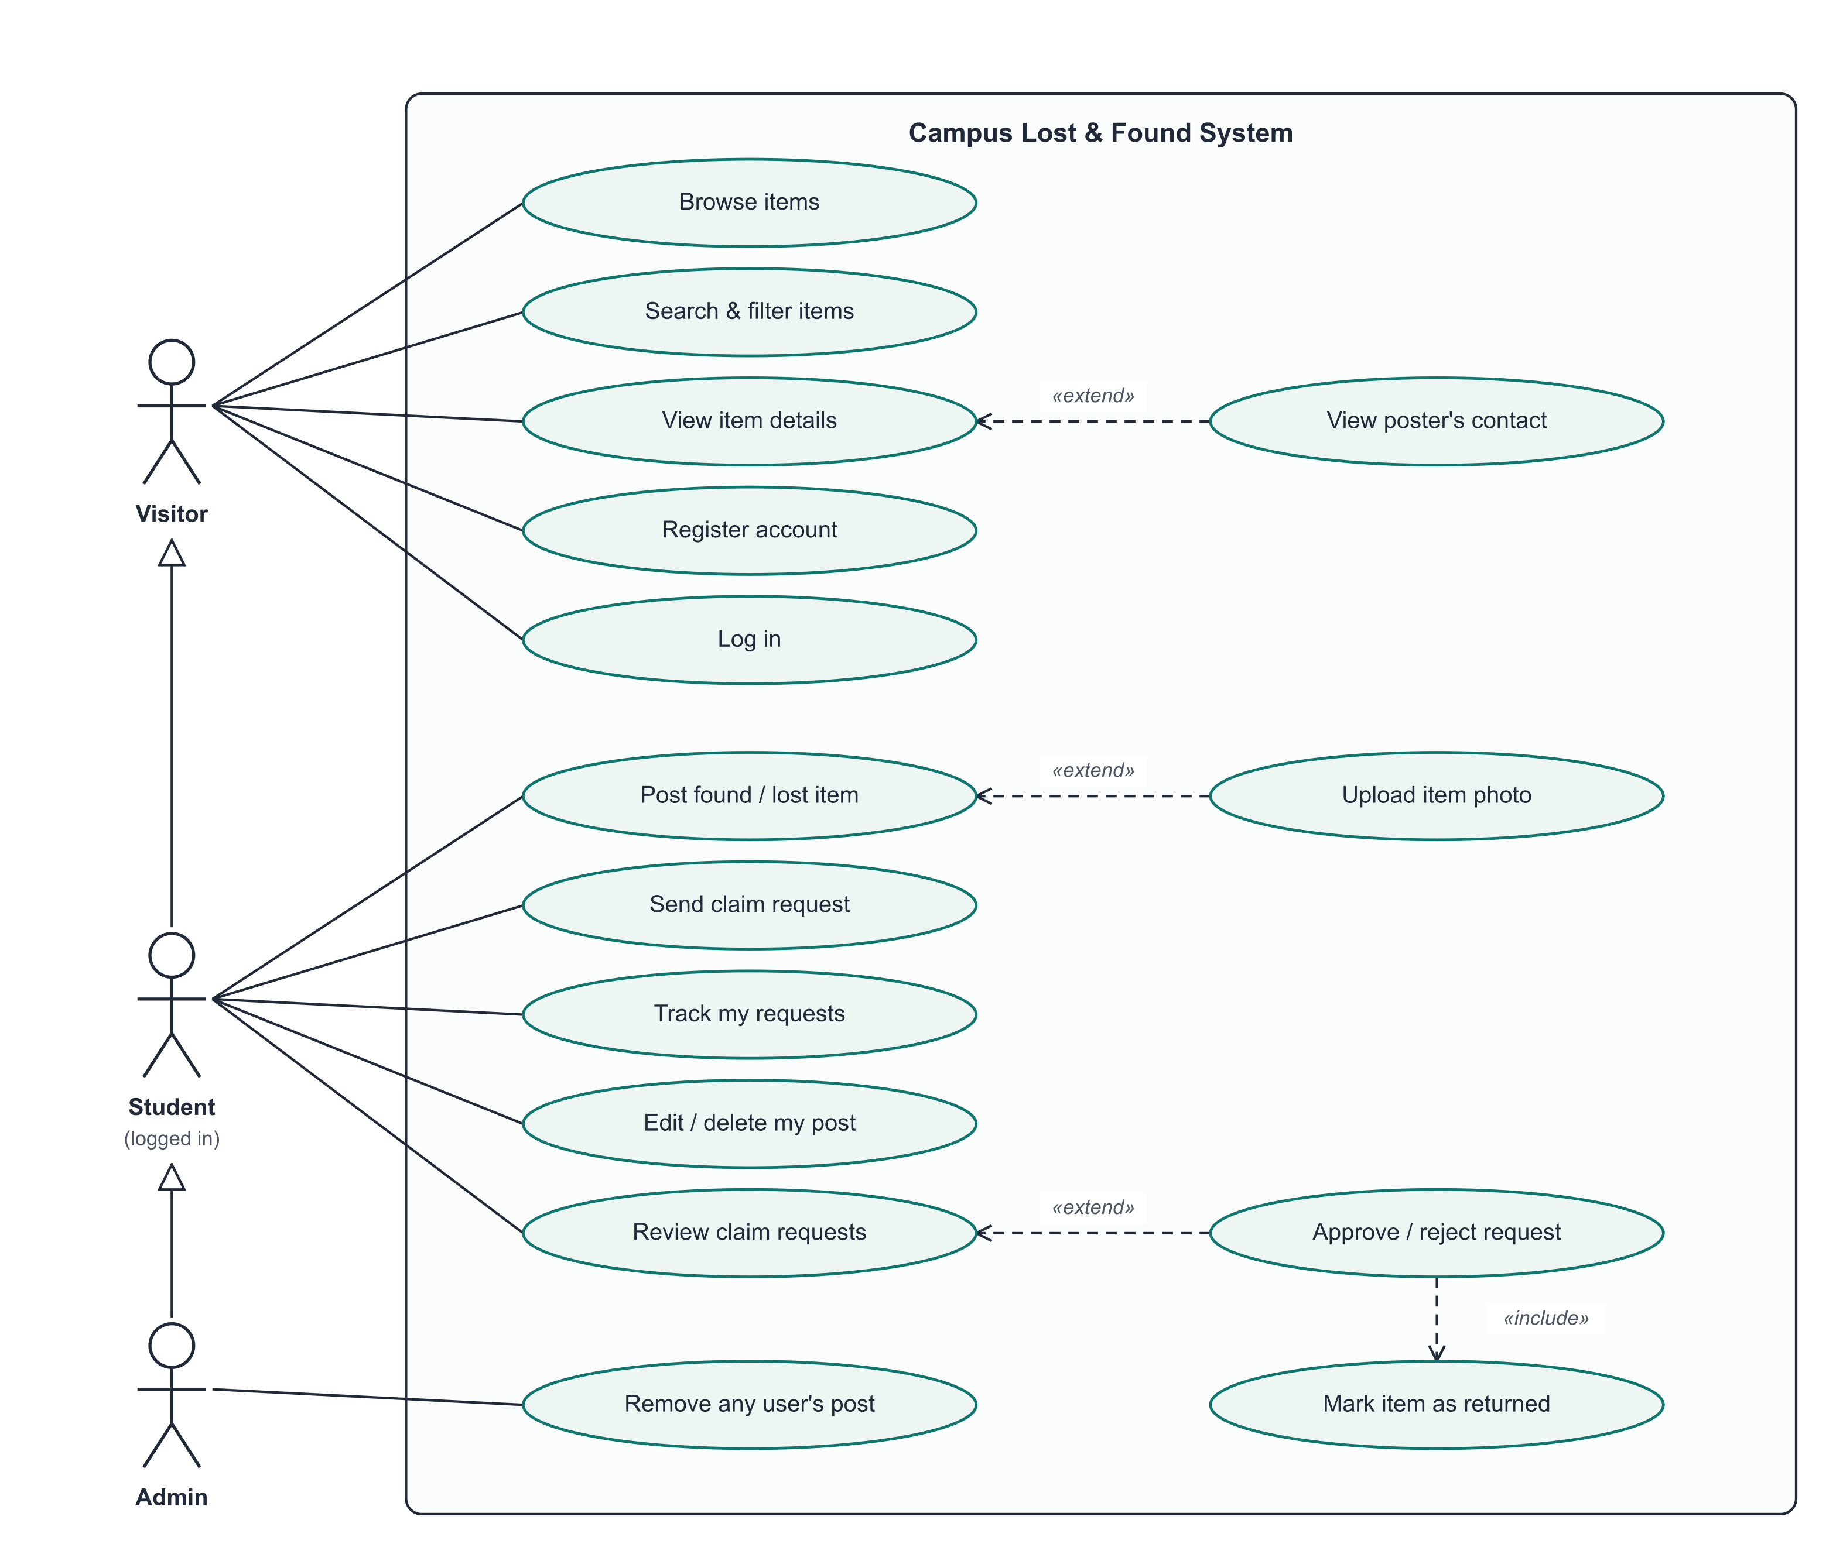
Student 2 | System Design
Use case diagram
How to read it
Three actors: Visitor (not logged in), Student (logged in) and Admin. The hollow-triangle arrows are generalisation: a Student can do everything a Visitor can, and an Admin everything a Student can.
Visitors can browse, search, view items, register and log in.
Students can post items, send and track claim requests, manage their own posts and review requests on their posts.
«extend» marks optional behaviour: uploading a photo extends posting; seeing the poster's contact extends viewing (only when logged in); approving / rejecting extends reviewing.
«include» marks behaviour that always happens: approving a request always marks the item as returned.
Notes:
Student 2 (about 45 seconds). Point to the three actors on the left: Visitor, Student and Admin. The hollow arrows mean a Student can do everything a Visitor can. Explain one extend (uploading a photo is optional when posting) and the include (approving a request always marks the item as returned).

Slide 9
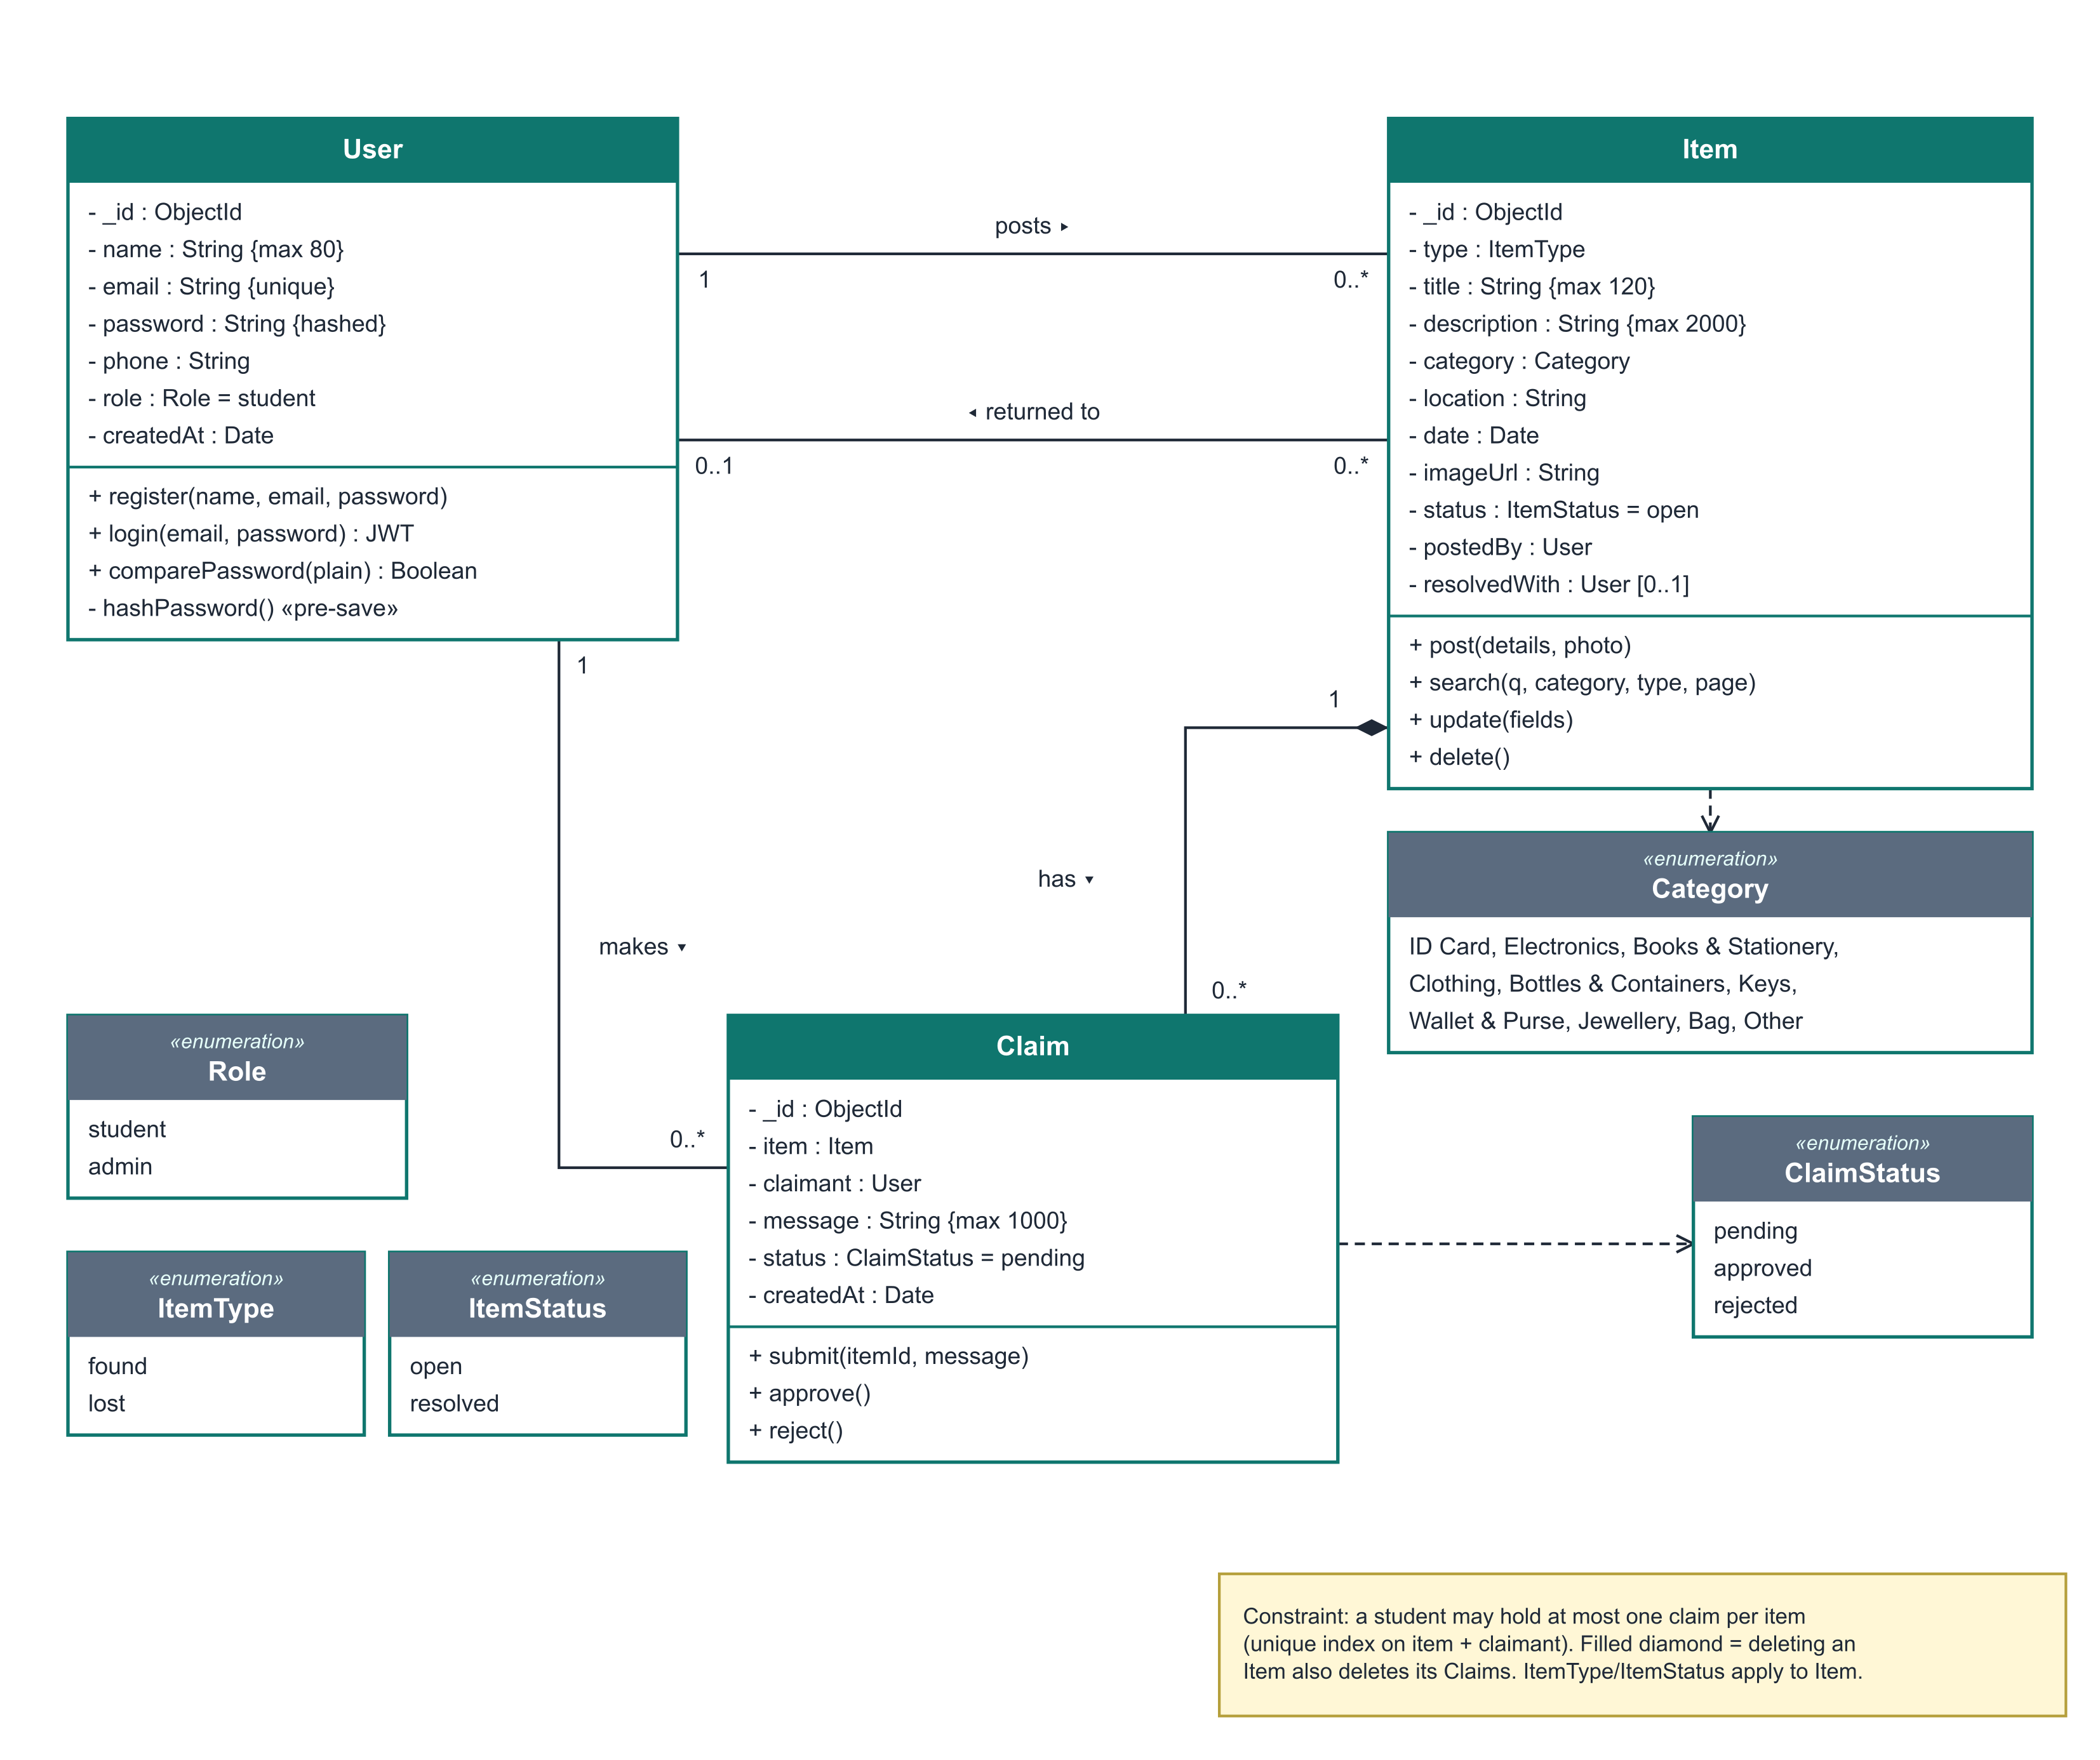
Student 2 | System Design
Class diagram
How to read it
User posts 0..* Items; an Item may be returned to 0..1 User (resolvedWith).
A User makes 0..* Claims; each Claim belongs to exactly one Item and one claimant.
The filled diamond between Item and Claim is composition: deleting an Item deletes all its Claims.
Enumerations restrict values: ItemType (found/lost), ItemStatus (open/resolved), ClaimStatus (pending/approved/rejected), Role and the 10 Categories.
The note records a business rule enforced by a unique database index: one claim per student per item.
Notes:
Student 2 (about 45 seconds). Three classes - User, Item, Claim. A user posts many items and makes many claims. The filled diamond means composition: deleting an item deletes its claims. Point out the enumerations and the note: one claim per student per item, enforced by a unique database index.

Slide 10
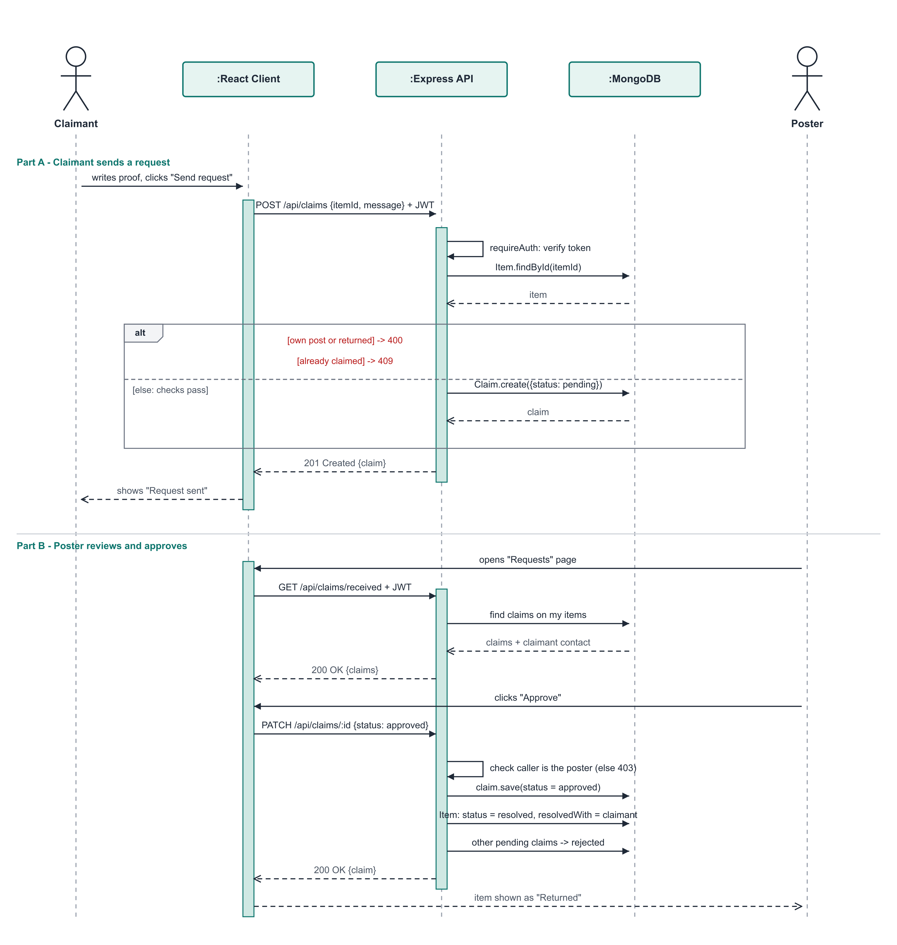
Student 2 | System Design
Sequence diagram: claiming an item
How to read it
Part A: the claimant's browser sends POST /api/claims with the login token; the API verifies the token, loads the item and runs the business checks.
The alt fragment shows the alternatives: own post or returned item gives 400, an earlier request gives 409, otherwise the claim is saved as pending.
Part B: the poster loads received requests, then approves one with PATCH /api/claims/:id.
On approval the API performs three database updates: claim approved, item resolved, other pending claims rejected.
Solid arrows are requests; dashed arrows are replies. Tall rectangles show when each object is active.
Notes:
Student 2 (about 45 seconds). Part A: the claimant's browser sends a POST request with the login token; the API checks the token, loads the item and runs the checks in the alt box. Part B: the poster loads the requests and approves one; the API makes three updates - claim approved, item resolved, other claims rejected.

Slide 11
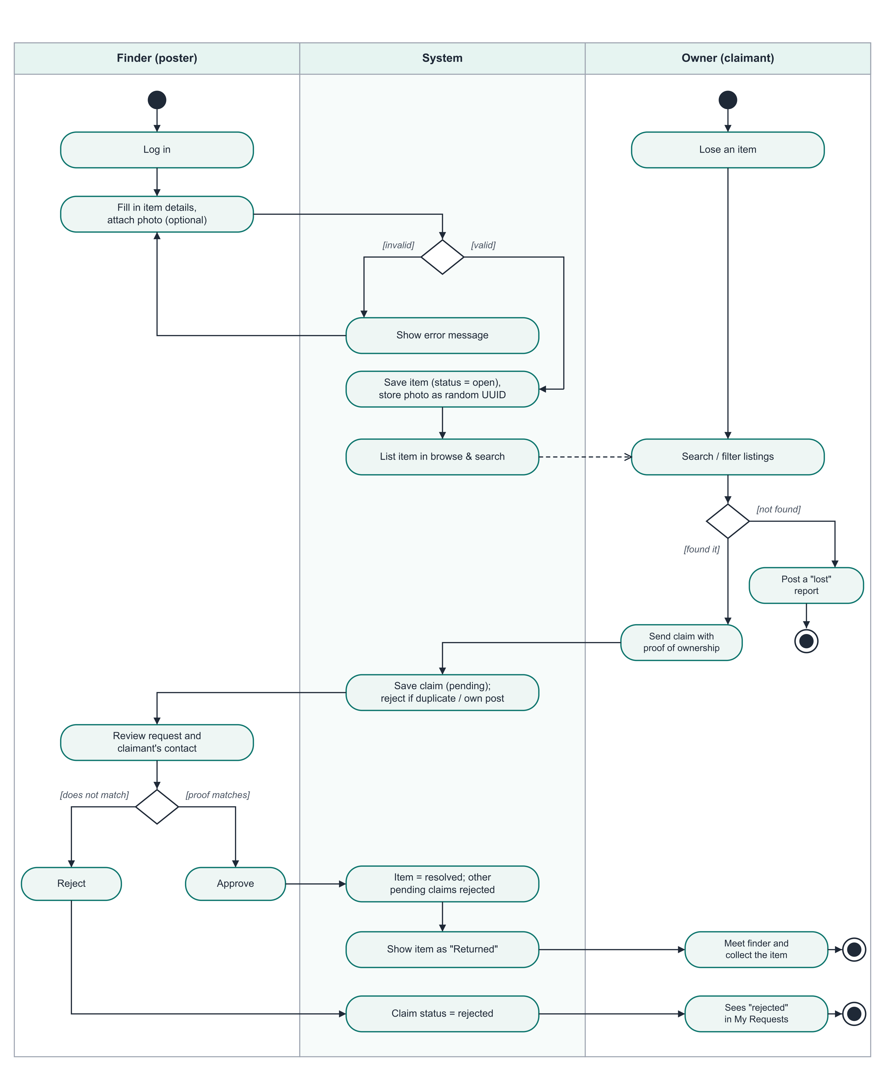
Student 2 | System Design
Activity diagram: post to return
How to read it
Swimlanes: Finder (poster), System and Owner (claimant) - each action sits in the lane of whoever performs it.
Diamonds are decisions with guard conditions in square brackets, e.g. [valid] / [invalid] form data.
The Owner's flow joins the Finder's when they find the listing and send a claim with proof.
The Finder's decision [proof matches] leads to approval and the item being returned; [does not match] leads to rejection.
Filled circle = start; ringed circle = end. There are three possible end states.
Notes:
Student 2 (about 45 seconds). Three swimlanes: Finder, System and Owner. Follow the flow from the finder posting, through validation, to the owner searching and claiming, and finally the finder approving or rejecting. Point out the decision diamonds with guard conditions.

Slide 12
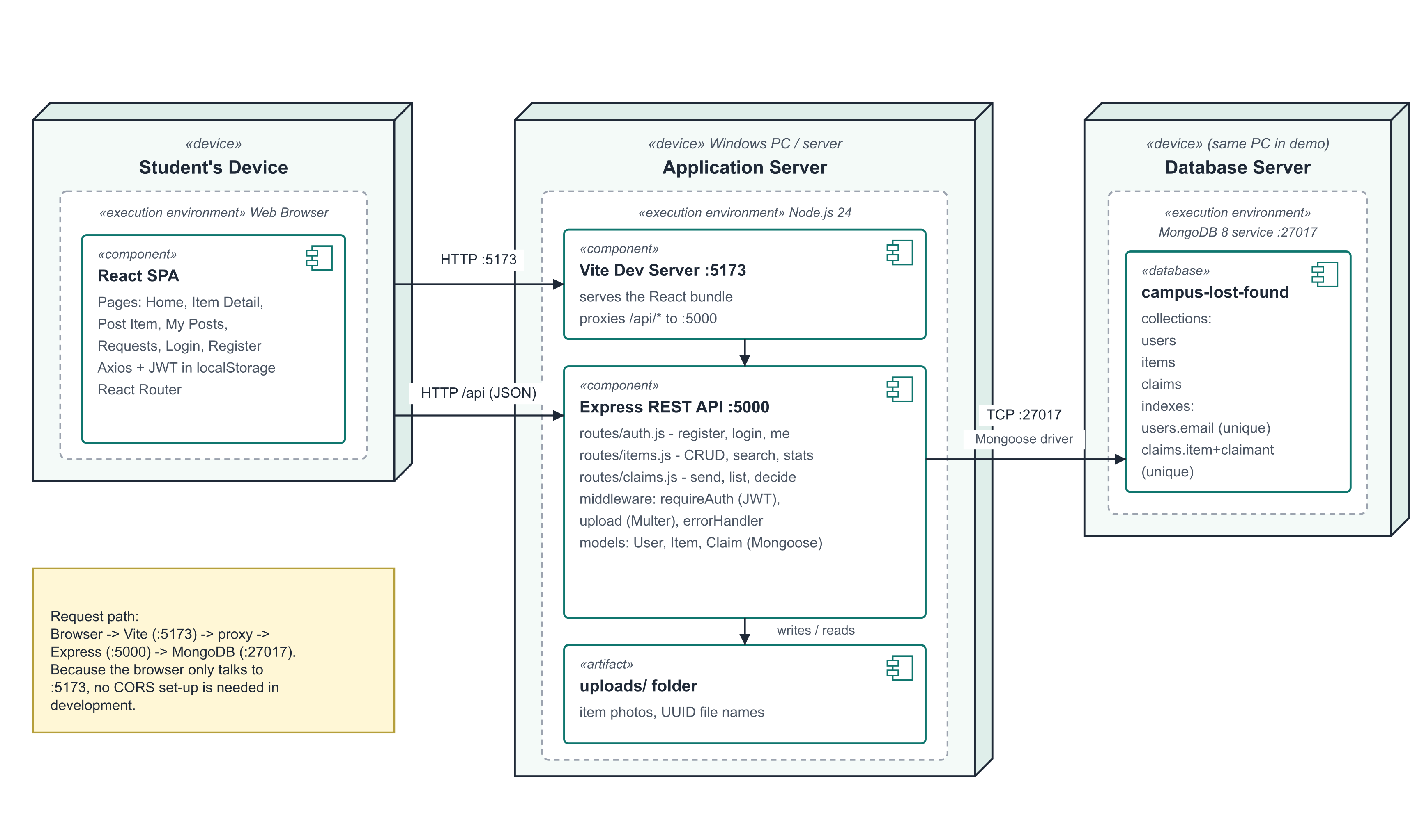
Student 2 | System Design
Deployment diagram
How to read it
The student's browser runs the React single-page app.
The application server runs Node.js with two processes: the Vite dev server (port 5173) that serves the React bundle and proxies /api calls, and the Express REST API (port 5000).
Express stores photos in the uploads/ folder and talks to MongoDB (port 27017) through the Mongoose driver.
For the demonstration all three nodes are the same laptop; in production they could be separate servers.
Notes:
Student 2 (about 30 seconds). The browser runs the React app. On the application server, Vite serves the app on port 5173 and forwards API calls to Express on port 5000, which stores photos in the uploads folder and talks to MongoDB on port 27017. In the demo all three are the same laptop. Then hand over to Student 3.

Slide 13
Student 3 | Development
Technology stack
M
E
R
N
MongoDB
Express 5
React 19
Node.js 24
3 collections: users, items, claims. Mongoose schemas with validation and indexes.
REST API: 15 endpoints in 3 route files, plus auth, upload and error middleware.
Single-page app: 7 pages, React Router, shared login state via Context.
Runs the API and the Vite dev server; one command to start each.
Supporting libraries
bcryptjs (password hashing) | jsonwebtoken (login sessions) | multer (photo upload) | axios (HTTP from React) | Vite (dev server & proxy) | node:test (automated tests)
Notes:
Student 3 (about 45 seconds). We used the MERN stack. MongoDB stores users, items and claims through Mongoose schemas. Express provides the REST API with 15 endpoints. React builds the single-page interface with 7 pages. Node.js runs the server. Mention the supporting libraries at the bottom and why: bcryptjs for passwords, jsonwebtoken for login sessions, multer for photo uploads.

Slide 14
Student 3 | Development
Live demonstration
1
Browse & search
2
Post an item
3
Send a claim
Search "bottle" while logged out - contact details hidden
Log in as Aarav, post a found item with a photo
As Priya (private window), claim it with proof of ownership
4
Approve
5
Returned
6
Validation
As Aarav, open Requests and approve Priya's claim
Item shows "Returned"; Priya sees "Approved"
Try to claim your own post - clear error message
Demo logins (password123): aarav@campus.edu | priya@campus.edu | rahul@campus.edu Site: http://localhost:5173
Notes:
Student 3 (about 3 minutes - the most important part). BEFORE CLASS: start MongoDB, run "npm run seed" and "npm run dev" in server, and "npm run dev" in client; open http://localhost:5173 in two browser windows (one normal, one private). DURING THE DEMO follow the six steps: (1) browse and search for "bottle" while logged out - point out that contact details are hidden; (2) log in as Aarav and post a found item with a photo; (3) in the private window log in as Priya, open the item and send a claim describing a detail; (4) back as Aarav, open Requests and approve; (5) show the item now has the Returned tag and Priya sees Approved; (6) show one validation message, e.g. try to claim your own post. If something fails, stay calm and show the screenshots from the Testing Report.

Slide 15
Student 3 | Development
Validation, error handling & security
Hashed passwords
Login sessions
✓
✓
bcrypt hash before saving; the password field is never returned by the API.
JWT token sent with every request; expires after 7 days.
Ownership checks
Contact privacy
✓
✓
Only the poster (or admin) can edit, delete or decide on claims.
Email and phone are removed from responses for visitors.
Safe uploads
Clear errors
✓
✓
Images only, max 5 MB, saved under random UUID file names.
Every failure returns a readable message, shown in a red banner.
Notes:
Student 3 (about 45 seconds). The assignment asks for validation, error handling and user-friendly interfaces - these are the measures we built in. Explain two in detail: passwords are hashed with bcrypt so even we cannot read them, and the item endpoint hides email and phone from visitors who are not logged in. Then hand over to Student 4.

Slide 16
Student 4 | Testing
Testing approach
45
10
4
100%
automated test cases
manual UI test cases
defects found & fixed
pass rate after fixes
Test types covered
System (black box)
Functional
Negative
Boundary value
Security
Regression
UI / usability
Tool: Node.js built-in test runner | Separate test database, wiped before and after | One command: npm test | File: server/tests/api.test.js
Notes:
Student 4 (about 1 minute). We wrote 45 automated system test cases that start the real API and send real HTTP requests, using a separate test database so demo data is never touched. They cover functional, negative, boundary and security cases, and can be re-run with one command: npm test. We also have 10 manual UI test cases. The first run found 4 real defects; after fixing them every test passes.

Slide 17
Student 4 | Testing
Results and defects
ID | Defect found | Severity
D-01 | Invalid email addresses are accepted at sign-up | Medium
D-02 | Non-text login input crashes the request (500) | Medium
D-03 | Uploading a non-image returns a server error | Low
D-04 | A returned item can be "returned" again to another claimant | High
All 4 defects fixed and re-tested (Run 2: 45 / 45 pass). TC-24 failed in Run 1 because the test's expected value was wrong - the test was corrected, not the product.
Notes:
Student 4 (about 1.5 minutes). The chart compares the two runs per module. Run 1 had 5 failures: 4 were real product defects, and 1 (TC-24) was a mistake in our own test - the expected count was wrong - which we corrected. Explain the most serious defect, D-04: after an item was returned, the poster could still approve another claim and change who the item was returned to. We fixed it so decisions are refused once an item is returned, re-ran everything, and all 45 passed. Then hand over to Student 5.

Slide 18
Student 5 | Documentation
SRS document (IEEE 830 structure)
1
Introduction
Purpose, scope, definitions, references
Deliverables
2
Overall description
Product perspective, user classes, environment, constraints, assumptions
Requirements Analysis
System Design (5 UML diagrams)
Working software + README
Testing Report (45 + 10 cases)
SRS document
This presentation
3
External interfaces
UI screens, software & communication interfaces, 15 API endpoints
4
System features
Stimulus / response and FR-01 - FR-16 per feature
5
Non-functional
Performance, security, quality attributes, business rules
6
Data requirements
Class diagram and field rules for 3 collections
7
Verification
Requirement -> test case -> result traceability
Notes:
Student 5 (about 1 minute). The SRS follows the IEEE 830 / ISO 29148 structure and brings together all project details: introduction and scope, overall description with user classes and constraints, external interfaces including the full API, system features with stimulus-response sequences, non-functional requirements and business rules, the data model, and a verification section linking every requirement to its test results. The companion documents are the requirements analysis, the UML design document and the testing report.

Slide 19
Student 5 | Documentation
Conclusion and future work
What we achieved
Future enhancements
A working full-stack application solving a real campus problem
All 16 functional requirements implemented and verified
Ownership check and privacy built into the claim workflow
4 defects found by testing, fixed and re-tested
Complete SDLC documentation, with traceability from requirements to tests
1
Email / push notifications
2
Sign-up with college email only
3
Admin dashboard for spam posts
4
Automatic lost-found matching
5
Cloud hosting with HTTPS
Notes:
Student 5 (about 45 seconds). Summarise what was achieved on the left, then mention future work on the right - notifications and college-email sign-up are the most requested. Close with: Thank you, we are happy to take questions.

Slide 20
Campus Lost & Found
Thank you
Questions?
[Student 1 name] | [Student 2 name] | [Student 3 name] | [Student 4 name] | [Student 5 name]
Notes:
Any team member. Likely questions and who should answer: Why MERN? (Student 3). How do you stop a false claim? - the poster reads the proof and only then approves; future work is college-email sign-up (Student 1). Why these five diagrams? (Student 2). How do you run the tests? - npm test in the server folder (Student 4). What standard does the SRS follow? - IEEE 830 / ISO 29148 (Student 5).

