Slide 1
LEADERSHIP BRIEFING
July 2026
CAMP4
Automated SAP Public Cloud Configuration
SAP S/4HANA Public Cloud
Working prototype · Production-grade architecture
Notes:
CAMP4 automates the configuration of SAP S/4HANA Public Cloud end to end. Today: what it does, how it works, and what the business case looks like. Status: working prototype on a production-grade architecture.

Slide 2
01
The Problem
Every S/4HANA Public Cloud implementation is configured by hand in SSCUIs — SAP's self-service configuration screens. Hundreds of tables, thousands of rows, typed field by field.
The effort repeats for every project and scales only with headcount.
200–1,000+
15–45 min
5–8%
SSCUI screens per implementation
manual effort per screen
typical manual error rate — typos and row drift
CAMP4 · Automated SAP Public Cloud Configuration
Notes:
Every cloud implementation repeats the same manual work: hundreds of SSCUI screens, thousands of rows, typed by consultants. It is slow, error-prone, and scales only with headcount.

Slide 3
02
The Solution
Three products split the work: one delivers the data, one learns the configuration, one executes it.
HAND-OFF
SOURCE
PRODUCT 1
PRODUCT 2
PRODUCT 3
TARGET
SAP ECC
x-Ray
Knowledge Builder
Export package
Config Bot
S/4HANA Cloud
→
mass ECC export + data quality analytics
→
→
→
→
on-premise, SM30 tables
learns and maps the tenant
metadata · Excel · recordings
executes the configuration
configured tenant
01 · x-Ray
02 · Knowledge Builder
03 · Config Bot
Mass-exports the existing ECC configuration tables and applies analytics to assess data quality — the data feed for the pipeline.
Crawls every SSCUI, reads structure and complexity with AI vision, and maps the ECC values onto the cloud fields.
Loads the package and performs the configuration in the live tenant — logging every step.
CAMP4 · Automated SAP Public Cloud Configuration
Notes:
Three products split the work. x-Ray mass-exports the ECC tables and checks data quality, the Knowledge Builder learns the tenant configuration and maps it, the Config Bot executes it. The hand-off is a portable export package.

Slide 4
03
Knowledge Builder
Product two crawls, analyzes and structures a tenant's entire configuration knowledge — automatically.
1
2
3
CBC Crawler
Technical Crawler
ECC Mapper
→
→
Inventories every SSCUI in the Configuration Business Catalog — numbers, names, direct URLs.
Opens each screen; Claude Vision reads field structure, tab order and complexity level.
Maps the existing on-premise configuration values onto the S/4HANA Cloud fields.
Complexity, classified by AI:
L1
direct table
L2
dialog navigation — recorded once, replayed
L3
multi-step wizard
OUTPUT
One portable export package — metadata, Excel mappings and recorded navigation for complex screens.
CAMP4 · Automated SAP Public Cloud Configuration
Notes:
Product two — three automated steps: inventory every SSCUI, let AI vision read each screen structure and complexity, then map the existing ECC configuration onto the cloud fields. Complex screens get a recorded navigation path. Everything is bundled into one portable package.

Slide 5
04
Config Bot
Product three loads the export package and performs the configuration in the live tenant — choosing the right mode per screen.
A
B
C
Tab Navigation
Replay Mode
Vision Mode
Types values straight into tables via keyboard navigation — fast and deterministic.
Replays the recorded navigation path from the library, then enters the data.
Claude Vision reads the screen and locates fields and checkboxes dynamically.
For L1 · direct tables
For L2–L3 · dialogs and wizards
For complex forms · fallback
Manual login
→
Automated execution
→
→
HUMAN IN THE LOOP
Row-by-row confirmation (optional)
Full audit trail
CAMP4 · Automated SAP Public Cloud Configuration
Notes:
Product three picks the right strategy per screen: direct keyboard entry for simple tables, recorded replays for dialogs and wizards, AI vision when layouts shift. The operator keeps control of login, confirmation and save — with a full audit trail.

Slide 6
05
AI in the Pipeline
Vision models read SAP's screens the way a consultant does — no brittle UI selectors to maintain.
TASK
MODEL
WHY
Complexity classification
Claude Haiku
Fast, low-cost triage of every screen into L1–L3
Field recognition
Claude Sonnet
Turns a screenshot into a structured map of fields and checkboxes
Replay recovery
Claude Sonnet
Re-finds targets visually when screen coordinates drift
ECC field mapping
Claude Sonnet
Resolves non-obvious field renames between ECC and Cloud
Model choice per task keeps AI cost proportional to difficulty.
CAMP4 · Automated SAP Public Cloud Configuration
Notes:
AI is used where rules break. Haiku triages screen complexity cheaply at scale; Sonnet reads forms into structured field maps, recovers replays visually when coordinates drift, and resolves non-obvious field renames. Model choice per task keeps cost proportional to difficulty.

Slide 7
06
Business Case
EFFORT PER SCREEN
10–15×
Manual
15–45 min
Automated
1–3 min
ERROR RATE
faster than manual configuration
Manual
5–8%
Automated
< 1%
Across 200–1,000+ screens per implementation, weeks of consultant time become days.
CAMP4 · Automated SAP Public Cloud Configuration
Notes:
Per screen, 15 to 45 minutes become 1 to 3. Across 200 to 1,000+ screens that is a 10 to 15 times reduction — and the error rate drops below one percent because every entry is scripted, confirmed and logged.

Slide 8
07
Differentiation
01
02
03
No RPA platform
AI-native
Built for SAP's DOM
Lightweight Python stack — no UiPath or Blue Prism licenses and infrastructure.
Vision analysis instead of fragile CSS selectors — adapts when SAP changes its UI.
Understands Web Dynpro's proprietary markup, where generic tools fail.
04
05
06
Reusable recordings
Portable packages
Audit and control
Navigation captured once is replayed across projects and tenants.
Configuration knowledge becomes a transportable, system-independent artifact.
Every step logged; the operator keeps login, confirmation and save.
CAMP4 · Automated SAP Public Cloud Configuration
Notes:
This is not an RPA platform play — no licenses, no fragile selectors. It is specialized for SAP's proprietary UI, and it produces reusable, auditable artifacts: recordings and portable packages.

Slide 9
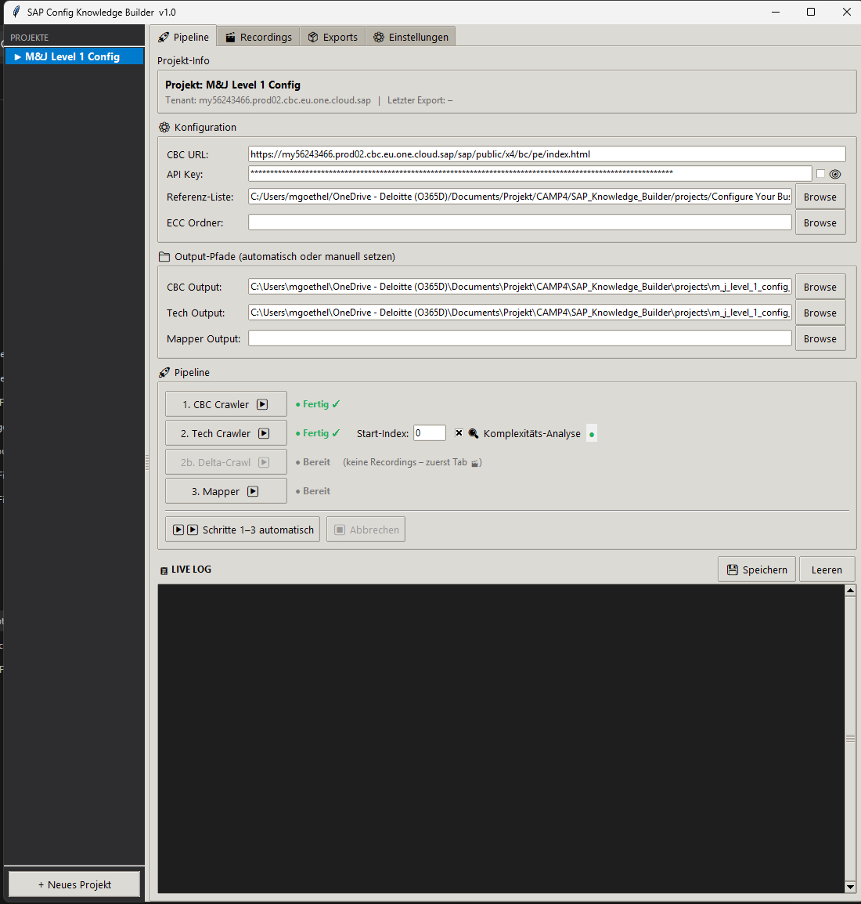
08
Product Preview
Knowledge Builder
Config Bot
Pipeline control, recording library, export manager
Execution progress, live log, row-by-row confirmation
A live end-to-end demo is available for a follow-up session.
Notes:
Both applications run today against a live tenant — these are the actual desktop apps. A live end-to-end demo is available as a follow-up session.

Slide 10
09
Outlook
The suite keeps growing — the next stage is already in planning.
Diate
IN PLANNING
A recommendation engine for the target configuration: Diate analyzes the ECC configuration tables together with transactional usage data and proposes which settings to carry over — and which to retire.
EXAMPLE
Material groups with no usage in recent years are excluded from the new cloud configuration.
MORE TO COME
CAMP5
·
CAMP6
the next expansion stages of the CAMP suite
Notes:
Beyond execution, Diate is in planning: a recommendation engine that combines configuration tables with transactional usage data to propose what to migrate and what to retire — for example, material groups unused for years are excluded. CAMP5 and CAMP6 are the next expansion stages of the suite.

