Slide 1

CS 112 – Java Programming
Instructor: Binayak Bhattacharyya
bbinayak@yahoo.com

Slide 2
CS 112
Course: CS 112 - Java Programming
Instructor: Binayak Bhattacharyya
  Email: bbinayak@yahoo.com
Where: SAC A-210
Office: None
Time: 7:00 pm - 10:10 pm Th

Slide 3
Website
Course website
http://sacbusiness.org/cs/BhattacharyyaB/cs112.htm
Syllabus and schedule
http://sacbusiness.org/cs/BhattacharyyaB/cs112Syllabus.htm

Slide 4
Syllabus
Course Detail & Prerequisite proficiency in a programming language
Grading
Homework
Exams
Attendance
Textbook
Software + hardware
Schedule
Academic Honesty

Slide 5

What is Java?
Java is a high-level Object oriented programming language that has many functions. It is used to develop applets that reside on Web pages, applications that run on your desktop, server-side middleware that are used to communicate between clients and server resources. Java is also used on Web servers and in embedded systems and smart devices, just to name a few of its many functions.
Java was created by Sun Microsystems in 1995.

Slide 6
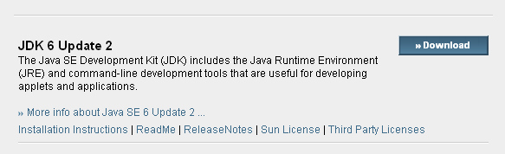
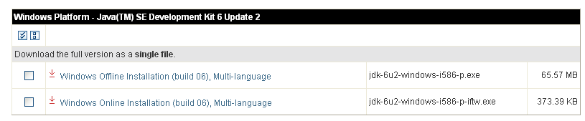
Setting up the Environment
Download and install The Java Standard Edition Development Kit (JDK):
http://java.sun.com/javase/downloads/index.jsp

Slide 7
Setting up the Environment
A text editor for writing programs.
We'll use NotePad, the simple editor included with the Windows platforms. To find NotePad, from the Start menu select All Programs > Accessories > NotePad.

Slide 8
Hello World Program
Start Notepad and type the following code:
public class HelloWorldApp
{
public static void main(String[] args)
{
// Display "Hello World!"
System.out.println("Hello World!");
}
}
Go to File > Save As > Go to the directory where you want to save and name the file HelloWorldApp.java

Slide 9
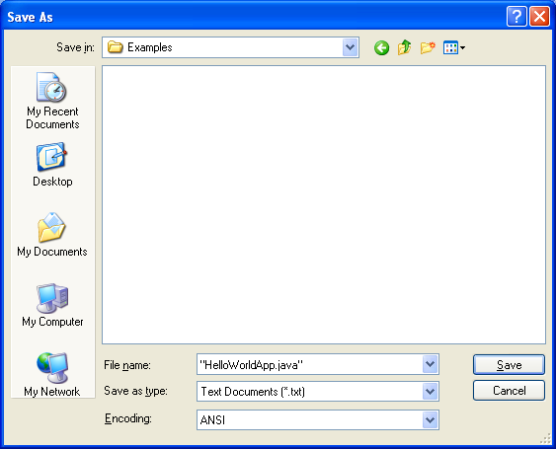
Hello World Program
Make sure that you write the name of the file in double-quotes.

Slide 10
Hello World Program
Now go to All Programs > Accessories > Command Prompt
Change the directory to where you stored you java file.
Use cd command to change directory
e.g. cd “C:\Java\Examples”
Set the system path for javac compiler
SET PATH="C:\Program Files\Java\jdk1.6.0_01\bin";%PATH%
The above directory is the installation directory for java
Compile the file using the command:
javac HelloWorldApp.java

Slide 11
Hello World Program
The compiler has generated a Java bytecode file, HelloWorldApp.class. At the prompt, type dir to see the new file that was generated.
Run the program:
In the same directory run the command:
java HelloWorldApp
The result should be the following displayed to the screen:
Hello World!

Slide 12
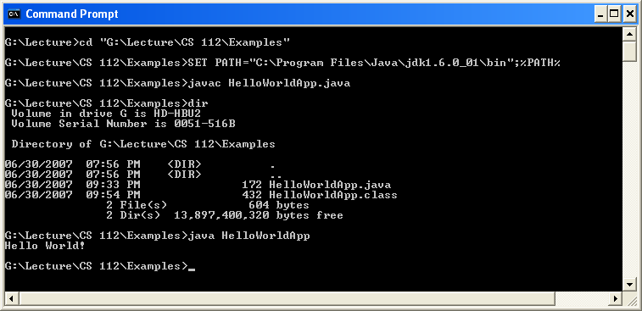
Hello World Program

Slide 13
Using a Batch File
Using a batch file (.bat) the compilation and running process can be automated.
Instructor is going to give you makeJava.bat which contains the scripts for compiling and running java apps. Copy the batch file in the same directory as the java file.
REM The following line can be customized for your system:
REM **********************************BEGIN customize
SET PATH="C:\Program Files\Java\jdk1.6.0_01\bin";%PATH%
REM **********************************END customize
REM Invoke JAVAC (the compiler):
javac %1.java
if errorlevel 1 goto terminate
REM Display all files related to this program:
DIR %1.*
REM Run the Application:
java %1
:terminate
pause

Slide 14
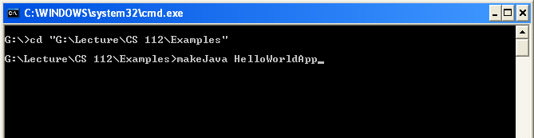
Using a Batch File
Change the directory to where you stored you java file.
Use cd command to change directory
e.g. cd “C:\Java\Examples”
Run the batch file as follows:
makeJava HelloWorldApp
Note: Don’t put .java extension
The result should be the following displayed to the screen:
Hello World!

Slide 15
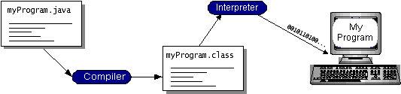
About the Java Technology
With most programming languages, you either compile or interpret a program so that you can run it on your computer. The Java programming language is unusual in that a program is both compiled and interpreted. With the compiler, first you translate a program into an intermediate language called Java bytecodes —the platform-independent codes interpreted by the interpreter on the Java platform.
The interpreter parses and runs each Java bytecode instruction on the computer. Compilation happens just once; interpretation occurs each time the program is executed. The following figure illustrates how this works.

Slide 16
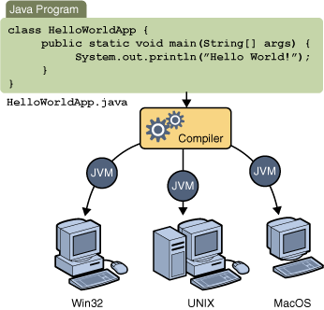
About the Java Technology
You can think of Java bytecodes as the machine code instructions for the Java Virtual Machine (Java VM). Every Java interpreter, whether it's a development tool or a Web browser that can run applets, is an implementation of the Java VM.

Slide 17
The Java Platform
A platform is the hardware or software environment in which a program runs. We've already mentioned some of the most popular platforms like Microsoft Windows, Linux, Solaris OS, and Mac OS. Most platforms can be described as a combination of the operating system and underlying hardware. The Java platform differs from most other platforms in that it's a software-only platform that runs on top of other hardware-based platforms.
The Java platform has two components:
The Java Virtual Machine
The Java Application Programming Interface (API)
You've already been introduced to the Java Virtual Machine; it's the base for the Java platform and is ported onto various hardware-based platforms.

Slide 18
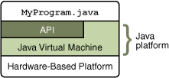
The Java Platform
The API is a large collection of ready-made software components that provide many useful capabilities. It is grouped into libraries of related classes and interfaces; these libraries are known as packages.
As a platform-independent environment, the Java platform can be a bit slower than native code. However, advances in compiler and virtual machine technologies are bringing performance close to that of native code without threatening portability.

Slide 19
Understanding Your First Program
public static void main( String[] args )
that is a member of the HelloWorldApp class called main. main is a very special function in Java, specifically for applications. main is the entry point that the Java Runtime Engine (JRE), or java.exe, processes when it starts. When you launch the application later by typing
java HelloWorldApp
you are telling the Java Runtime Engine to open the class file HelloWorldApp.class and process the main function.
System.out.println( "Hello World!" );
Here println method of the out object is called to write a line on the console.

Slide 20
Modifying the Program
public class L1S1HelloWorldApp
{
public static void main(String[] args)
{
System.out.print("Hello ");
System.out.print("World \n");
System.out.print("Java");
}
}
print() does not position the output cursor at the beginning of the next line in the command window
The escape sequence \n represents the newline character.

Slide 21
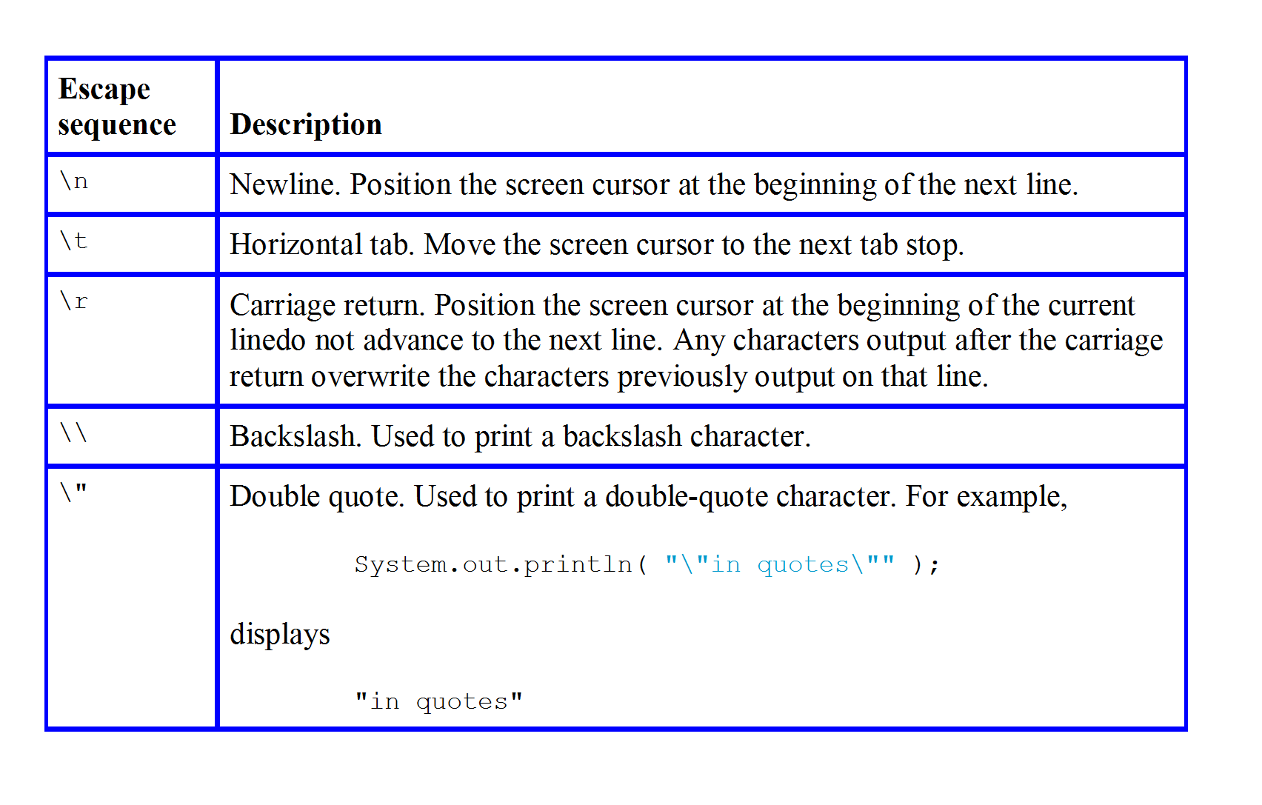
Some common escape sequences

Slide 22
Java Comments
Comments are ignored by the compiler.
Single-line comments:
// Display the string.
Multi-line comments:
/* The HelloWorldApp class implements an application that simply prints "Hello World!" to standard output. */
/** documentation */
This indicates a documentation comment (doc comment, for short). The compiler ignores this kind of comment, just like it ignores comments that use /* and */. The javadoc tool uses doc comments when preparing automatically generated documentation

Slide 23
CS112-Ex1a
Write a Java program to write you name and address in the next line. Compile and run the application.

Slide 24
Data Types
The Java programming language is strongly-typed, which means that all variables must first be declared before they can be used.
Data types in Java are divided into two categories primitive types and reference types. The primitive types are boolean, byte, char, short, int, long, float and double. Classes which specify the types of objects, are reference types.

Slide 25
Primitive Data Types
A primitive type is predefined by the language and is named by a reserved keyword. The primitive data types supported by the Java programming language are:
IntegralType:
byte
short
int
long
char
FloatingPointType:
float
double
boolean

Slide 26
Integral Types and Values
byte: The byte data type is an 8-bit signed two's complement integer. It has a minimum value of -128 and a maximum value of 127 (inclusive).
short: The short data type is a 16-bit signed two's complement integer. It has a minimum value of -32,768 and a maximum value of 32,767 (inclusive).
int: The int data type is a 32-bit signed two's complement integer. It has a minimum value of -2,147,483,648 and a maximum value of 2,147,483,647 (inclusive).
long: The long data type is a 64-bit signed two's complement integer. It has a minimum value of -9,223,372,036,854,775,808 and a maximum value of 9,223,372,036,854,775,807 (inclusive).
char: The char data type is a single 16-bit Unicode character. It has a minimum value of '\u0000' (or 0) and a maximum value of '\uffff' (or 65,535 inclusive).

Slide 27
Floating-Point Types and boolean
float
4 bytes (32 bits)
+/– 3.40282347E+38 (6–7 significant digits)
double
8 bytes (64 bits)
+/– 1.7976931346231570E+308 (15 significant digits)
A boolean data type has one of two values: true or false. These are not strings, but keywords in the Java programming language.

Slide 28
string
In addition to the eight primitive data types listed above, the Java programming language also provides special support for character strings via the java.lang.String class.
Enclosing your character string within double quotes will automatically create a new String object; for example, String s = "this is a string";. String objects are immutable, which means that once created, their values cannot be changed.
The String class is not technically a primitive data type, but considering the special support given to it by the language, you'll probably tend to think of it as such.

Slide 29
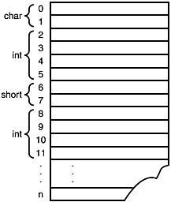
Variables
Data types define the storage capacity and usage for a region in memory, but how is that memory accessible? Memory itself has a numerical address associated with it that, when accessed, references its value.
Data in memory.

Slide 30
Variables
In Java when you assign a meaningful identifier to a region of memory, that identifier is called a variable.
The act of creating a variable is called declaring a variable, and it has the following form:
datatype variableName;
It must start with an alphabetic character (a through z, A through Z, or any Unicode character that denotes a letter in a language), an underscore, or the dollar sign.
It can have any alphabetic or numeric value as well as an underscore anywhere in its name.
It can be of unlimited length.
It cannot have any spaces or non-alphanumeric characters, such as + or -, in it.
It cannot be a Java keyword.
It is case sensitive (the case of a letter—uppercase or lowercase—has meaning, for example, myBook is not the same as myBooK.

Slide 31
Variables
In Java, every variable has a type. You declare a variable by placing the type first, followed by the name of the variable. Here are some examples:
double salary;
int vacationDays;
long earthPopulation;
boolean done;

Slide 32
Literals
A literal is the source code representation of a fixed value; literals are represented directly in your code without requiring computation. As shown below, it's possible to assign a literal to a variable of a primitive type:
boolean result = true;
char capitalC = 'C';
byte b = 100;
short s = 10000;
int i = 100000;

Slide 33
A statement
After a variable as been declared, a value can be assigned to it. Remember that its data type defines the valid values for a variable. Java defines an assignment operator for assigning values to variables: the equal sign (=).
For example:
int myAge;
myAge = 30;
A line of Java code is called a statement, and a semicolon terminates each statement in Java. Another more common method of initializing a variable is to do so during its declaration. For example:
int myAge = 30;

Slide 34
Conversion Between Numeric Types
Variables in Java can be participants in various operations including, but not limited to, addition, subtraction, multiplication, and division.
When using numeric variables (variables defined to be ints, floats, and so on) the type does not necessarily have to be the same; in other words you can add an int to a byte.

Slide 35
Conversion Between Numeric Types
All mathematical operations in Java are performed by promoting each operand in the operation to a specific data type, following these rules in this order:
If any of the operands is of type double, the other one will by converted to a double.
If any of the operands is of type float, the other one will be converted to a float.
If any of the operands is of type long, the other one will be converted to a long.
Otherwise all operands will be converted in ints.
The promotion, or conversion, of a narrower type (fewer number of bytes) to a wider type (greater number of bytes), such as the conversion of a short to an int, is accomplished by prepending the narrower type with enough bytes to be the same size as the wider type

Slide 36
Conversion Between Numeric Types
These rules ensure that all operations resolve to the widest type (in number of bytes) in the operation. Thus, the result of the following operation is a long:
long l = 10;
int i = 10;
byte b = 10;
long result = l + i + b;
The int and byte are promoted to be longs before the operation is performed.

Slide 37
Conversion Between Numeric Types
You might have noticed that short and byte variables are promoted to ints during operations, even if there are no ints in the operation. Thus, the following statement would generate an unexpected error:
byte b1 = 10;
byte b2 = 10;
byte result = b1 + b2;
The Java compiler would complain about this operation saying that there is a "possible loss of precision" because although b1 and b2 are both bytes, they are promoted to ints before assigning the result to result. A byte has 1 byte, whereas an int has 4 bytes, so assigning an int to a byte loses the top 3 bytes during the assignment.

Slide 38
Conversion Between Numeric Types
The rule for conversion between primitive numeric types is that a type can be assigned to a wider type (one with more bytes), but not a narrower type (one with less bytes). So, the following conversions are permissible by the compiler:
byte—short, int, long, float, double
short—int, long, float, double
int—long, float, double
long—float, double
float—double
char—int
For example:
int i = 10;
long l = i; // legal
double d = i; // legal
short s = i; // Illegal!

Slide 39
Example
public class L1S2Calc
{
public static void main(String[] args)
{
double salary = 600.00;
int hours = 8;
double payRate = salary / hours;
System.out.print("Rate is : " + payRate);
System.out.println();
}
}

Slide 40
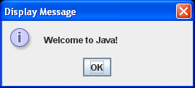
Text in a Message Dialog Box
import javax.swing.JOptionPane;
public class L1S3MessageDialog
{
public static void main(String[] args)
{
// Display Welcome to Java! in a message dialog box
JOptionPane.showMessageDialog(null, "Welcome to Java!",
"Display Message", JOptionPane.INFORMATION_MESSAGE);
}
}

Slide 41
CS112-Ex1b
Write a Java program that displays the area of a rectangular page (40.34 X 23) on a MessageDialog.

Slide 42
Casting Between Data Types
Casting tells the compiler to convert the data to the specified type even though it might lose data. By casting you are assuring the compiler that either data will not be lost, or if it is, that you will not care. Casting is performed by prefixing the variable or value by the desired data type enclosed in parentheses:
datatype variable = ( datatype )value;
For example:
int i = 10;
short s = ( short )i;
long l = 100;
byte b = ( byte )l;

Slide 43
Constants
The value of a variable may change during the execution of the program, but a constant represents permanent data that never changes.
Here is the syntax for declaring a constant:
final datatype CONSTANTNAME = VALUE;
A constant must be declared and initialized in the same statement. The word final is a Java keyword which means that the constant cannot be changed. For example, in the ComputeArea program, you could define p as a constant and rewrite the program as follows:
public class ComputeArea {
public static void main(String[] args) {
final double PI = 3.14159; // Declare a constant
// Assign a radius
double radius = 20;
// Compute area
double area = radius * radius * PI;
// Display results
System.out.println("The area for the circle of radius " +
radius + " is " + area);
}
}

Slide 44
Interesting Links
The Java Tutorial:
http://java.sun.com/docs/books/tutorial/
Download JDK:
http://java.sun.com/javase/downloads/index.jsp
Java API:
http://java.sun.com/javase/6/docs/api/

Slide 45
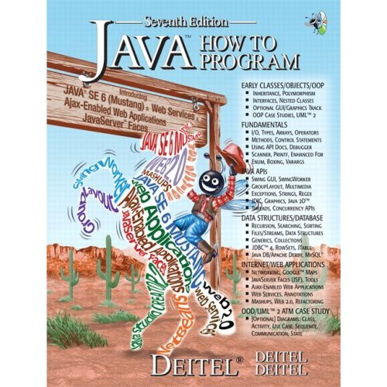
Reading from the Book
Chapter 2 :Page 37-83
Chapter 3 :Page 84-126

