Slide 1

CS 112 – Java Programming
Instructor: Binayak Bhattacharyya
bbinayak@yahoo.com

Slide 2
Homework #1 is due on: 09/13/2007

Slide 3
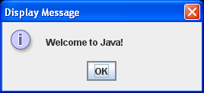
Text in a Message Dialog Box
import javax.swing.JOptionPane;
public class L1S3MessageDialog
{
public static void main(String[] args)
{
// Display Welcome to Java! in a message dialog box
JOptionPane.showMessageDialog(null, "Welcome to Java!",
"Display Message", JOptionPane.INFORMATION_MESSAGE);
}
}

Slide 4
Casting Between Data Types
Casting tells the compiler to convert the data to the specified type even though it might lose data. By casting you are assuring the compiler that either data will not be lost, or if it is, that you will not care. Casting is performed by prefixing the variable or value by the desired data type enclosed in parentheses:
datatype variable = ( datatype )value;
For example:
int i = 10;
short s = ( short )i;
long l = 100;
byte b = ( byte )l;

Slide 5
Constants
The value of a variable may change during the execution of the program, but a constant represents permanent data that never changes.
Here is the syntax for declaring a constant:
final datatype CONSTANTNAME = VALUE;
A constant must be declared and initialized in the same statement. The word final is a Java keyword which means that the constant cannot be changed. For example, in the ComputeArea program, you could define p as a constant and rewrite the program as follows:
public class ComputeArea {
public static void main(String[] args) {
final double PI = 3.14159; // Declare a constant
// Assign a radius
double radius = 20;
// Compute area
double area = radius * radius * PI;
// Display results
System.out.println("The area for the circle of radius " +
radius + " is " + area);
}
}

Slide 6
Getting Input from Input Dialogs
import javax.swing.JOptionPane;
public class L2S1InputDialog
{
public static void main(String[] args)
{
String name = "";
name=JOptionPane.showInputDialog(null, "Please enter your name", "Input Demo",
JOptionPane.QUESTION_MESSAGE);
JOptionPane.showMessageDialog(null, "Hello "+ name,
"Input Demo", JOptionPane.INFORMATION_MESSAGE);
}
}

Slide 7
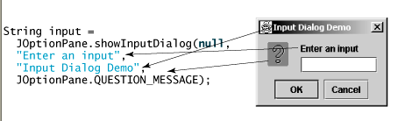
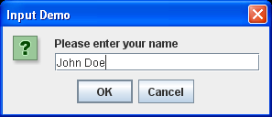
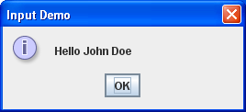
Getting Input from Input Dialogs

Slide 8
Converting Strings to Numbers
The input returned from the input dialog box is a string. If you enter a numeric value such as 123, it returns "123". You have to convert a string into a number to obtain the input as a number.
To convert a string into an int value, use the parseInt method in the Integer class, as follows:
int intValue = Integer.parseInt(intString);
where intString is a numeric string such as "123".
To convert a string into a double value, use the parseDouble method in the Double class, as follows:
double doubleValue = Double.parseDouble(doubleString);
where doubleString is a numeric string such as "123.45".

Slide 9
Converting Strings to Numbers
import javax.swing.JOptionPane;
public class L2S2InputDialogNum
{
public static void main(String[] args)
{
String num= "";
num = JOptionPane.showInputDialog(null, "Please enter a number", "Input Demo",
JOptionPane.QUESTION_MESSAGE);
int intValue = Integer.parseInt(num);
JOptionPane.showMessageDialog(null, "number/2 is "+ intValue/2, "Input Demo", JOptionPane.INFORMATION_MESSAGE);
}
}

Slide 10
Console based user input
import java.io;
public static void main(String[] args) {
// Create BufferedReader object from Standard input device.
// Standard input device is typically a keyborad.
BufferedReader dataIn = new BufferedReader(new
InputStreamReader( System.in) );
// Prompt a user to enter his/her name
String name = "";
System.out.println("Please Enter Your Name:");
// Read data into name variable
try{
name = dataIn.readLine();
}catch( IOException e ){
System.out.println("Error!");
}
// Display the name
System.out.println("Hello " + name +"!");
}
}

Slide 11
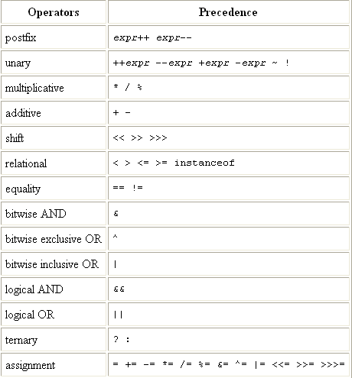
Operator Precedence
Decreasing precedence from the top of the table

Slide 12
Precedence and Associativity
All binary operators, except for the relational and assignment operators, associate from left to right. The relational operators are nonassociative.
Except for unary postfix increment and decrement operators, all unary operators, all assignment operators, and the ternary conditional operator associate from right to left.
Precedence rules are used to determine which operator should be applied first if there are two operators with different precedence
Associativity rules are used to determine which operator should be applied first if there are two operators with the same precedence

Slide 13
Precedence and Associativity
Examples:
2 + 3 * 4 is evaluated as 2 + (3 * 4) (with the result 14) since * has higher precedence than +.
1 + 2 - 3 is interpreted as ((1 + 2) - 3), since the binary operators + and - both have same precedence and left associativity.
- - 4 is interpreted as (- (- 4)) (with the result 4), since the unary operator - has right associativity.

Slide 14
Integer Arithmetic
Integer arithmetic always returns a value that is in range, except in the case of integer division by zero and remainder by zero, which causes an ArithmeticException. A valid value does not necessarily mean that the result is correct, as demonstrated by the following examples:
int tooBig = Integer.MAX_VALUE + 1; // -2147483648 which is Integer.MIN_VALUE.
int tooSmall = Integer.MIN_VALUE - 1; // 2147483647 which is Integer.MAX_VALUE.
In order to avoid wrapping of out-of-range values, programs should either use explicit checks or a wider type. If the type long is used in the examples above, the results would be correct in the long range:
long notTooBig = Integer.MAX_VALUE + 1L; // 2147483648L in range.
long notTooSmall = Integer.MIN_VALUE - 1L; // -2147483649L in range.

Slide 15
Remainder Operator: %
In mathematics, when we divide a number (the dividend) by another number (the divisor), the result can be expressed in terms of a quotient and a remainder. For example, dividing 7 by 5, the quotient is 1 and the remainder is 2. The remainder operator % returns the remainder of the division performed on the operands.
int quotient = 7 / 5; // Integer division operation: 1
int remainder = 7 % 5; // Integer remainder operation: 2

Slide 16
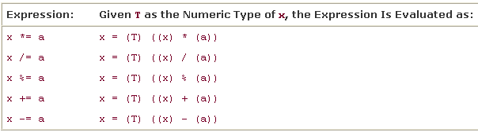
Compound Assignment Operators
int i = 2;
i *= i + 4; // (1) Evaluated as i = (int) (i * (i + 4)).
byte b = 2;
b += 10; // (2) Evaluated as b = (byte) ((int) b + 10).
b = b + 10; // (3) Will not compile. Explicit cast required.

Slide 17
Increment and Decrement Operators
Prefix increment:
++i adds 1 to i first, then uses the new value of i as the value of the expression.
Postfix Increment:
j++ uses the current value of j as the value of the expression first, then adds 1 to j.
Same Rule for decrement operators.
class PrePostDemo {
public static void main(String[] args){
int i = 3;
i++;
System.out.println(i); // "4"
++i;
System.out.println(i); // "5"
System.out.println(++i); // "6"
System.out.println(i++); // "6"
System.out.println(i); // "7"
}
}

Slide 18
Relational Operators
== equal to
!= not equal to
> greater than
>= greater than or equal to
< less than
<= less than or equal to
All relational operators are binary operators, and their operands are numeric expressions. Binary numeric promotion is applied to the operands of these operators. The evaluation results in a boolean value.
double hours = 45.5;
boolean overtime = hours >= 35.0; // true.
boolean order = 'A' < 'a'; // true. Binary numeric promotion applied.

Slide 19
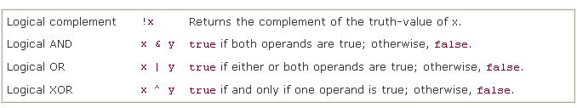
Boolean Logical Operators
Boolean logical operators can be applied to boolean operands, returning a boolean value. The operators &, |, and ^ can also be applied to integral operands to perform bitwise logical operations
boolean b1, b2, b3 = false, b4 = false;
b1 = 4 == 2 & 1 < 4; // false, evaluated as (b1 = ((4 == 2) & (1 < 4)))
b2 = b1 | !(2.5 >= 8); // true
b3 = b3 ^ b2; // true
b4 = b4 | b1 & b2; // false

Slide 20

Conditional Operators
Conditional operators && and || are similar to their counterpart logical operators & and |, except that their evaluation is short-circuited.
Unlike their logical counterparts & and |, which can also be applied to integral operands for bitwise operations, the conditional operators && and || can only be applied to boolean operands. Their evaluation results in a boolean value.

Slide 21
Short-circuit Evaluation
In evaluation of boolean expressions involving conditional AND and OR, the left-hand operand is evaluated before the right one, and the evaluation is short-circuited (i.e., if the result of the boolean expression can be determined from the left-hand operand, the right-hand operand is not evaluated). In other words, the right-hand operand is evaluated conditionally.
The binary conditional operators have precedence lower than either arithmetic, relational, or logical operators, but higher than assignment operators. The following examples illustrate usage of conditional operators:
boolean b1 = 4 == 2 && 1 < 4; // false, short-circuit evaluated //as (b1 = ((4 == 2) && (1 < 4)))
boolean b2 = b1 && 9.5 > 8; // false, short-circuit evaluated as
// (b2 = ((b1) && (9.5 > 8)))

Slide 22
CS112-Ex2a
Which of the following expressions evaluates to true?
Select the two correct answers.
(false | true)
(null != null)
(4 <= 4)
(!true)
(true & false)

Slide 23
CS112-Ex2b
long i = 10;
long k = i++ + i--;
i++;
What is the value of i and k?
Notes:
11L and 21L

Slide 24
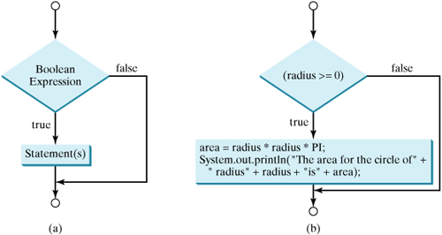
if Statements
A simple if statement executes an action if and only if the condition is true. The syntax for a simple if statement is shown below:
if (booleanExpression) {
statement(s);
}

Slide 25
if Statements Examples
In the following examples of the if statement, it is assumed that the variables and the methods have been defined appropriately:
if (emergency) // emergency is a boolean variable
operate();
if (temperature > critical)
soundAlarm();
if (isLeapYear() && endOfCentury())
celebrate();
if (catIsAway()) { // Block
getFishingRod();
goFishing();
}

Slide 26
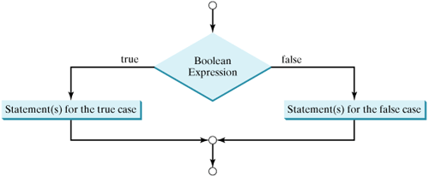
if-else Statement
if (booleanExpression) {
statement(s)-for-the-true-case;
}
else {
statement(s)-for-the-false-case;
}

Slide 27
Example
if (isMoving)
{
currentSpeed--;
}
else
{
System.err.println("The bicycle has already stopped!");
}
boolean

Slide 28
If - else if - else Statement
if( age < 18 ) {
System.out.println( "You are a child – kids rule!" );
}
else if( age < 55 ) {
System.out.println( "You are an adult – adults are alright!" );
}
else {
System.out.println( "You are a senior – seniors are great!" );
}

Slide 29
CS112-Ex2c
Ask the user to enter his/her grade using an InputDialog.
Output the grade in messagedialog according to the following scale:
85 or more -> A
75-84 ->B
60-74 ->C
50-59-> D
49 or less -> F

Slide 30
Ternary Operator
the form of the ternary operator is
condition ? true statement : false statement;
if (x > 0)
y = 1
else
y = -1;
Alternatively, as in this example, you can use a conditional expression to achieve the same result.
y = (x > 0) ? 1 : -1;

Slide 31
Ternary Operator
For another example, the following statement displays the message "num is even" if num is even, and otherwise displays "num is odd."
System.out.println((num % 2 == 0) ? "num is even" : "num is odd");

Slide 32
switch Statement
Conceptually the switch statement can be used to choose one among many alternative actions, based on the value of an expression. Its general form is as follows:
switch (<non-long integral expression>) {
case label1: <statement1>
case label2: <statement2>
...
case labeln: <statementn>
default: <statement>
} // end switch

Slide 33
switch Statement
The semantics of the switch statement are as follows:
The switch expression is evaluated first.
The value of the switch expression is compared with the case labels. Control is transferred to the <statement> associated with the case label that is equal to the value of the switch expression. After execution of the associated statement, control falls through to the next statement unless there is a break/continue/return statement present.
If no case label is equal to the value of the switch expression, the statement associated with the default label is executed.

Slide 34
Example
switch( col ) {
case 0:
System.out.println( "id" );
break;
case 1:
System.out.println( "name" );
break;
case 2:
System.out.println( "address" );
break;
case 3:
System.out.println( "phone" );
break;
default:
System.out.println( "unknown" );
}

Slide 35
Example
Do not forget to use a break statement when one is needed. Once a case is matched, the statements starting from the matched case are executed until a branching statement or the end of the switch statement is reached. This phenomenon is referred to as the fall-through behavior. For example, the following code prints character a three times if ch is 'a':
switch (ch) {
case 'a': System.out.println(ch);
case 'b': System.out.println(ch);
case 'c': System.out.println(ch);
}

Slide 36
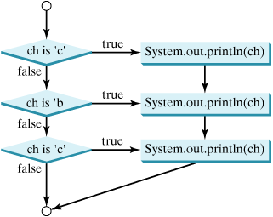
Fall-Through

Slide 37
while Statement
The while statement tells the compiler to repeatedly execute a set of code until a condition is satisfied. The general form of the while statement is
while( boolean_condition ) {
//statements;
}
class WhileDemo {
public static void main(String[] args){ int count = 1;
while (count < 11) {
System.out.println("Count is: " + count);
count++;
}
}
}//what will be the output?

Slide 38
do-while Statements
The difference between do-while and while is that do-while evaluates its expression at the bottom of the loop instead of the top. Therefore, the statements within the do block are always executed at least once
The syntax of the do-while loop is
do
<loop body>
while (<loop condition>);

Slide 39
do-while Statements
class DoWhileDemo {
public static void main(String[] args){
int count = 1;
do {
System.out.println("Count is: " + count);
count++;
} while (count <= 11);
}
}
//what is the output?

Slide 40
The for Loop
The for loop provides a compact way to iterate over a range of values. The general form of the for statement can be expressed as follows:
for (initialization; termination condition; increment) {
statement(s)
}
When using this version of the for statement, keep in mind that:
The initialization expression initializes the loop; it's executed once, as the loop begins.
When the termination expression evaluates to false, the loop terminates.
The increment expression is invoked after each iteration through the loop; it is perfectly acceptable for this expression to increment or decrement a value.

Slide 41
The for Loop
class ForDemo {
public static void main(String[] args){
for(int i=1; i<11; i++){
System.out.println("Count is: " + i);
} }
}
The output of this program is:
Count is: 1
Count is: 2
Count is: 3
Count is: 4
Count is: 5
Count is: 6
Count is: 7
Count is: 8
Count is: 9
Count is: 10

Slide 42
for Loop and while loop
for (<initialization>; <loop condition>; <increment expression>)
{ <loop body> }
Can be written as a while loop:
<initialization>
while (<loop condition>) {
<loop body>
<increment expression>
}

Slide 43

Infinite Loop
If the loop-continuation-condition in a for loop is omitted, it is implicitly true. Following are infinite loops:
int i=10;
while (i>=5)
{
System.out.println (“i= ”+i);
}
//This might be an unintentional infinite loop. Fix??

Slide 44
Transfer Statements
Java provides six language constructs for transferring control in a program:
break
continue
return
try-catch-finally
throw
assert
This lecture discusses the first three statements

Slide 45
break Statement
The break statement comes in two forms: the unlabeled and the labeled form.
break; // the unlabeled form
break <label>; // the labeled form

Slide 46
Unlabeled break Statement
The unlabeled break statement terminates loops (for, while, do-while) and switch statements which contain the break statement, and transfers control out of the current context (i.e., the closest enclosing block). The rest of the statement body is skipped, terminating the enclosing statement, with execution continuing after this statement.
for (int i = 1; i <= 5; ++i) {
if (i == 4) break; // (1) Terminate loop. //Control to (2). Rest of loop body skipped when i gets //the value 4.
System.out.println(i + "\t" + Math.sqrt(i));
}
// (2) Continue here.

Slide 47
Labeled break Statement
A labeled break statement can be used to terminate any labeled statement that contains the break statement. Control is then transferred to the statement following the enclosing labeled statement. In the case of a labeled block, the rest of the block is skipped and execution continues with the statement following the block:
out:
{ // (1) Labeled block
if (j == 10) break out; // (2) Terminate block. //Control to (3).
System.out.println(j); // Rest of the block not //executed if j == 10.
} // (3) Continue here.

Slide 48
continue Statement
Like the break statement, the continue statement also comes in two forms: the unlabeled and the labeled form.
continue; // the unlabeled form
continue <label>; // the labeled form
The continue statement can only be used in a for, while, or do-while loop to prematurely stop the current iteration of the loop body and proceed with the next iteration, if possible. In the case of the while and do-while loops, the rest of the loop body is skipped, that is, stopping the current iteration, with execution continuing with the <loop condition>. In the case of the for loop, the rest of the loop body is skipped, with execution continuing with the <increment expression>.

Slide 49
unlabeled continue statement
class ContinueDemo {
public static void main(String[] args) {
String searchMe = "peter piper picked a peck of pickled peppers";
int max = searchMe.length();
int numPs = 0;
for (int i = 0; i < max; i++) {
//interested only in p's
if (searchMe.charAt(i) != 'p')
continue;
//process p's
numPs++;
}
System.out.println("Found " + numPs + " p's in the string.");
}
}

Slide 50
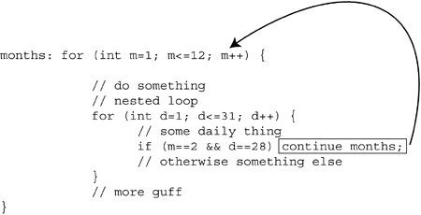
Labeled continue statement
A labeled continue statement must occur within a labeled loop that has the same label. Execution of the labeled continue statement then transfers control to the end of that enclosing labeled loop.

Slide 51
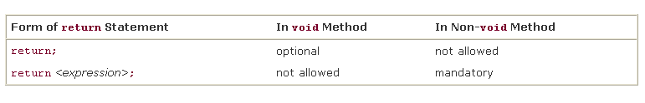
The return Statement
The return statement is used to stop execution of a method and transfer control back to the calling code

Slide 52
Examples
void resetFields (Customer c) {
if (c==null) return;
// otherwise, go on to reset the fields of c
}
int hourOfDay( ) {
java.util.Calendar now = java.util.Calendar.getInstance();
int hrs = now.get(java.util.Calendar.HOUR_OF_DAY);
return hrs;
}

Slide 53
CS112-Ex2d
What will be the result of attempting to compile and run the following code?
class MyClass {
public static void main(String[] args) {
boolean b = false;
int i = 1;
do {
i++;
b = ! b;
} while (b);
System.out.println(i);
}
}

Slide 54
CS112-Ex2e
Given the following code fragment, which of the following lines will be a part of the output?
outer:
for (int i = 0; i < 3; i++) {
for (int j = 0; j < 2; j++) {
if (i == j) {
continue outer;
}
System.out.println ("i=" + i + ", j=" + j);
}
}

Slide 55
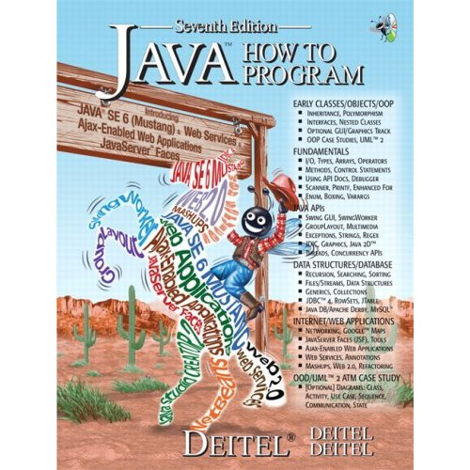
Reading from the Book
Chapter 4 :Page 127-185
Chapter 5 :Page 186-238

