Slide 1

CS 112 – Java Programming
Instructor: Binayak Bhattacharyya
bbinayak@yahoo.com

Slide 2
Homework #2 is due on: 09/20/2007

Slide 3
continue Statement
Like the break statement, the continue statement also comes in two forms: the unlabeled and the labeled form.
continue; // the unlabeled form
continue <label>; // the labeled form
The continue statement can only be used in a for, while, or do-while loop to prematurely stop the current iteration of the loop body and proceed with the next iteration, if possible. In the case of the while and do-while loops, the rest of the loop body is skipped, that is, stopping the current iteration, with execution continuing with the <loop condition>. In the case of the for loop, the rest of the loop body is skipped, with execution continuing with the <increment expression>.

Slide 4
unlabeled continue statement
class ContinueDemo {
public static void main(String[] args) {
String searchMe = "peter piper picked a peck of pickled peppers";
int max = searchMe.length();
int numPs = 0;
for (int i = 0; i < max; i++) {
//interested only in p's
if (searchMe.charAt(i) != 'p')
continue;
//process p's
numPs++;
}
System.out.println("Found " + numPs + " p's in the string.");
}
}

Slide 5
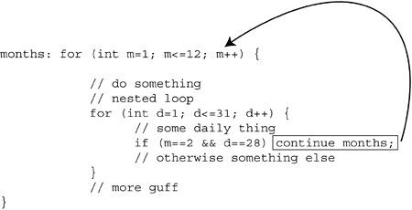
Labeled continue statement
A labeled continue statement must occur within a labeled loop that has the same label. Execution of the labeled continue statement then transfers control to the end of that enclosing labeled loop.

Slide 6
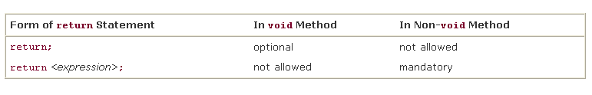
The return Statement
The return statement is used to stop execution of a method and transfer control back to the calling code

Slide 7
Examples
void resetFields (Customer c) {
if (c==null) return;
// otherwise, go on to reset the fields of c
}
int hourOfDay( ) {
java.util.Calendar now = java.util.Calendar.getInstance();
int hrs = now.get(java.util.Calendar.HOUR_OF_DAY);
return hrs;
}

Slide 8
Methods
Methods (called functions or procedures in other programming languages) allow the programmer to modularize a program by separating its tasks into self-contained units.
Often, you can create programs mostly from standardized methods rather than by building customized code.
But sometimes you need to create your own custom method.

Slide 9
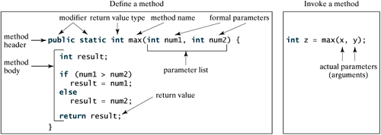
Creating a Method
In general, a method has the following syntax:
modifier returnValueType methodName(list of parameters)
{
// Method body;
}

Slide 10
Static Fields and Methods
If you define a field as static, then there is only one such field per class. In contrast, each object has its own copy of all instance fields. For example, let's suppose we want to assign a unique identification number to each employee. We add an instance field id and a static field nextId to the Employee class:
class Employee
{ . . .
private int id;
private static int nextId = 1;
}
Every employee object now has its own id field, but there is only one nextId field that is shared among all instances of the class.

Slide 11
Static Fields and Methods
A class can also have static methods that belong only to the class, and not to any objects of the class. Static variables and static methods are collectively known as static members, and are distinguished from instance members in a class definition by the keyword static in their declaration.
You can call any static method by specifying the name of the class in which the method is declared, followed by a dot (.) and the method name, as in
ClassName.methodName( arguments )
Class Math provides a collection of methods that enable you to perform common mathematical calculations. For example, you can calculate the square root of 900.0 with the static method call
Math.sqrt( 900.0 )
A static method can't access instance variables, but it can access static variables.

Slide 12
Calling static methods
There are two cases.
Called from within the same class
  Just write the static method name. Eg,
  // Called from inside the MyUtils class
  double avgAtt = mean(attendance);
Called from outside the class
  If a method (static or instance) is called from another class, something must be given before the method name to specify the class where the method is defined. For instance methods, this is the object that the method will access. For static methods, the class name should be specified. Eg,
  // Called from outside the MyUtils class.
  double avgAtt = MyUtils.mean(attendance);
  If an object is specified before it, the object value will be ignored and the the class of the object will be used.
Static method

Slide 13
Example
public class TestMax {
/** Main method */
public static void main(String[] args) {
int i = 5;
int j = 2;
int k = max(i, j);
System.out.println("The maximum between " + i +
" and " + j + " is " + k);
}
/** Return the max between two numbers */
public static int max(int num1, int num2) {
int result;
if (num1 > num2)
result = num1;
else
result = num2;
return result;
}
}

Slide 14
void Method Example
public class TestVoidMethod {
public static void main(String[] args)
{ printGrade(78.5); }
public static void printGrade(double score) {
if (score >= 90.0) {
System.out.println('A');
}
else if (score >= 80.0) {
System.out.println('B');
}
else if (score >= 70.0) {
System.out.println('C');
}
else if (score >= 60.0) {
System.out.println('D');
}
else {
System.out.println('F');
}
}
}

Slide 15
Another Example
Your classes are not limited to defining a single method, on the contrary you will define multiple methods in most of your classes.
public class L3S1StaticMethod {
static int n = 5;
public static int square( ) {
return n*n;
}
public static int cube( ) {
return n*n*n;
}

Slide 16
Another Example
public static int toThePower( int power ) {
int result=n;
for( int i=0; i<power; i++ ) {
result *= n;
}
return result;
}
public static void main( String[] args ) {
System.out.println(square( ) );
System.out.println( cube( ) );
System.out.println( toThePower( 4 ) );
}
}

Slide 17
Variable Scope
The scope of an identifier for a variable, reference, or method is the portion of the program in which the identifier can be referenced.
There are three types of scope defined in Java:
Class Scope: Available to all methods in the class
Block Scope: Available only with the block it is declared to, or within nested blocks
Method Scope: Special type for labels used with break and continue statements

Slide 18
Variable Scope
public class Scope {
static int x = 5;
public static int timesX( int n ) {
int result = n*x;
return result;
}
public static void main( String[] args ) {
int m = 10;
System.out.println( "m times x = " + timesX( m ) );
}
}
Class Scope
timeX Method Scope
main Method Scope

Slide 19
Pass By Value
When you invoke a method with a parameter, the value of the argument is passed to the parameter. This is referred to as pass-by-value. If the argument is a variable rather than a literal value, the value of the variable is passed to the parameter. The variable is not affected, regardless of the changes made to the parameter inside the method.

Slide 20
Pass By Value
public class L3S2BadSwap {
public static void main(String[] args) {
int num1 = 1;
int num2 = 2;
System.out.println("Before invoking the swap method, num1 is " + num1 + " and num2 is " + num2);
swap(num1, num2);
System.out.println("After invoking the swap method, num1 is " + num1 + " and num2 is " + num2);
}
public static void swap(int n1, int n2) {
int temp = n1;
n1 = n2;
n2 = temp;
}
}

Slide 21
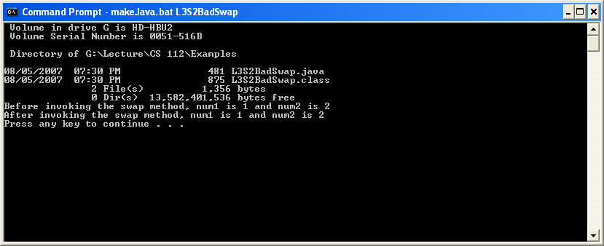
Pass By Value

Slide 22
Pass By Value
Note:
If a method takes an object as parameter instead of a primitive type, although parameter gets passed by value the calling objects will be changed if they are altered in the called method. The reason is the parameters are object references and when copied by value into the called method, they still access the same object as the calling method.

Slide 23
Example
public class L3S3ChangeObject {
public static void tricky(Point arg1)
{
arg1.x = 100;
arg1.y = 100;
}
public static void main(String [] args)
{
Point pnt1 = new Point(0,0);
System.out.println("X: " + pnt1.x + " Y: " +pnt1.y);
System.out.println();
tricky(pnt1);
System.out.println("X: " + pnt1.x + " Y:" + pnt1.y);
}
}
class Point
{
int x, y;
Point (int a, int b){x =a; y=b;}
}

Slide 24
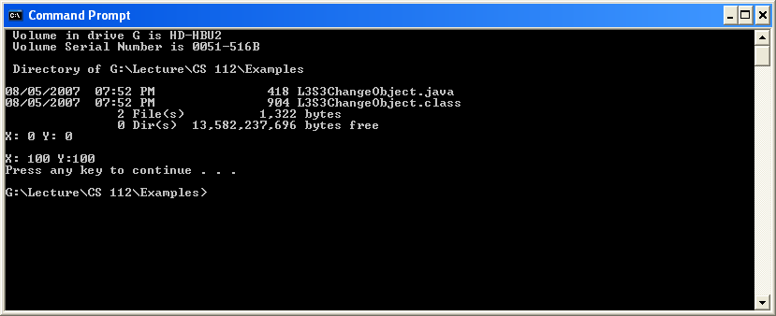
Example

Slide 25
Method Overloading
Methods of the same name can be declared in the same class, as long as they have different sets of parameters (determined by the number, types and order of the parameters) this is called method overloading.
public class SquareOverload {
public static int square( int n ) {
System.out.println( "Integer Square" );
return n*n;
}
public static long square( long l ) {
System.out.println( "Long Square" );
return l*l;
}

Slide 26
Method Overloading
public static double square( double d ) {
System.out.println( "Double Square" );
return d*d;
}
public static void main( String[] args ) {
int n = 5;
long l = 100;
double d = 1000.0;
System.out.println( "n squared=" + square( n ) );
System.out.println( "l squared=" + square( l ) );
System.out.println( "d squared=" + square( d ) );
}
}

Slide 27
Note
In the Java programming language, method signatures for an object is the method name and the number and type of its parameters. Return types are not considered to be a part of the method signature.
The following two methods cannot be defined in the same Java class:
public int square( long l ) { ... }
public long square( long l ) { ... } //error
The compiler only looks at the method name and parameter list, and does not consider the return type.

Slide 28
CS112-Ex3a
Write the max method(s) which returns the larger of the 2 numbers, where the main method calls the max method as follows:
public static void main(String[] args) {
System.out.println(max(1, 2));
System.out.println(max(3.7, -12.68));
}

Slide 29
The Math Class
The Math class contains the methods needed to perform basic mathematical functions.
The Math class contains the following trigonometric methods:
public static double sin(double radians)
public static double cos(double radians)
public static double tan(double radians)
public static double asin(double radians)
public static double acos(double radians)
public static double atan(double radians)
public static double toRadians(double degree)
public static double toDegrees(double radians)

Slide 30
The Math Class
There are five methods related to exponents in the Math class:
/** Return e raised to the power of x (ex) */
public static double exp(double x)
/** Return the natural logarithm of x (ln(x) = loge(x)) */
public static double log(double x)
/** Return the base 10 logarithm of x (log10(x)) */
public static double log10(double x)
/** Return a raised to the power of b (xb) */
public static double pow(double x, double b)
/** Return the square root of x */
public static double sqrt(double x)

Slide 31
The Math Class
The Math class contains five rounding methods:
/** x rounded up to its nearest integer. This integer is
* returned as a double value. */
public static double ceil(double x)
/** x is rounded down to its nearest integer. This integer is
* returned as a double value. */
public static double floor(double x)
/** x is rounded to its nearest integer. If x is equally close
* to two integers, the even one is returned as a double. */
public static double rint(double x)
/** Return (int)Math.floor(x + 0.5). */
public static int round(float x)
/** Return (long)Math.floor(x + 0.5). */
public static long round(double x)

Slide 32
The Math Class
The min and max methods are overloaded to return the minimum and maximum numbers between two numbers (int, long, float, or double). For example, max(3.4, 5.0) returns 5.0, and min(3, 2) returns 2.
The abs method is overloaded to return the absolute value of the number (int, long, float, and double). For example,
Math.max(2, 3) returns 3
Math.max(2.5, 3) returns 3.0
Math.min(2.5, 3.6) returns 2.5
Math.abs(-2) returns 2
Math.abs(-2.1) returns 2.1

Slide 33

The Math Class
The Math class also has a powerful method, random, which generates a random double value greater than or equal to 0.0 and less than 1.0 (0.0 <= Math.random() < 1.0). This method is very useful.
You can use it to write a simple expression to generate random numbers in any range. For example,

Slide 34
Arrays
An array is a data structure that defines an indexed collection of a fixed number of homogeneous data elements.
This means that all elements in the array have the same data type.
A position in the array is indicated by a non-negative integer value called the index. An element at a given position in the array is accessed using the index. The size of an array is fixed and cannot increase to accommodate more elements.
The first element is always at index 0 and the last element at index n-1, where n is the value of the length field in the array.
Arrays are objects, so they are considered reference types.
Arrays can be of primitive data types or reference types. In the former case, all elements in the array are of a specific primitive data type. In the latter case, all elements are references of a specific reference type.

Slide 35
Declaring Array Variables
To use an array in a program, you must declare a variable to reference the array, and you must specify the type of array the variable can reference. Here is the syntax for declaring an array variable:
dataType[] arrayRefVar;
or
dataType arrayRefVar[]; // This style is allowed, but not preferred
It is important to understand that the declaration does not actually create an array. It only declares a reference that can denote an array object.
int anIntArray[], oneInteger;
Pizza[] mediumPizzas, largePizzas;
Integer variable
Arrays

Slide 36
Constructing an Array
After an array variable is declared, you can create an array by using the new operator with the following syntax:
arrayRefVar = new dataType[arraySize];
Declaring an array variable, creating an array, and assigning the reference of the array to the variable can be combined in one statement, as shown below:
dataType[] arrayRefVar = new dataType[arraySize];
or
dataType arrayRefVar[] = new dataType[arraySize];

Slide 37
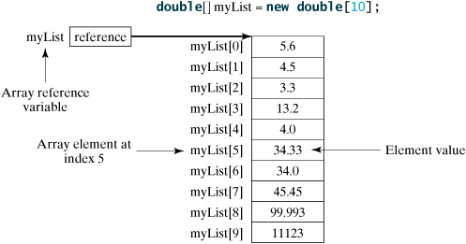
Example
int anIntArray[], oneInteger;
Pizza[] mediumPizzas, largePizzas;
the arrays can be constructed as follows:
anIntArray = new int[10]; // array for 10 integers
mediumPizzas = new Pizza[5]; // array of 5 pizzas
largePizzas = new Pizza[3]; // array of 3 pizzas

Slide 38
Array Size and Default Values
When space for an array is allocated, the array size must be given, to specify the number of elements that can be stored in it. The size of an array cannot be changed after the array is created. Size can be obtained using arrayRefVar.length. For example, myList.length is 10.
When an array is created, its elements are assigned the default value of 0 for the numeric primitive data types, '\u0000' for char types, and false for boolean types.
The elements in an object array are initialized to be null by default.

Slide 39
Initializing an Array
Java has a shorthand notation, known as the array initializer, which combines declaring an array, creating an array, and initializing in one statement using the following syntax:
dataType[] arrayRefVar = {value0, value1, ..., valuek};
For example,
double[] myList = {1.9, 2.9, 3.4, 3.5};
This statement declares, creates, and initializes the array myList with four elements, which is equivalent to the statements shown below:
double[] myList = new double[4];
myList[0] = 1.9;
myList[1] = 2.9;
myList[2] = 3.4;
myList[3] = 3.5;

Slide 40
Initializing an Array
Topping[] pizzaToppings = { new Topping("cheese"), new Topping("tomato")};
This will initialize an array of type Topping[]. Topping is a class ( reference type) as follows:
class Topping
{
String s;
public Topping (String _s) { s = _s;}
}

Slide 41
Using an Array
The whole array is referenced by the array name, but individual array elements are accessed by specifying an index with the [] operator. The array element access expression has the following syntax:
arrayRefVar [index expression]
Each individual element is treated as a simple variable of the element type.
int[] a = new int[100];
for (int i = 0; i < 100; i++)
a[i] = i; // fills the array with 0 to 99
To find the number of elements of an array, use array.length. For example,
for (int i = 0; i < a.length; i++)
System.out.println(a[i]);

Slide 42
Examples
(Finding the largest element) Use a variable named max to store the largest element. Initially max is myList[0]. To find the largest element in the array myList, compare each element in myList with max, and update max if the element is greater than max.
public static void main(String[] args) {
double[] myList = {12.3, 11.7, -30.9, 17.99};
double max = myList[0];
for (int i = 1; i < myList.length; i++) {
if (myList[i] > max) max = myList[i];
}
System.out.println (max);
}

Slide 43
CS112-Ex3b
Write a Java Program that initializes an array of type integer and then finds the sum of all elements.

Slide 44
foreach Loops
JDK 1.5 introduced a new for loop, known as foreach loop or enhanced for loop, which enables you to traverse the complete array sequentially without using an index variable.
The syntax of an enhanced for statement is:
for ( parameter : arrayName )
statement
For example, the following code displays all the elements in the array myList:
double[] myList = {12.3, 11.7, -30.9, 17.99};
for (double element: myList) {
System.out.println(element);
}

Slide 45
Anonymous Arrays
You can initialize an anonymous array:
new <element type>[] { <array initialize list> }
new int[] {3, 5, 2, 8, 6}
The construct returns an array reference that can be assigned and passed as parameter. In particular, the following two examples of declaration statements are equivalent.
int[] intArray = {3, 5, 2, 8, 6}; // (1)
int[] intArray = new int[] {3, 5, 2, 8, 6}; // (2)
In (1), an array initializer block is used to create and initialize the elements. In (2), an anonymous array expression is used. It is tempting to use the array initialization block as an expression; for example, in an assignment statement as a short cut for assigning values to array elements in one go. However, this is illegal—instead, an anonymous array expression should be used.
int[] daysInMonth;
daysInMonth = {31, 28, 31, 30, 31, 30, 31, 31, 30, 31, 30, 31}; // Not ok.
daysInMonth = new int[] {31, 28, 31, 30, 31, 30, 31, 31, 30, 31, 30, 31}; // ok.

Slide 46
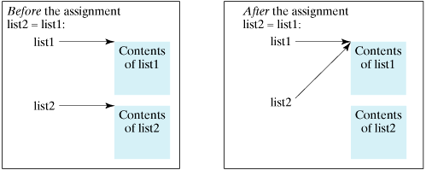
Array Copying
Often, in a program, you need to duplicate an array or a part of an array. In such cases you could attempt to use the assignment statement (=), as follows:
list2 = list1;
This statement does not copy the contents of the array referenced by list1 to list2, but merely copies the reference value from list1 to list2. After this statement, list1 and list2 reference to the same array

Slide 47
Array Copying
In Java, you can use assignment statements to copy primitive data type variables, but not arrays. Assigning one array variable to another array variable actually copies one reference to another and makes both variables point to the same memory location.
There are three ways to copy arrays:
Use a loop to copy individual elements one by one.
Use the static arraycopy method in the System class.
Use the clone method to copy arrays; this will be discussed later.

Slide 48
Array Copying
You can write a loop to copy every element from the source array to the corresponding element in the target array. The following code, for instance, copies sourceArray to targetArray using a for loop:
int[] sourceArray = {2, 3, 1, 5, 10};
int[] targetArray = new int[sourceArray.length];
for (int i = 0; i < sourceArray.length; i++) {
targetArray[i] = sourceArray[i];
}

Slide 49
Array Copying
Another approach is to use the arraycopy method in the java.lang.System class to copy arrays instead of using a loop. The syntax for arraycopy is shown below:
arraycopy(sourceArray, srcPos, targetArray, tarPos, length);
The parameters srcPos and tarPos indicate the starting positions in sourceArray and targetArray, respectively. The number of elements copied from sourceArray to targetArray is indicated by length. For example, you can rewrite the loop in the last slide using the following statement:
System.arraycopy(sourceArray, 0, targetArray, 0, sourceArray.length);

Slide 50
CS112-Ex3c
What is the output?
int[] smallPrimes = {2, 3, 5, 7, 11, 13};
int[] luckyNumbers = {1001, 1002, 1003, 1004, 1005, 1006, 1007};
System.arraycopy(smallPrimes, 2, luckyNumbers, 3, 4);
for (int i = 0; i < luckyNumbers.length; i++)
System.out.println(i + ": " + luckyNumbers[i]);

Slide 51
Array Sorting
To sort an array of numbers, you can use one of the sort methods in the Arrays class:
int[] a = new int[10000];
. . .
Arrays.sort(a);
This method uses a tuned version of the QuickSort algorithm that is claimed to be very efficient on most data sets. The Arrays class provides several other convenience methods for arrays
http://java.sun.com/j2se/1.4.2/docs/api/java/util/Arrays.html

Slide 52
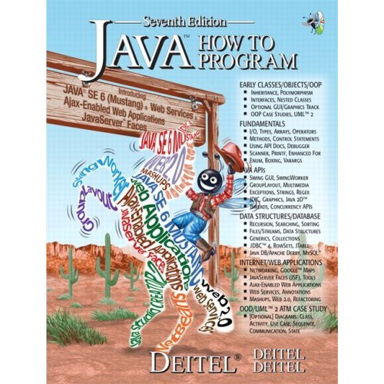
Reading from the Book
Chapter 4 :Page
Chapter 5 :Page

