Slide 1

CS 112 – Java Programming
Instructor: Binayak Bhattacharyya
bbinayak@yahoo.com
CS 112 – Java Programming
© Binayak Bhattacharyya 2006

Slide 2
Homework #3 is due on: 09/27/2007

Slide 3
Midterm #1 is on 09/27/2007
7:00-8:00pm

Slide 4
Midterm#1 Exam
When: 9/27/2007 - 7pm-8pm
Where: SAC A-210
Total Time: 1 hour
Open book & Open Notes Exam. No Computer/notebook!!
Syllabus: Everything that has been covered in the class lectures up to 9/27/2007.
Chapters from the Text: 2,3,4,5,6,7,8
Weight of midterm towards your grade: 20%
If you miss the midterm, Midterm#2 will count as 40% of the grade.
No makeup exam.

Slide 5
Format of the Midterm
Section A
Multiple choice questions, short answer type questions and small program writing in Java.
Section B
Complete Java Programs.

Slide 6
How to Prepare?
Read the Text Book.
Look at the Lecture notes, Homework.
Try the programs from the Exercises at the end of the chapters.

Slide 7
Homework #1 Solution: ftp://sacbusiness.org/downloads/cs/BhattacharyyaB/CS112/Solutions/CS112Homework1.java

Slide 8
foreach Loops
JDK 1.5 introduced a new for loop, known as foreach loop or enhanced for loop, which enables you to traverse the complete array sequentially without using an index variable.
The syntax of an enhanced for statement is:
for ( parameter : arrayName )
statement
For example, the following code displays all the elements in the array myList:
double[] myList = {12.3, 11.7, -30.9, 17.99};
for (double element: myList) {
System.out.println(element);
}

Slide 9
Anonymous Arrays
You can initialize an anonymous array:
new <element type>[] { <array initialize list> }
new int[] {3, 5, 2, 8, 6}
The construct returns an array reference that can be assigned and passed as parameter. In particular, the following two examples of declaration statements are equivalent.
int[] intArray = {3, 5, 2, 8, 6}; // (1)
int[] intArray = new int[] {3, 5, 2, 8, 6}; // (2)
In (1), an array initializer block is used to create and initialize the elements. In (2), an anonymous array expression is used. It is tempting to use the array initialization block as an expression; for example, in an assignment statement as a short cut for assigning values to array elements in one go. However, this is illegal—instead, an anonymous array expression should be used.
int[] daysInMonth;
daysInMonth = {31, 28, 31, 30, 31, 30, 31, 31, 30, 31, 30, 31}; // Not ok.
daysInMonth = new int[] {31, 28, 31, 30, 31, 30, 31, 31, 30, 31, 30, 31}; // ok.

Slide 10
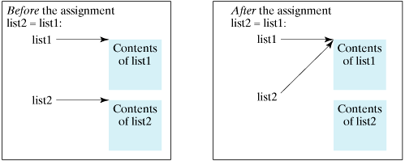
Array Copying
Often, in a program, you need to duplicate an array or a part of an array. In such cases you could attempt to use the assignment statement (=), as follows:
list2 = list1;
This statement does not copy the contents of the array referenced by list1 to list2, but merely copies the reference value from list1 to list2. After this statement, list1 and list2 reference to the same array

Slide 11
Array Copying
In Java, you can use assignment statements to copy primitive data type variables, but not arrays. Assigning one array variable to another array variable actually copies one reference to another and makes both variables point to the same memory location.
There are three ways to copy arrays:
Use a loop to copy individual elements one by one.
Use the static arraycopy method in the System class.
Use the clone method to copy arrays; this will be discussed later.

Slide 12
Array Copying
You can write a loop to copy every element from the source array to the corresponding element in the target array. The following code, for instance, copies sourceArray to targetArray using a for loop:
int[] sourceArray = {2, 3, 1, 5, 10};
int[] targetArray = new int[sourceArray.length];
for (int i = 0; i < sourceArray.length; i++) {
targetArray[i] = sourceArray[i];
}

Slide 13
Array Copying
Another approach is to use the arraycopy method in the java.lang.System class to copy arrays instead of using a loop. The syntax for arraycopy is shown below:
arraycopy(sourceArray, srcPos, targetArray, tarPos, length);
The parameters srcPos and tarPos indicate the starting positions in sourceArray and targetArray, respectively. The number of elements copied from sourceArray to targetArray is indicated by length. For example, you can rewrite the loop in the last slide using the following statement:
System.arraycopy(sourceArray, 0, targetArray, 0, sourceArray.length);

Slide 14
CS112-Ex4a
What is the output?
int[] smallPrimes = {2, 3, 5, 7, 11, 13};
int[] luckyNumbers = {1001, 1002, 1003, 1004, 1005, 1006, 1007};
System.arraycopy(smallPrimes, 2, luckyNumbers, 3, 4);
for (int i = 0; i < luckyNumbers.length; i++)
System.out.println(i + ": " + luckyNumbers[i]);

Slide 15
Array Sorting
To sort an array of numbers, you can use one of the sort methods in the Arrays class:
int[] a = new int[10000];
. . .
Arrays.sort(a);
This method uses a tuned version of the QuickSort algorithm that is claimed to be very efficient on most data sets. The Arrays class provides several other convenience methods for arrays
http://java.sun.com/j2se/1.4.2/docs/api/java/util/Arrays.html

Slide 16
Object-oriented programming
Object-oriented programming (OOP) involves programming using objects. An object represents an entity in the real world that can be distinctly identified. For example, a student, a desk, a circle, a button, and even a loan can all be viewed as objects. An object has a unique identity, state, and behaviors.
The state of an object is represented by data fields (also known as properties) with their current values.
The behavior of an object is defined by a set of methods. Invoking a method on an object means that you ask the object to perform a task.
A circle object, for example, has a data field, radius, which is the property that characterizes a circle. One behavior of a circle is that its area can be computed using the method getArea().
CS 112 – Java Programming
© Binayak Bhattacharyya 2006

Slide 17
Class
Objects of the same type are defined using a common class. A class is a template or blueprint that defines what an object's data and methods will be. An object is an instance of a class. You can create many instances of a class. Creating an instance is referred to as instantiation. The terms object and instance are often interchangeable. The relationship between classes and objects is analogous to the relationship between apple pie recipes and apple pies. You can make as many apple pies as you want from a single recipe.
CS 112 – Java Programming
© Binayak Bhattacharyya 2006

Slide 18
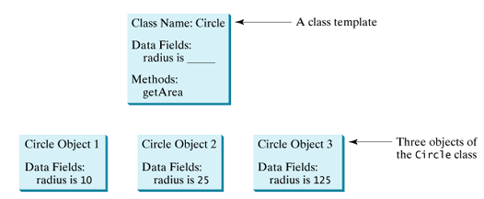
Class
CS 112 – Java Programming
© Binayak Bhattacharyya 2006

Slide 19
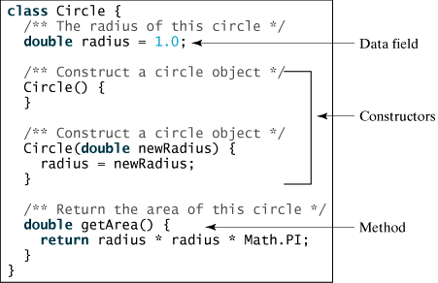
Class
A Java class uses variables to define data fields and methods to define behaviors. Additionally, a class provides methods of a special type, known as constructors, which are invoked when a new object is created. A constructor is a special kind of method. A constructor can perform any action, but constructors are designed to perform initializing actions, such as initializing the data fields of objects. Following Figure shows an example of the class for Circle objects.
CS 112 – Java Programming
© Binayak Bhattacharyya 2006

Slide 20
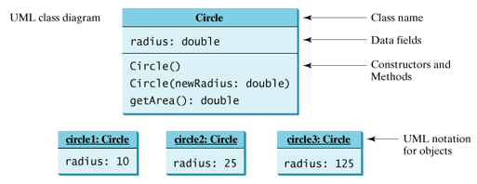
Note
The Circle class is different from all of the other classes you have seen thus far. It does not have a main method and therefore cannot be run; it is merely a definition used to declare and create Circle objects.
The illustration of class templates and objects can be standardized using UML (Unified Modeling Language) notations.
CS 112 – Java Programming
© Binayak Bhattacharyya 2006

Slide 21
Declaring Member Variables
There are several kinds of variables:
Member variables in a class—these are called fields.
Variables in a method or block of code—these are called local variables.
Variables in method declarations—these are called parameters.
Member variables / Field declarations are composed of three components, in order:
Zero or more modifiers, such as public or private.
The field's type.
The field's name.
CS 112 – Java Programming
© Binayak Bhattacharyya 2006

Slide 22
Access Modifiers
The first (left-most) modifier used lets you control what other classes have access to a member field. For the moment, consider only public and private. Other access modifiers will be discussed later.
public modifier—the field is accessible from all classes.
private modifier—the field is accessible only within its own class.
In the spirit of encapsulation, it is common to make fields private. This means that they can only be directly accessed from the Bicycle class. We still need access to these values, however. This can be done indirectly by adding public methods that obtain the field values for us
CS 112 – Java Programming
© Binayak Bhattacharyya 2006

Slide 23
Example
public class Bicycle {
// the Bicycle class has three fields
public int cadence;
public int gear;
public int speed;
// the Bicycle class has one constructor
public Bicycle(int startCadence, int startSpeed, int startGear) {
gear = startGear;
cadence = startCadence;
speed = startSpeed;
}
CS 112 – Java Programming
© Binayak Bhattacharyya 2006

Slide 24
Example
// the Bicycle class has four methods
public void setCadence(int newValue) {
cadence = newValue;
}
public void setGear(int newValue) {
gear = newValue;
}
public void applyBrake(int decrement) {
speed -= decrement;
}
public void speedUp(int increment) {
speed += increment;
}
}
CS 112 – Java Programming
© Binayak Bhattacharyya 2006

Slide 25
Defining Methods
Here is an example of a typical method declaration:
public double calculateAnswer(double wingSpan, int numberOfEngines, double length, double grossTons)
{
//do the calculation here
}
method declarations have six components, in order:
Modifiers—such as public, private, and others you will learn about later.
The return type—the data type of the value returned by the method, or void if the method does not return a value.
The method name—the rules for field names apply to method names as well, but the convention is a little different.
The parameter list in parenthesis—a comma-delimited list of input parameters, preceded by their data types, enclosed by parentheses, (). If there are no parameters, you must use empty parentheses.
An exception list—to be discussed later.
The method body, enclosed between braces—the method's code, including the declaration of local variables, goes here.
CS 112 – Java Programming
© Binayak Bhattacharyya 2006

Slide 26
Overloading Methods
The Java programming language supports overloading methods, and Java can distinguish between methods with different method signatures. This means that methods within a class can have the same name if they have different parameter lists
public class DataArtist {
...
public void draw(String s) {
...
}
public void draw(int i) {
...
}
public void draw(double f) {
...
}
public void draw(int i, double f) {
...
}
}
CS 112 – Java Programming
© Binayak Bhattacharyya 2006

Slide 27
Constructors
A class contains constructors that are invoked to create objects from the class blueprint. Constructor declarations look like method declarations—except that they use the name of the class and have no return type. For example, Bicycle has one constructor:
public Bicycle(int startCadence, int startSpeed, int startGear)
{ gear = startGear;
cadence = startCadence;
speed = startSpeed;
}
To create a new Bicycle object called myBike, a constructor is called by the new operator:
Bicycle myBike = new Bicycle(30, 0, 8);
CS 112 – Java Programming
© Binayak Bhattacharyya 2006

Slide 28
Multiple Constructors
new Bicycle(30, 0, 8) creates space in memory for the object and initializes its fields.
Although Bicycle only has one constructor, it could have others, including a no-argument constructor:
public Bicycle() {
gear = 1;
cadence = 10;
speed = 0;
}
Bicycle yourBike = new Bicycle();
invokes the no-argument constructor to create a new Bicycle object called yourBike.
CS 112 – Java Programming
© Binayak Bhattacharyya 2006

Slide 29
Multiple Constructors
A class normally provides a constructor without arguments (e.g., Bicycle()). Such a constructor is called a no-arg or no-argument constructor.
A class may be declared without constructors. In this case, a no-arg constructor with an empty body is implicitly declared in the class. This constructor, called a default constructor, is provided automatically only if no constructors are explicitly declared in the class.
CS 112 – Java Programming
© Binayak Bhattacharyya 2006

Slide 30
Example Point Class
public class Point {
public int x = 0;
public int y = 0;
// a constructor!
public Point(int a, int b) {
x = a;
y = b;
}
}
CS 112 – Java Programming
© Binayak Bhattacharyya 2006

Slide 31
Example Rectangle class
public class Rectangle {
public int width = 0;
public int height = 0;
public Point origin;
// four constructors
public Rectangle() {
origin = new Point(0, 0);
}
public Rectangle(Point p) {
origin = p;
}
public Rectangle(int w, int h) {
origin = new Point(0, 0);
width = w;
height = h;
}
CS 112 – Java Programming
© Binayak Bhattacharyya 2006

Slide 32
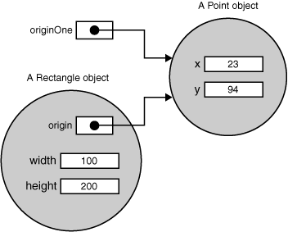
Example
public Rectangle(Point p, int w, int h) {
origin = p;
width = w;
height = h;
}
// a method for moving the rectangle
public void move(int x, int y) {
origin.x = x;
origin.y = y;
}
// a method for computing the area of the rectangle
public int getArea() {
return width * height;
}
}
CS 112 – Java Programming
© Binayak Bhattacharyya 2006

Slide 33
Creating Objects
The new operator instantiates a class by allocating memory for a new object and returning a reference to that memory. The new operator also invokes the object constructor.
The new operator requires a single, postfix argument: a call to a constructor. The name of the constructor provides the name of the class to instantiate.
The new operator returns a reference to the object it created. This reference is usually assigned to a variable of the appropriate type, like:
Point originOne = new Point(23, 94);
The reference returned by the new operator does not have to be assigned to a variable. It can also be used directly in an expression. For example:
int height = new Rectangle().Height;
CS 112 – Java Programming
© Binayak Bhattacharyya 2006

Slide 34
Creating Objects
public class CreateObjectDemo {
public static void main(String[] args) {
//Declare and create a point object
//and two rectangle objects.
Point originOne = new Point(23, 94);
Rectangle rectOne = new Rectangle(originOne, 100, 200);
Rectangle rectTwo = new Rectangle(50, 100);
//display rectOne's width, height, and area
System.out.println("Width of rectOne: " +
rectOne.width);
System.out.println("Height of rectOne: " +
rectOne.height);
CS 112 – Java Programming
© Binayak Bhattacharyya 2006

Slide 35
Creating Objects
System.out.println("Area of rectOne: " + rectOne.getArea());
//set rectTwo's position
rectTwo.origin = originOne;
//display rectTwo's position
System.out.println("X Position of rectTwo: "
+ rectTwo.origin.x);
System.out.println("Y Position of rectTwo: "
+ rectTwo.origin.y);
//move rectTwo and display its new position
rectTwo.move(40, 72);
System.out.println("X Position of rectTwo: "
+ rectTwo.origin.x);
System.out.println("Y Position of rectTwo: "
+ rectTwo.origin.y);
}
}
CS 112 – Java Programming
© Binayak Bhattacharyya 2006

Slide 36
Using Objects
You may use a simple name for a field within its own class. For example, we can add a statement within the Rectangle class that prints the width and height:
System.out.println("Width and height are: " + width + ", " + height);
Code that is outside the object's class must use an object reference or expression, followed by the dot (.) operator, followed by a simple field name, as in: objectReference.fieldName
For example, the code in the CreateObjectDemo class is outside the code for the Rectangle class. So to refer to the origin, width, and height fields within the Rectangle object named rectOne, the CreateObjectDemo class must use the names rectOne.origin, rectOne.width, and rectOne.height, respectively. The program uses two of these names to display the width and the height of rectOne:
System.out.println("Width of rectOne: " + rectOne.width);
System.out.println("Height of rectOne: " + rectOne.height);
CS 112 – Java Programming
© Binayak Bhattacharyya 2006

Slide 37
Calling an Object's Methods
You also use an object reference to invoke an object's method. You append the method's simple name to the object reference, with an intervening dot operator (.).
Also, you provide, within enclosing parentheses, any arguments to the method. If the method does not require any arguments, use empty parentheses.
objectReference.methodName(argumentList);
or
objectReference.methodName();
The Rectangle class has two methods: getArea() to compute the rectangle's area and move() to change the rectangle's origin.
Here's the CreateObjectDemo code that invokes these two methods: System.out.println("Area of rectOne: " + rectOne.getArea()); ... rectTwo.move(40, 72);
CS 112 – Java Programming
© Binayak Bhattacharyya 2006

Slide 38
Packages
Packages are used to group classes. So far, all the classes in this course are grouped into a default package. You can explicitly specify a package for each class.
Steps to put your class on a package.
Write the following code in HelloWorld.java
package world;
public class HelloWorld {
public static void main(String[] args) {
System.out.println("Hello World");
}
}
Put this file in a directory C:\Java\Examples\world
Compile the programs as javac HelloWorld.java
From command line set classpath as:
set CLASSPATH=.;C:\Java\Examples\;
Run the program as java world.HelloWorld
CS 112 – Java Programming
© Binayak Bhattacharyya 2006

Slide 39
Visibility Modifiers
Java provides several modifiers that control access to data fields, methods, and classes. This section introduces the public, private, and default modifiers.
public makes classes, methods, and data fields accessible from any class.
private makes methods and data fields accessible only from within its own class.
If public or private is not used, then by default the classes, methods, and data fields are accessible by any class in the same package. This is known as package-private or package-access.
CS 112 – Java Programming
© Binayak Bhattacharyya 2006

Slide 40
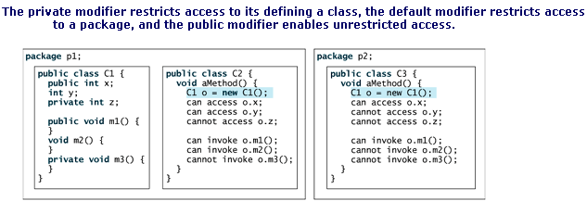
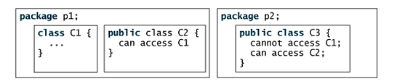
Visibility Modifiers
If a class is not declared public, it can only be accessed within the same package
CS 112 – Java Programming
© Binayak Bhattacharyya 2006

Slide 41
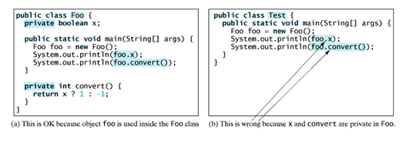
Another Example
CS 112 – Java Programming
© Binayak Bhattacharyya 2006

Slide 42
Data Field Encapsulation
The data fields width and height in the Rectangle class in slide 32 can be modified directly (e.g., rectOne.height = 5 or rectOne.width = 10). This is not a good practice for two reasons:
First, data may be tampered.
Second, it makes the class difficult to maintain and vulnerable to bugs. Suppose you want to modify the Rectangle class to ensure that the height is non-negative after other programs have already used the class. You have to change not only the Rectangle class, but also the programs that use the Rectangle class. Such programs are often referred to as clients. This is because the clients may have modified the radius directly (e.g., myRect.height = -5).
CS 112 – Java Programming
© Binayak Bhattacharyya 2006

Slide 43
Data Field Encapsulation
To prevent direct modifications of properties, you should declare the field private, using the private modifier. This is known as data field encapsulation.
A private data field cannot be accessed by an object through a direct reference outside the class that defines the private field. But often a client needs to retrieve and modify a data field. To make a private data field accessible, provide a get method to return the value of the data field. To enable a private data field to be updated, provide a set method to set a new value.
Colloquially, a get method is referred to as a getter (or accessor), and a set method is referred to as a setter (or mutator).
CS 112 – Java Programming
© Binayak Bhattacharyya 2006

Slide 44
Data Field Encapsulation
A get method has the following signature:
public returnType getPropertyName()
A set method has the following signature:
public void setPropertyName(dataType propertyValue)
CS 112 – Java Programming
© Binayak Bhattacharyya 2006

Slide 45
Example
public class Circle3 {
/** The radius of the circle */
private double radius = 1;
/** The number of the objects created */
private static int numberOfObjects = 0;
/** Construct a circle with radius 1 */
public Circle3() {
numberOfObjects++;
}
/** Construct a circle with a specified radius */
public Circle3(double newRadius) {
radius = newRadius;
numberOfObjects++;
}
CS 112 – Java Programming
© Binayak Bhattacharyya 2006

Slide 46
Example
/** Return radius */
public double getRadius() {
return radius;
}
/** Set a new radius */
public void setRadius(double newRadius) {
radius = (newRadius >= 0) ? newRadius : 0;
}
/** Return numberOfObjects */
public static int getNumberOfObjects() {
return numberOfObjects;
}
/** Return the area of this circle */
public double getArea() {
return radius * radius * Math.PI;
}
}
CS 112 – Java Programming
© Binayak Bhattacharyya 2006

Slide 47
Client Program
public class TestCircle3 {
public static void main(String[] args) {
// Create a Circle with radius 5.0
Circle myCircle = new Circle(5.0);
System.out.println("The area of the circle of radius "
+ myCircle.getRadius() + " is " + myCircle.getArea());
// Increase myCircle's radius by 10%
myCircle.setRadius(myCircle.getRadius() * 1.1);
System.out.println("The area of the circle of radius "
+ myCircle.getRadius() + " is " + myCircle.getArea());
}
}
CS 112 – Java Programming
© Binayak Bhattacharyya 2006

Slide 48
this keyword
Within an instance method or a constructor, this is a reference to the current object — the object whose method or constructor is being called. You can refer to any member of the current object from within an instance method or a constructor by using this.
The most common reason for using the this keyword is because a field is shadowed by a method or constructor parameter.
public class Point {
public int x = 0;
public int y = 0;
//constructor
public Point(int x, int y) {
this.x = x;
this.y = y; }
}
CS 112 – Java Programming
© Binayak Bhattacharyya 2006

Slide 49
Using this with a Constructor
From within a constructor, you can also use the this keyword to call another constructor in the same class. Doing so is called an explicit constructor invocation. public class Rectangle {
private int x, y;
private int width, height;
public Rectangle() {
this(0, 0, 0, 0);
}
public Rectangle(int width, int height) {
this(0, 0, width, height);
}
public Rectangle(int x, int y, int width, int height) {
this.x = x;
this.y = y;
this.width = width;
this.height = height;
} ...}
CS 112 – Java Programming
© Binayak Bhattacharyya 2006

Slide 50
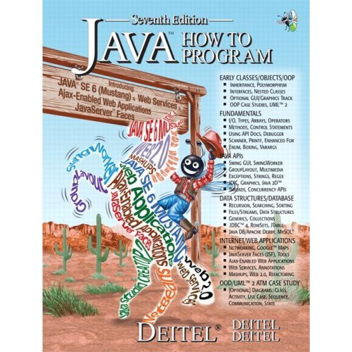
Reading from the Book
Chapter 8 :Page 368-426
CS 112 – Java Programming
© Binayak Bhattacharyya 2006

