Slide 1
NFL/NCAA Database Project
Manli Gomari; Lucio Perez

Slide 2
Use Case
Provides a list of statistics for NFL players for both the Professional and Collegiate levels
User (football player) can input their own statistics for a given year and compare with professional players
User (scout) can lookup a specific players statistics

Slide 3
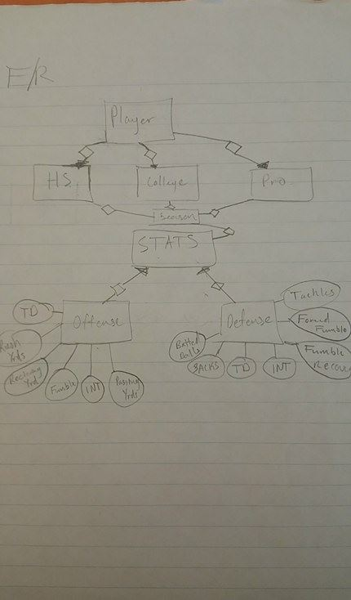
E/R Diagram

Slide 4
Schema
College(Name, Conf, c_key)
Pro(Name, pro_key)
Player(Name, player_key)
Offense(Name, Year, Level, Class, TD, RushYds, RecYds, PassYds, Fumble, INT, c_key, pro_key, Position, player_key)
Defense(Name, Year, Level, Class, TD, Tackles, PassDef, FumbleRec, ForceFumble, Sack, INT, c_key, pro_key, Position, player_key)

Slide 5
Implementation Details
SQLite
Data Imported using CSV files
Java
JDBC

