Slide 1
WUENIC implementation in R
Matthias Gondan
University of Innsbruck

Slide 2
Background
WUENIC estimates* are based on a complex set of rules that take into account the situation of the administration in the member states.
*and confidence ratings
Coverage estimate
Gov’t
Admin
Plausibility
Interpolate
Extrapolate
Surveys
Working group
Calibrate

Slide 3
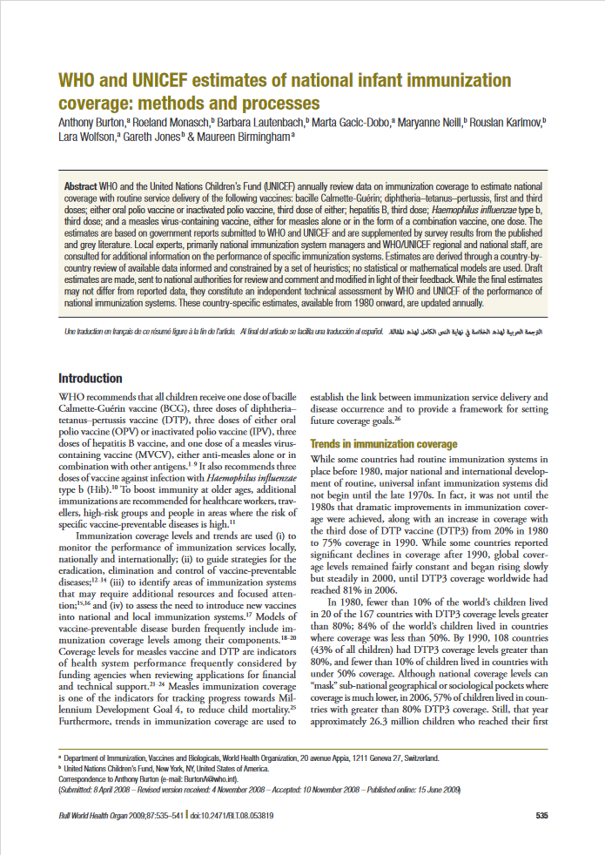
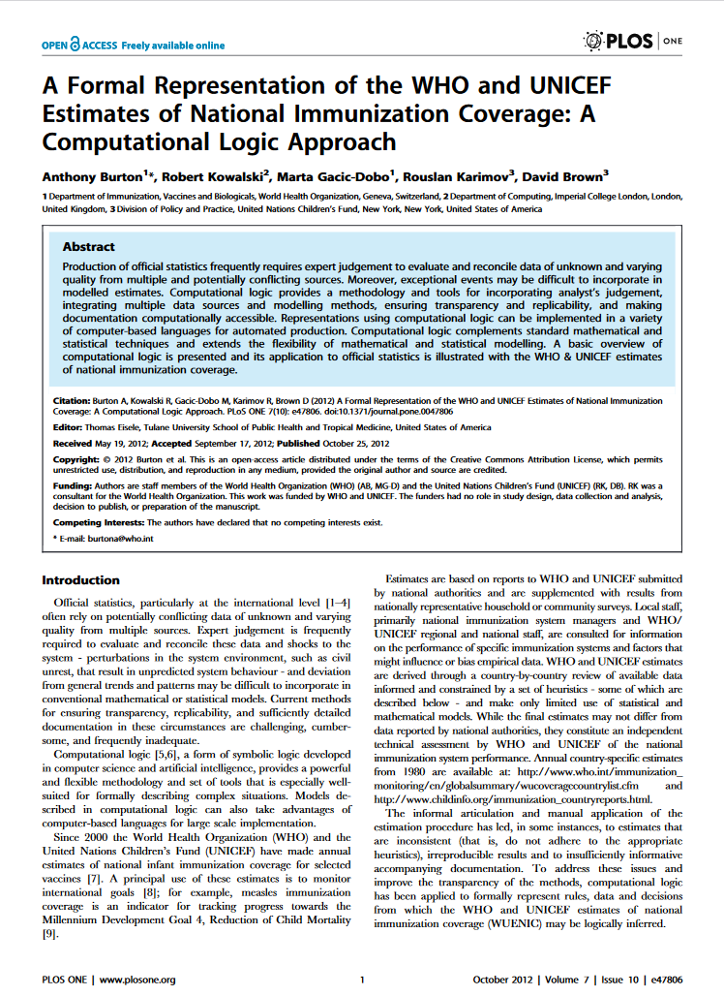
Formalization
The estimation process is an interesting instance of “decision under uncertainty”.
It has been formalized in two scientific papers.

Slide 4
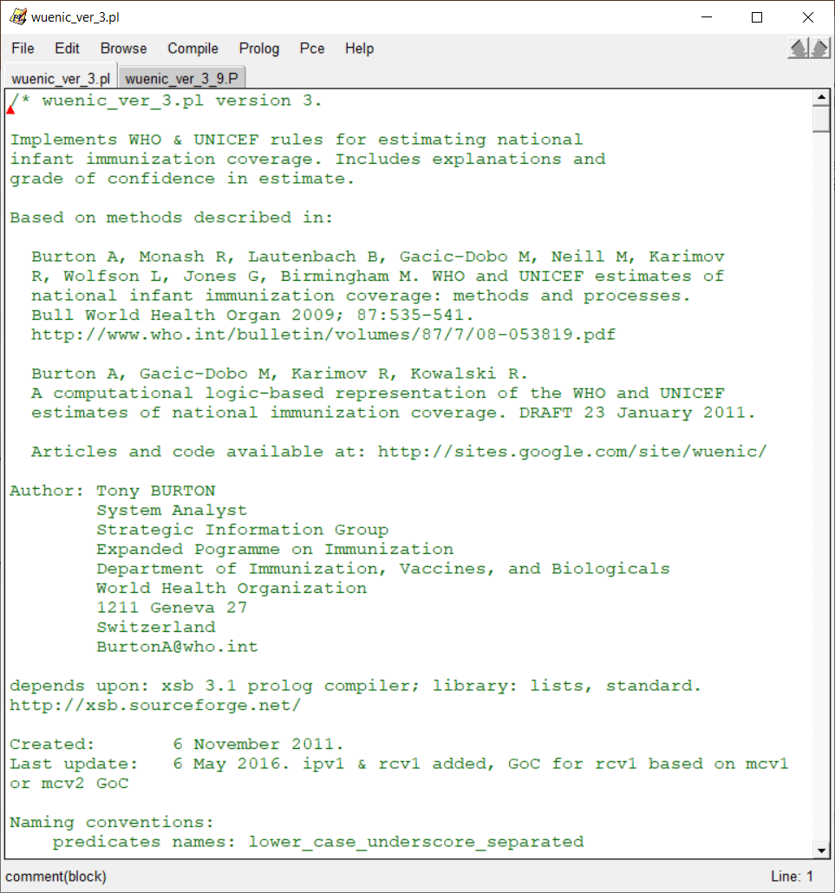
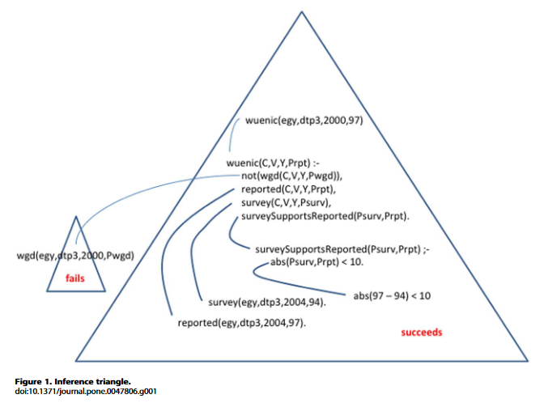
Implementation
The different stages in the estimation process have been implemented in a computer program written in Prolog.

Slide 5
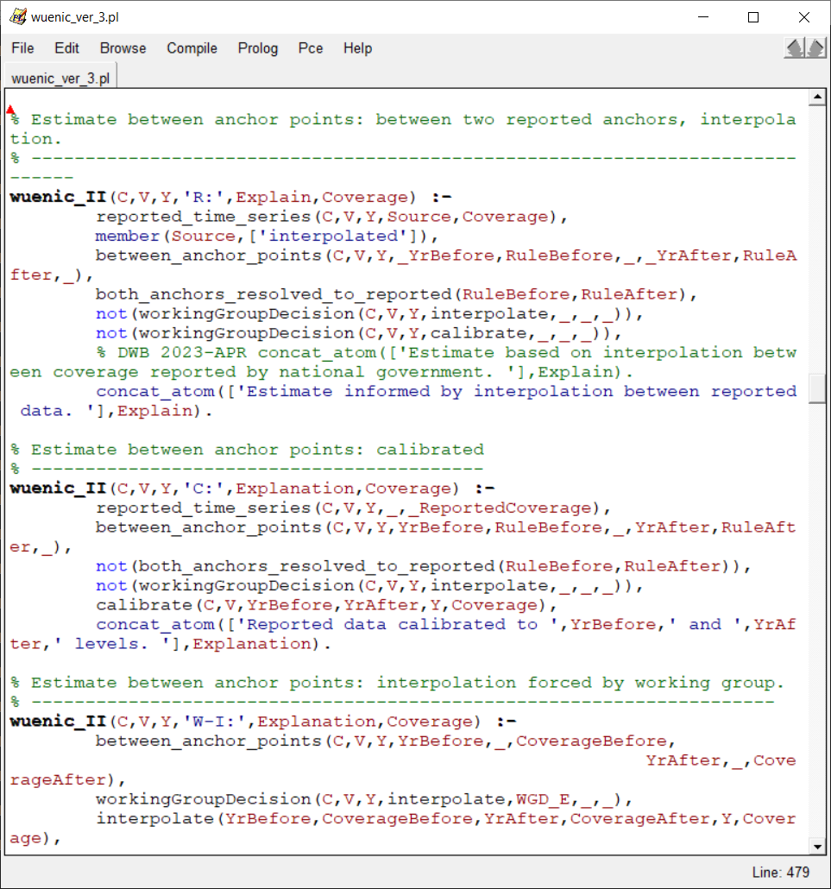
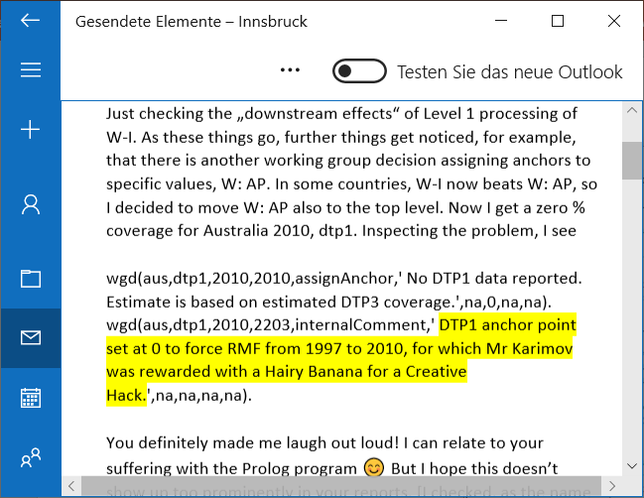
The problem
The Prolog program has been amended a number of times. Over the years, it became more and more difficult to maintain it.

Slide 6
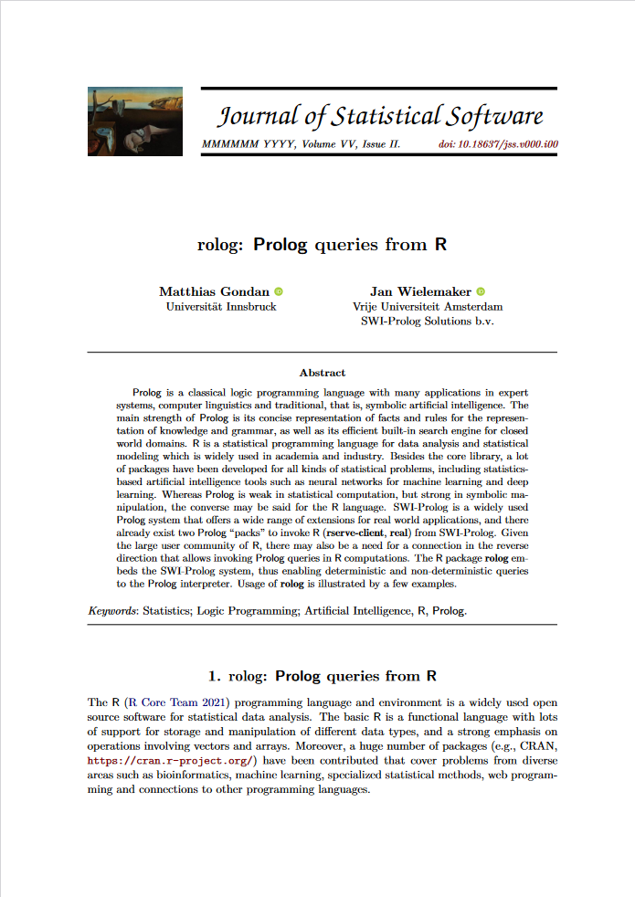
Solution
Find someone who translates the Prolog script to a more common programming language.
Step 1
Clean up, translate “pure” to “procedural” Prolog
Step 2
Clean up a bit more
Step 3 (if still needed)
Translate to an R program

Slide 7
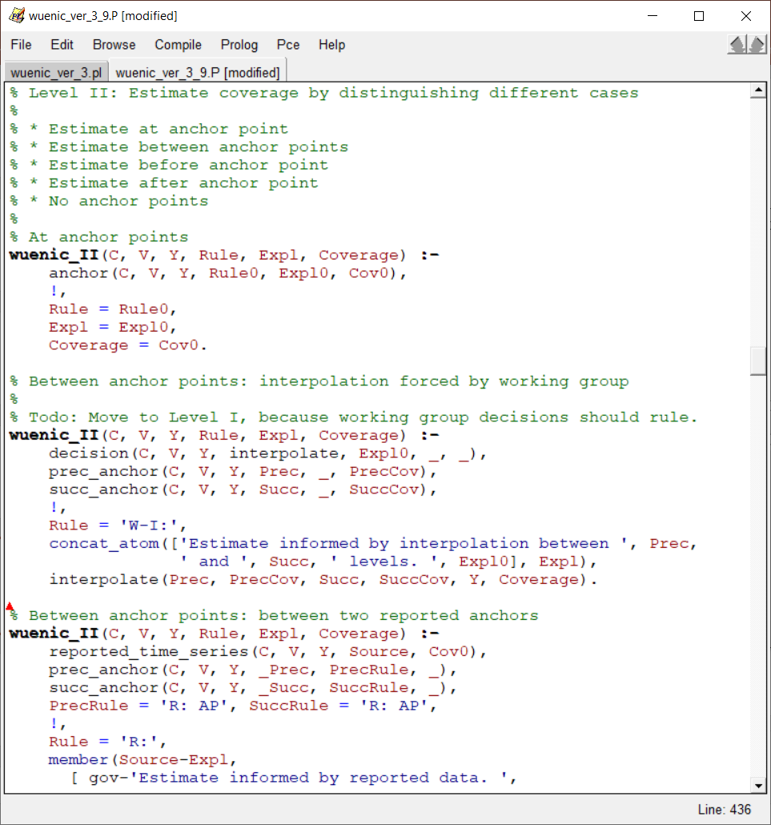
V3.9: Clean up “Procedural” Prolog
Instead of testing all conditions in each decision rule, catch special cases first and move on until default rule.
Validation
The revised program should produce exactly the same output as the original program.
Status
done
check special
case
cut
commit
otherwise, …

Slide 8
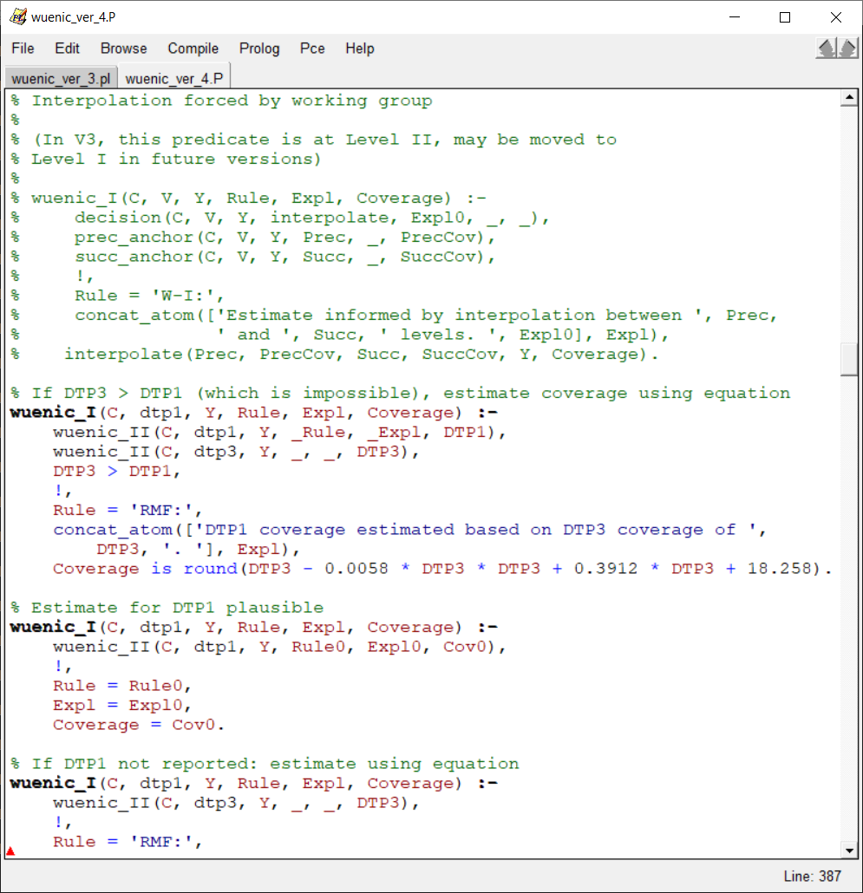
V4.x Clean up a bit more
Increase consistency of outputs, add missing blanks, reorder comments, make free texts more informative.
Validation
V4.0 should produce the same coverage estimates as the original program. Texts may differ a bit.
Status
done (more improvements welcome)
Reorder priorities (?)
check special
case
cut
commit
Fix inconsistent colon
otherwise, …

Slide 9
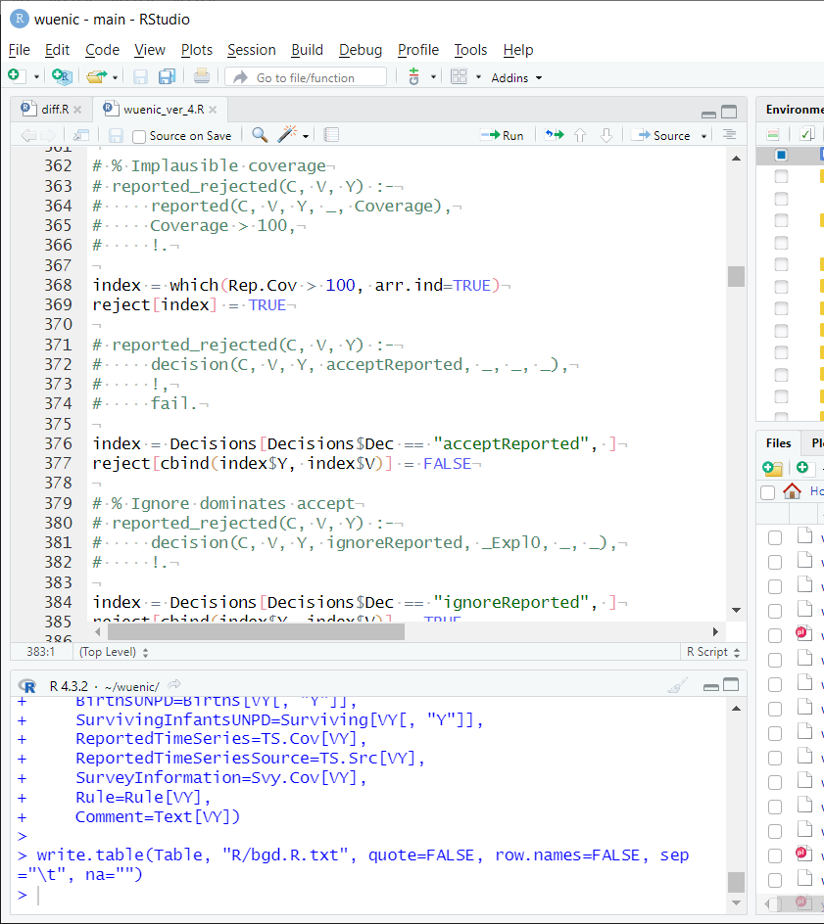
R program
Translate everything to R. Other people should easily understand and be able to maintain it.
Challenge
R is good for statistics, but terrible for programming.
Validation
Produce exactly the same output as Prolog V4.x
Status
Works for all countries. Not yet “pretty”.

Slide 10
Refactoring in Prolog
V3.9
V4.0

Slide 11
The plan
Several steps
Either
many changes in the program
output must stay the same
Alternatively
Few changes in the program (that can be inspected)
output may differ, but coverage must stay the same
V3.0
Pure Prolog
slow, complicated
V3.9
Many changes in the program (procedural)
Validation: Same output as V3.0
V4.0
Few changes for consistency, improvements
Validation: code review, coverage estimates
V4.0 in R
Many changes (R differs a lot from Prolog)
Validation: Same output as V4.0

Slide 12
V3.0
“Pure Prolog”, but slow and complicated due to many changes over the years.
Pure Prolog
parent(fred, susan). parent(susan, wolf).
ancestor(A, X) :- parent(A, X).
ancestor(A, Y) :- parent(A, X), ancestor(X, Y).
Query
Purely relational, no real input or output arguments, query yields all possible solutions.
?- ancestor(A, wolf). A = susan ; A = fred

Slide 13
V3.9
Reimplement the Prolog program, simplify things, use “procedural Prolog” instead of “pure Prolog”.
Procedural Prolog
fib(0, X) :- !, X is 1.
fib(1, X) :- !, X is 1.
fib(A, X) :- A1 is A – 1, fib(A1, F1), A2 is A – 2, fib(A2, F2), X is F1 + F2.
Query
Input left, output right. Special cases: check condition with “guards”, then cut (!) and commit to the unification of output arguments. The default case is handled in the end.
?- fib(5, X). X = 10

Slide 14
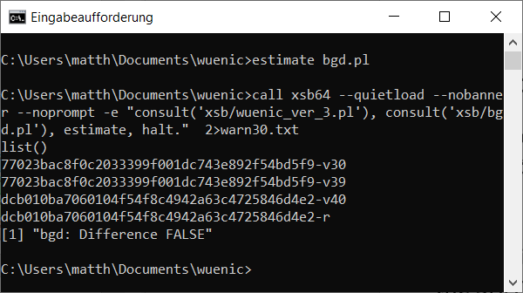
Validation
estimate.bat
call xsb64 --quietload --nobanner --noprompt -e "consult('xsb/wuenic_ver_3.pl'), consult('xsb/%1'), estimate, halt." 2>warn30.txt
call xsb64 --quietload --nobanner --noprompt -e "consult('xsb/wuenic_ver_3_9.P'), consult('xsb/%1'), estimate, halt." 2>warn39.txt
…
swipl -g "(file_sha1('out/%1.v30.txt', V30), file_sha1('out/%1.v39.txt', V39), writeln(V30-v30), writeln(V39-v39))" -g halt
V3.9 should produce exactly the same output as V3.0.
Here, it is validated with the SHA1 checksum for the output files of each country.

Slide 15
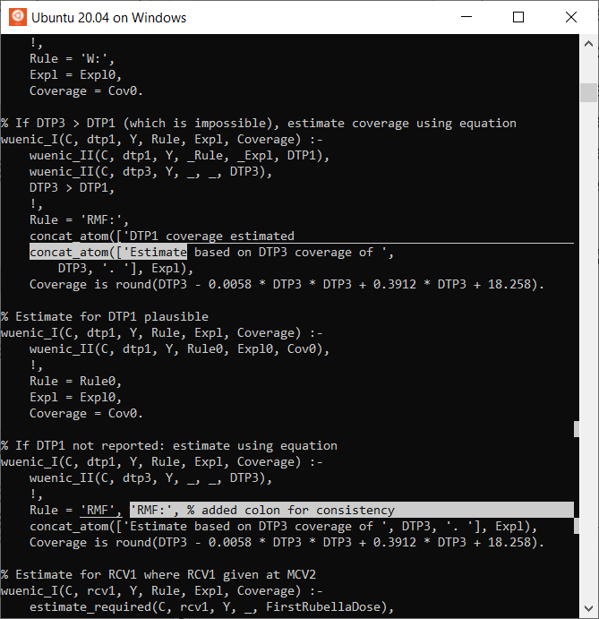
V4.0
Several cleanups w.r.t. V3.9, for example:
Fix inconsistent output
Simplify comments
Suppress some comments (e.g., survey-specific comments for surveys that were excluded anyway)
Group comments that belong together

Slide 16
Validation
Minimalistic changes between V3.9 and V4.0 allow manual code review. Output may differ, but coverage estimates must not change.
estimate.bat
…
call xsb64 --quietload --nobanner --noprompt -e "consult('xsb/wuenic_ver_3_9.P'), consult('xsb/%1'), estimate, halt."
swipl -g "consult('xsb/wuenic_ver_4.pl'), consult('xsb/%1'), estimate" -g halt
…
R --quiet --no-echo --file=R\diff.R --args %1

Slide 17
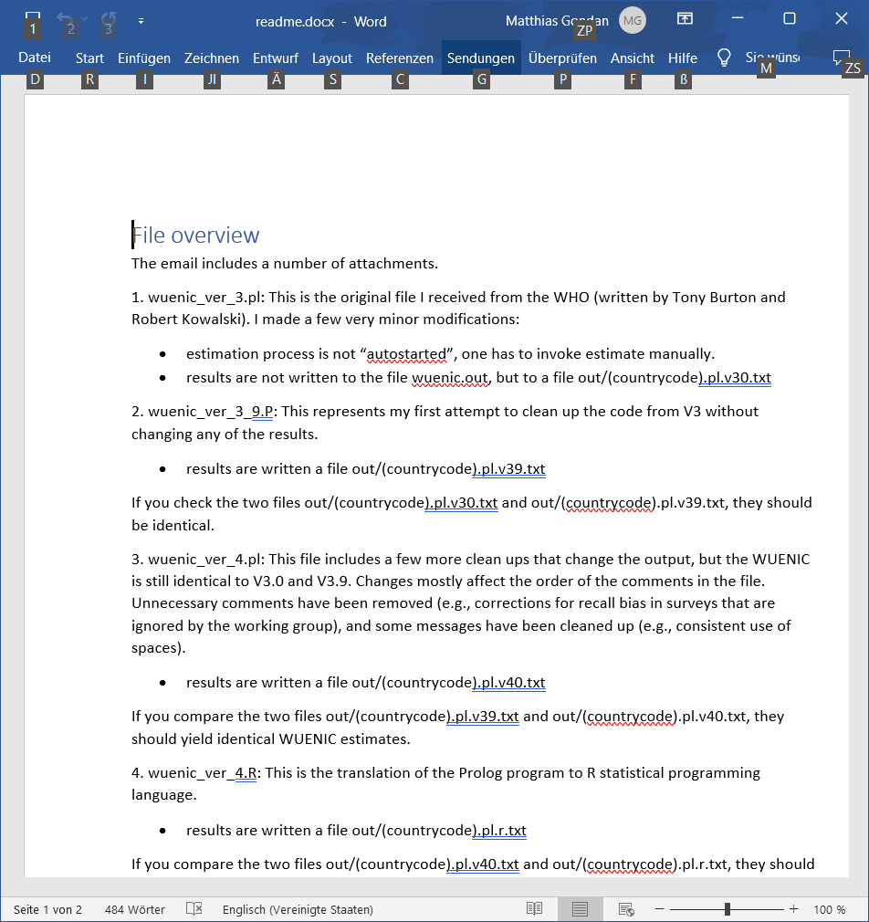
Practical session
Todo list
Install XSB prolog and add it to the PATH
Install SWI-Prolog, but do not add it to the PATH
adjust estimate.bat
Run validation on your computer

