Slide 1
WUENIC implementation in R
Matthias Gondan
University of Innsbruck

Slide 2
Background
WUENIC estimates* are based on a complex set of rules that take into account the situation of the administration in the member states.
*and confidence ratings
Coverage estimate
Gov’t
Admin
Plausibility
Interpolate
Extrapolate
Surveys
Working group
Calibrate

Slide 3
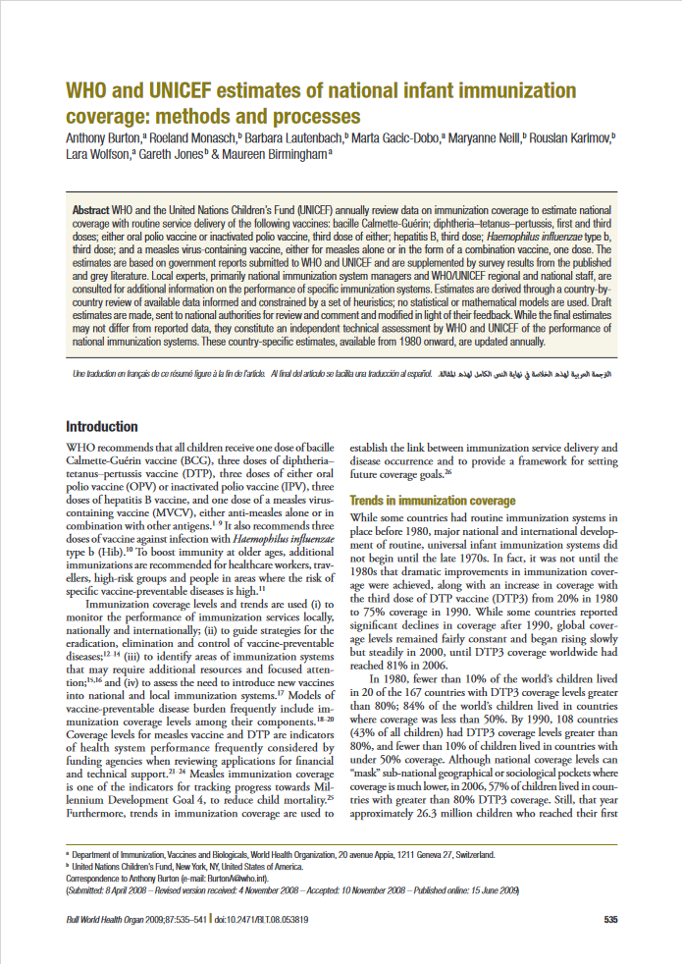
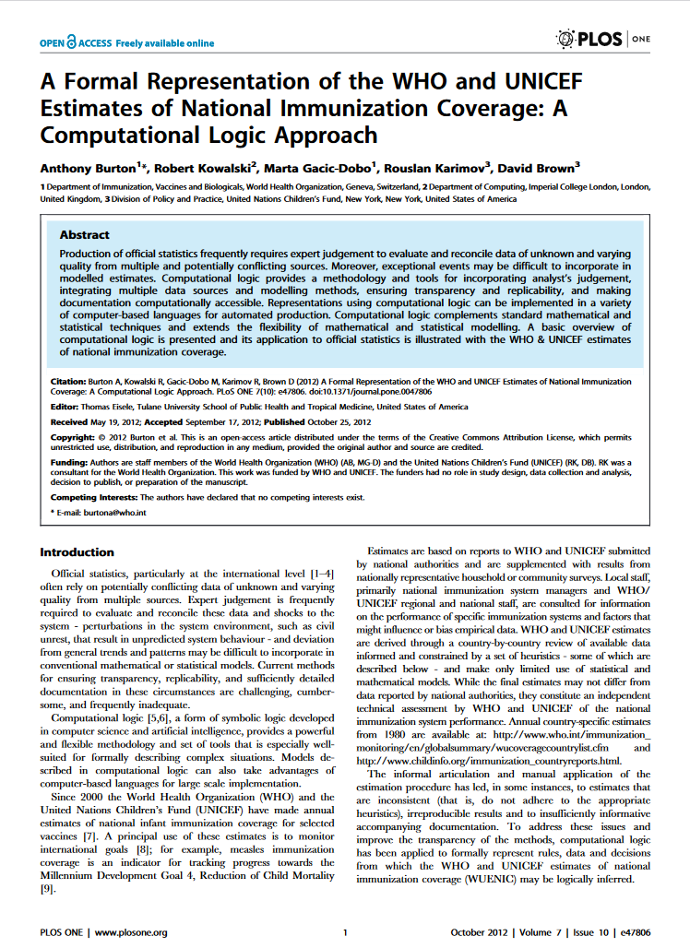
Formalization
The estimation process is an interesting instance of “decision under uncertainty”.
It has been formalized in two scientific papers.

Slide 4
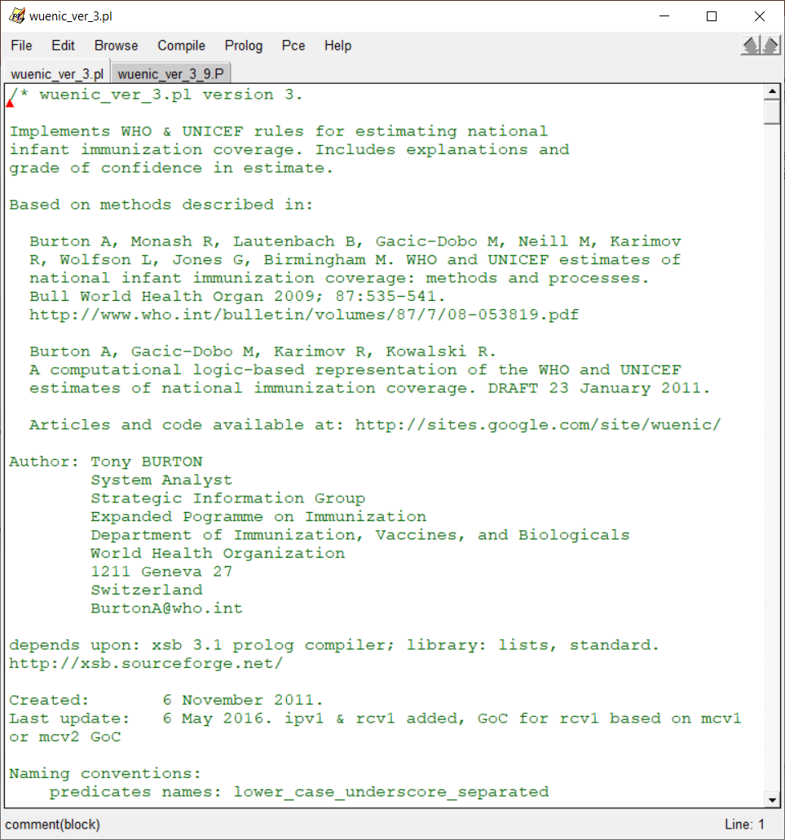
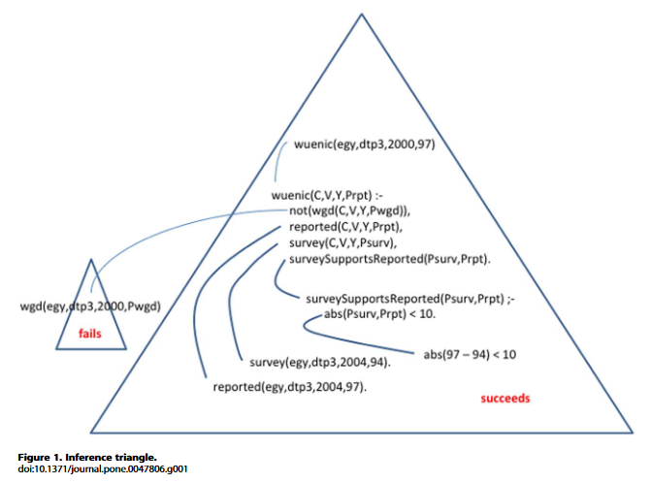
Implementation
The different stages in the estimation process have been implemented in a computer program written in Prolog.

Slide 5
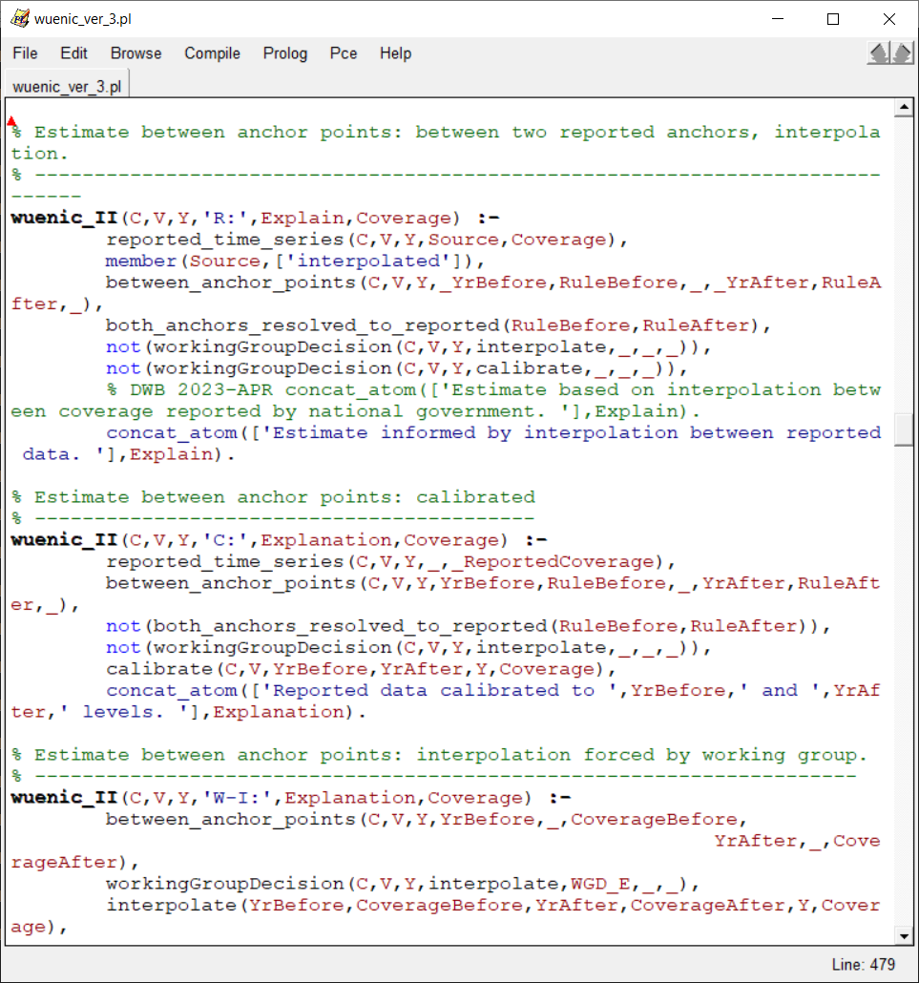
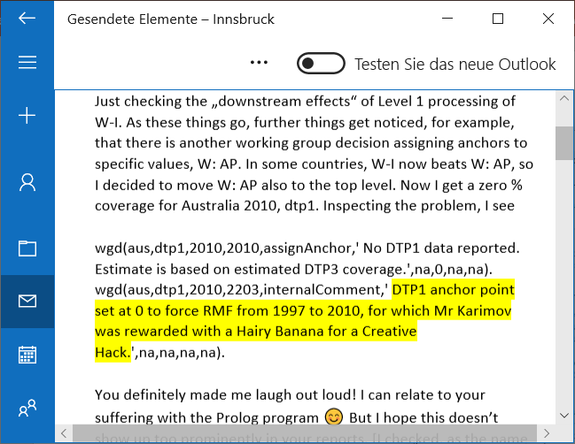
The problem
The Prolog program has been amended a number of times. Over the years, it became more and more difficult to maintain it.

Slide 6
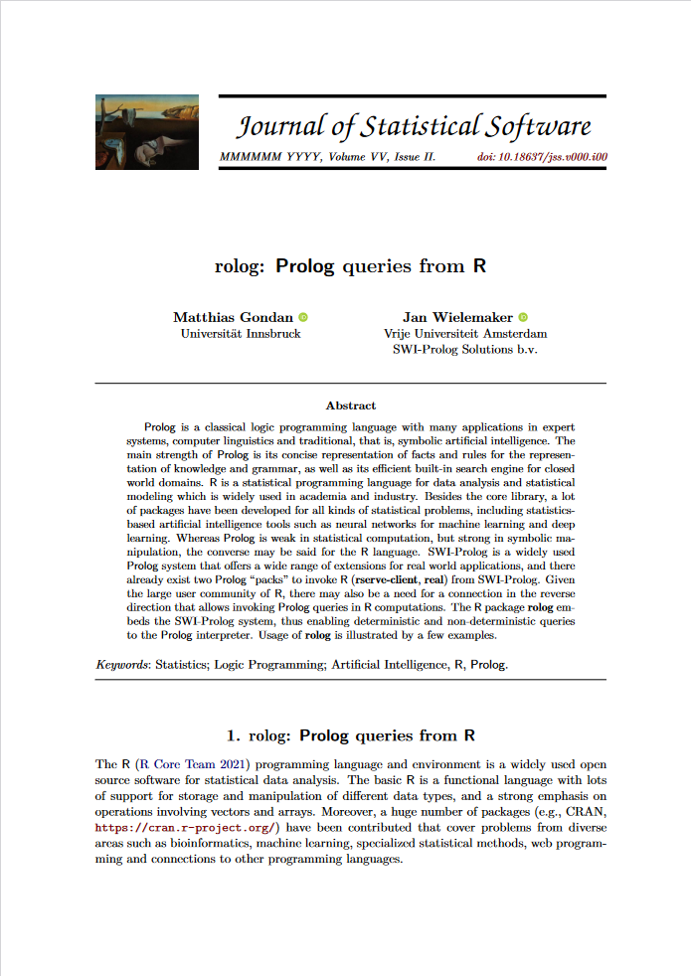
Solution
Find someone who translates the Prolog script to a more common programming language.
Step 1
Clean up, translate “pure” to “procedural” Prolog
Step 2
Clean up a bit more
Step 3 (if still needed)
Translate to an R program

Slide 7
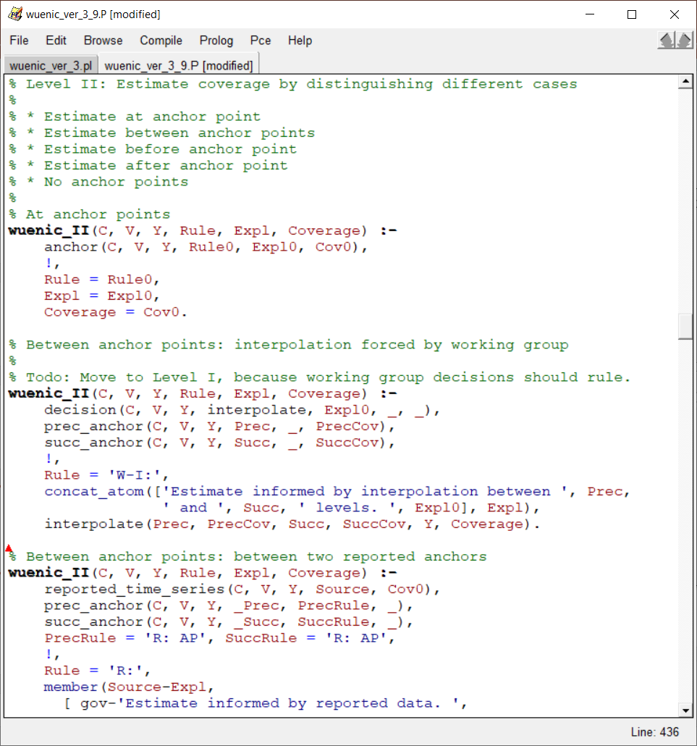
V3.9: Clean up “Procedural” Prolog
Instead of testing all conditions in each decision rule, catch special cases first and move on until default rule.
Validation
The revised program should produce exactly the same output as the original program.
Status
done
check special
case
cut
commit
otherwise, …

Slide 8
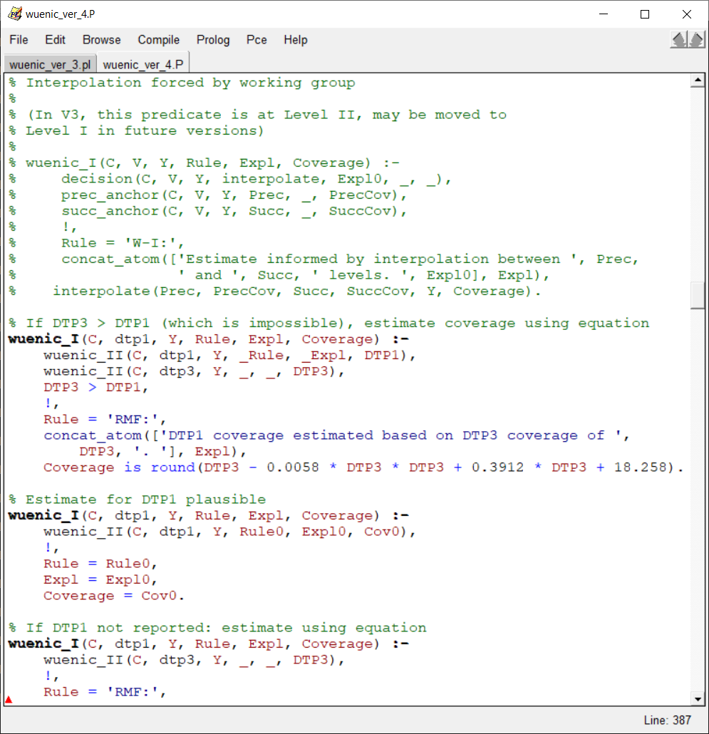
V4.x Clean up a bit more
Increase consistency of outputs, add missing blanks, reorder comments, make free texts more informative.
Validation
V4.0 should produce the same coverage estimates as the original program. Texts may differ a bit.
Status
done (more improvements welcome)
Reorder priorities (?)
check special
case
cut
commit
Fix inconsistent colon
otherwise, …

Slide 9
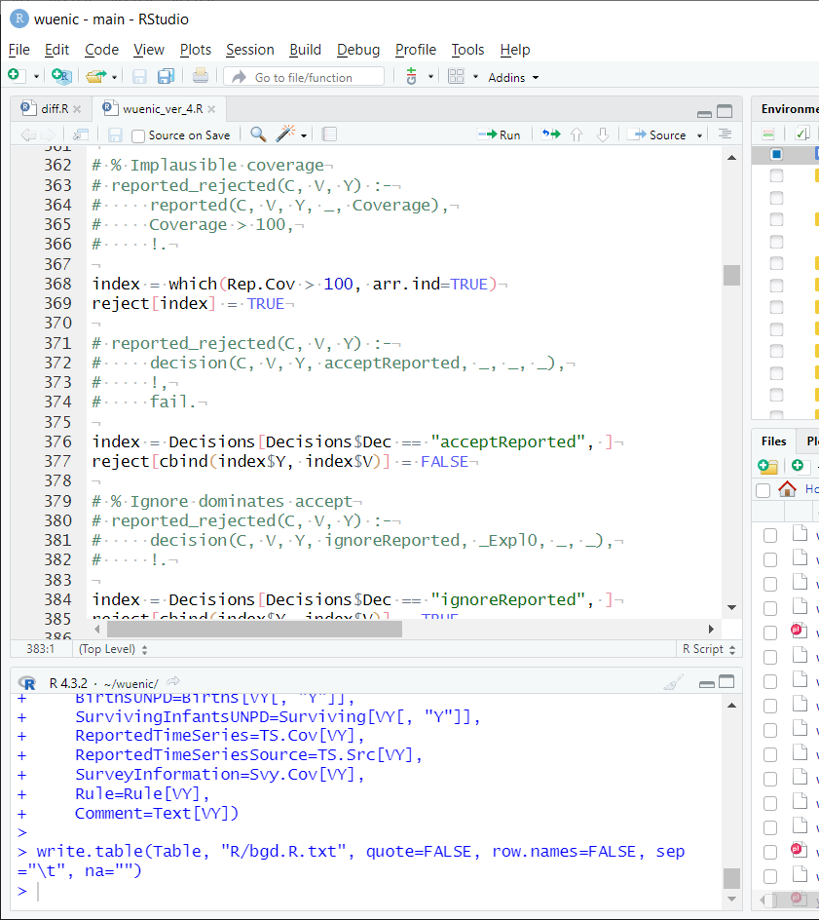
R program
Translate everything to R. Other people should easily understand and be able to maintain it.
Challenge
R is good for statistics, but terrible for programming.
Validation
Produce exactly the same output as Prolog V4.x
Status
Works for Bangladesh. Not yet “pretty”.

