Slide 1
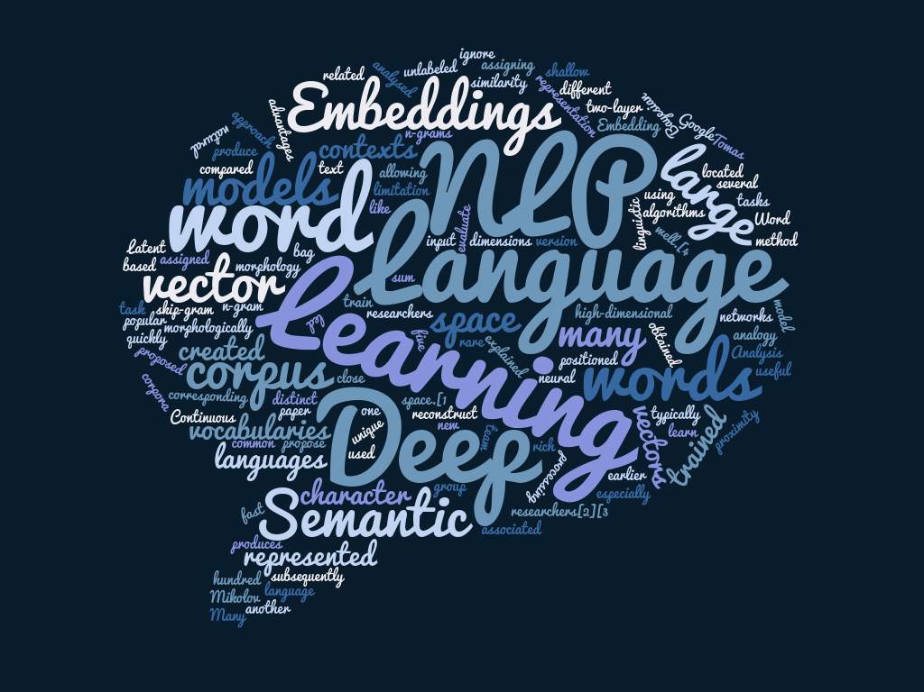
Understanding Natural Language
Dataset: Natural Language for Visual Reasoning ²
18.05.2019 Loom Princesa, Madrid
<número>
Notes:
encabezado
pie de pagina
<número>

Slide 2
Contenidos
Team
State of the art
Solution
Technology
Example
Applications
<número>

Slide 3
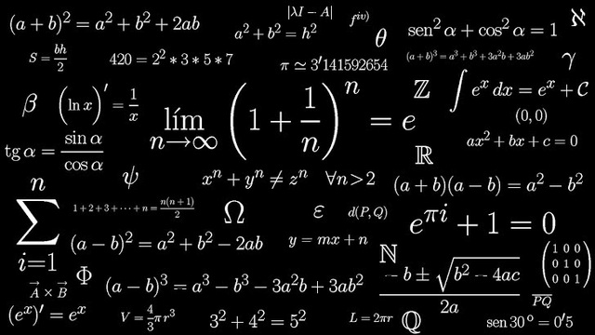

Team
Multidisciplinar team
Mix of experience and youth
Passionate about technology and innovation
<número>
Notes:
dynamic semantics: meaning representation as dynamic programs that update an existing context.
semantic compression: reducing a lexicon maintaining text semantics.
conceptual space: points denote objects and regions denote concepts
<número>

Slide 4


State of the art
<número>
Notes:
dynamic semantics: meaning representation as dynamic programs that update an existing context.
semantic compression: reducing a lexicon maintaining text semantics.
conceptual space: points denote objects and regions denote concepts
<número>

Slide 5
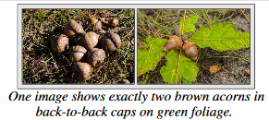
Solution
Improving NLU:
Better understanding of complex sentences
Source: https://arxiv.org
<número>
Notes:
dynamic semantics: meaning representation as dynamic programs that update an existing context.
semantic compression: reducing a lexicon maintaining text semantics.
conceptual space: points denote objects and regions denote concepts
<número>

Slide 6
Technology
JSON (Corpus)
Libraries: Keras, TensorFlow
Sequence to Sequence Model
Samples: YOLO, COCO
<número>
Notes:
dynamic semantics: meaning representation as dynamic programs that update an existing context.
semantic compression: reducing a lexicon maintaining text semantics.
conceptual space: points denote objects and regions denote concepts
<número>

Slide 7

Example
There is a red cup
<número>
Notes:
dynamic semantics: meaning representation as dynamic programs that update an existing context.
semantic compression: reducing a lexicon maintaining text semantics.
conceptual space: points denote objects and regions denote concepts
<número>

Slide 8
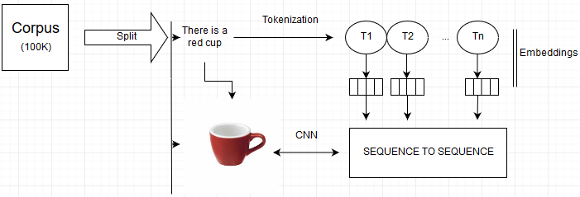
Our model
<número>
Notes:
dynamic semantics: meaning representation as dynamic programs that update an existing context.
semantic compression: reducing a lexicon maintaining text semantics.
conceptual space: points denote objects and regions denote concepts
<número>

Slide 9
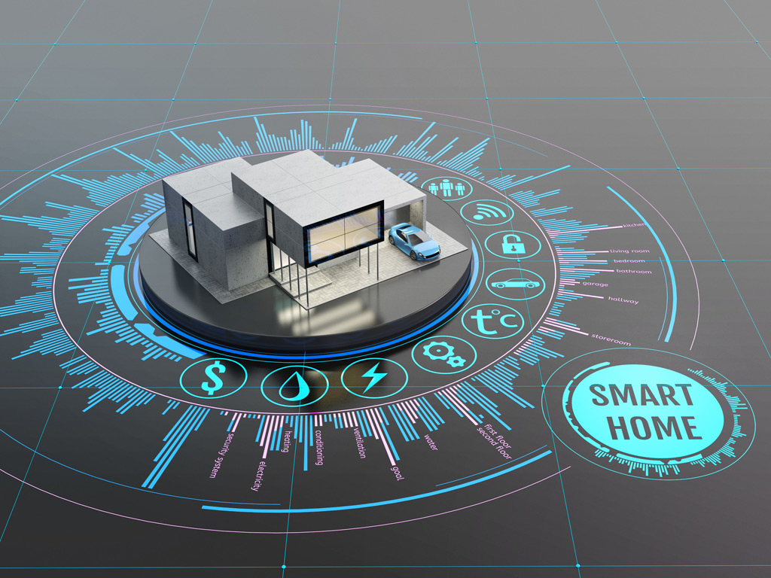



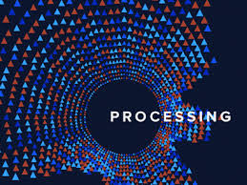
Applications
-Domotics
-Operating Systems
-Personal Assistant
-3D Modeling
-Image Processing
The limit is your imagination
<número>
Notes:
dynamic semantics: meaning representation as dynamic programs that update an existing context.
semantic compression: reducing a lexicon maintaining text semantics.
conceptual space: points denote objects and regions denote concepts
<número>

Slide 10
References
Alane Suhr, Stephanie Zhou, Iris Zhang, Huajun Bai and Yoav Artzi. 2018. A Corpus for Reasoning About Natural Language Grounded in Photographs. Retrieved from: https://arxiv.org/pdf/1811.00491.pdf
<número>
Notes:
<número>

Slide 11

Diego – nlp@fairbill.com
Francisco – 100383172@alumnos.uc3m.es
Miguel – miguelalted@yahoo.es
Luis – la.glezc@gmail.com
<número>

