Slide 1
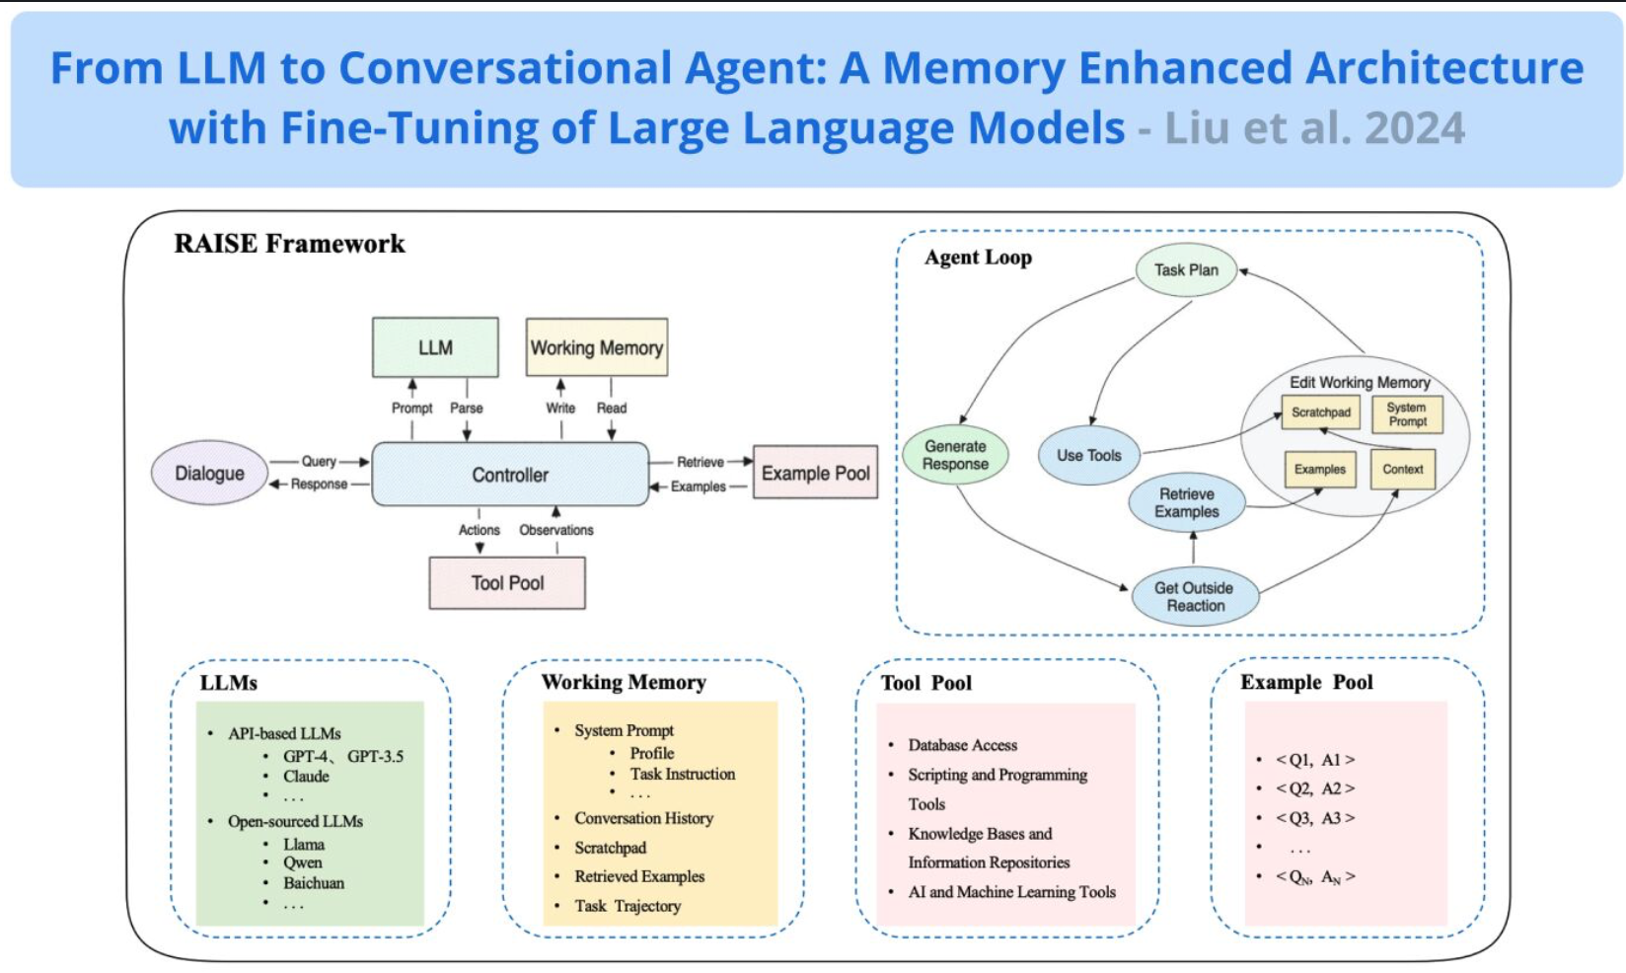

Slide 2
From LLM to Conversational Agent Proposes RAISE, an advanced architecture to enhance LLMs for conversational agents. It's inspired by the ReAct framework and integrates a dual-component memory system. It utilizes a scratchpad and retrieved examples to augment the agent's capabilities. The scratchpad serves as a transient storage (akin to short-term memory) and the retrieval module operates as the agent's long-term memory. So you can think of this as a framework that combines ReAcT, a scratchpad, and a retrieval system. This system mirrors human short-term and long-term memory and helps to maintain context and continuity which are key in conversational systems. One benefit of such a system is the ability to customize and control the behavior of the conversational system. This work also shows the potential to fine-tune the LLM within the RAISE framework which leads to enhanced controllability. RAISE was tested on the real-estate domain and showed superior performance as compared to the conventional conversational agents. For every use case, there might be a need to control for different aspects of an LLM-powered agent. This can range from customizing the working memory components to changing the effectiveness of retrieval of certain types of information. I like the idea of modularity in a conversational agent but that means there are more variables to control. Lots of potential with this framework for building more tailored and personalized agents.

