Slide 1
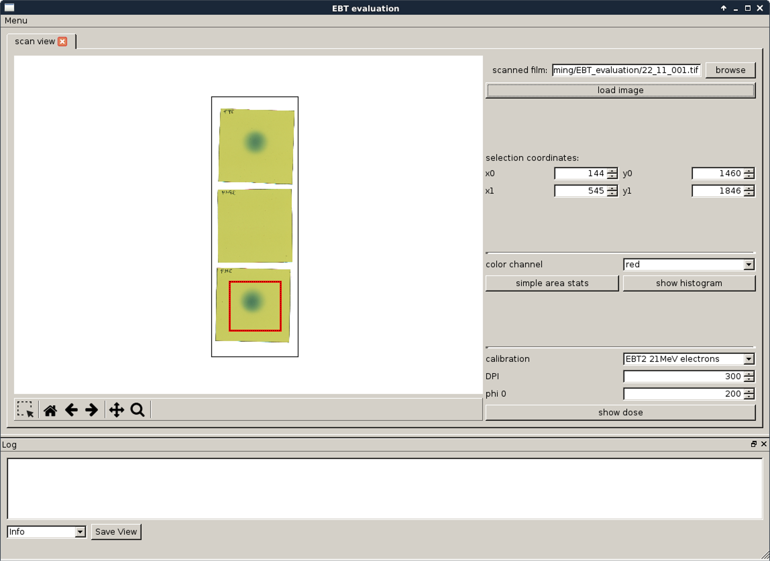
Start Window (scan view)
more options and restore closed windows
1.
load a scanned image, by either typing the path or browsing for it
pan and zoom the image
2.
select an area by either putting in the coordinates or using the selction tool
go back or forward in the zoom history or return to the original view
(2.5)
show statistic for a color, e.g. average value of an unirradiated area to get a phi_0
3.
select the calibration to use, set DPI (for getting the cm scale) and phi_0, click show dose to get the dose picture
Logging area:
Shows errors and warnings from the program as well as all the ouput, e.g. from the area stats.

Slide 2
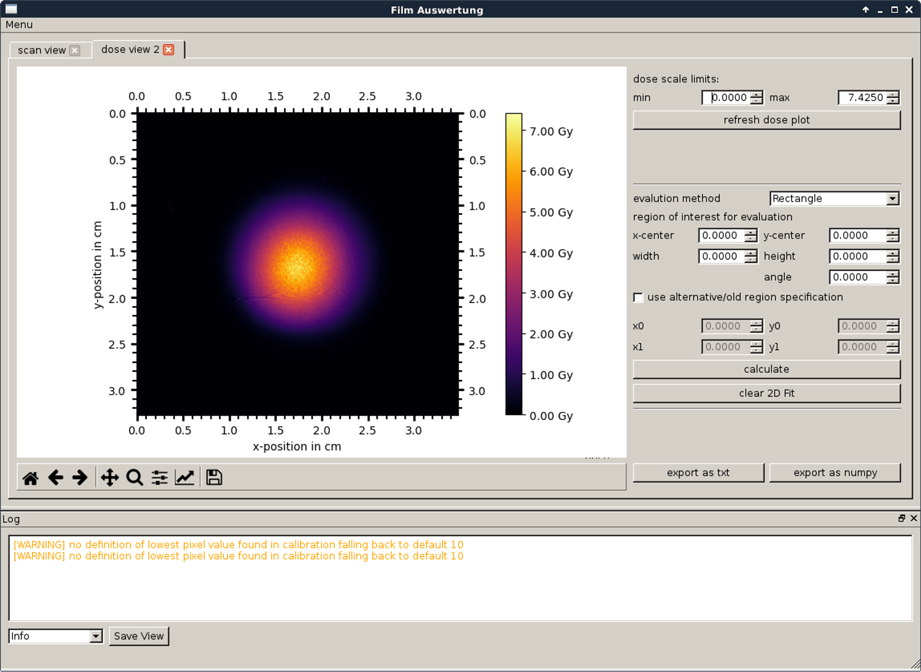
dose view
set the limits of the colormap, then refresh the plot
Select the evaluation to use and set its coordinates.
The alternative specification uses upper left and lower right corner, instead of a center + height and width.
The corners and the center can be given by selecting the field and then clicking the image, width and height must be entered manually
2D fit must be cleared manually
Export the dose view, txt is a tab seperated format, numpy is for import into python
save as png
see results here

Slide 3
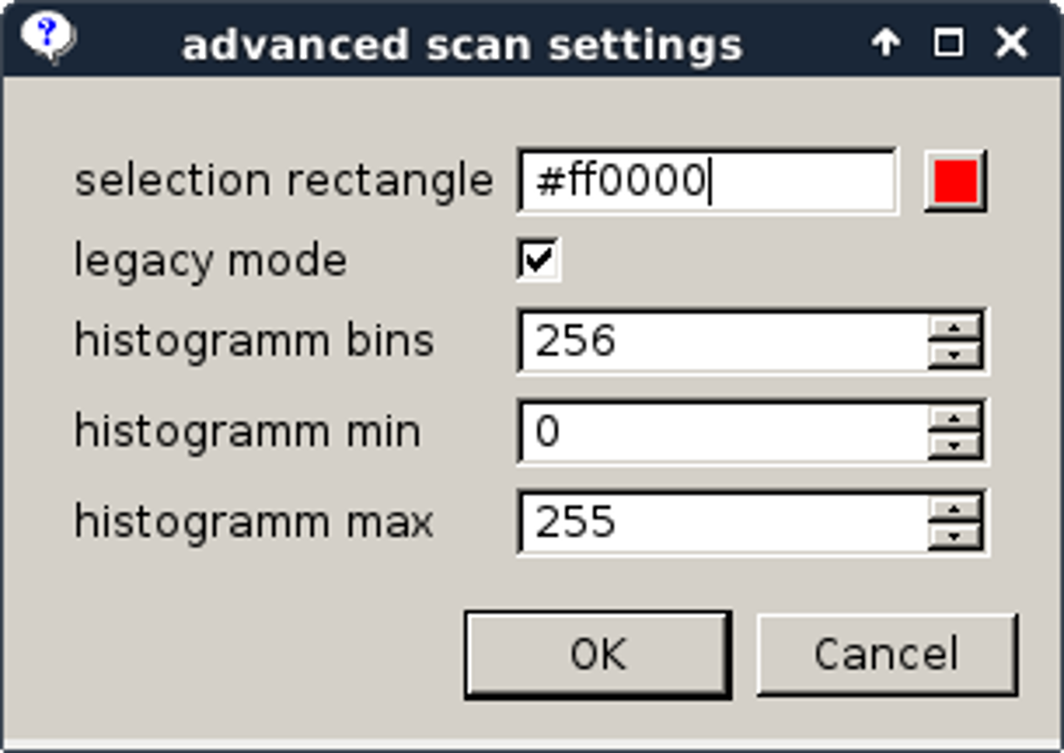
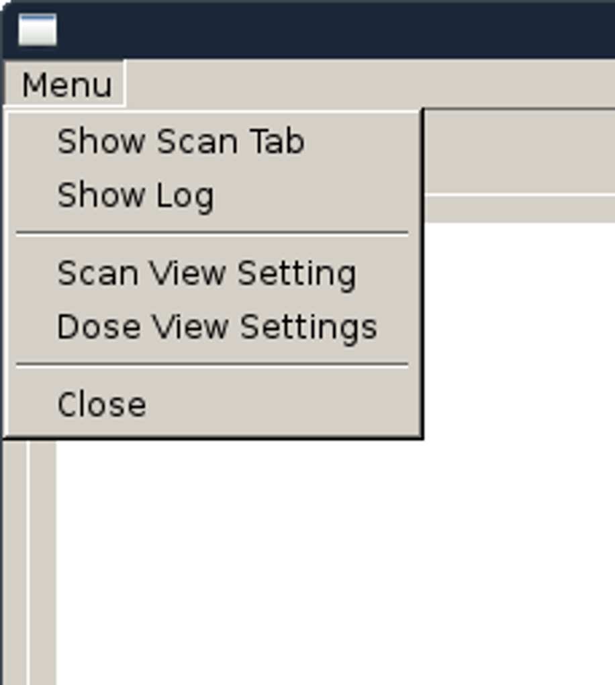
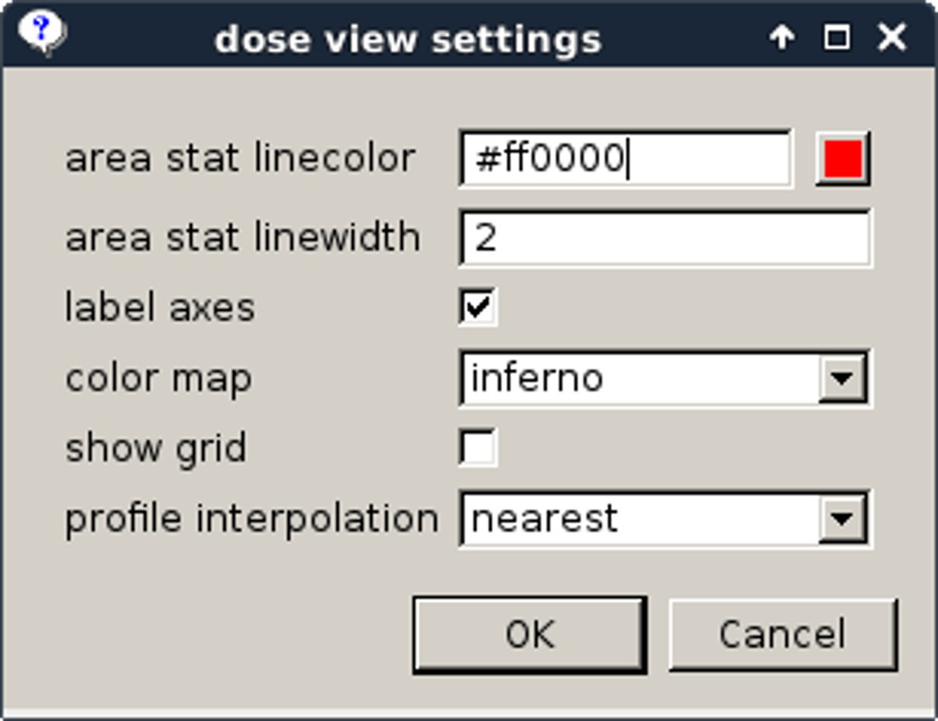
more options
the color of the marker for the selection
restore the starting tab, if closed
if unchecked the scan is flipped upon loading (undo the mirroring of the scan)
settings for the histogram
properties of the marker of the region of interest
restore the log window if closed
the dose is shown as a color, this selects how dose maps to color, please don‘t use spectral, aka rainbow: http://ieeexplore.ieee.org/document/4118486/
the interpolation method used when showing a profile

