Slide 1
Reinforcement Learning
Deep Reinforcement Learning
Mathieu Goutay, Nokia Bell Labs
mathieu.goutay@nokia.com
INSA Lyon, France

Slide 2
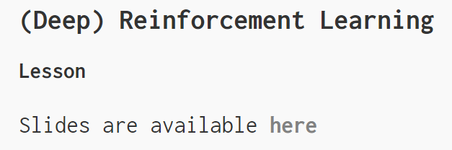
Follow the course at
mgoutay.github.io
→Blog → Machine Learning Course

Slide 3
Reinforcement Learning, part I
Multi-armed Bandits
Action, reward, action-value, estimated action-value
Policies
Your turn ☺
Renforcement Learning, part II
Classic RL problem and Markov Decision Process
Return, state-value, action-value
Temporal Difference Learning
Your turn ☺
Deep Reinforcement Leaning
Q-network
Experience replay
Target Network
Your turn ☺

Slide 4
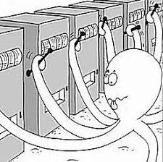
Reinforcement Learning, Part I
Multi-armed Bandit
Problem formulation:
You have a Wi-Fi network with 7 different channels
You need to transmit 10.000 packets
→ Which channel do you choose?
Framework:
For each attempt, you choose a channel (action)
If the packet was sent, you got a reward : 1
If there was a collision, you got no reward : 0
Goal: Online training
→ Find the best action to maximize the total number of transmitted packets (received rewards)

Slide 5

Reinforcement Learning, Part I
Action, reward, action-value, estimated action-value
Notations:
The action and reward at times step t denoted in capital letters: $A_{t}, R_{t}$
Their possible values are denoted in lower case : $a, r$
We evaluate each action with its action-value function :
What is the expected return if we choose this channel (action)?
$$q_{∗}\left(a\right)= Ε\left[R_{t} | A_{t}=a\right]$$
Problem : We don’t know it ☹

Slide 6

Reinforcement Learning, Part I
Action, reward, action-value, estimated action-value
We need to estimate the action-value function :
Test each channel many times
Compute an average for each channel
$$Q_{t}\left(a\right)=\frac{sum of rewards when we took the action a}{number of time we took the action a}$$
$$=\frac{\sum_{i=1}^{N_{t}(a)}{R_{i}^{a}}}{N_{t}(a)}$$
Notations:
The true action-value function is denoted in lower case : $q_{∗}(a)$
Its estimate at time $t$ is denoted in capital letters : $Q_{t}(a)$
$N_{t}(a)$ denotes the number of times action $a$ has been selected at time $t$
$\left[R_{1}^{a},R_{2}^{a}, …,R_{N_{t}(a)}^{a}\right]$ denotes the rewards we got when taking the action $a$

Slide 7

Reinforcement Learning, Part I
Action, reward, action-value, estimated action-value
We can then choose the best action at time $t$ :
$$A_{t}=\arg{\max_{a}{Q_{t}\left(a\right)}}$$
We chose the action that will most probably give the best reward
Tradeoff:
We need to test each channel many times to have the best estimate $Q_{t}\left(a\right)$ → Exploration
We need to take the best action to maximize the rewards → Exploitation

Slide 8

Reinforcement Learning, Part I
Policies
How to both explore and exploit ? We follow a policy $π$
The policy define how we chose the action at each time step $t$
The most basic policy is the $ε$-greedy policy:
At each time step $t$:
With a probability $ε$, take a random action
→ Refine the action-value estimation for that action
With a probability (1- $ε$), take the best action $A_{t}=\arg{\max_{a}{Q_{t}\left(a\right)}}$
→ Maximize the reward
$ε$ defines the tradeoff exploration/exploitation

Slide 9
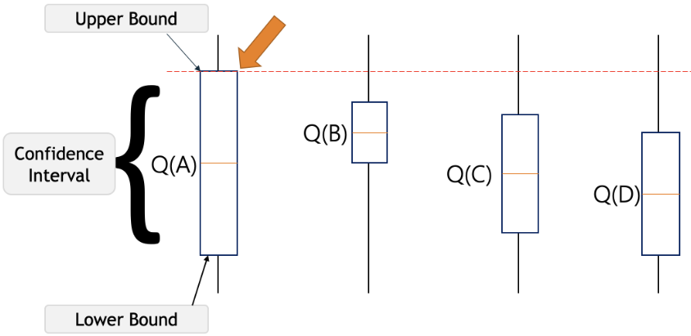
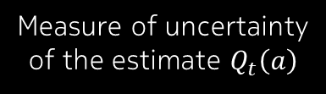

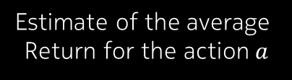
Reinforcement Learning, Part I
Policies
Another one is the Upper-Confidence-Bound (UCB) policy:
$N_{t}(a)$ denotes the number of times action $a$ has been selected at time $t$
Select the best action according to :
$A_{t}=\arg{\max_{a}\left[Q_{t}\left(a\right)+\sqrt{\frac{2 ln⁡(t)}{N_{t}(a)}} \right]}$
Often takes the best action but still refine the estimate $Q_{t}\left(a\right)$
Estimate of the average
Return for the action $a$
Measure of uncertainty
of the estimate $Q_{t}\left(a\right)$

Slide 10
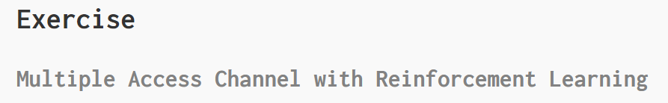
Reinforcement Learning, Part I
Let’s play ☺

Slide 11
Reinforcement Learning, part I
Multi-armed Bandits
Action, reward, action-value, estimated action-value
Policies
Your turn ☺
Renforcement Learning, part II
Classic RL problem and Markov Decision Process
Return, state-value, action-value
Temporal Difference Learning
Your turn ☺
Deep Reinforcement Leaning
Q-network
Experience replay
Target Network
Your turn ☺

Slide 12
Reinforcement Learning, Part II
Classic RL problem
Problem formulation:
You are in an industrial environment with 7 different channels
All existing machines transmit with a certain periodicity
You install a new IoT sensor, and need to find on which channel to transmit 5 packets
You can sense the channels before sending a packet(!)
Which channels do you choose?
Framework: At each time step
You sense the channels (state)
You see if the previously transmitted packet has been correctly received (reward)
You decide on which channel you transmit next (action)
Offline Training : you can learn as much as you want

Slide 13

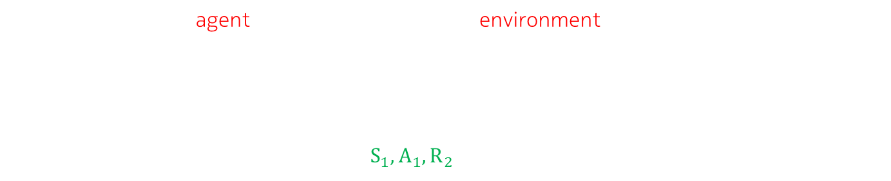
Reinforcement Learning, Part II
Classic RL problem
The IoT sensor is a agent which interacts with an environment
At each time step $t$ :
The agent receives a state (sensed channels) and a reward (previous tx successful?)
The agent takes an action (choose the next channel)
The sequence is defined by $S_{0},A_{0}, R_{1},S_{1},A_{1},R_{2},S_{2},A_{2},R_{3},…$

Slide 14
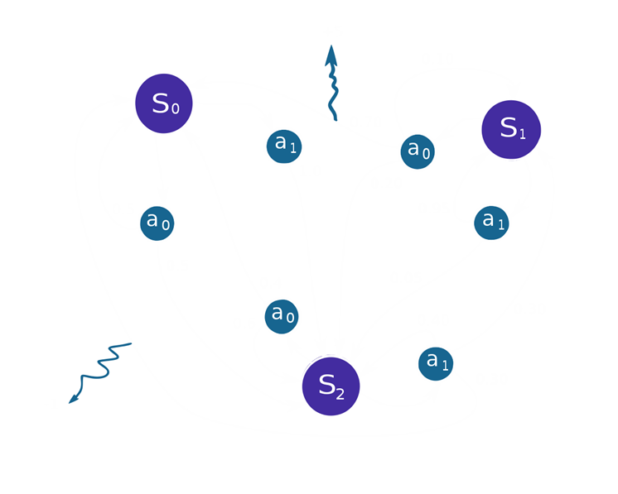
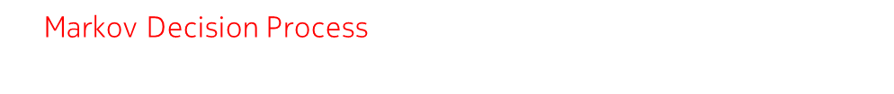

Reinforcement Learning, Part II
Markov Decision Process
A Markov Decision Process (MDP) is a 4-tuple $(𝒮, 𝒜_{s}, 𝒫_{a}, ℛ_{a})$ :
$𝒮$ is a finite set of states
$𝒜_{s}$ is the finite set of actions available from state $s$
$𝒫_{a}\left(s, s^{′}\right)=Pr\left(s_{t+1}=s^{′} | s_{t}=s, a_{t}=a\right)$ is the probability that action $a$ in state $s$ at time $t$ will lead to state $s′$ at time $t+1$
$ℛ_{a}(s, s^{′})$ is the reward received after transitioning from state $s$ to state $s′$, due to action $a$

Slide 15
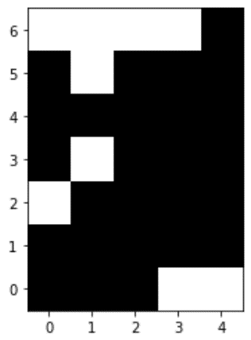

Reinforcement Learning, Part II
Classic RL problem
For simplicity, let’s have a known deterministic environment:
The white boxes are free channels
The black boxes are already used channels
You have 5 different channel states
You start at the “starting point”
Goal : Find the best channels for the 5 transmissions
The transmission of 5 packets is called an episode
$$s_{0}$$
Starting point
Channels
State indices

Slide 16
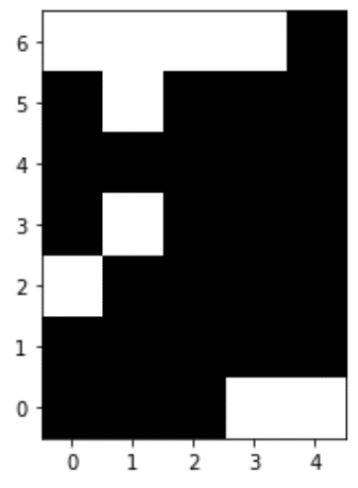




Reinforcement Learning, Part II
Classic RL problem
The state consists of:
The state index we sense (5 possibilities)
The channel in which we transmitted (7 possibilities)
A Boolean to indicate if we reached the last state (5 transmissions)
The rewards are :
1 if the transmission was successful
0 otherwise
The possible actions are:
Transmit in the channel above (mod 7) :$A$
Transmit in the same channel : $S$
Transmit in the channel below (mod 7) : $B$
$$s_{3}$$
$$s_{2}$$
$$s_{0}$$
Starting point
Channels
$$s_{1}$$
State indices

Slide 17






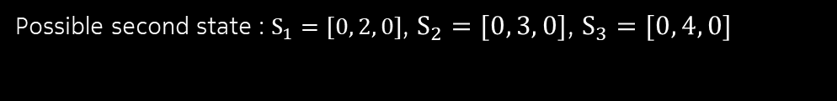




Reinforcement Learning, Part II
Classic RL problem
First state : $S_{0}=[state_index, prev_channel, bool]=[4, 3, 0]$
$$s_{0}$$
$$s_{3}$$
$$s_{2}$$
$$s_{0}$$
Starting point
Channels
$$a_{A}$$
$$s_{1}$$
$$R_{s_{0}, a_{B}}=1$$
$$R_{s_{0}, a_{A}}=0$$
$$s_{1}$$
$$a_{B}$$
$$a_{S}$$
$$s_{3}$$
$$R_{s_{0}, a_{S}}=0$$
$$s_{2}$$
State indices
Possible second state : $S_{1}=[0, 2, 0]$, $S_{2}=[0, 3, 0]$, $S_{3}=[0, 4, 0]$

Slide 18








Reinforcement Learning, Part II
Return, state-value, action-value
$$s_{0}$$
The discounted return is the sum of rewards after a time step $t$ :
$$G_{t}=R_{t+1}+γR_{t+2}+γ^{2}R_{t+3}+…= \sum_{k=0}^{∞}{γ^{k}R_{t+k+1}}$$
$=R_{t+1}+{γ G}_{t+1}$
The discount factor $γ$ , with $0 ≤ γ≤1$, is used for:
Having a finite return even if the number of future time steps $k$ is infinite
Maximizing short-term ($γ=0)$or long-term ($γ=1)$ reward
Note that in our problem, the maximum time step is 5
$$a_{A}$$
$$s_{1}$$
$$a_{B}$$
$$a_{S}$$
$$s_{3}$$
$$R_{s_{0}, a_{S}}$$
$$s_{2}$$

Slide 19








Reinforcement Learning, Part II
Return, state-value, action-value
$$v_{π}\left(s_{0} \right)$$
$$s_{0}$$
For a given state $s$ :
The policy $π(a|s)$ is the probability of choosing an action $a$
The state-value function is the expected return
$v_{π}\left(s\right)=Ε\left[G_{t}(π)| S_{t}=s\right]$
The action-value function is the expected return if we choose action $a$
$q_{π}\left(s, a\right)=Ε\left[G_{t}(π)| S_{t}=s, A_{t}=a\right]$
We want to find a policy that choose the best actions according to the $q_{π}\left(s, a_{i}\right)$
But how do we estimate those $q_{π}\left(s, a_{i}\right)$ ?
$$q_{π}\left(s_{0}, a_{B}\right)$$
$$q_{π}\left(s_{0}, a_{A}\right)$$
$$q_{π}\left(s_{0}, a_{S}\right)$$
$$a_{A}$$
$$s_{1}$$
$$a_{B}$$
$$a_{S}$$
$$s_{3}$$
$$R_{s_{0}, a_{S}}$$
$$v_{π}\left(s_{1}\right)$$
$$s_{2}$$
$$v_{π}\left(s_{3}\right)$$
$$v_{π}\left(s_{2}\right)$$

Slide 20



















Reinforcement Learning, Part II
Return, state-value, action-value
$$v_{∗}\left(s_{0} \right)$$
$$s_{0}$$
The optimal policy is the one that maximizes $v_{π}(s)$ and $q_{π}(s)$:
The optimal action-value function is
$$q_{∗}\left(s, a\right)= \max_{π}{q_{π}(s, a)}$$
The optimal state-value function is
$v_{∗}\left(s\right)= \max_{π}{v_{π}(s)}$
$= \max_{a}{q_{∗}(s, a)}$
Bellman optimality equation :
$q_{∗}\left(s, a\right)=\max_{π} Ε\left[G_{t}(π)| S_{t}=s, A_{t}=a\right]$
$=\max_{π} Ε\left[R_{t+1}+{γG}_{t+1}(π)| S_{t}=s, A_{t}=a\right]$
$=Ε\left[R_{t+1}+γv_{∗}(S_{t+1})| S_{t}=s, A_{t}=a\right]$
= $Ε\left[R_{t+1}+γ \max_{a′} q_{∗}(S_{t+1}, a^{′})| S_{t}=s, A_{t}=a\right]$
$$q_{∗}\left(s_{0}, a_{B}\right)$$
$$q_{∗}\left(s_{0}, a_{A}\right)$$
$$q_{∗}\left(s_{0}, a_{S}\right)$$
$$a_{A}$$
$$s_{1}$$
$$a_{B}$$
$$a_{S}$$
$$s_{3}$$
$$R_{s_{0}, a_{S}}$$
$$v_{∗}\left(s_{1}\right)$$
$$s_{2}$$
$$v_{∗}\left(s_{3}\right)$$
$$v_{∗}\left(s_{2}\right)$$
$$q_{∗}\left(s_{2}, a_{B}\right)$$
$$q_{∗}\left(s_{2}, a_{A}\right)$$
$$q_{∗}\left(s_{2}, a_{S}\right)$$

Slide 21


















Reinforcement Learning, Part II
Return, state-value, action-value
$$v_{π}\left(s_{0} \right)$$
Bellman optimality equation
$q_{∗}\left(s, a\right)=$ $Ε\left[R_{t+1}+γ \max_{a′} q_{∗}(S_{t+1}, a^{′})| S_{t}=s, A_{t}=a\right]$
$v_{∗}\left(s\right)=$ $\max_{a}{Ε\left[R_{t+1}+γ v_{∗}(S_{t+1})| S_{t}=s, A_{t}=a\right]}$
Next goal :
find an estimate $Q_{∗}(s, a)$ of $q_{∗}\left(s, a\right)$
find an estimate $V_{∗}(s, a)$ of $v_{∗}\left(s\right)$
$$s_{0}$$
$$q_{π}\left(s, a_{1}\right)$$
$$q_{π}\left(s, a_{3}\right)$$
$$q_{π}\left(s, a_{2}\right)$$
$$a_{3}$$
$$s_{1}$$
$$a_{1}$$
$$a_{2}$$
$$s_{3}$$
$$v_{π}\left(s_{1}\right)$$
$$s_{2}$$
$$v_{π}\left(s_{3}\right)$$
$$v_{π}\left(s_{2}\right)$$
$$q_{π}\left(s, a_{4}\right)$$
$$q_{π}\left(s, a_{6}\right)$$
$$q_{π}\left(s, a_{5}\right)$$

Slide 22

Reinforcement Learning, Part II
Return, state-value, action-value
$$v_{∗}\left(s_{0} \right)$$
Bellman optimality equation
Trick : when the latest reward is received, there is no more state
“End” Boolean $ξ$: 1 if we reached the last state, 0 otherwise
$q_{∗}\left(s, a\right)=$ $Ε\left[R_{t+1}+γ(1−ξ)\max_{a′} q_{∗}(S_{t+1}, a^{′})| S_{t}=s, A_{t}=a\right]$
Next goal : find an estimate $Q_{∗}(s, a)$ of $q_{∗}\left(s, a\right)$
$$s_{0}$$
$$q_{∗}\left(s_{0}, a_{B}\right)$$
$$q_{∗}\left(s_{0}, a_{A}\right)$$
$$q_{∗}\left(s_{0}, a_{S}\right)$$
$$a_{A}$$
$$s_{1}$$
$$a_{B}$$
$$a_{S}$$
$$s_{3}$$
$$R_{s_{0}, a_{S}}$$
$$v_{∗}\left(s_{1}\right)$$
$$s_{2}$$
$$v_{∗}\left(s_{3}\right)$$
$$v_{∗}\left(s_{2}\right)$$
$$q_{∗}\left(s_{2}, a_{B}\right)$$
$$q_{∗}\left(s_{2}, a_{A}\right)$$
$$q_{∗}\left(s_{2}, a_{S}\right)$$

Slide 23

Reinforcement Learning, Part II
Temporal Difference Learning
$$v_{π}\left(s_{0} \right)$$
With a policy $π$: $v_{π}\left(s\right)=Ε\left[R_{t+1}+γ(1−ξ)v_{π}(S_{t+1})| S_{t}=s\right]$
TD(0): We use the next reward to refine our current estimate:
(0. Initialize all $V(s)$ randomly)
Take $V(S_{t})$, and choose an action $A_{t}$
Get a reward $R_{t+1}$ and a new state $S_{t+1}$
Compute a better estimate $V^{′}\left(S_{t}\right)=R_{t+1}+γV(S_{t+1})$
Compute an error $V^{′}\left(S_{t}\right)−V\left(S_{t}\right)$
Update $V\left(S_{t}\right)$ ←$V\left(S_{t}\right)+α [V^{′}\left(S_{t}\right)−V\left(S_{t}\right)]$
$α$ is the learning rate
Temporal Difference: use the time step $t+1$ to refine the time step $t$
$$s_{0}$$
$$q_{π}\left(s, a_{1}\right)$$
$$q_{π}\left(s, a_{3}\right)$$
$$q_{π}\left(s, a_{2}\right)$$
$$a_{3}$$
$$s_{1}$$
$$a_{1}$$
$$a_{2}$$
$$s_{3}$$
$$v_{π}\left(s_{1}\right)$$
$$s_{2}$$
$$v_{π}\left(s_{3}\right)$$
$$v_{π}\left(s_{2}\right)$$
$$q_{π}\left(s, a_{4}\right)$$
$$q_{π}\left(s, a_{6}\right)$$
$$q_{π}\left(s, a_{5}\right)$$

Slide 24

Reinforcement Learning, Part II
Temporal Difference Learning
$$v_{∗}\left(s_{0} \right)$$
Estimate $q_{∗}\left(s, a\right)=Ε\left[R_{t+1}+γ(1−ξ)\max_{a′} q_{∗}(S_{t+1}, a^{′})|S_{t}=s, A_{t}=a\right]$
Q-Learning : wait to finish a $S_{t}, A_{t}, R_{t+1}, S_{t+1}$ (with a policy $π$)
(0. Initialize all $Q_{∗}(s, a)$ randomly)
Take the $Q_{∗}(S_{t}, A_{t})$ associated with your state and action
When in $S_{t+1}$, take the best q-value:$\max_{a}{Q_{∗}(S_{t+1}, a)}$
Compute a better estimate $Q_{∗}^{′}\left(S_{t}, A_{t}\right)=R_{t+1}+γ(1−ξ)\max_{a}{Q_{∗}(S_{t+1}, a)}$
Compute an error $Q_{∗}^{′}\left(S_{t}, A_{t}\right)−Q_{∗}\left(S_{t}, A_{t}\right)$
Update $Q_{∗}\left(S_{t}, A_{t}\right)$ ←$Q_{∗}\left(S_{t}, A_{t}\right)+α [Q_{∗}^{′}\left(S_{t}, A_{t}\right)−Q_{∗}\left(S_{t}, A_{t}\right)]$
$α$ is the learning rate
Temporal Difference (TD): use the time step 𝑡+1 to refine the time step 𝑡
$$s_{0}$$
$$q_{∗}\left(s_{0}, a_{B}\right)$$
$$q_{∗}\left(s_{0}, a_{A}\right)$$
$$q_{∗}\left(s_{0}, a_{S}\right)$$
$$a_{A}$$
$$s_{1}$$
$$a_{B}$$
$$a_{S}$$
$$s_{3}$$
$$R_{s_{0}, a_{S}}$$
$$v_{∗}\left(s_{1}\right)$$
$$s_{2}$$
$$v_{∗}\left(s_{3}\right)$$
$$v_{∗}\left(s_{2}\right)$$
$$q_{∗}\left(s_{2}, a_{B}\right)$$
$$q_{∗}\left(s_{2}, a_{A}\right)$$
$$q_{∗}\left(s_{2}, a_{S}\right)$$

Slide 25

Reinforcement Learning, Part II
Temporal Difference Learning
$$v_{∗}\left(s_{0} \right)$$
With a policy $π$: $q_{π}\left(s, a\right)=Ε\left[R_{t+1}+γ(1−ξ)q_{π}(S_{t+1}, A_{t+1})| S_{t}=s, A_{t}=a\right]$
SARSA : wait to finish a $S_{t}, A_{t}, R_{t+1}, S_{t+1}, A_{t+1}$
(0. Initialize all $Q(s, a)$ randomly)
Take the $Q_{π}(S_{t}, A_{t})$ associated with your state and action
Compute a better estimate $Q_{π}^{′}\left(S_{t}, A_{t}\right)=R_{t+1}+γ(1−ξ)Q_{π}(S_{t+1}, A_{t+1})$
Compute an error $Q_{π}^{′}\left(S_{t}, A_{t}\right)−Q_{π}\left(S_{t}, A_{t}\right)$
Update $Q_{π}\left(S_{t}, A_{t}\right)$ ←$Q_{π}\left(S_{t}, A_{t}\right)+α [Q_{π}^{′}\left(S_{t}, A_{t}\right)−Q_{π}\left(S_{t}, A_{t}\right)]$
$α$ is the learning rate
Here we estimated the $q_{π}\left(s, a\right)$ according to the same policy $π$
$$s_{0}$$
$$q_{∗}\left(s_{0}, a_{B}\right)$$
$$q_{∗}\left(s_{0}, a_{A}\right)$$
$$q_{∗}\left(s_{0}, a_{S}\right)$$
$$a_{A}$$
$$s_{1}$$
$$a_{B}$$
$$a_{S}$$
$$s_{3}$$
$$R_{s_{0}, a_{S}}$$
$$v_{∗}\left(s_{1}\right)$$
$$s_{2}$$
$$v_{∗}\left(s_{3}\right)$$
$$v_{∗}\left(s_{2}\right)$$
$$q_{∗}\left(s_{2}, a_{B}\right)$$
$$q_{∗}\left(s_{2}, a_{A}\right)$$
$$q_{∗}\left(s_{2}, a_{S}\right)$$

Slide 26
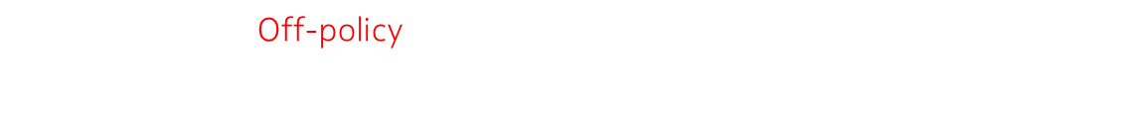
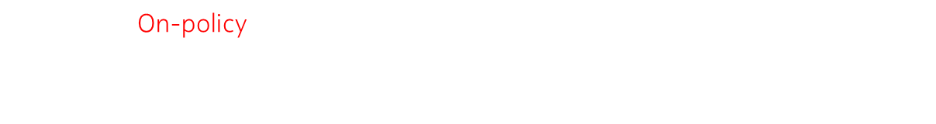



Reinforcement Learning, Part II
Temporal Difference Learning
With a policy $π$, record $S_{t}, A_{t}, R_{t+1}, S_{t+1}, A_{t+1}$
SARSA: On-policy method
$Q_{π}\left(S_{t}, A_{t}\right)←Q_{π}\left(S_{t}, A_{t}\right)+α\left[R_{t+1}+γ(1−ξ)Q_{π}(S_{t+1}, A_{t+1}) −Q_{π}\left(S_{t}, A_{t}\right)\right]$
Behavior policy
i.e., $ε$-greedy
Behavior policy
i.e., $ε$-greedy
You estimate the $Q_{π}$ according to the policy you are using
Q-Learning : Off-policy method
$Q_{∗}\left(S_{t}, A_{t}\right)←Q_{∗}\left(S_{t}, A_{t}\right)+α\left[R_{t+1}+γ(1−ξ)\max_{a}{Q_{∗}(S_{t+1}, a)} −Q_{∗}\left(S_{t}, A_{t}\right)\right]$
Optimal policy
Optimal policy
You use the policy $π$ to explore and estimate the optimal policy

Slide 27
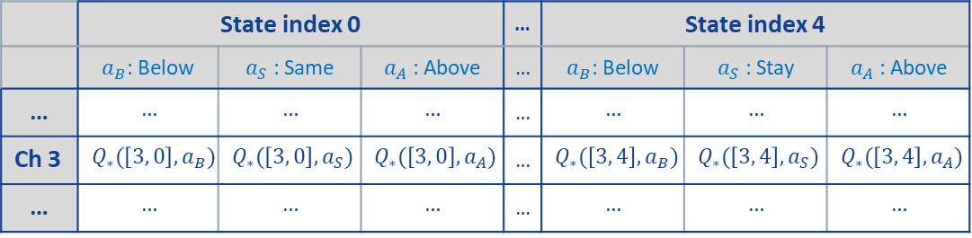
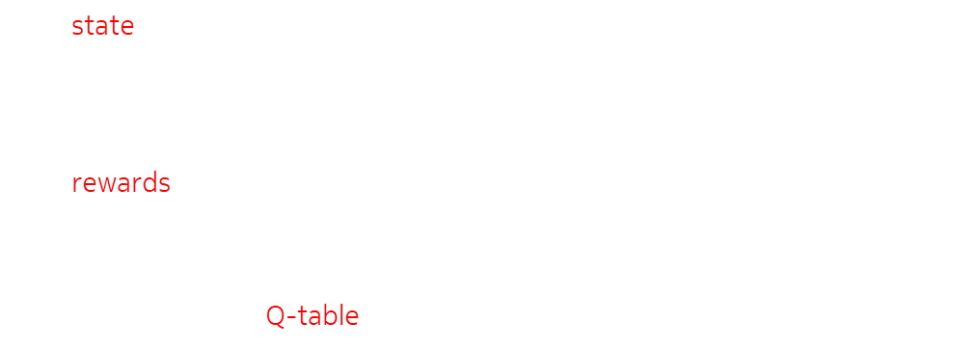
Reinforcement Learning, Part II
Classic RL problem
The possible actions are :
Tx in channel above (mod 7)
Tx in same chanel
Tx in channel below (mod 7)
The state comprises both:
The channel in which we transmitted (7 possibilities)
The channel state index we sense (5 possibilities)
The $ξ$ Boolean (=1 if it’s the end, =0 otherwise)
The rewards are :
1 if the transmission was successful
0 otherwise
Q-Learning : fill the Q-table following a $ε$-greedy policy
$$s_{3}$$
$$s_{2}$$
$$s_{0}$$
Starting point
Channels
$$s_{1}$$
 | State index 0 |  |  | … | State index 4
 | $a_{B}$: Below | $a_{S}$ : Same | $a_{A}$ : Above | … | $a_{B}$: Below | $a_{S}$ : Stay | $a_{A}$ : Above
… | $$…$$ | $$…$$ | $$…$$ | … | $$…$$ | $$…$$ | $$…$$
Ch 3 | $$Q_{∗}(\left[3, 0\right], a_{B})$$ | $$Q_{∗}(\left[3, 0\right], a_{S})$$ | $$Q_{∗}(\left[3, 0\right], a_{A})$$ | … | $$Q_{∗}(\left[3, 4\right], a_{B})$$ | $$Q_{∗}(\left[3, 4\right], a_{S})$$ | $$Q_{∗}(\left[3, 4\right], a_{A})$$
… | $$…$$ | $$…$$ | $$…$$ | … | $$…$$ | $$…$$ | $$…$$
State indices

Slide 28
Reinforcement Learning, Part II
Let’s play ☺

Slide 29
Reinforcement Learning, part I
Multi-armed Bandits
Action, reward, action-value, estimated action-value
Policies
Your turn ☺
Renforcement Learning, part II
Classic RL problem and Markov Decision Process
Return, state-value, action-value
Temporal Difference Learning
Your turn ☺
Deep Reinforcement Leaning
Q-network
Experience replay
Target Network
Your turn ☺

Slide 30
Deep Reinforcement Learning
Q-Network
Previously, we knew that there were only 5 channel indices
What if we don’t know that?
One state is now defined by the state vector :
Starting point
channels
Channel state
Current channel
0 | 0 | 0 | 0 | 0 | 0 | 1 | 0 | 0 | 0 | 1 | 0 | 0 | 0
Free channels are set to 1
The channel we are in is set to 1
Time steps
And the $ξ$ boolean

Slide 31
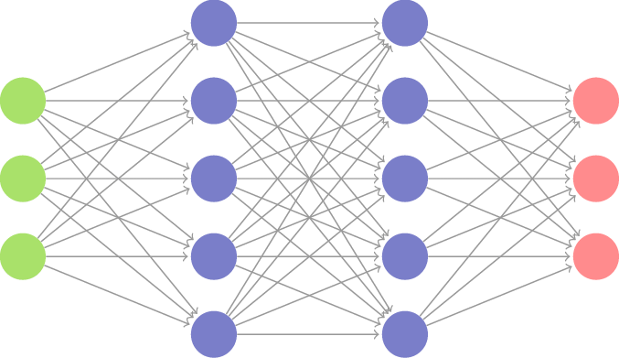




Deep Reinforcement Learning
Q-Network
We don’t want to store a huge Q-table.
We can use a Q-Network instead :
$S_{t}$vector
0
0
0
0
0
0
1
0
0
0
1
0
0
0
Starting point
channels
$$Q_{∗}\left(S_{t}, a_{A}\right)$$
$$Q_{∗}\left(S_{t}, a_{S}\right)$$
$$Q_{∗}\left(S_{t}, a_{B}\right)$$
Time steps
The Q-Network outputs all the Q values for a given states

Slide 32

Deep Reinforcement Learning
Q-Network
$$v_{∗}\left(s_{0} \right)$$
Estimate $q_{∗}\left(s, a\right)=Ε\left[R_{t+1}+γ(1−ξ)\max_{a′} q_{∗}(S_{t+1}, a^{′})|S_{t}=s, A_{t}=a\right]$
Q-Learning : wait to finish a $S_{t}, A_{t}, R_{t+1}, S_{t+1}$(with a policy $π$)
(0. Initialize Q-Network randomly)
Take the $Q_{∗}(S_{t}, A_{t})$ associated with your state and action
When in $S_{t+1}$, take the best q-value :$\max_{a}{Q_{∗}(S_{t+1}, a)}$
Compute a better estimate $Q_{∗}^{′}\left(S_{t}, A_{t}\right)=R_{t+1}+γ(1−ξ)\max_{a}{Q_{∗}(S_{t+1}, a)}$
Compute loss : $MSE\left(Q_{∗}^{′}\left(S_{t}, A_{t}\right), Q_{∗}\left(S_{t}, A_{t}\right)\right)$
Update parameters of the Q-Network by SGD to minimize the loss
$$s_{0}$$
$$q_{∗}\left(s_{0}, a_{B}\right)$$
$$q_{∗}\left(s_{0}, a_{A}\right)$$
$$q_{∗}\left(s_{0}, a_{S}\right)$$
$$a_{A}$$
$$s_{1}$$
$$a_{B}$$
$$a_{S}$$
$$s_{3}$$
$$R_{s_{0}, a_{S}}$$
$$v_{∗}\left(s_{1}\right)$$
$$s_{2}$$
$$v_{∗}\left(s_{3}\right)$$
$$v_{∗}\left(s_{2}\right)$$
$$q_{∗}\left(s_{2}, a_{B}\right)$$
$$q_{∗}\left(s_{2}, a_{A}\right)$$
$$q_{∗}\left(s_{2}, a_{S}\right)$$

Slide 33
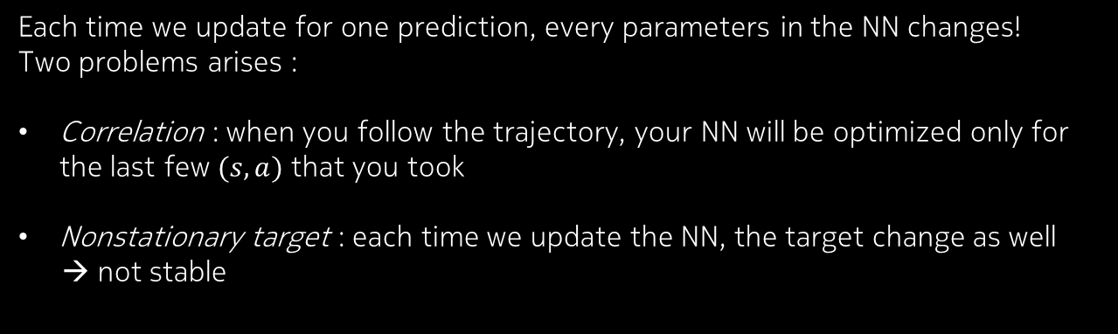
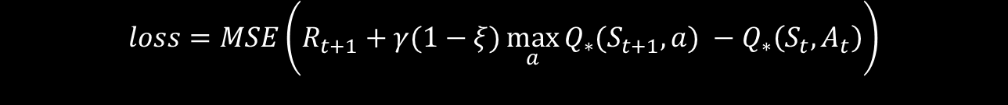
Deep Reinforcement Learning
Q-Network
Target
Prediction
$$loss=MSE\left(R_{t+1}+γ(1−ξ)\max_{a}{Q_{∗}(S_{t+1}, a)} −Q_{∗}\left(S_{t}, A_{t}\right)\right)$$
Each time we update for one prediction, every parameters in the NN changes!
Two problems arises :
Correlation : when you follow the trajectory, your NN will be optimized only for the last few $(s,a)$ that you took
Nonstationary target : each time we update the NN, the target change as well
→ not stable

Slide 34
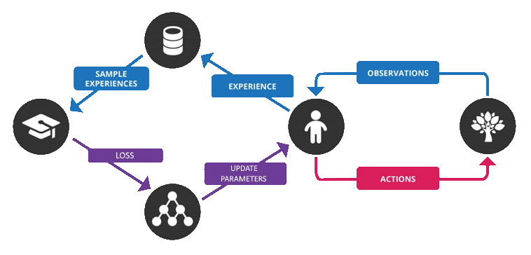
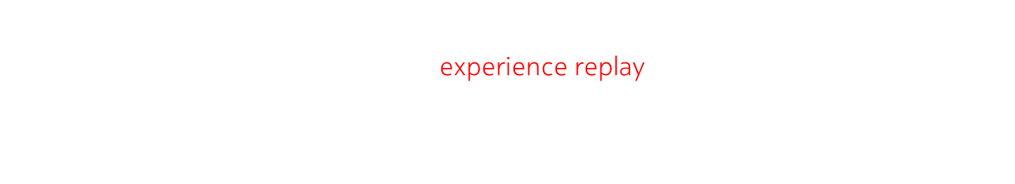
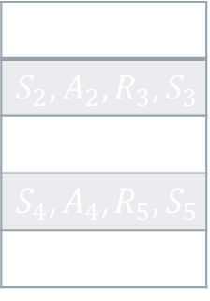
Deep Reinforcement Learning
Experience Replay
To remove correlation, we store all experiences $(S_{t}, A_{t}, R_{t+1}, S_{t+1})$ in a dataset.
Then, at each iteration, we perform experience replay:
We take a random batch of experiences
We compute the predictions and targets
We evaluate the loss and update the Q-Network
Circular buffer (FIFO)
$$loss=MSE\left(predictions,targets\right)$$
$$S_{1},A_{1},R_{2},S_{2}$$
$$S_{2},A_{2},R_{3},S_{3}$$
$$S_{3},A_{3},R_{4},S_{4}$$
$$S_{4},A_{4},R_{5},S_{5}$$
…

Slide 35








Deep Reinforcement Learning
Experience Replay
To remove correlation, we store all samples $(S_{t}, A_{t}, R_{t+1}, S_{t+1})$ in a dataset.
$$loss=MSE\left(predictions,targets\right)$$
The targets can only reflect the action chosen in the sample
If at state $S_{t}$, the action taken was $a_{A}$:
Prediction
Target
$Q_{∗}\left(S_{t}, a_{A}\right)$ - $R_{t+1}+γ(1−ξ)\max_{a}{Q_{∗}(S_{t+1}, a)}$
$$pred −target$$
$$MSE$$
$Q_{∗}\left(S_{t}, a_{S}\right) \text{−} Q_{∗}\left(S_{t}, a_{s}\right)$
$$= MSE$$
$$0$$
$$Q_{∗}\left(S_{t}, a_{B}\right) \text{−} Q_{∗}\left(S_{t}, a_{B}\right)$$
$$0$$

Slide 36
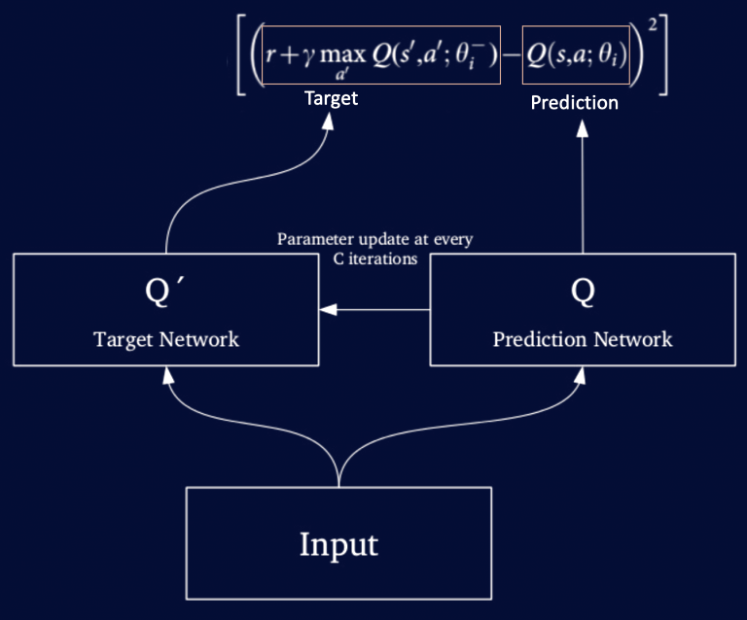


Deep Reinforcement Learning
Target Network
To alleviate the nonstationary target, we maintain a target Q-Network :
The targets are computed according to the target network
The parameters of the target network are updated every $C$ iterations
$$loss=$$

Slide 37
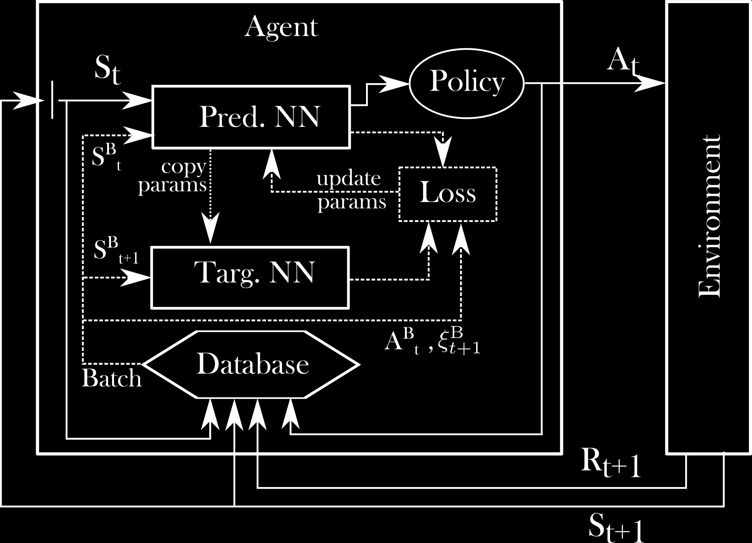

Deep Reinforcement Learning
Target Network
Main algorithm :
Initialize the pred.NN and the targ.NN with the same params
Play actions according to a policy $π$ to populate the datasets
For a given number of episodes :
While $ξ≠1$ :
Choose an action $A_{t}$ according to the state $S_{t}$ and the policy $π$
Receive $R_{t+1}$, $S_{t+1}$ and store $\left({S_{t}{, A}_{t}, R}_{t+1}\text{, }S_{t+1}\right)$ in the database
Take a random batch from the database ($B$ = batch size)
Compute the loss using targets from the target network
Update the prediction Q-Network
Every $C$ iterations, copy the parameters of the pred.NN to the targ.NN

Slide 38
Deep Reinforcement Learning
Let’s play ☺

Slide 39
Thank you
Everything is available on
mgoutay.github.io

