Slide 1
An introduction to
Deep Learning
Mathieu Goutay
Nokia Bell Labs France
INSA Lyon

Slide 2
An introduction to
Tensorflow 2.0
Introduction to Deep Learning
Tensorflow for beginners

Slide 3
1. Introduction to Deep Learning
Representation
learning
Ex : Shallow
autoencoder
Machine
learning
Ex : Logistic
Regression
AI
Ex : Knowledge
base
Deep learning
Ex : MLPs

Slide 4
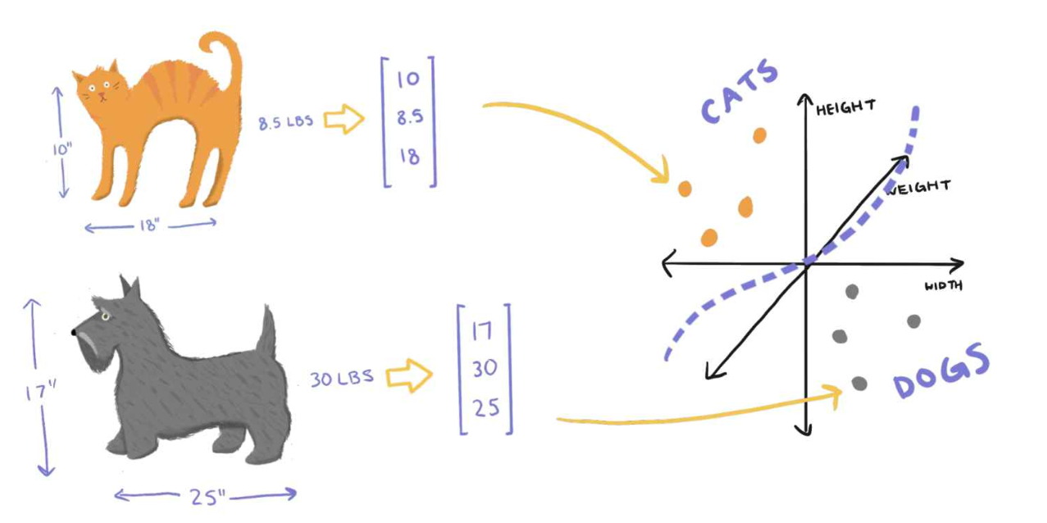
1. Introduction to Deep Learning
We usually have:
A set of Features : height, weight, width
A set of Labels : Cats, Dogs

Slide 5
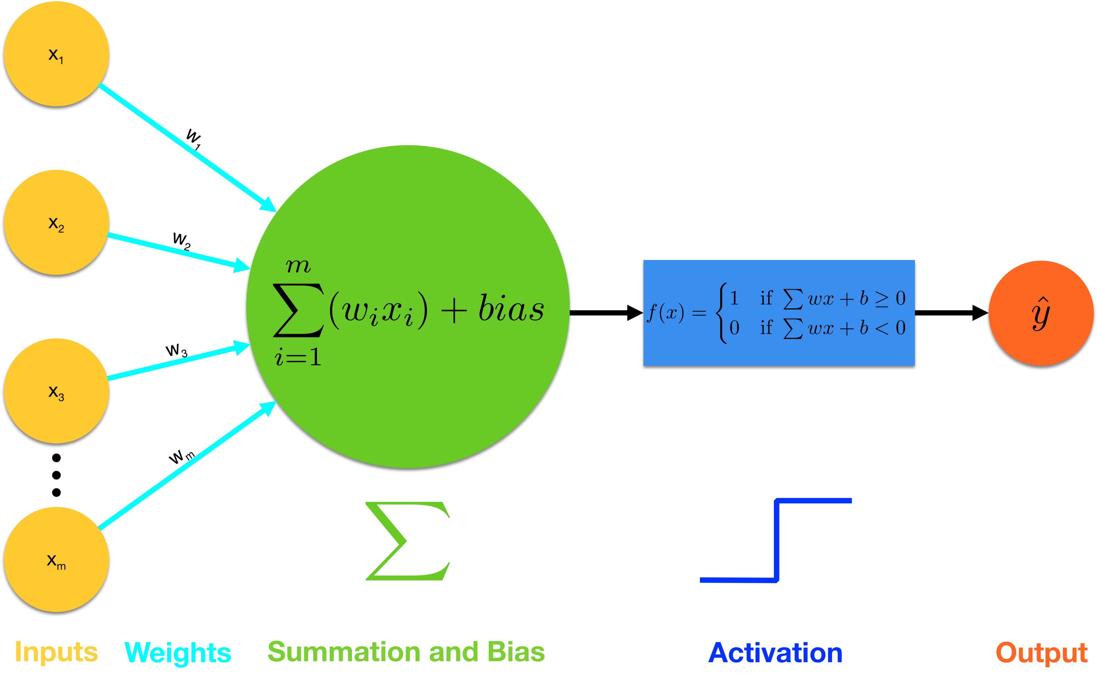
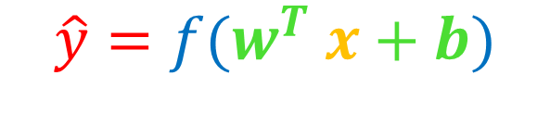
1. Introduction to Deep Learning
The basic element is a Neuron
$$\hat{y}=f(w^{T} x+b)$$
https://towardsdatascience.com/introducing-deep-learning-and-neural-networks-deep-learning-for-rookies-1-bd68f9cf5883

Slide 6
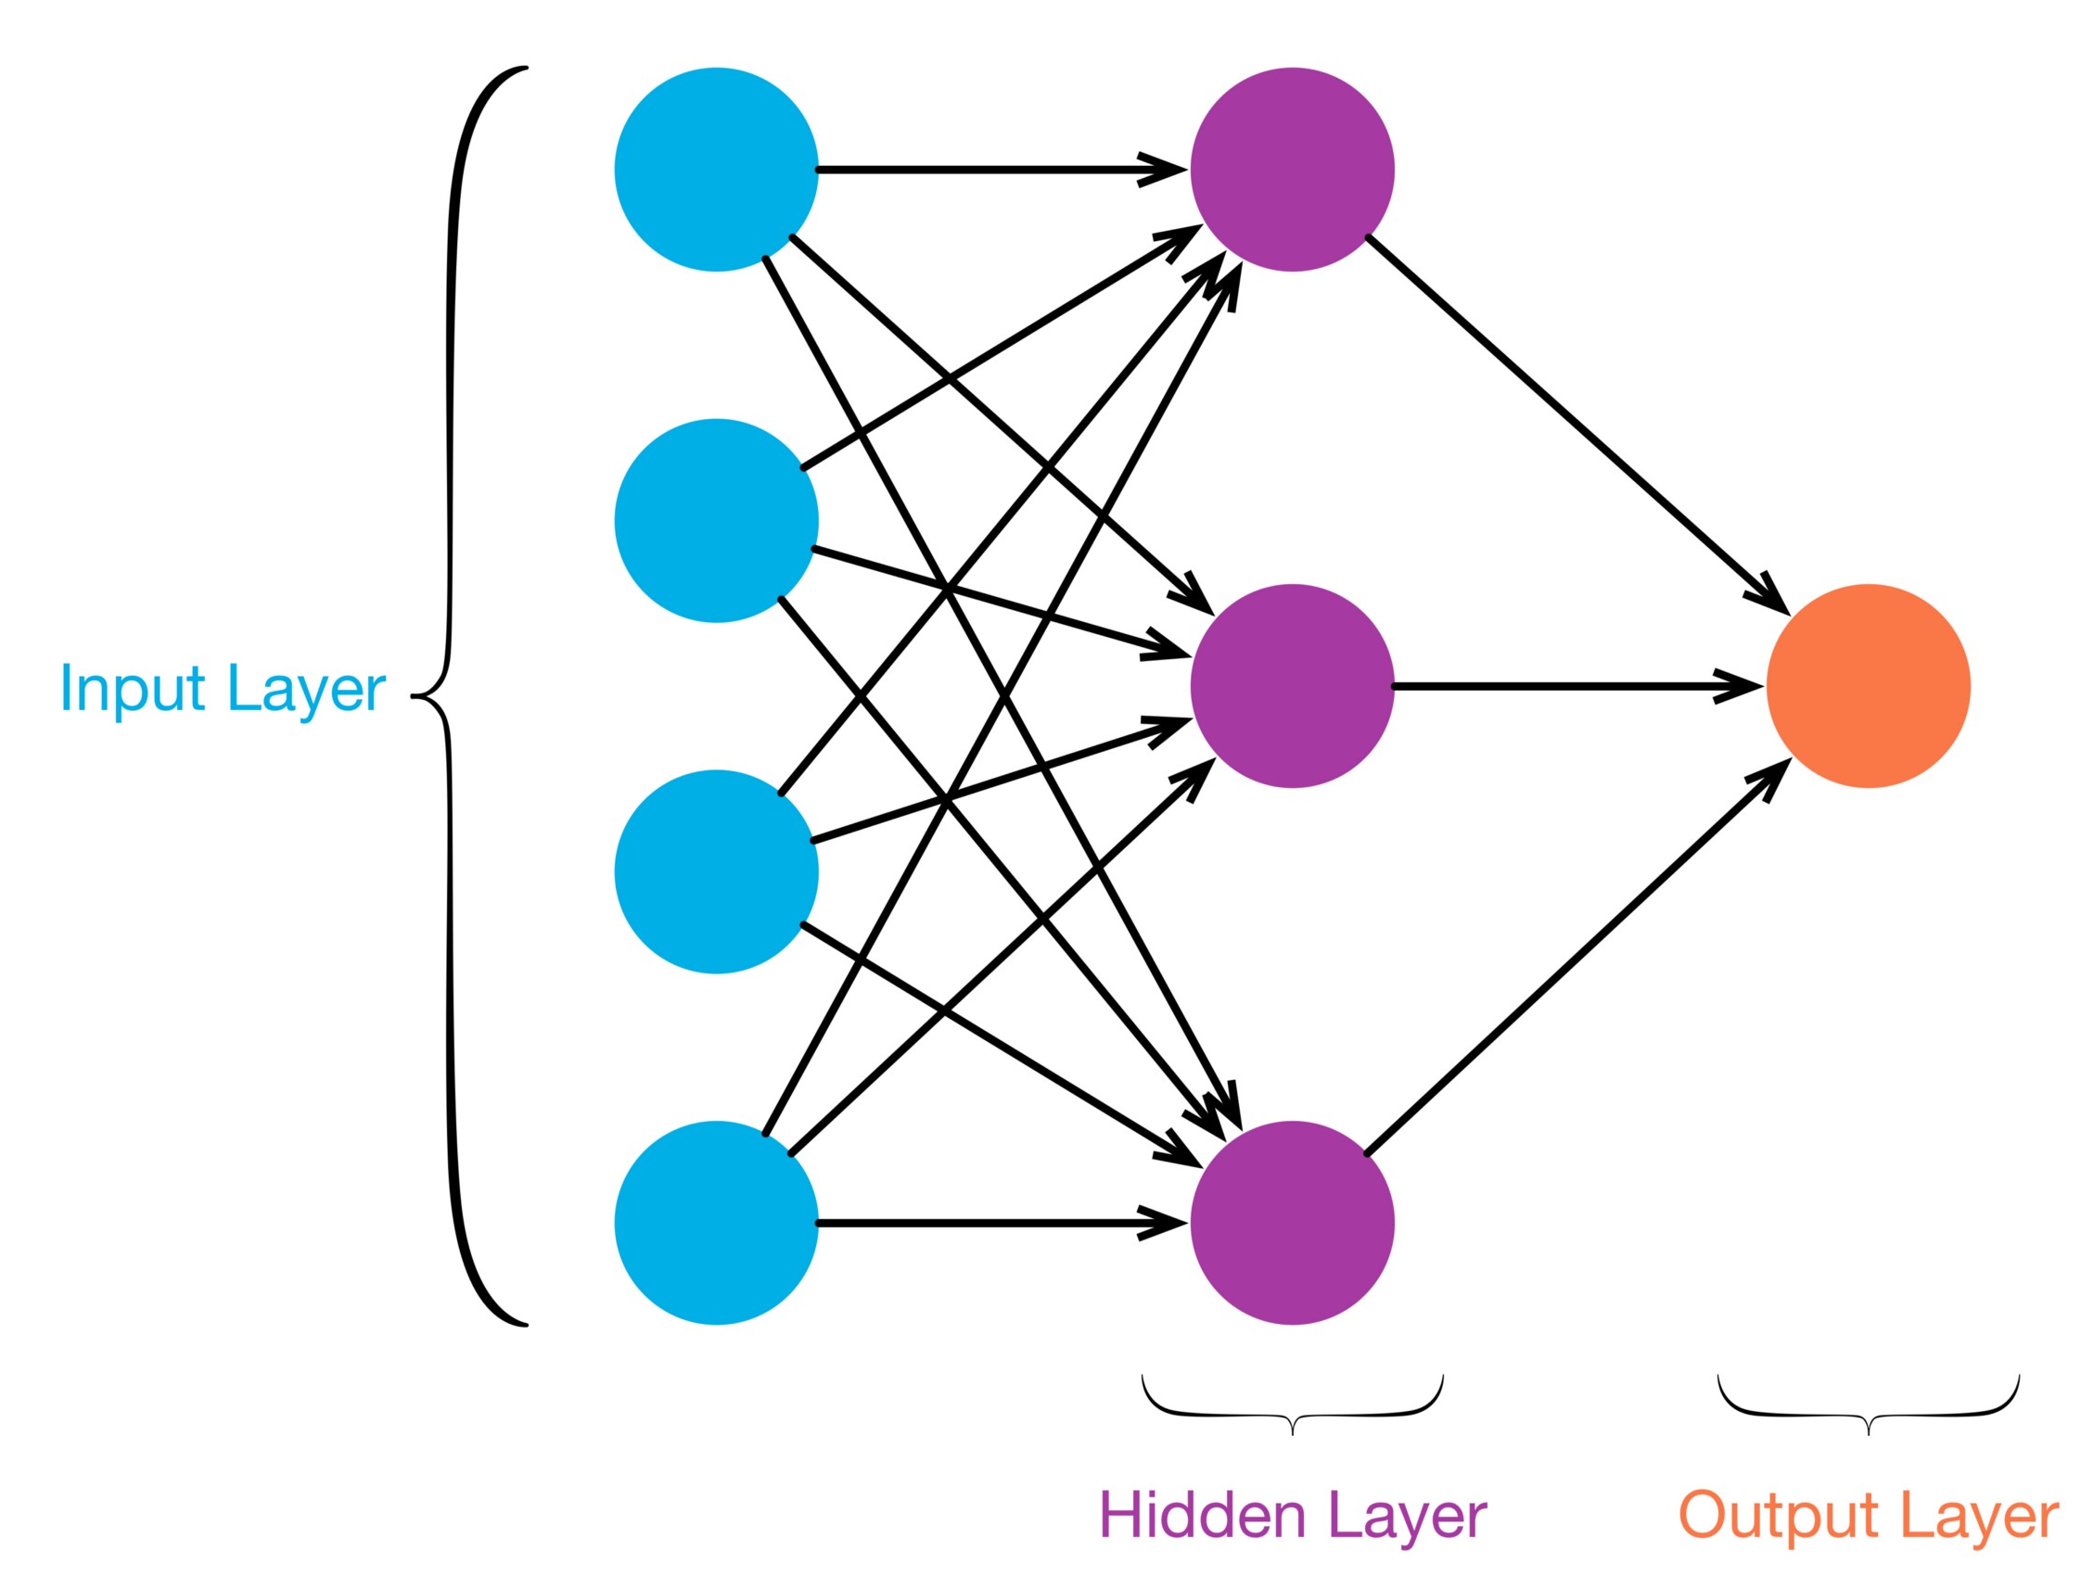


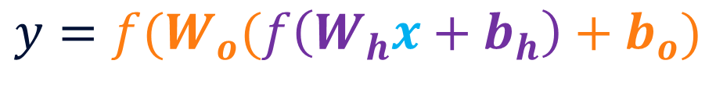






1. Introduction to Deep Learning
Neural Network with 1 hidden dense layer
$$x_{1}$$
$$h_{1}$$
$$x_{2}$$
$$y=f(W_{o}(f\left(W_{h}x+b_{h}\right)+b_{o})$$
$$h_{2}$$
$$y$$
$$x_{3}$$
$$x_{m}$$
$$h_{n}$$
https://towardsdatascience.com/multi-layer-neural-networks-with-sigmoid-function-deep-learning-for-rookies-2-bf464f09eb7f

Slide 7
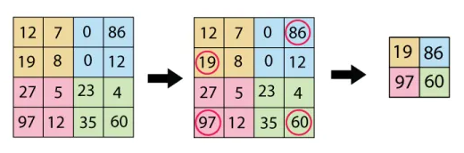
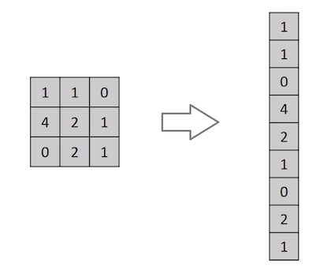
1. Introduction to Deep Learning
Other types of layers:
2D Convolutional :
Multiplies the 2D inputs by N kernels creating N 2D outputs
Parameters : # of kernels N, kernel size, …
2D Max Pooling :
Down-sample the inputs by taking the maximum of sub-regions
Parameters : sub-regions sizes, …
Flatten :
Converts the inputs into a dimension [batch_size, -1]
Etc.
https://mlnotebook.github.io/post/CNN1/
Notes:
Convolutional: Filter image to extract features
Max pooling: Downsample image to keep most relevant features

Slide 8
1. Introduction to Deep Learning
Typical training loop
Compute
a loss
Update weights
using an optimizer
Convolutional layer
Convolutional layer
Dense layer
Labels
Dense layer
Dense layer
Dense layer
Dense layer
Dense layer
Dense layer
prediction 1 vs label 1
Dense layer
Dense layer
Dense layer
Dense layer
Features
Dense layer
Dense layer
prediction 2 vs label 2
Dense layer
Dense layer
Dense layer
Dense layer
prediction 3 vs label 3
Image 1
Dense layer
Batch size
prediction 4 vs label 4
Image 2
prediction 5 vs label 5
Image 3
Image 4
Image 5
Multiple copy of the same Neural Network

Slide 9
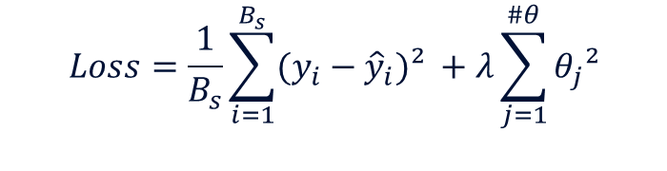
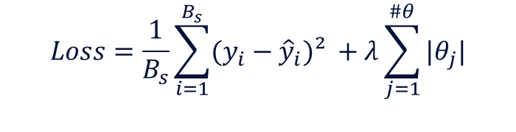
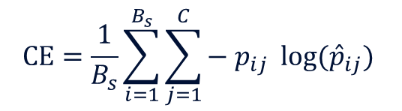
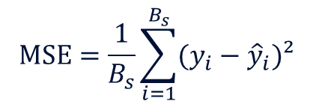
1. Introduction to Deep Learning
The loss function depends on the task
(for a batch: compute forward path → compute loss & gradients → apply optimizer)
$$MSE=\frac{1}{B_{s}}\sum_{i=1}^{B_{s}}{(y_{i}−{\hat{y}}_{i})² }$$
For a regression problem: Mean Squared Error, etc.
For a classification problem : Cross Entropy, etc.
$$CE=\frac{1}{B_{s}}\sum_{i=1}^{B_{s}}{\sum_{j=1}^{C}{− p_{ij} log⁡({\hat{p}}_{ij}) }}$$
Regularization adds a penalty terms depending on the weights:
L1 regularization increase sparsity
L2 regularization avoids overfitting
$$Loss=\frac{1}{B_{s}}\sum_{i=1}^{B_{s}}{(y_{i}−{\hat{y}}_{i})² }+λ\sum_{j=1}^{\#θ}{|θ_{j}|}$$
$$Loss=\frac{1}{B_{s}}\sum_{i=1}^{B_{s}}{(y_{i}−{\hat{y}}_{i})² }+λ\sum_{j=1}^{\#θ}{θ_{j}²}$$
MSE
L1
MSE
L2
Tuning parameter
Tuning parameter

Slide 10
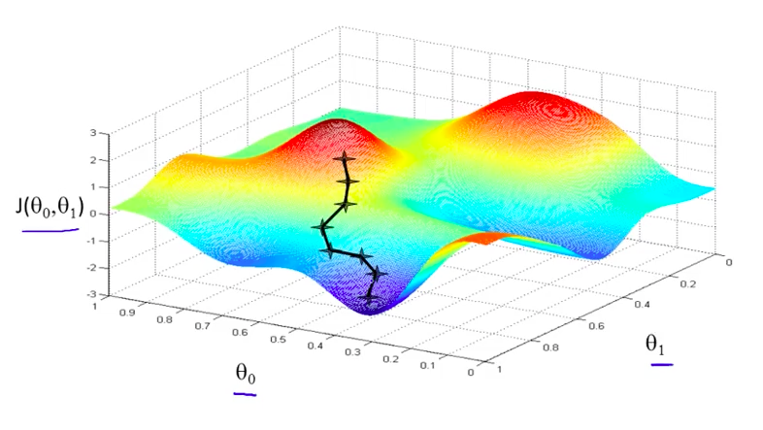

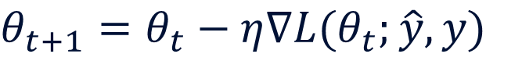

1. Introduction to Deep Learning
Training is done by Stochastic Gradient Descent (SGD) or a variant
(for a batch: compute forward path → compute loss & gradients → apply optimizer)
SGD updates the weights in the
negative gradient direction
$θ_{t+1}=θ_{t}−η∇L(θ_{t};\hat{y}, y)$
Loss
Learning rate
Labels
Predictions
Gradient of the
Loss function
$$θ_{2}$$
$$θ_{1}$$
The most used variant is Adam:
Individual adaptive learning rate for each parameters
Exponential moving average of gradients
Computationally efficient

Slide 11
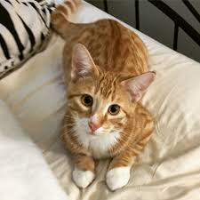
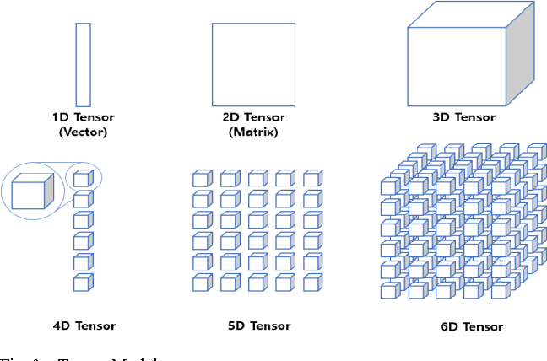
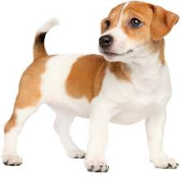
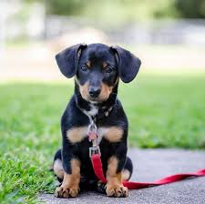
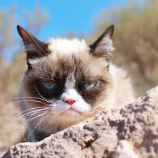
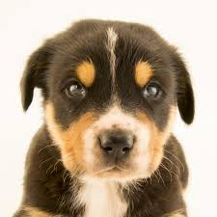
2. Tensorflow for beginners
A Tensor is a N-dimensional Matrix
The first dimension is usually the batch size
255
255
255
255
5
dim = [5, 255, 255]

Slide 12
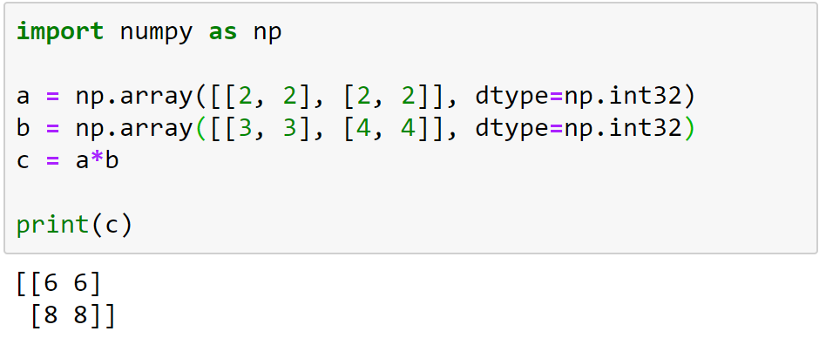
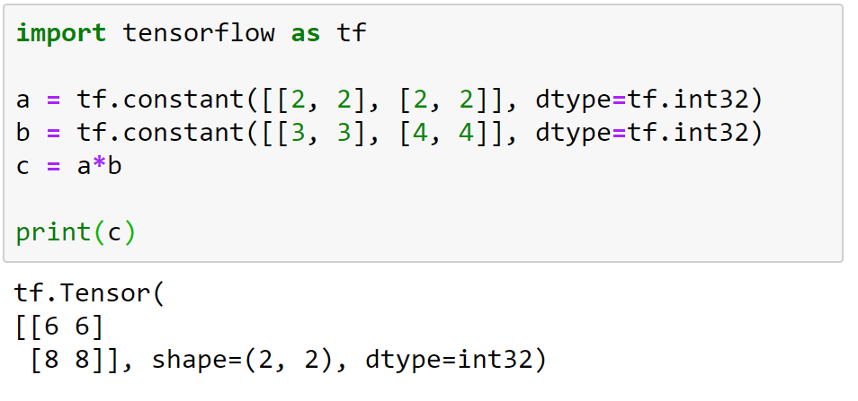
2. Tensorflow for beginners
Tensorflow 2.0 is very pythonic
Lots of equivalent functions between Numpy & Tensorflow
Numpy
Tensorflow
Supported TF data types : bool, string, int8/16/32/64, float32/64, complex64/128, etc.

Slide 13
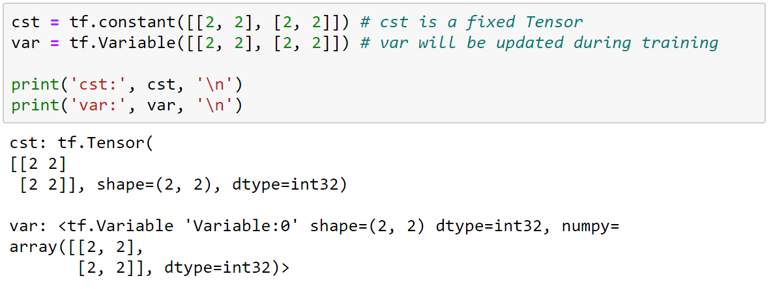
2. Tensorflow for beginners
The parameters of a NN are created as Variables

Slide 14
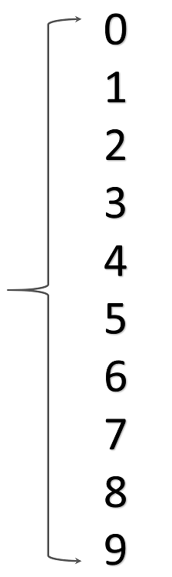
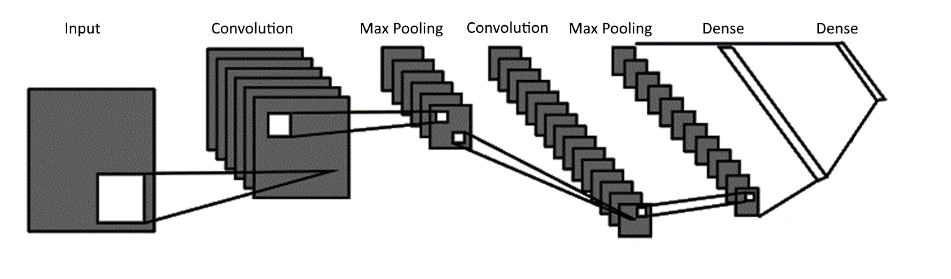
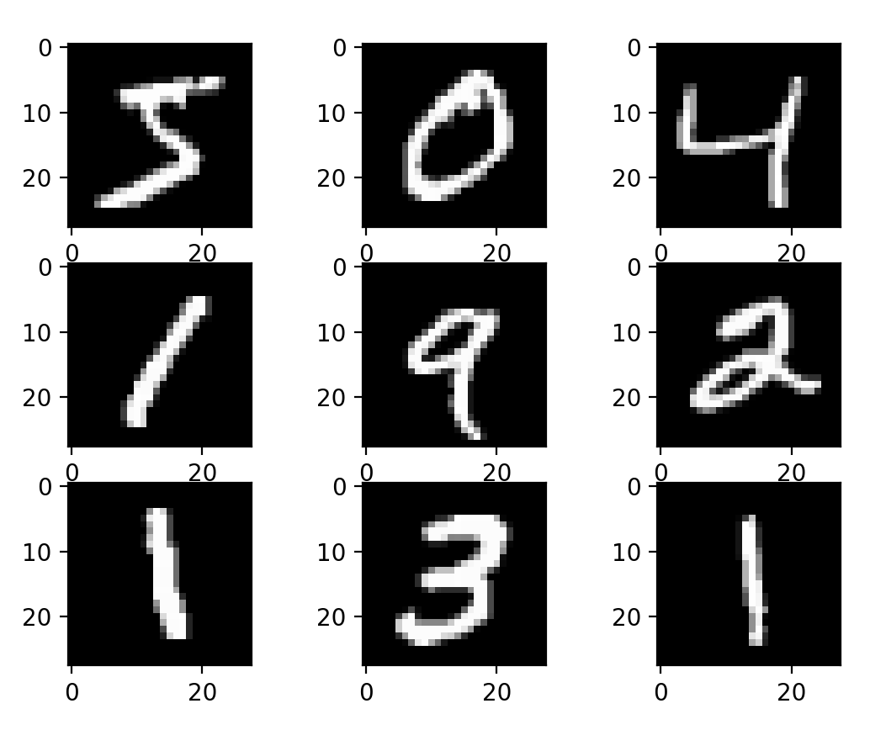
2. Tensorflow for beginners
Let’s play with MNIST : A large database of handwritten digits
Goal : predict the digit given an image

Slide 15
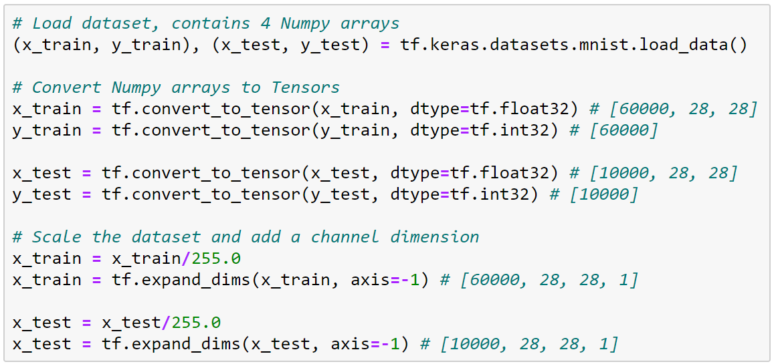
2. Tensorflow for beginners
Preparing the dataset

Slide 16

2. Tensorflow for beginners
Keras is a high-level neural networks API
Give access to pre-made Layers

Slide 17
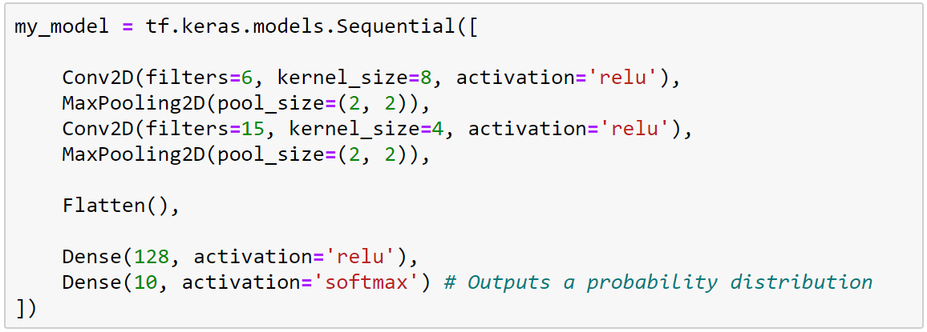
2. Tensorflow for beginners
The Sequential API : Easily define models

Slide 18
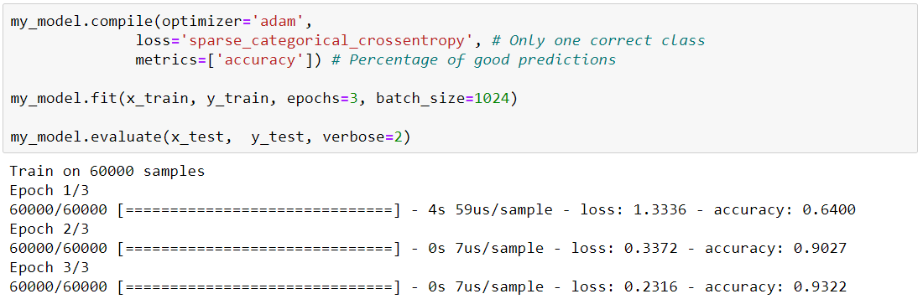
2. Tensorflow for beginners
Keras gives access to pre-made training functions
Final loss Final accuracy

Slide 19
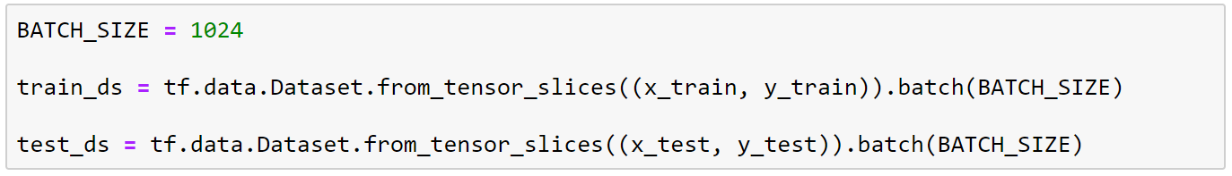
3. Tensorflow for experts
Creating a Tensorflow dataset
Using TF dataset
helps with parallelization
Creates a TF dataset from
given tensors
Splits the dataset into batches
for future training iterations

Slide 20
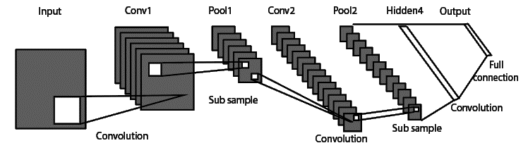
3. Tensorflow for experts
Inputs
Creating custom models and layers
conv_pool_1
conv_2D
pool_2D
conv_pool_2
=
conv_2D
pool_2D
flatten
multi_linear
linear_1
linear_2
ConvPool
ConvPool
MultiLinear
Outputs

Slide 21
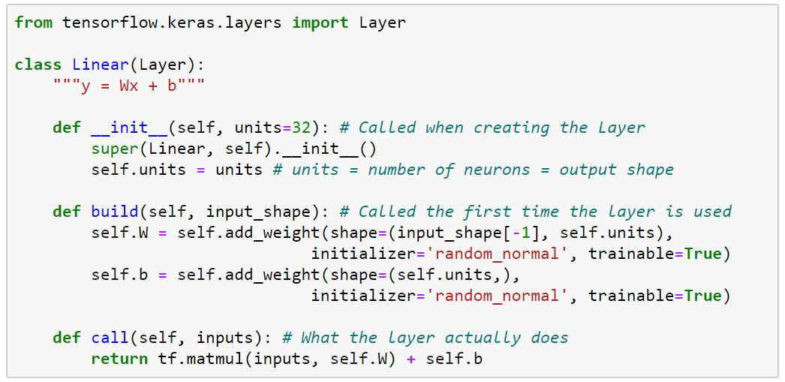
3. Tensorflow for experts
The subclassing API: defining new layers
Inputs
linear
Outputs

Slide 22
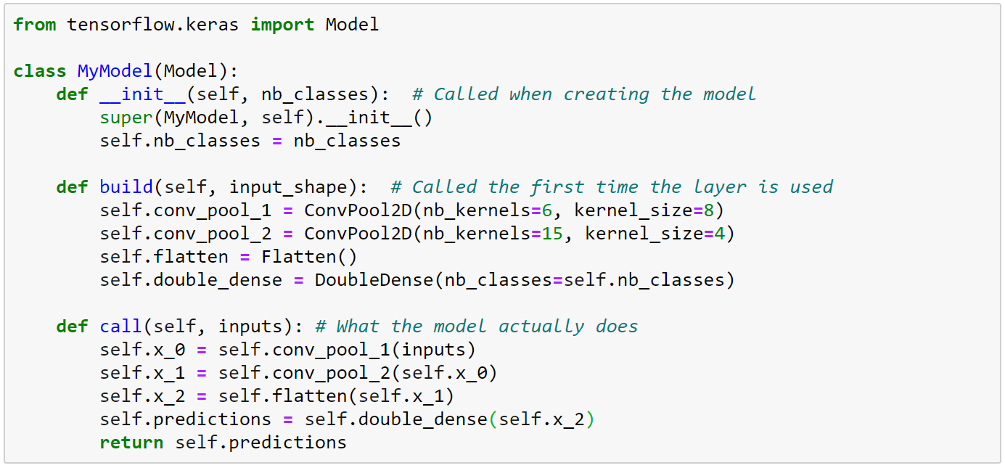
3. Tensorflow for experts
Inputs
The subclassing API: defining new Models
conv_pool_1
conv_2D
pool_2D
conv_pool_2
conv_2D
pool_2D
flatten
double_dense
linear_1
linear_2
Outputs

Slide 23
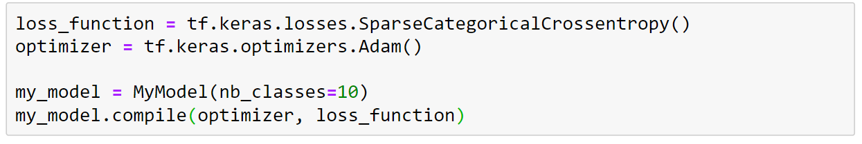
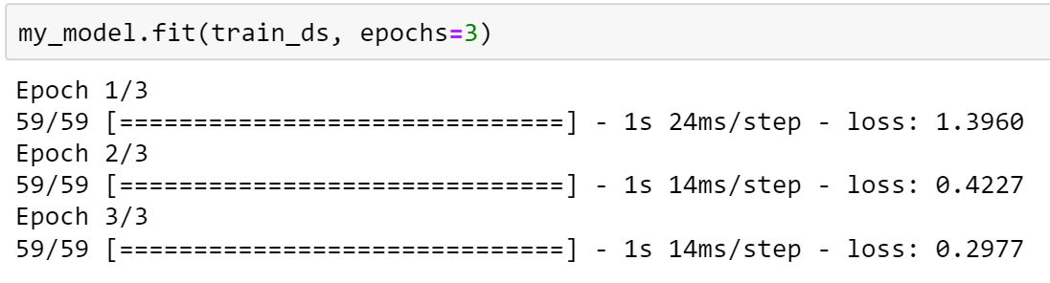
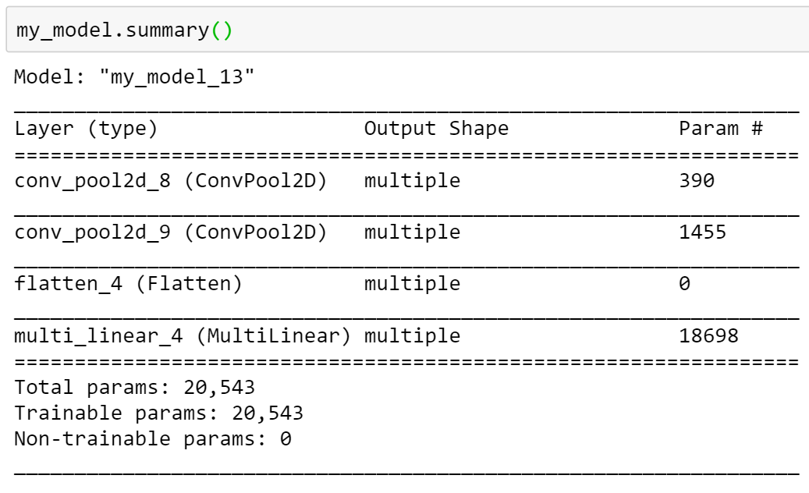
3. Tensorflow for experts
Creating the model using pre-made functions

Slide 24
4. Building a custom training loop
Update weights
using an optimizer
Compute
a loss
Convolutional layer
Convolutional layer
Dense layer
Labels
Dense layer
Dense layer
Dense layer
Dense layer
Dense layer
Dense layer
prediction 1 vs label 1
Dense layer
Dense layer
Dense layer
Dense layer
Features
Dense layer
Dense layer
prediction 2 vs label 2
Dense layer
Dense layer
Dense layer
Dense layer
prediction 3 vs label 3
Image 1
Dense layer
Batch size
prediction 4 vs label 4
Image 2
prediction 5 vs label 5
Image 3
Image 4
Image 5
Multiple copy of the same Neural Network

Slide 25
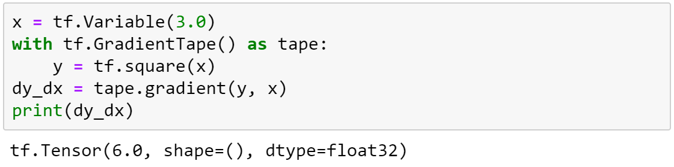
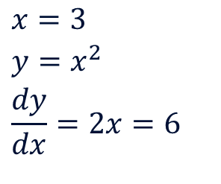
4. Building a custom training loop
The tf.GradientTape API provides automatic differentiation.
All operations executed inside a gradient tape are recorded.
$$x=3$$
$$y=x^{2}$$
$$\frac{dy}{dx}=2x=6$$
Notes:
The tape means record

Slide 26
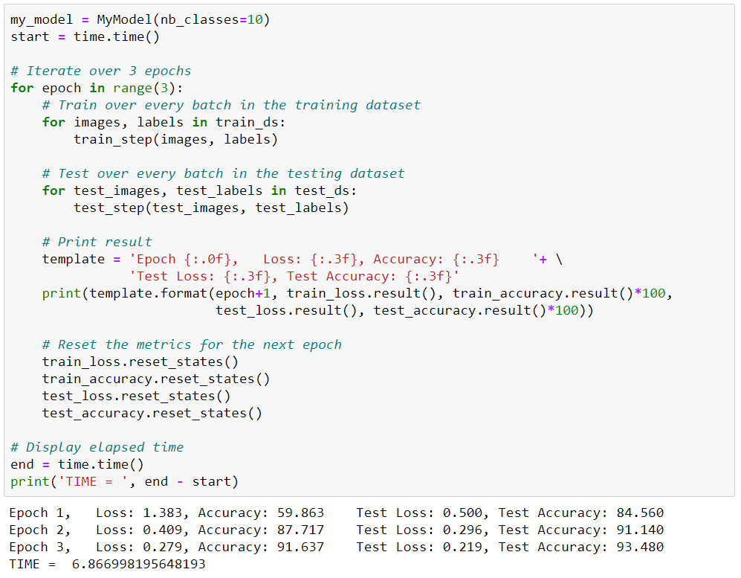
4. Building a
custom
training loop
Creating the
training loop

Slide 27
Thank you
Everything is available on
mgoutay.github.io

