Slide 1


Slide 2

R Packages
a survey of…

Slide 3
How Many Packages Are There?
Cran - 6,418 packages
Bioconductor – 939 packages
Github - ???

Slide 4
Package Search Resources
R package search platforms
http://www.rdocumentation.org/
7,393 packages; 150,590 functions
http://rseek.org/
http://crantastic.org/
http://www.inside-r.org/packages
https://www.versioneye.com/
Other places to find packages
Google
Stack Overflow

Slide 5
R Documentation Categories
Bayesian
Chem Phys
Clinical Trials
Cluster
Differential Equations
Distributions
Econometrics
Environmetrics
Experimental Design
Finance
Genetics
gR
Graphics
High Performance Computing
Machine Learning
Medical Imaging
Meta Analysis
Multivariate
Natural Language Processing
Numerical Mathematics
Official Statistics
Optimization
Pharmacokinetics
Phylogenetics
Psychometrics
Reproducible Research
Robust
Social Sciences
Spatial
Spatio Temporal
Survival
Time Series
Web Technologies

Slide 6
Cran logs
http://cran-logs.rstudio.com/
Cran Packages by Name
http://cran.r-project.org/web/packages/available_packages_by_name.html

Slide 7
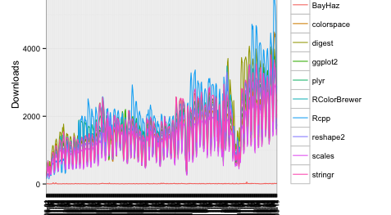

Slide 8
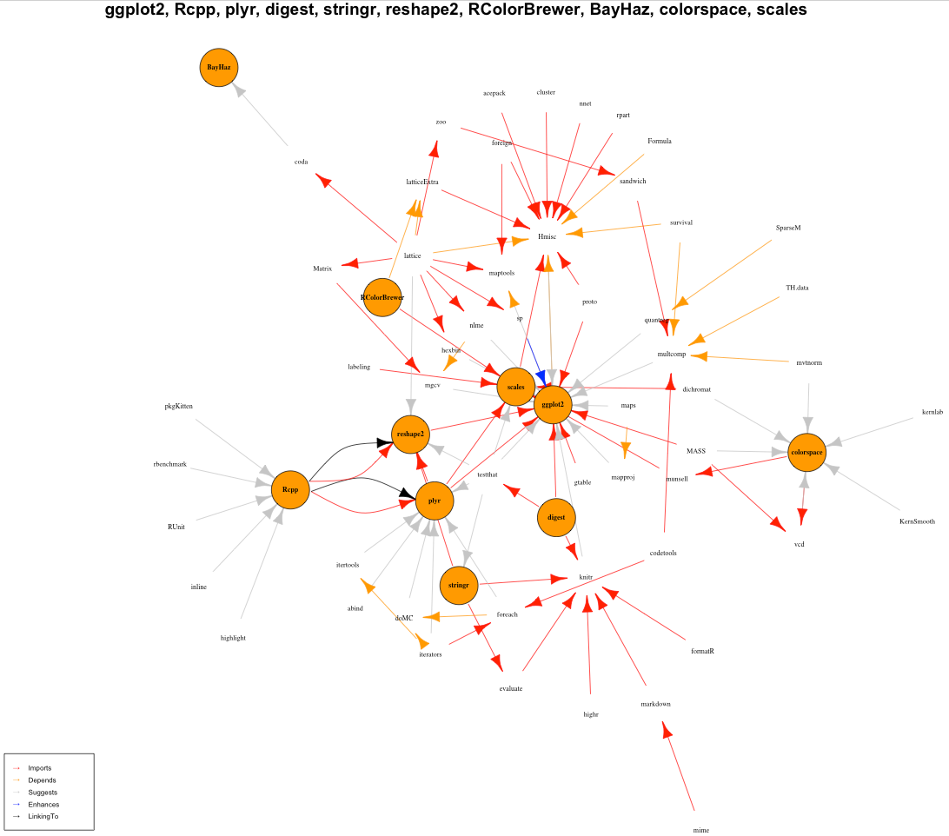

Slide 9
Top Cran 10 Packages
Package | What does it do?
ggplot2 | An implementation of the Grammar of Graphics
Rcpp | Seamless R and C++ Integration
plyr | Tools for splitting, applying and combining data
digest | Create cryptographic hash digests of R objects
stringr | Make it easier to work with strings
reshape2 | Flexibly reshape data: a reboot of the reshape package
RColorBrewer | ColorBrewer palettes
BayHaz | Bayesian estimation of smooth hazard rates via CPP and BPS priors
colorspace | Color Space Manipulation
scales | Scale functions for graphics

Slide 10
GitHub Trending Packages
https://github.com/trending?l=R&since=monthly
Github Account | Package | What does it do?
swirldev | swirl_courses | A collection of interactive courses for the swirl R package.
hadley | rvest | Simple web scraping for R
rstudio | shiny | Easy interactive web applications with R
genomicsclass | labs | Scripts for HarvardX courses: PH525x
hadley | ggplot2 | An implementation of the Grammar of Graphics in R
stan-dev | shinystan | shinyStan R package
yihui | knitr | A general-purpose tool for dynamic report generation in R
rstudio | rmarkdown | Dynamic Documents for R
genomicsclass | dagdata | Data for the HarvardX courses: PH525x
rstudio | ggvis | Interactive grammar of graphics for R
amplab-extras | SparkR-pkg | R frontend for Spark
takluyver | IRkernel | R kernel for IPython
smbache | import | An Import Mechanism For R
rich-iannone | DiagrammeR | Create graph diagrams and flowcharts using R.
ramnathv | htmlwidgets | HTML Widgets for R
google | rappor | RAPPOR: Privacy-Preserving Reporting Algorithms
systematicinvestor | SIT | Systematic Investor Toolkit
topepo | caret | caret (Classification And Regression Training) R package that contains misc functions for training and plotting classification and regression models
rstudio | DT | R Interface to the jQuery Plug-in DataTables
ropensci | plotly | Create beautiful, interactive, online Plotly graphs with R and ggplot2
JJ | top-github-users-data | Data obtained with the top-github-users script
stan-dev | rstan | RStan, the R interface to Stan
vqv | ggbiplot | A biplot based on ggplot2
Rapporter | pander | An R Pandoc Writer
ajdamico | usgsd | Analyze Survey Data for Free with the R Language

Slide 11
Bioconductor
Bioconductor provides tools for the analysis and comprehension of high-throughput genomic data. Bioconductor uses the R statistical programming language, and is open source and open development. It has two releases each year, 934 software packages, and an active user community. Bioconductor is also available as an AMI (Amazon Machine Image) and a series of Docker images.

Slide 12
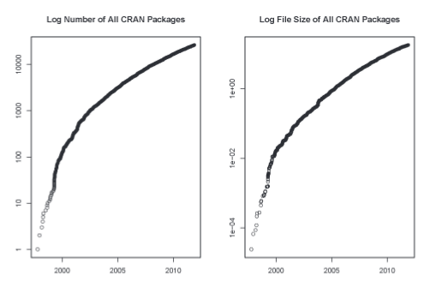

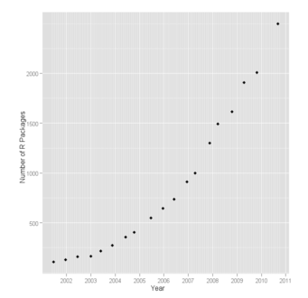
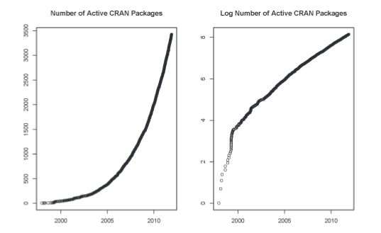
Are There Too Many R Packages?
Kurt Hornik
Wirtschaftsuniversitat at Wien
AUSTRIAN JOURNAL OF STATISTICS
Volume 41 (2012), Number 1, 59–66

Slide 13
Possible Directions for Improving
Dependency Versioning in R
Jeroen Ooms
The R Journal Vol. 5/1, June 2013
The dependency network
Package versioning

Slide 14
yHat Suggested Packages
http://blog.yhathq.com/posts/10-R-packages-I-wish-I-knew-about-earlier.html
sqldf
forecast
plyr
stringr
RPostgreSQL
RMySQL
RMongo
RODBC
RSQLite
lubridate
ggplot2
qcc
reshape2
randomForest

Slide 15
rOpenSci
http://ropensci.org/packages/
Data Publication
Data Access
Literature
Altmetrics
Reproducibility
Databases
Data Visualization
Geospatial Spatial data I/O and mapping.

Slide 16
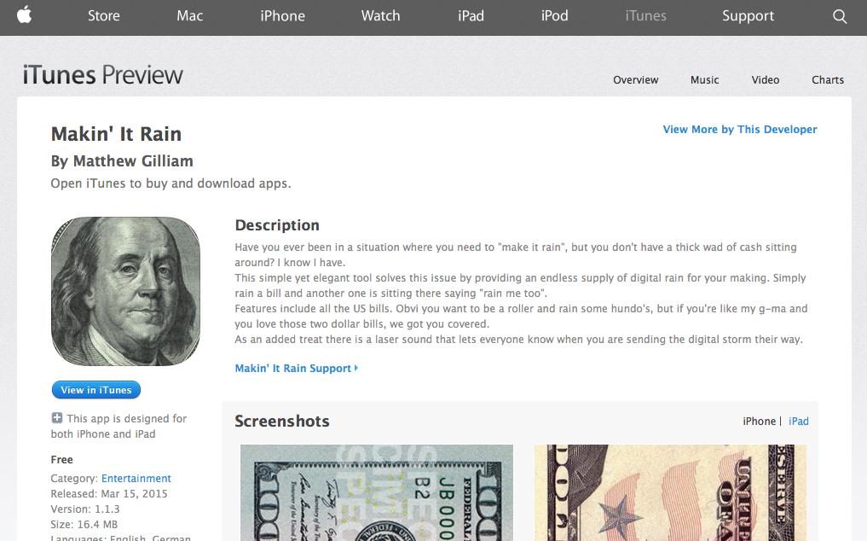
That’s All
https://itunes.apple.com/WebObjects/MZStore.woa/wa/viewSoftware?id=975044230&mt=8

