Slide 1
Group 2
Mr.roboto VS Ogrezilla 2

Slide 2
Software Engineer
Setting up SVN/Enviroment
Battling the Ogre
Creating the framework
Integrating everything into it

Slide 3
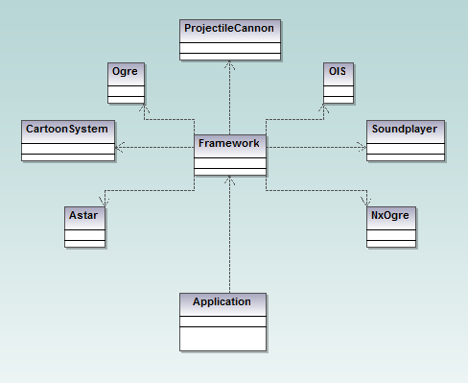
The basic structure

Slide 4
Multimedia
General
Sound extension
OpenAl and Alut
Extension
Dynamic echoes
Depends on surroundings
Implementation
Soundplayer
Extended soundplayer
Echo

Slide 5
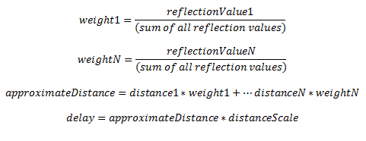
More multimedia
Calculation
Volume, calculated through surrounding objects’ reflection values, and reduced with distance
Delay, calculated through an approximate distance of surrounding objects, taking weight of values in consideration
The delay calculation

Slide 6
Graphics
Cartoon-styled sky and weather effects
Sky, clouds, sun, snow, rain, wind
Textures set on planes far away
Smiley-faces
Rotation to correctly face the camera
Whatever I could find or create

Slide 7
Graphics
Particle effects
Textures with transparency
Particle scripts
Affected by wind, different density and velocity settings
Skydome
Fast when switching between different domes

Slide 8
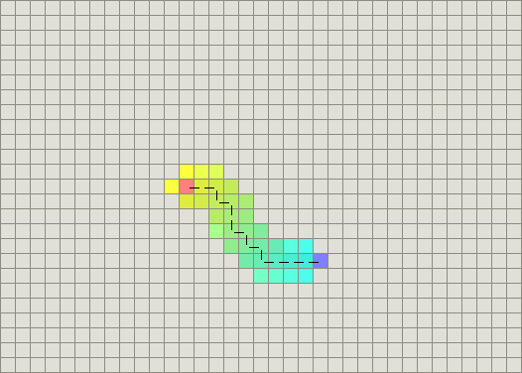
AI-Astar
Pathfinding
Astar
Combination
Shortest path
Heuristic algorithm
Manhattan

Slide 9
AI-Astar-Extension
Generate an Astar path
Generate an NxN graph with AstarNodes
Convert Astar node number to ogre coordinates

Slide 10
Physics
NxOgre wrapper
Help from PhysX

Slide 11
Bullets and grenades
Four projectiles
FastShell (raycast a location, spawn explosion)
Shell (spawn explosion, no raycasting)
Bullet (return the hit)
Grenade (explode after a certain amount of time)
A single class, manages all cannons.

Slide 12
Demo

