Slide 1

Mr.roboto VS Ogrezilla 2

Slide 2
Software Engineer
Setting up SVN/Environment
Battling the Ogre
Creating the framework
Integrating everything into it

Slide 3
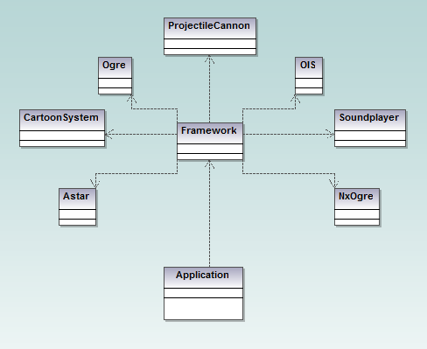
The basic structure

Slide 4
Multimedia
General
  Sound extension
  OpenAl and Alut
Extension
  Dynamic echoes
  Depends on surroundings
Implementation
  Soundplayer
  Extended soundplayer
  Echo

Slide 5
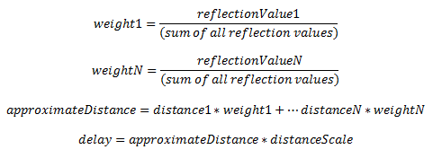
More multimedia
Calculation
  Volume, calculated through surrounding objects’ reflection values, and reduced with distance
  Delay, calculated through an approximate distance of surrounding objects, taking weight of values in consideration
The delay calculation

Slide 6
Graphics
Cartoon-styled sky and weather effects
  Sky, clouds, sun, snow, rain, wind
Textures set on planes far away
  Smiley-faces
    Rotation to correctly face the camera
  Whatever I could find or create

Slide 7
Graphics
Particle effects
  Textures with transparency
  Particle scripts
    Affected by wind, different density and velocity settings
Skydome
  Fast when switching between different domes

Slide 8
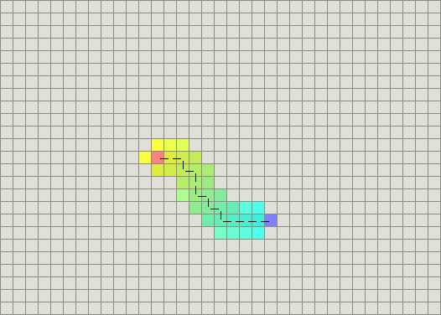
AI-Astar
Pathfinding
  Astar
    Combination
      Shortest path
      Heuristic algorithm
        Manhattan

Slide 9
AI-Astar-Extension
Generate an Astar path
Generate an NxN graph with AstarNodes
Convert Astar node number to ogre coordinates

Slide 10
Physics
NxOgre wrapper
Help from PhysX

Slide 11
Bullets and grenades
Four projectiles
FastShell (raycast a location, spawn explosion)
Shell (spawn explosion, no raycasting)
Bullet (return the hit)
Grenade (explode after a certain amount of time)
A single class, manages all cannons.

Slide 12
Demo

