Slide 1
Group 2
A wierd engine

Slide 2
Software Engineerer
Setting up SVN/Enviroment
Battling the Ogre
Creating the framework
Integrating everything into it

Slide 3
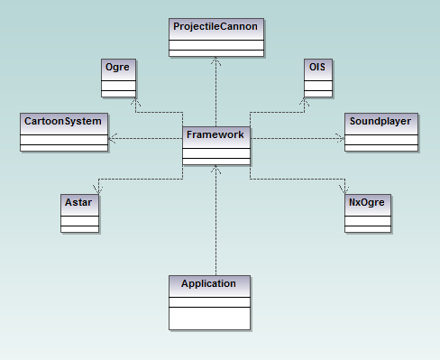
The basic structure

Slide 4
Multimedia
General
Sound extension
OpenAl and Alut
Extension
Dynamic echoes
Depends on surroundings
Implementation
Soundplayer
Echo

Slide 5
More multimedia
Calculation
Volume, calculated through surrounding objects’ reflection values
Delay, calculated through an approximate distance on objects, taking weight of values in consideration

Slide 6
Graphics

Slide 7
Cartoon filter

Slide 8
AI

Slide 9
Astar

Slide 10
Physics
NxOgre wrapper
Help from PhysX

Slide 11
Bullets and grenades
Four projectiles
FastShell (raycast a location, spawn explosion)
Shell (spawn explosion, no raycasting)
Bullet (return the hit)
Grenade (explode after a certain amount of time)
A single class, manages all cannons.

Slide 12
Demo

