Slide 1
Deep Leanring of ABAC in Cloud
Maitrey Govind Ranade
(18CS30026)
Divyanshu Kumar (18CS30016)
Gawai Laukik
(19CS10032)

Slide 2
What is Access Control
Access control is the practice of regulating who can access certain resources, data, or services in a computing environment.
It is a fundamental aspect of cybersecurity and is used to protect against unauthorized access, theft, modification, or destruction of sensitive information
Types of Access Control
Discretionary Access Control (DAC
Mandatory Access Control (MAC)
Role-Based Access Control (RBAC)
Attribute-Based Access Control (ABAC)

Slide 3
Related Approaches to Access Control
Classical policy mining approaches
Machine learning based policy mining approaches
ML approaches to make control decision instead of mining
Implemented framework:
DLBACα: Deep learning based decision making approach

Slide 4
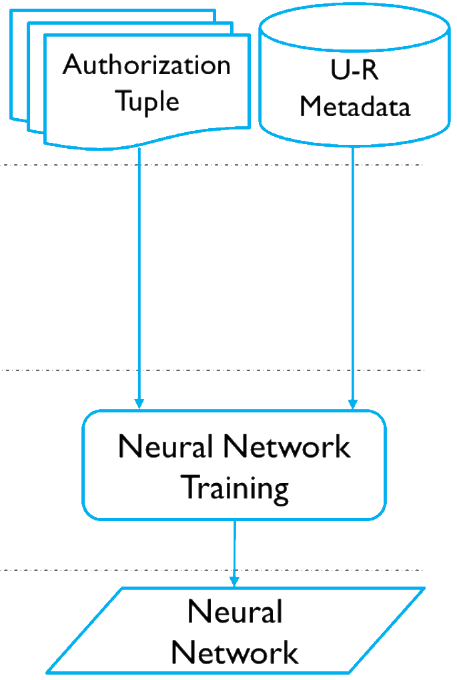
The DLBACα Framework
A framework to let user access resources
Each resource and user is associated with their own metadata
It constructs a Residual Deep neural network
Takes in user and resource metadata
Outputs an authorization tuple
A boolean vector with dimensions = Types of operations
0 meaning access denied to the type of operation
1 meaning access granted

Slide 5
Proposed Improvement
The original framework calcualates the number of epochs as:
IF d > 9 = e1 ELSE epochs = e2
For given dataset e1 = 30, e2 = 60
The depth function is proposed as d = n*6 + 2, where n is depth parameter based on metadata length
However in any dataset we do not observe any improvement on loss going beyond for about 20 epochs, hence propose to not take this decision. This leads to a faster training process which is crucial as the model may be needed to update in a real-life situation.
To improve learning of complex datasets like “u5k-r5k-auth12k” We double the number of convolution filters.
Through our experimentation, we found that the the if we set num_filters to the length of the feature vector, the model performed the best.

Slide 6
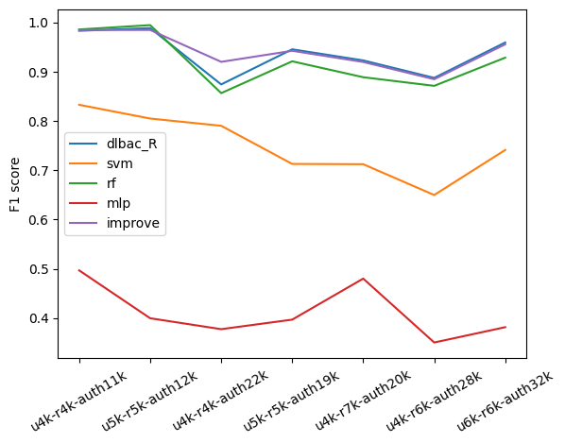
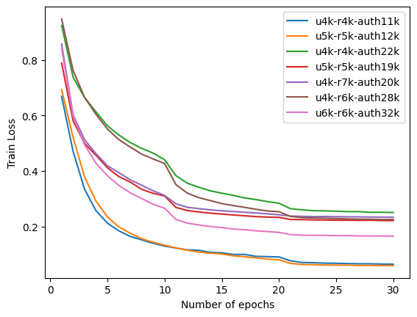
Observations

Slide 7
Deployment in cloud
As suggested, to deploy the framework in an actual cloud based scenario, we modify the “decision engine” for the framework DLBACα
This helps user access their files through the web
Th framework is easily deployed inside a docker container and lets user query and access files with the trained network as the access control barrier.

Slide 8
Thank you

