Slide 1


ROAD SAFETY
INSIGHTS
Preventing Accidents Before They Happen
Predictive road-risk intelligence for safer mobility
RSI
Notes:
Road Safety Insights pitch deck. Original embedded images are preserved without source modification.

Slide 2
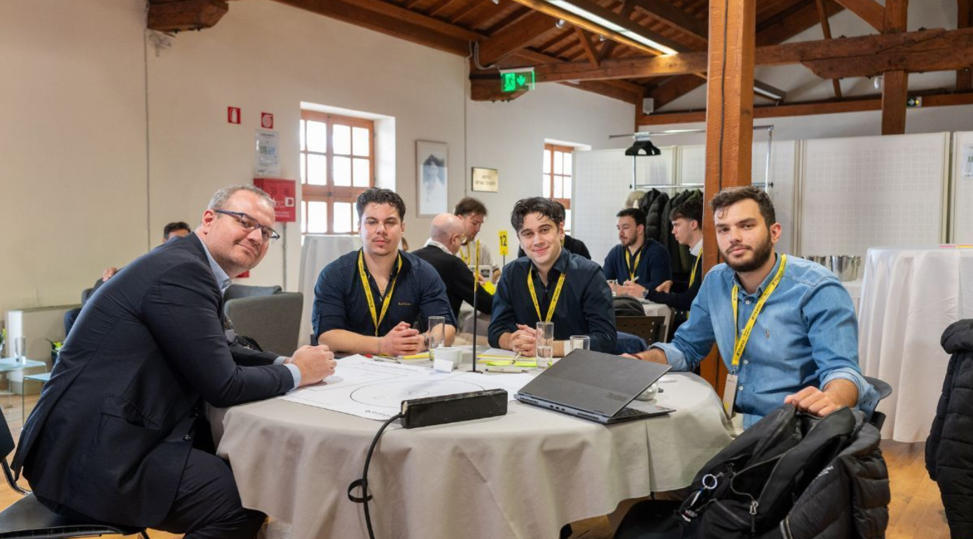

WHO WE ARE
02
A data-led approach to safer roads and lower mobility risk
Turning accident data into preventive intelligence
Road Safety Insights combines accident-data analysis with an in-car warning experience designed for drivers, fleets, and insurance partners.
The team is preparing a real-world pilot in Crete, where tourism and fleet density create a demanding road environment.
WORKSHOP TEAM
Notes:
Road Safety Insights pitch deck. Original embedded images are preserved without source modification.

Slide 3



STRATEGIC PARTNERS & EARLY RECOGNITION
03
Momentum built through the Piraeus Startup Accelerator and POS4work
EARLY RECOGNITION
€5,000
PRIZE
Recognition through the Piraeus Startup Accelerator and POS4work
RSI participated in the Piraeus Startup Accelerator with POS4work and received a €5,000 award.
Notes:
Road Safety Insights pitch deck. Original embedded images are preserved without source modification.

Slide 4
WHAT IS RSI
04
Four capabilities connect accident data with preventive action
01
02
REAL ACCIDENT DATA MAPPING
FLEET OPTIMIZATION
Maps and evaluates high-risk road segments using real accident data.
Supports accident prevention while reducing vehicle downtime and fleet costs.
03
04
PREDICTIVE INSIGHTS
REAL-TIME ALERTS
Transforms historical accident data into preventive intelligence for future risk.
Delivers push notifications through interactive driver overlays when risk rises.
Notes:
Road Safety Insights pitch deck. Original embedded images are preserved without source modification.

Slide 5

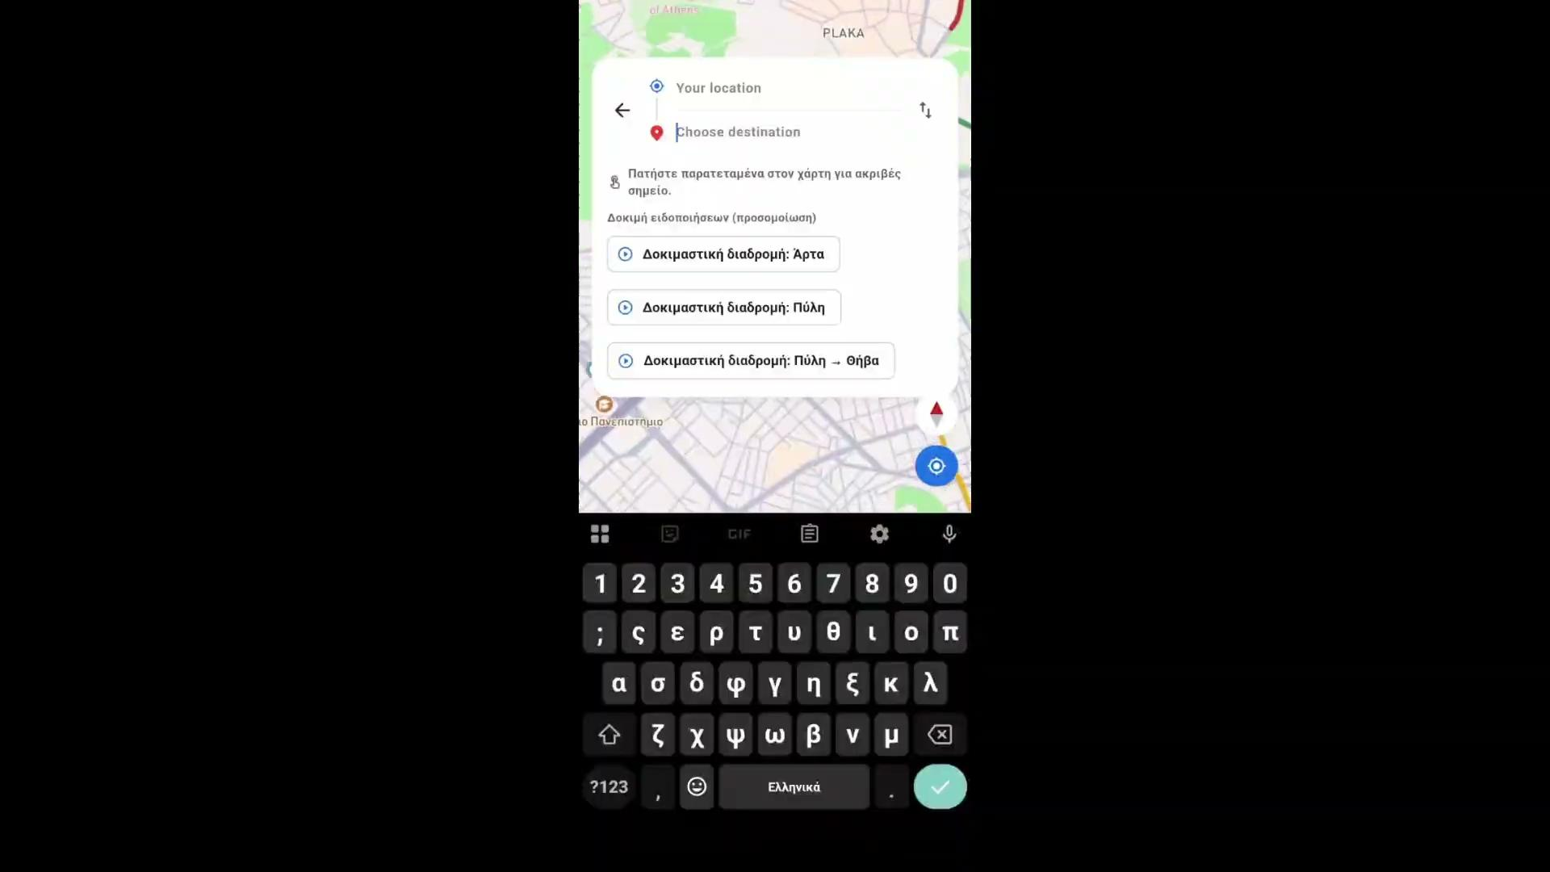
PLATFORM & VIDEO SHOWCASE
05
The driver experience brings road risk into a clear, timely interface
DRIVER EXPERIENCE
APPLICATION SHOWCASE
Real-time driver UI
Clear alerts surface the right hazard information without obscuring the route.
REAL-TIME
DRIVER UI
HAZARD DETECTION
Interactive risk map
The map links historical accident patterns with driver-facing warnings.
Notes:
Road Safety Insights pitch deck. Original embedded images are preserved without source modification.

Slide 6
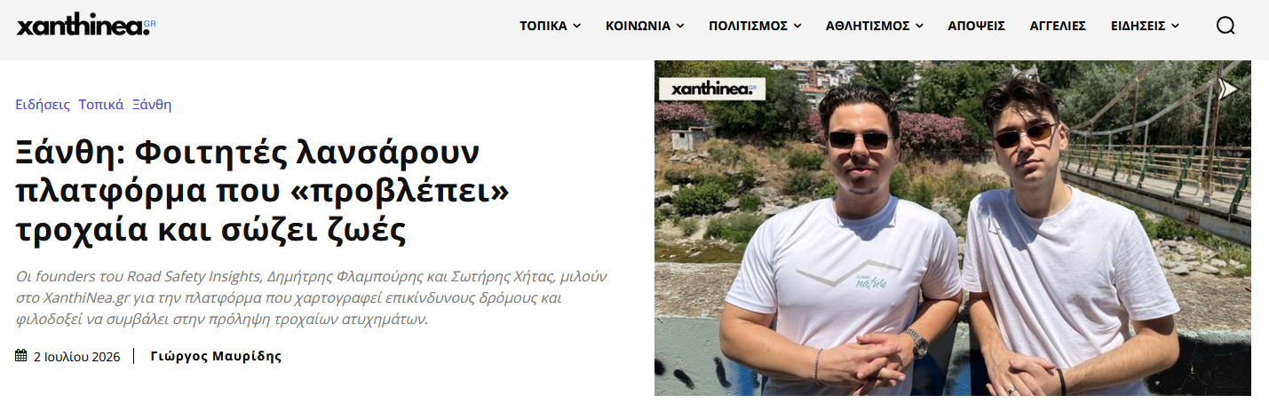
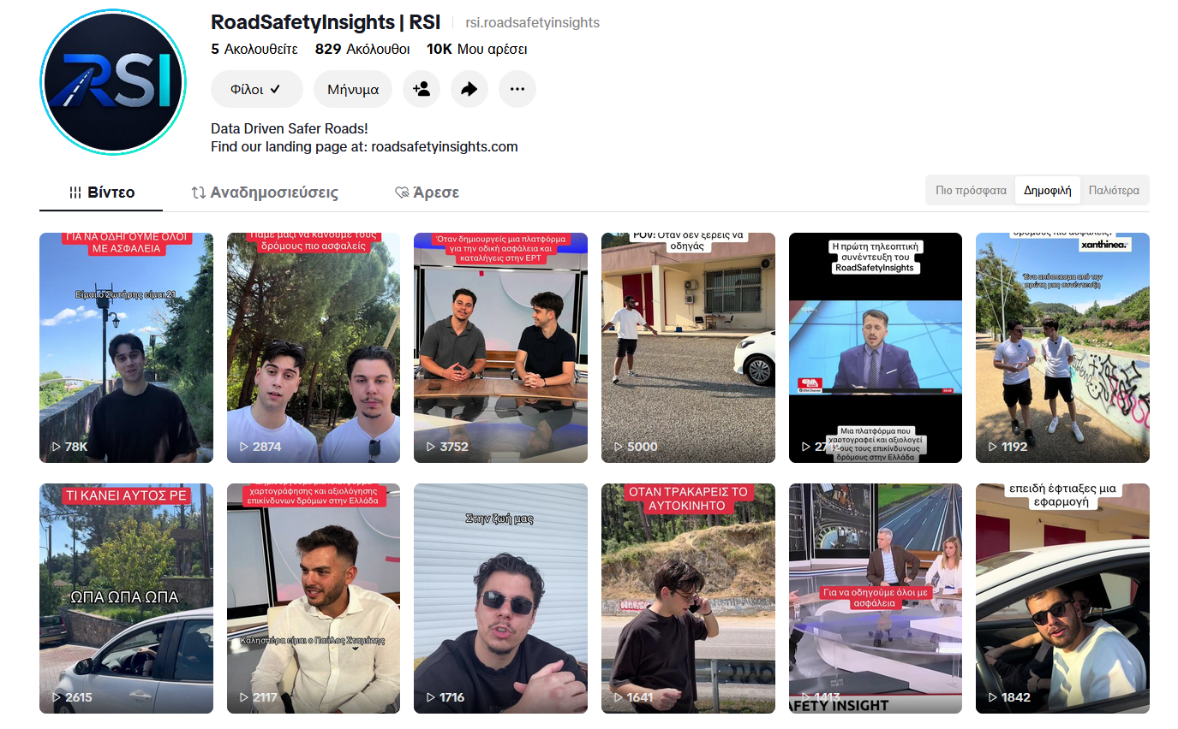

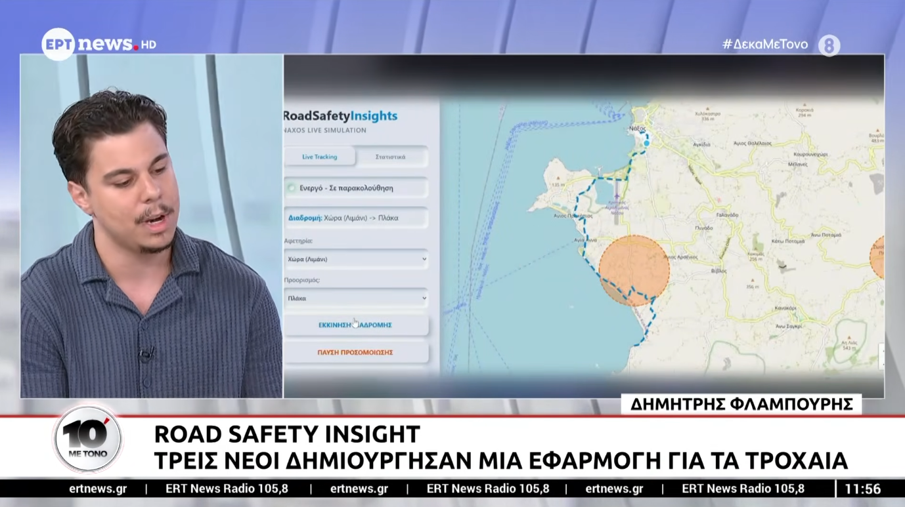
TRACTION & SOCIAL MEDIA PRESENCE
06
Organic reach and national media exposure demonstrate early public interest
PRESS & INTERVIEWS / 215.000 ORGANIC VIEWS WITH CONTINUED GROWTH
SOCIAL MEDIA PRESENCE
Notes:
Road Safety Insights pitch deck. Original embedded images are preserved without source modification.

Slide 7

WHERE DO WE START AND WHY
07
Crete combines fleet demand, road complexity, and real-world visibility
PILOT LOCATION
A focused test market for predictive risk detection and driver alerts
CRETE
T
TOURISM & SEASONAL PEAKS
F
FLEET DENSITY
High vehicle density and fluctuating flows create a clear need for timely road-risk information.
About 265 active rent-a-car companies provide a concentrated route to pilot distribution.
I
INFRASTRUCTURE
V
HIGH VISIBILITY
A large, complex network includes challenging road segments and varied driving conditions.
The island provides a strong real-world testing ground for predictive risk detection.
Notes:
Road Safety Insights pitch deck. Original embedded images are preserved without source modification.

Slide 8
WHAT WE SEEK
08
A partnership path from a focused pilot to a nationwide safety service
01
02
PILOT
03
SCALE
STRATEGIC PARTNERSHIP
Road accident data access and rent-a-car marketing affiliations in Crete.
Nationwide expansion of predictive hazard modeling using validated datasets.
Integration of RSI as an added-value safety service for insurance policyholders.
Notes:
Road Safety Insights pitch deck. Original embedded images are preserved without source modification.

Slide 9
Agenda – Road Safety Insights x Ethniki Asfalistiki
07
I
Percentage of road traffic accidents you have access to
II
Data available per accident and data format
What percentage of road traffic accidents do you have available data or relevant information on?
What data do you have available for each accident?
In what format is this data stored and made available?
III
Data transfer process and companies involved
IV
Marketing Affiliations / Partnerships
What process is currently used for data transfer?
Through which companies or partners is the transfer or exchange of data currently carried out?
How do you currently manage marketing affiliations or similar commercial partnerships with other companies?
V
Credit Score
VI
Pilot Affiliation for Crete
If you are already developing a Credit Score, what data do you use to create and evaluate it?
Exploration of a potential pilot collaboration / affiliation in Crete, with the aim of applying and evaluating the solution in a real-world environment.
Notes:
Road Safety Insights pitch deck. Original embedded images are preserved without source modification.

Slide 10
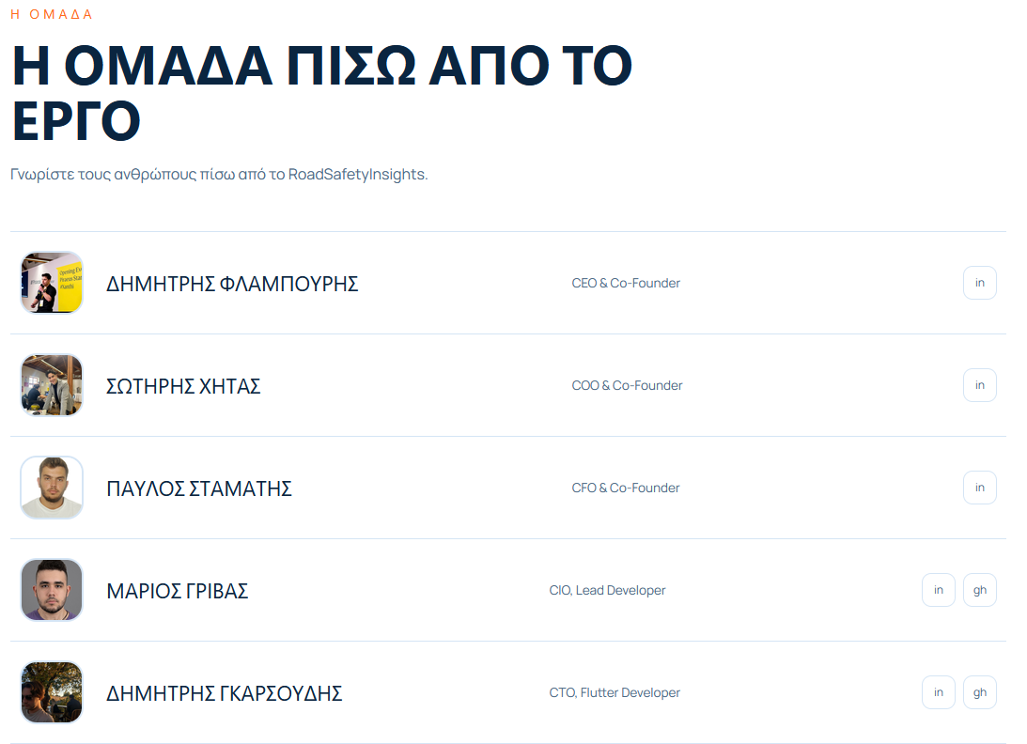

OUR TEAM & CONTACT
09
Meet the people building Road Safety Insights
RSI LANDING PAGE
SCAN TO EXPLORE
OUR LANDING PAGE
ROAD SAFETY INSIGHTS
Notes:
Road Safety Insights pitch deck. Original embedded images are preserved without source modification.

