Slide 1
OAS1 example in vignette

Slide 2
/multiseq/local/OAS1.R
Code to generate the data and the plot
Data: Bryce, after removing individuals with NA, and individuals with 0 counts
66 individuals

Slide 3
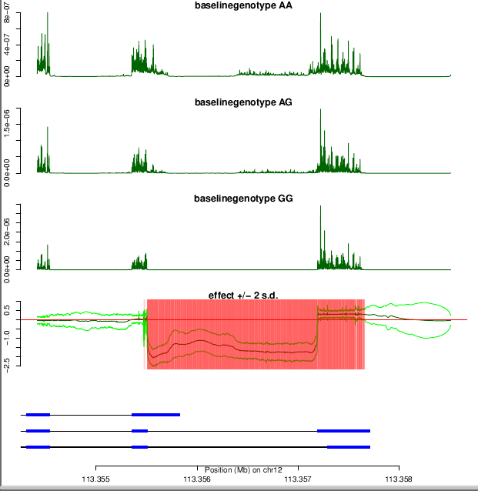
66 individuals

Slide 4
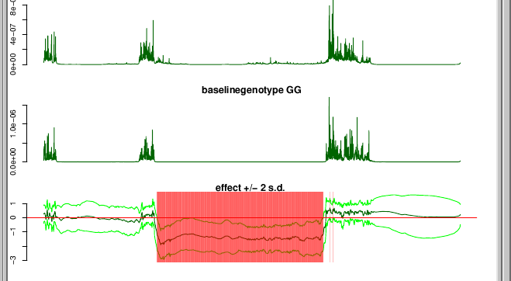
9 individuals (first 3 in each genotype class)

Slide 5
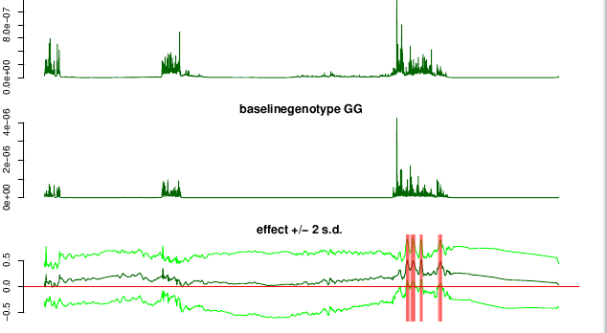
9 individuals (second 3 in each genotype class)

Slide 6
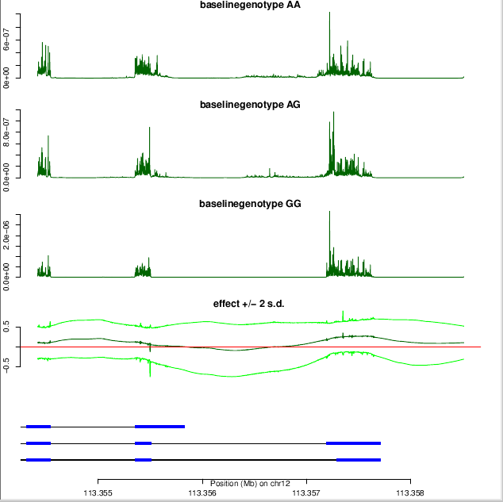
15 individuals (first 5 in each group)

Slide 7
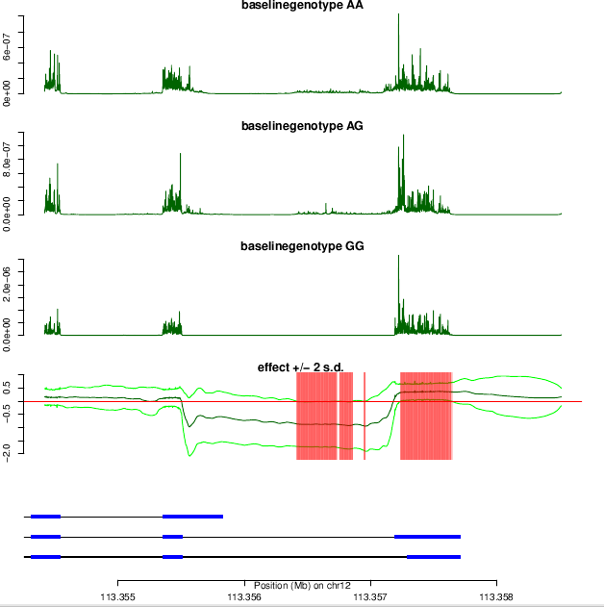
21 individuals (first 7 in each group)
In total there are just 7 individuals with genotype 0

Slide 8
Comparison
66 individuals vs 9 individuals vs 9 individuals (second set) vs 15 individuals vs 21 individuals:
If we want to reduce the data set the sets with 9 individuals or 15 don’t show similar pattern to 66 individuals
The 21 individuals show good pattern
66 individuals vs 21 individuals: 66 takes double the time (30 seconds), data set size ~ 4 times (39Kb)

