Slide 1
Choosing an example with ChipSeq data for the Vignette

Slide 2
ChipSeq Encode data 4 samples, 2 groups
I would like to choose a representative example among the examples in the following slides
I’m plotting 3 curves:
1. baseline for the first group (smoothing of 2 samples simultaneously)
2. baseline for the second group (smoothing of 2 samples simultaneously)
3. effect using 4 samples in two groups

Slide 3
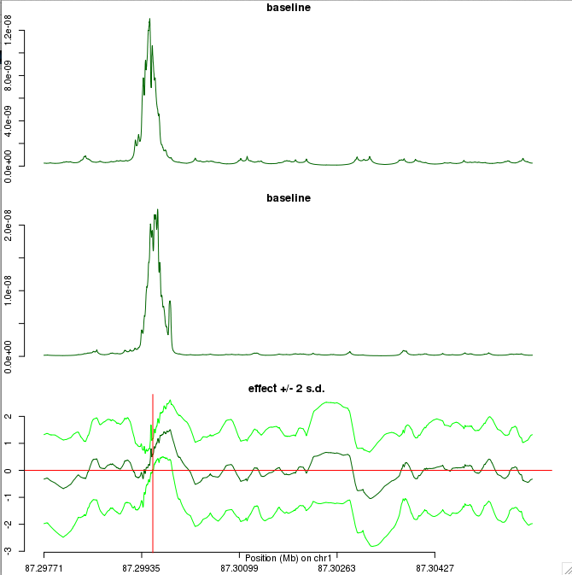
Note: in all plots, pink area in the 3rd curve is incomplete (I’m running R interactively and plotting is slow so I take a screenshot before coloring has completed) but you can guess from the errors where the pink area should be!

Slide 4
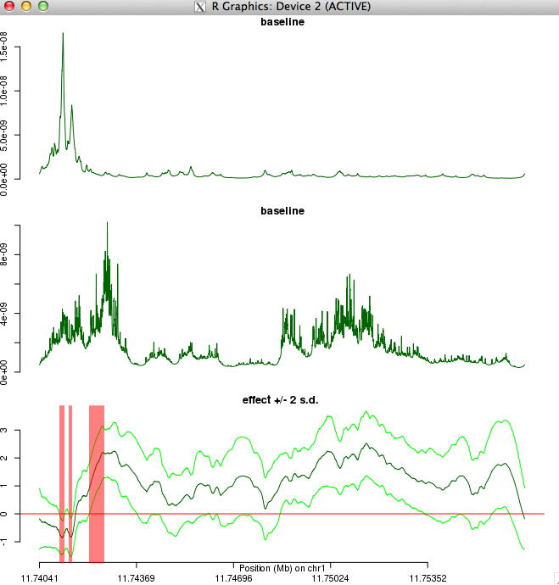

Slide 5
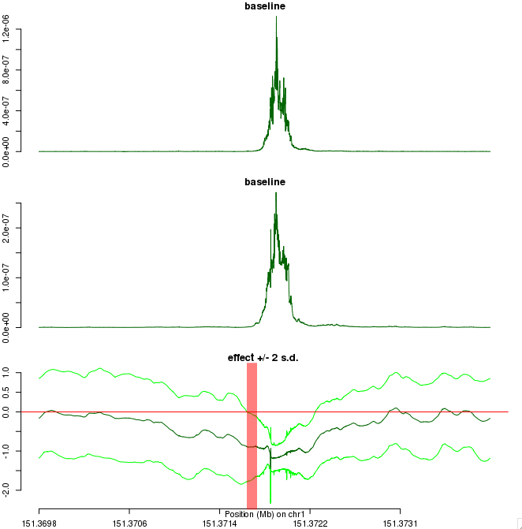

Slide 6
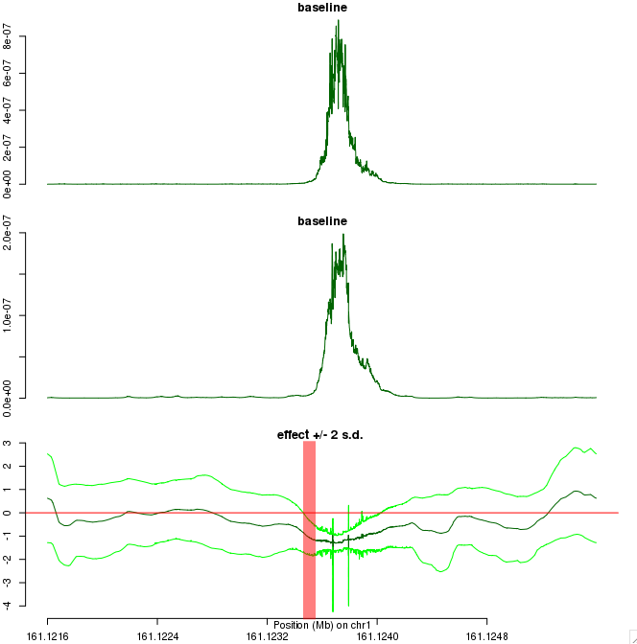

Slide 7
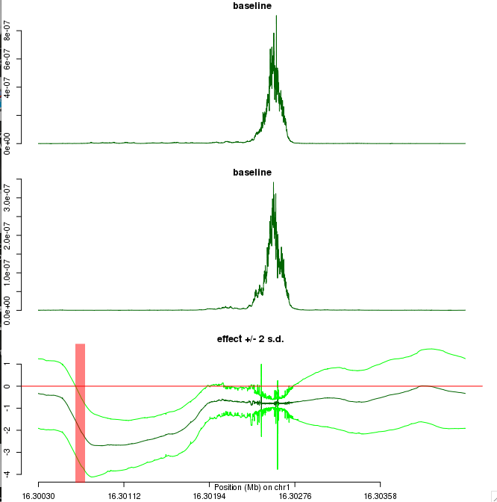

Slide 8
Some comments
Thresholding for peak identification in this dataset:
Max(baseline)~ 10^(-7)
Last example: effect in a region with no reads!
I would pick the second example.

