Slide 1
How many samples to select for the OAS1 example in vignette?

Slide 2
Data: Bryce (reads mapped with bwa)
After removing individuals with NA, and individuals with 0 counts: 66 individuals
I was trying to select a smaller dataset to put in the vignette but (see next slides) only with a total of 21 individuals I get a pattern that resemble the pattern with 66 individuals.
Comparison
66 individuals | 21 individuals (7 in each genotype class)
time ~30 seconds | ~15seconds
data size ~ 39Kb | ~10Kb
If you are interested: Code to generate the data and the plots
/multiseq/local/OAS1.R

Slide 3
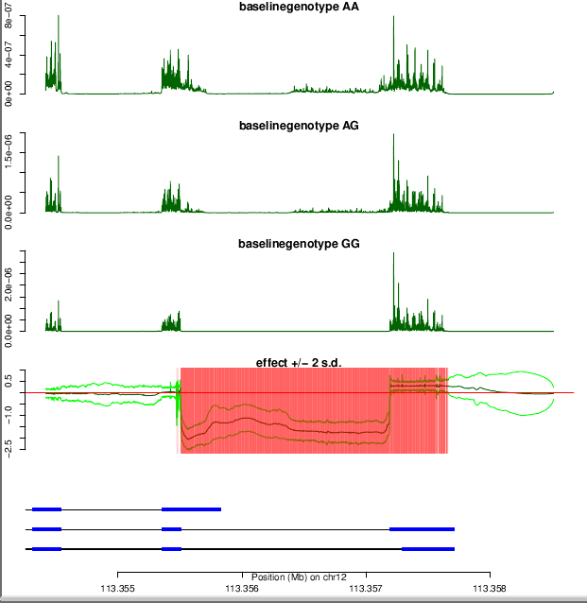
66 individuals

Slide 4
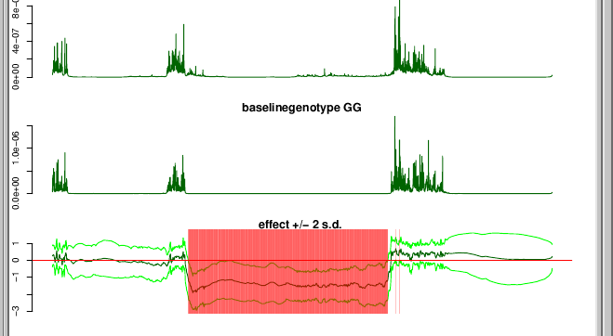
9 individuals (first 3 in each genotype class)

Slide 5
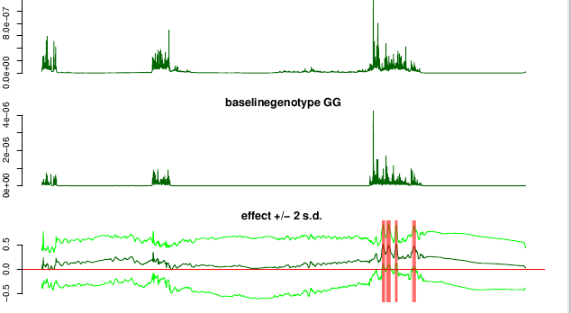
9 individuals (second 3 in each genotype class)

Slide 6
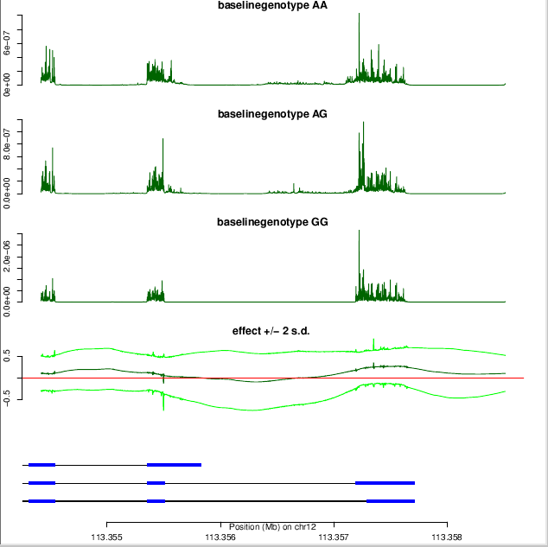
15 individuals (first 5 in each group)

Slide 7
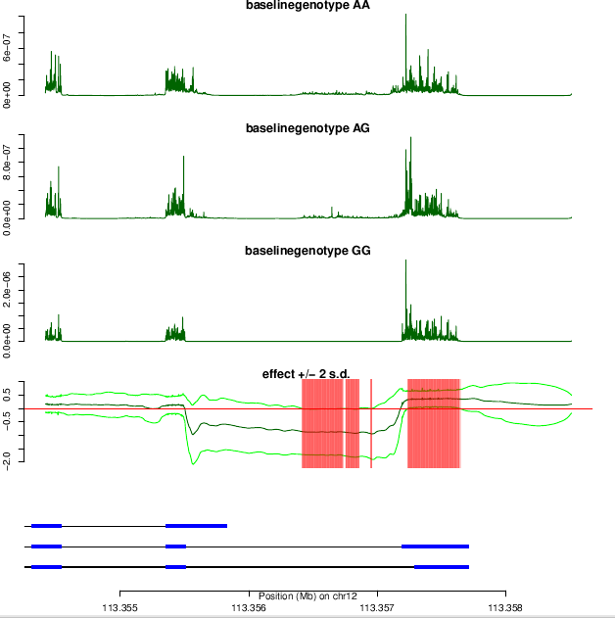
21 individuals (first 7 in each group)

Slide 8
Comparison
66 individuals vs 9 individuals vs 9 individuals (second set) vs 15 individuals vs 21 individuals:
If we want to reduce the data set the sets with 9 individuals or 15 don’t show similar pattern to 66 individuals
The 21 individuals show good pattern; I would pick this one or the complete 66 individuals

