Slide 1
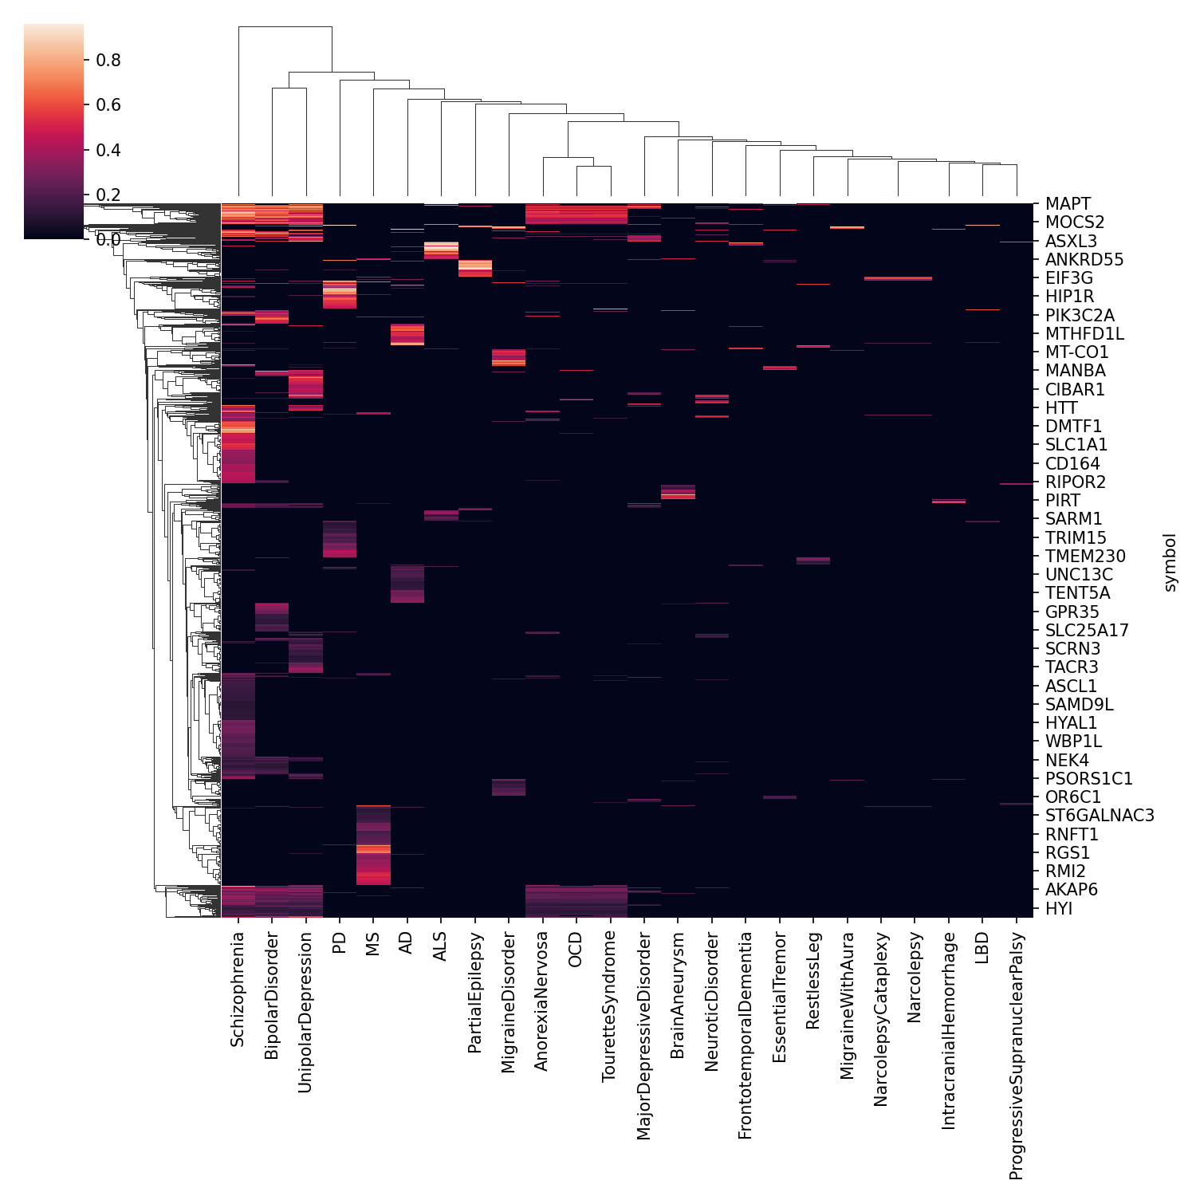
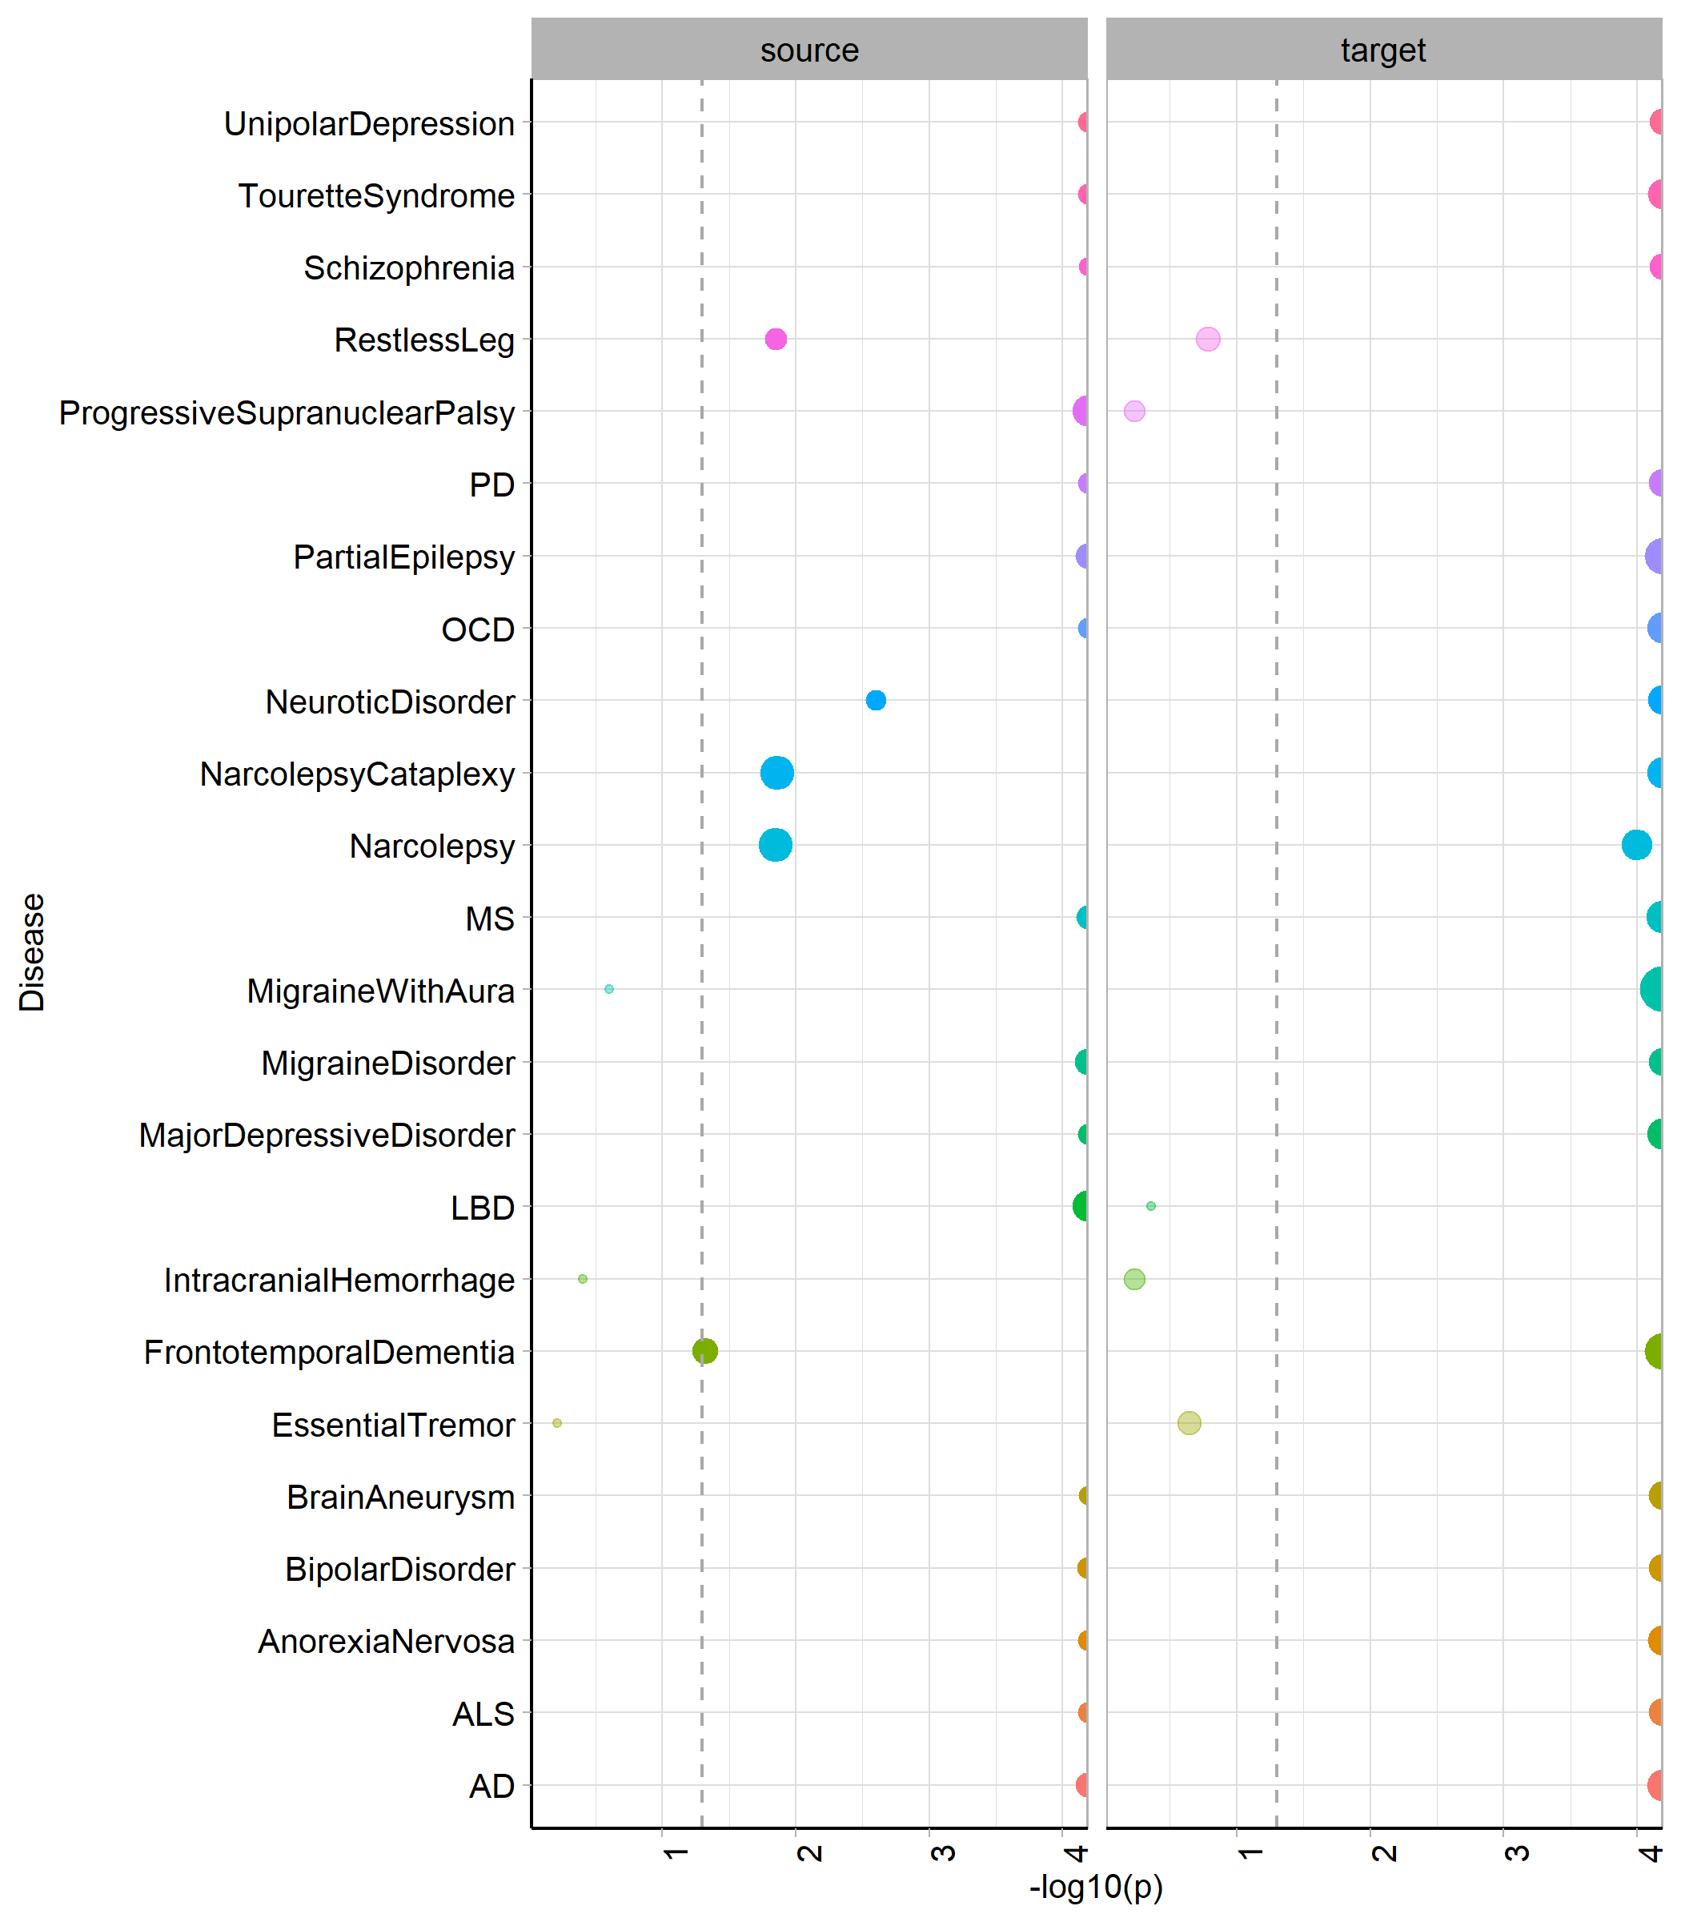
Hierarchical clustering of all genes associated with these disorders (genetic association >0.1)
Is ligand/receptor occurrence in risk genes significant for these diseases?
May need to rerun with more iterations (too many p=0)
Notes:
Direct genetic risk overlaps do not account for similarity across neurological diseases. The only diseases with an overlapping gene hub are psychiatric diseases. For most diseases, ligand-receptor occurrence among risk genes is significantly higher than would be expected of datasets of this size, suggesting LR roles may underlie similarities across diseases.

Slide 2
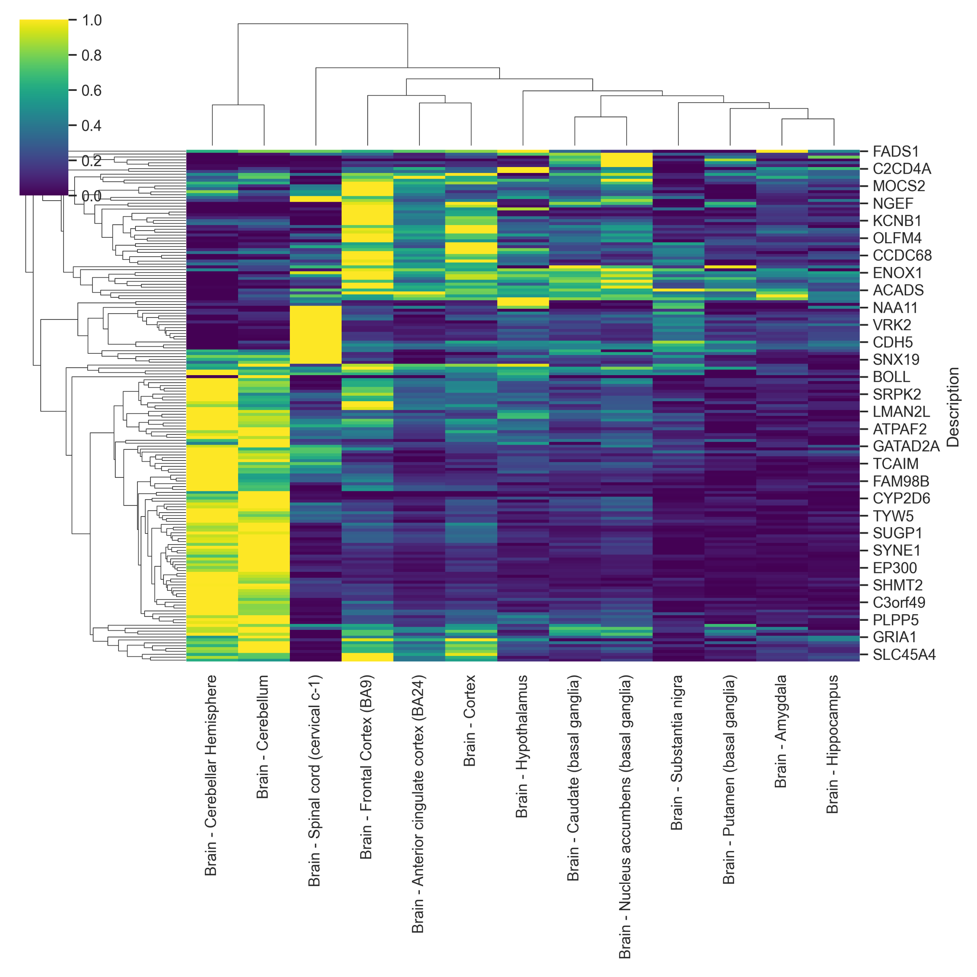
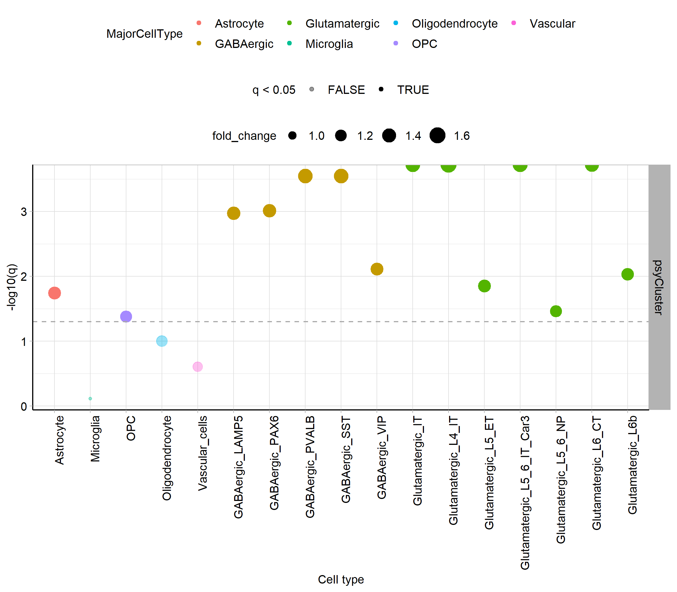
Characterising psychiatric gene hub (add details of how these were selected)
Tissue expression (GTEx)
Spatial domain scores (DLPFC)
L1
L1
L2
L5
L3
WM
L6
L4
WM
Cell type enrichment (EWCE)
Notes:
The hub of genes associated with psychiatric disorders are predominantly present in neuron rich brain regions, such as the cerebellum. As would be expected, they were enriched to neurons and astrocytes. The spatial domains with highest scores for these genes were neuronal cortical layers, in particular cortical layer 6

Slide 3
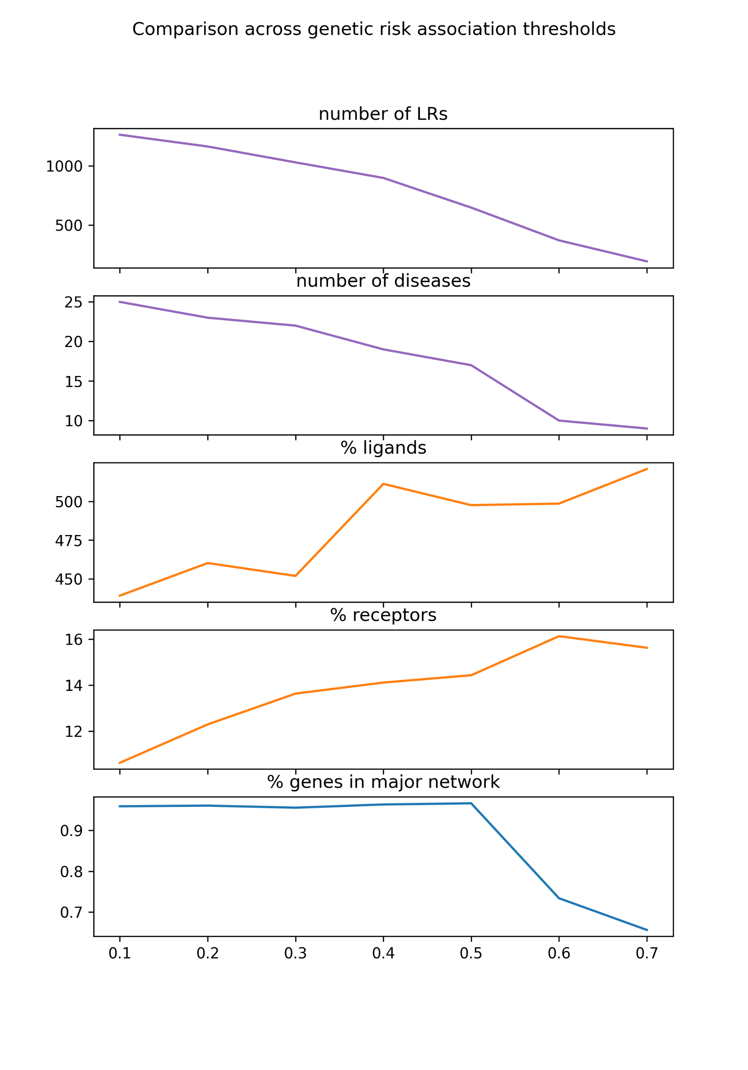
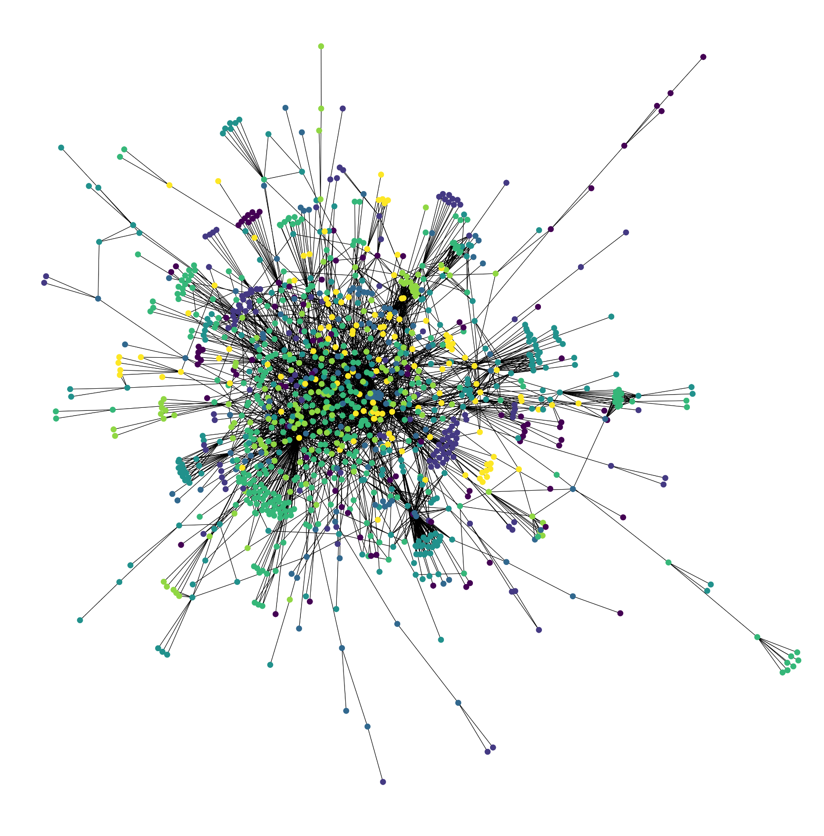
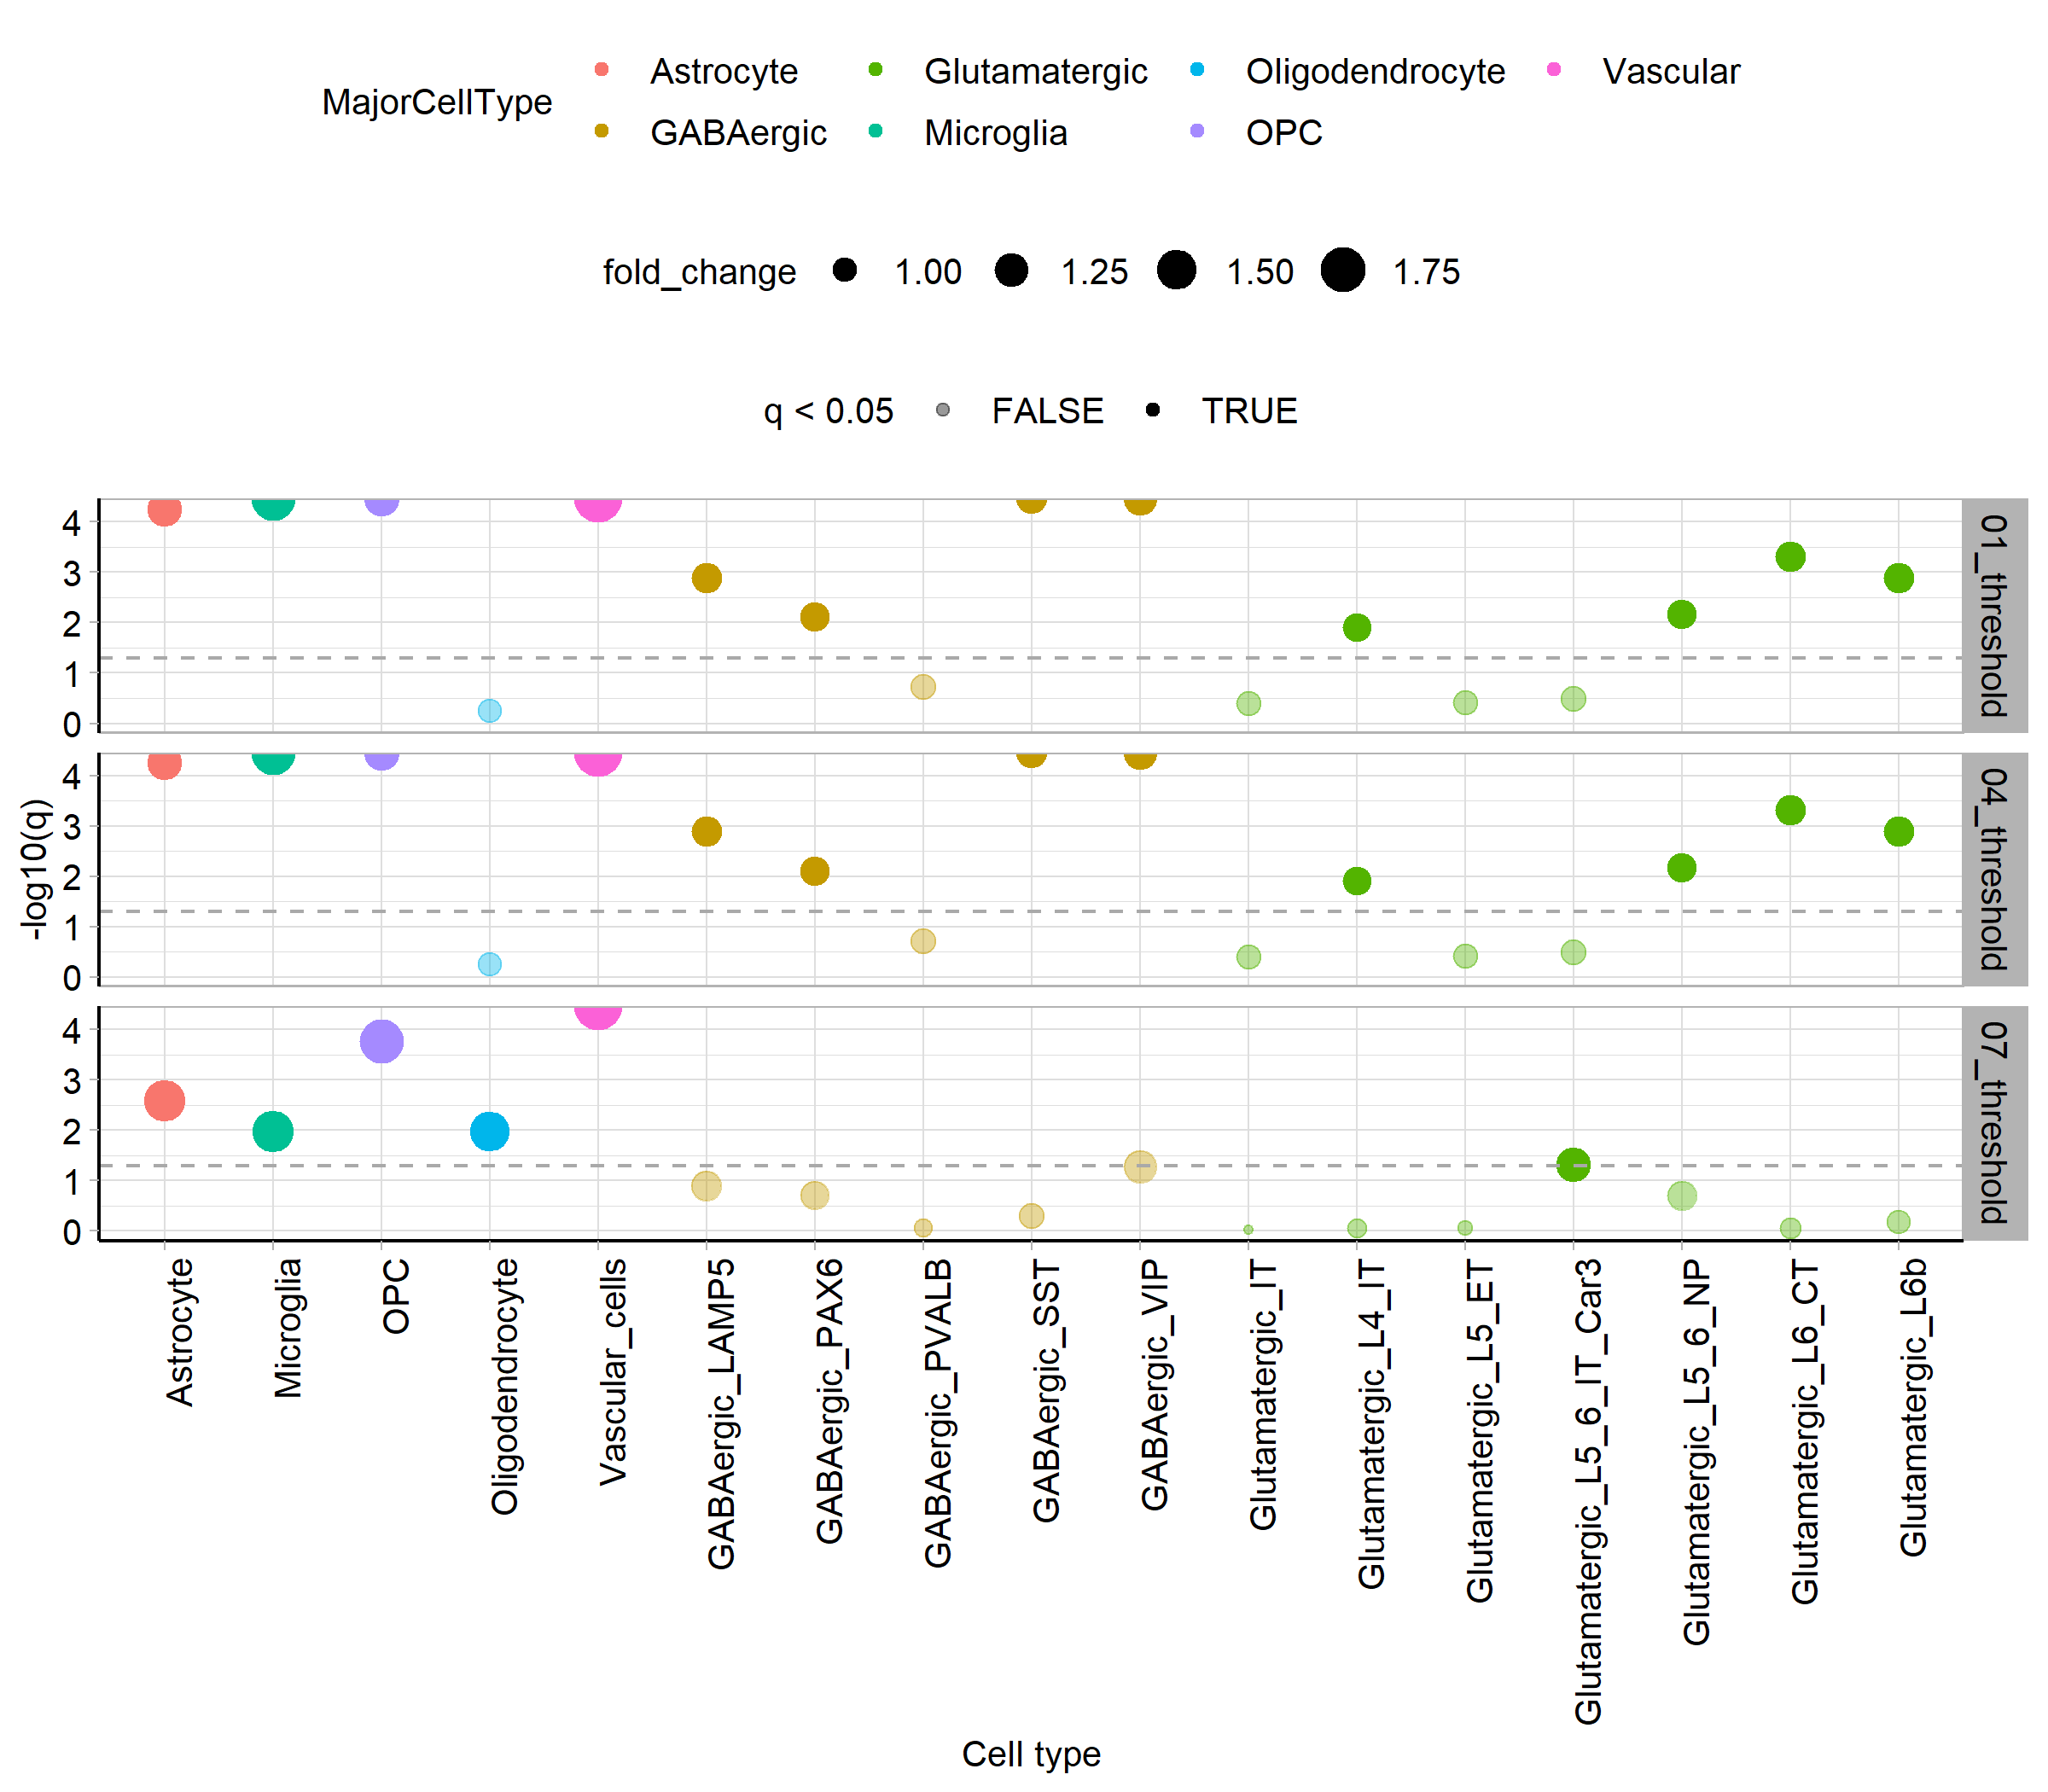
Characterising core disease LR network across thresholds
50,000 iterations
Notes:
We detected changes across the different thresholds and identified that ligand receptor occurrence increases with disease risk (meaning, disease genes are more likely to be ligands or receptors). Notably, the genes with highest risk tend to be expressed in non-neuronal cell types in the brain, such as OPCs, astrocytes, vascular cells and microglia.

Slide 4
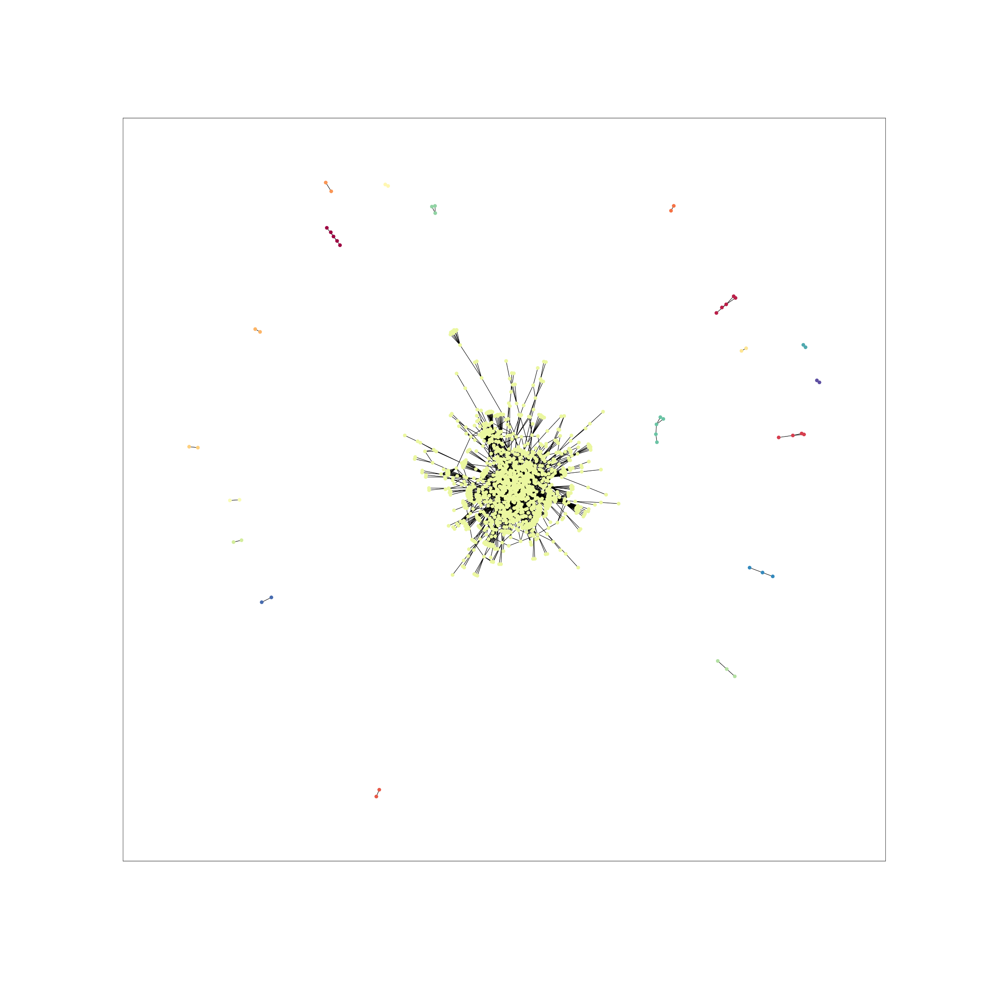
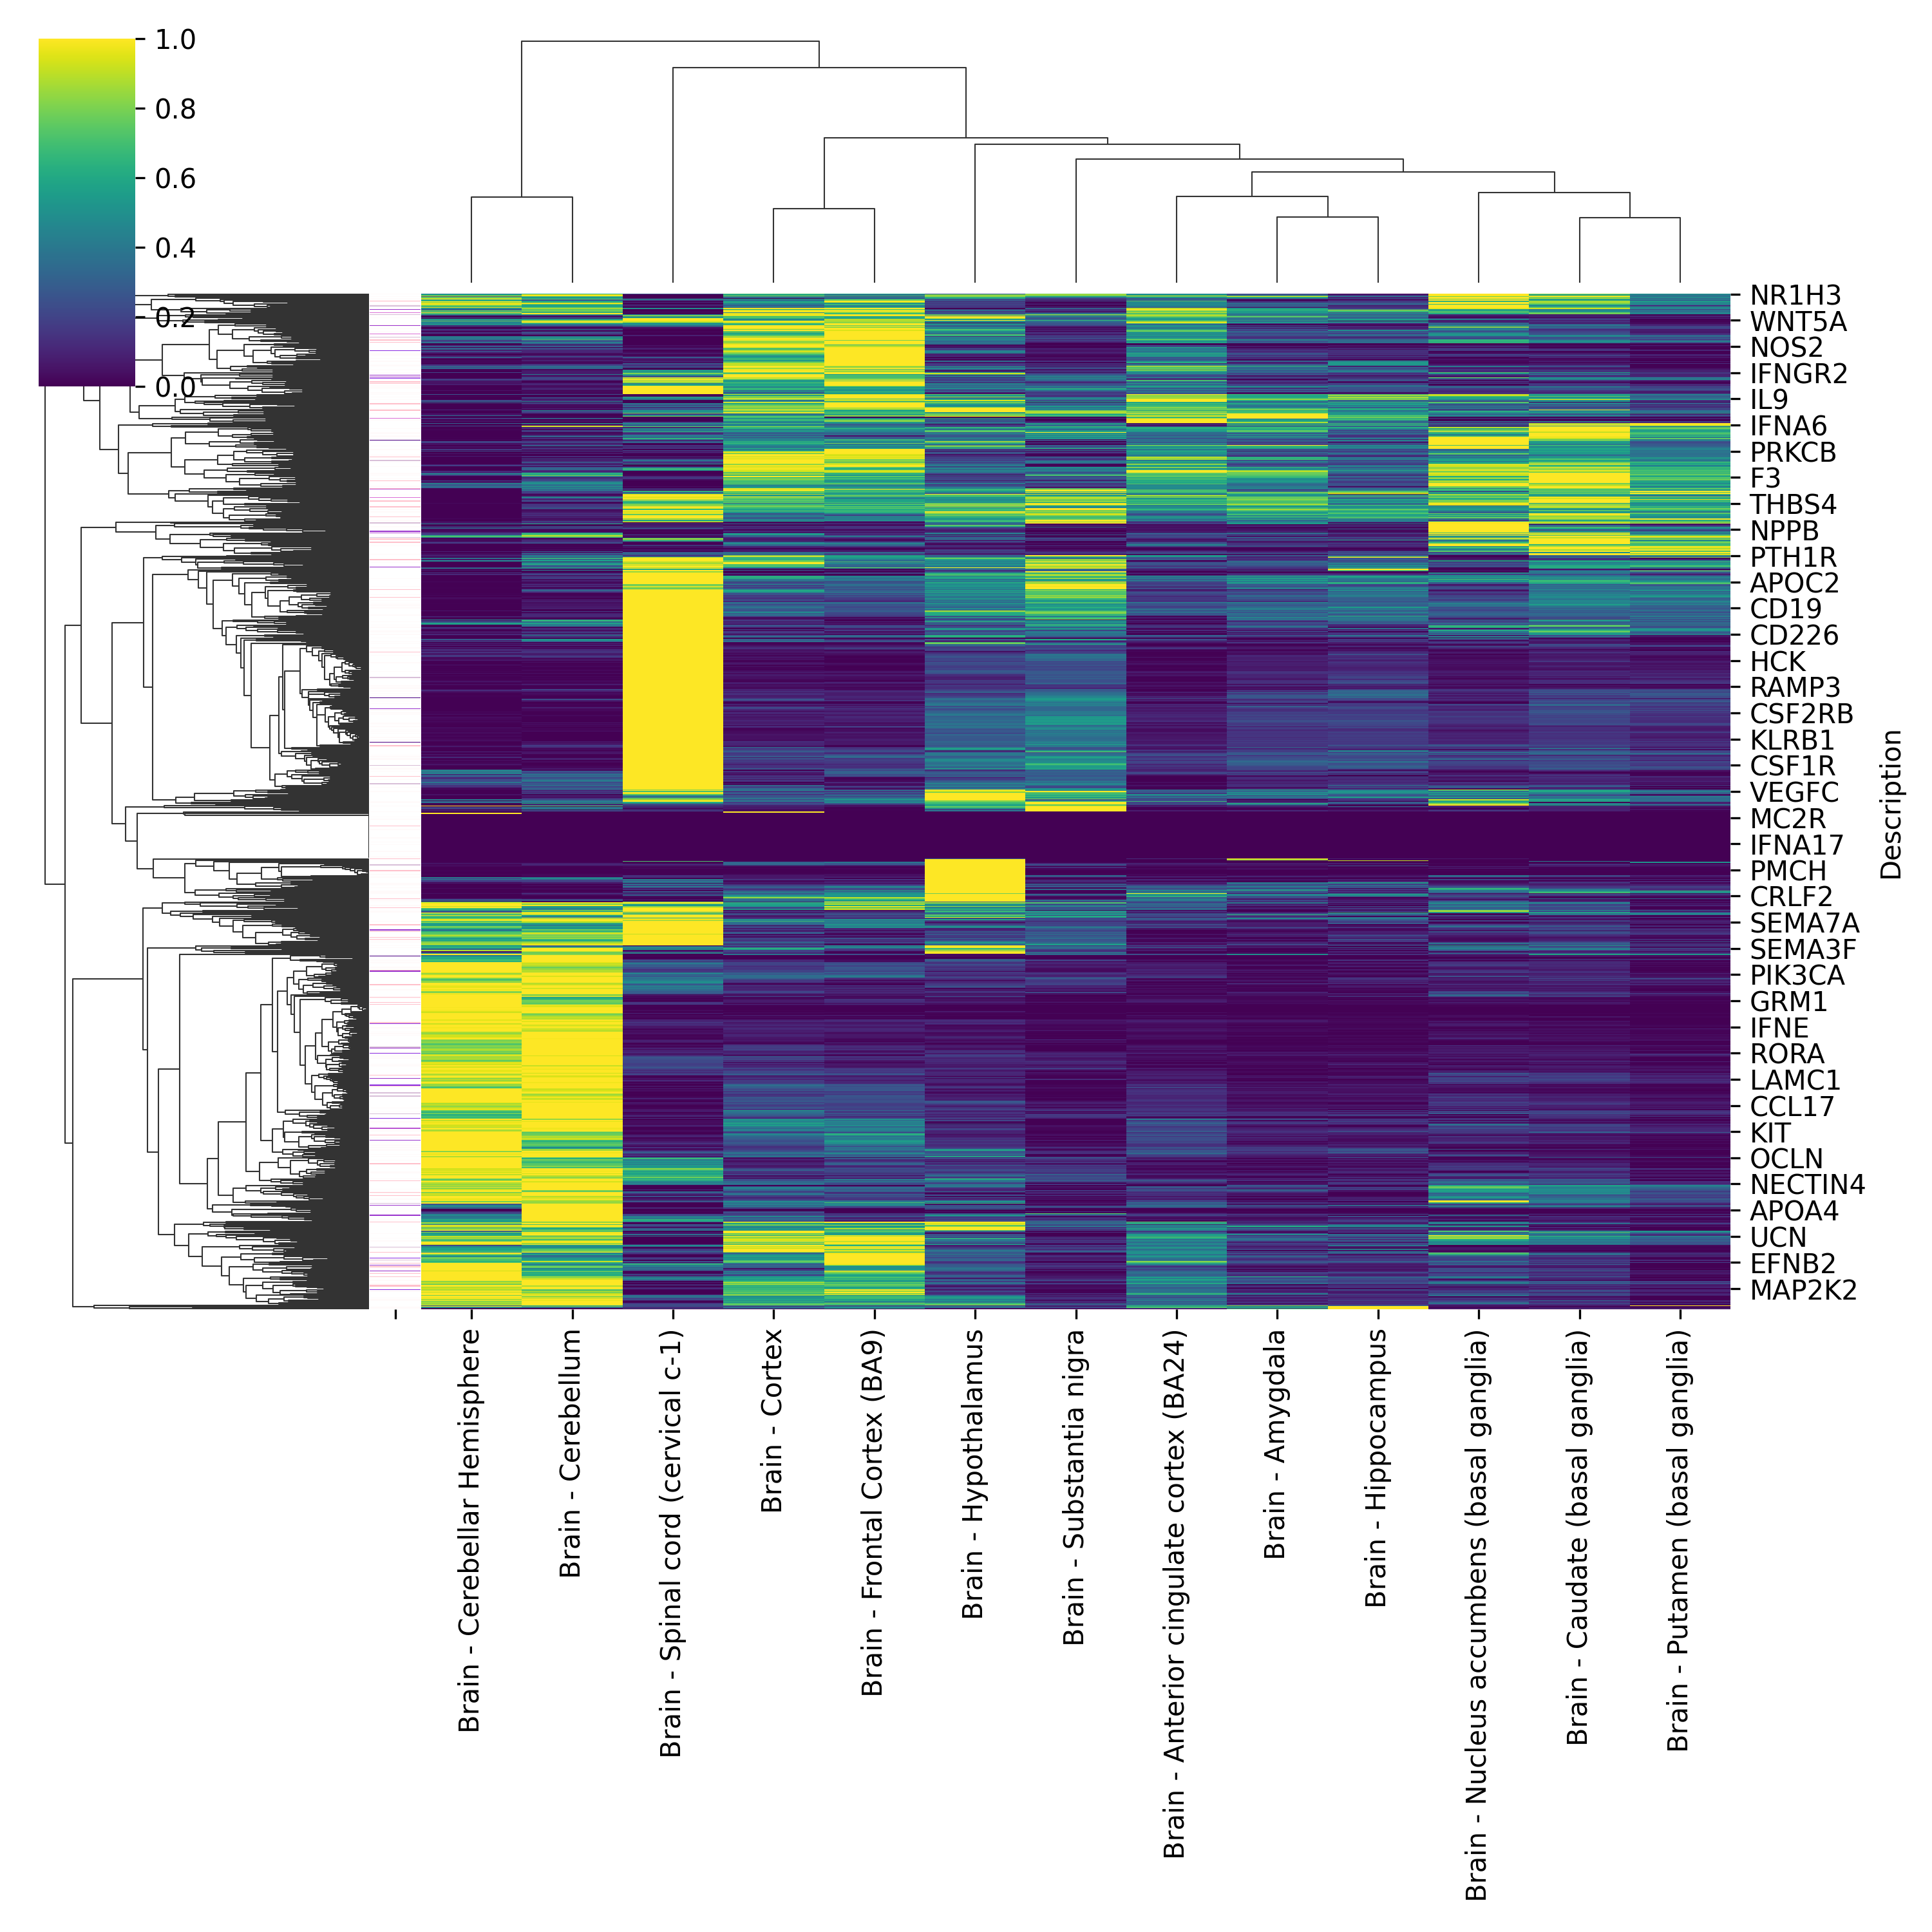
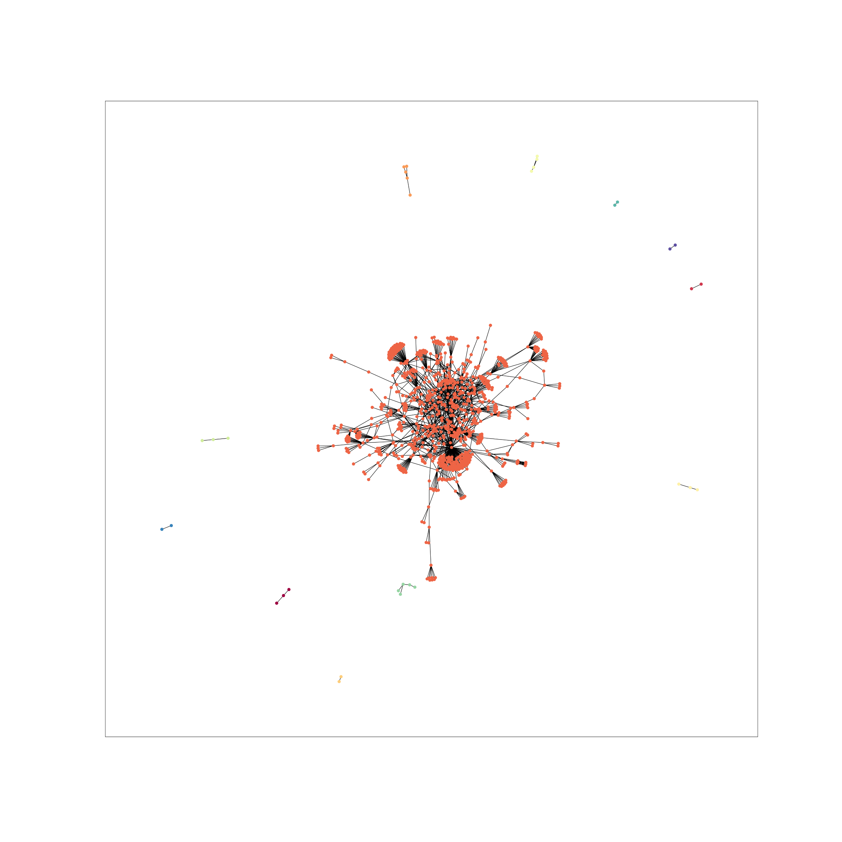
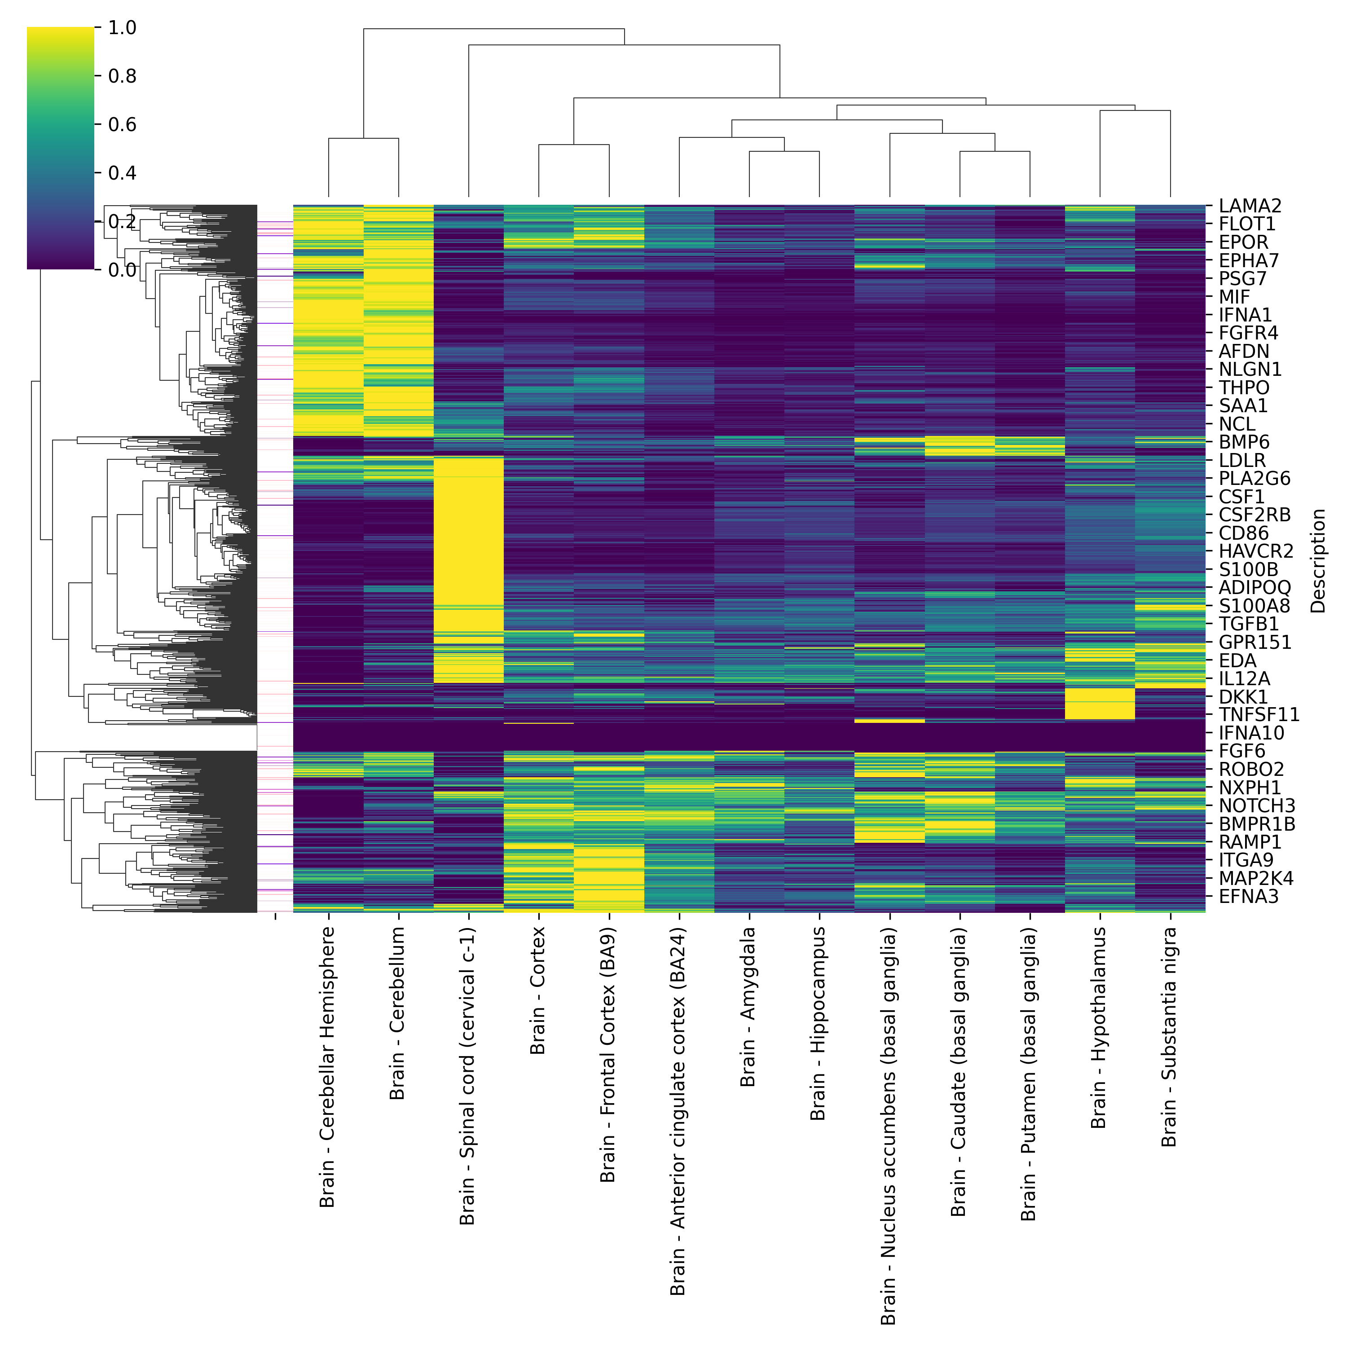
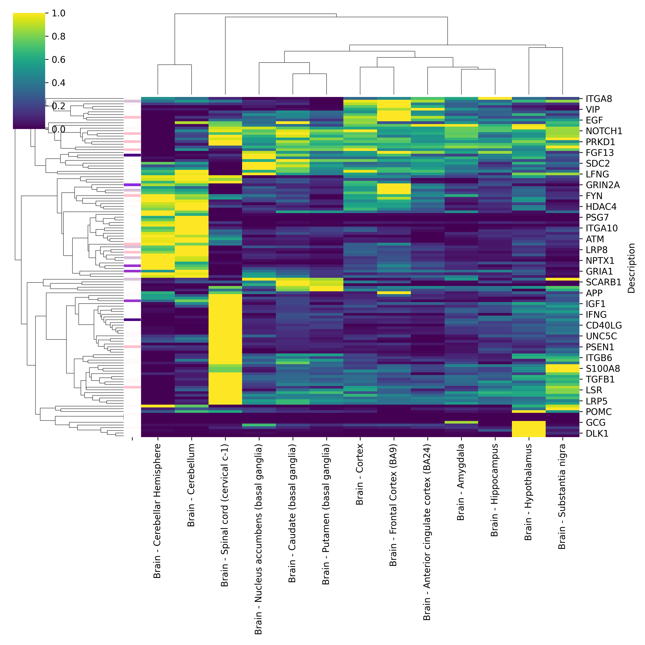
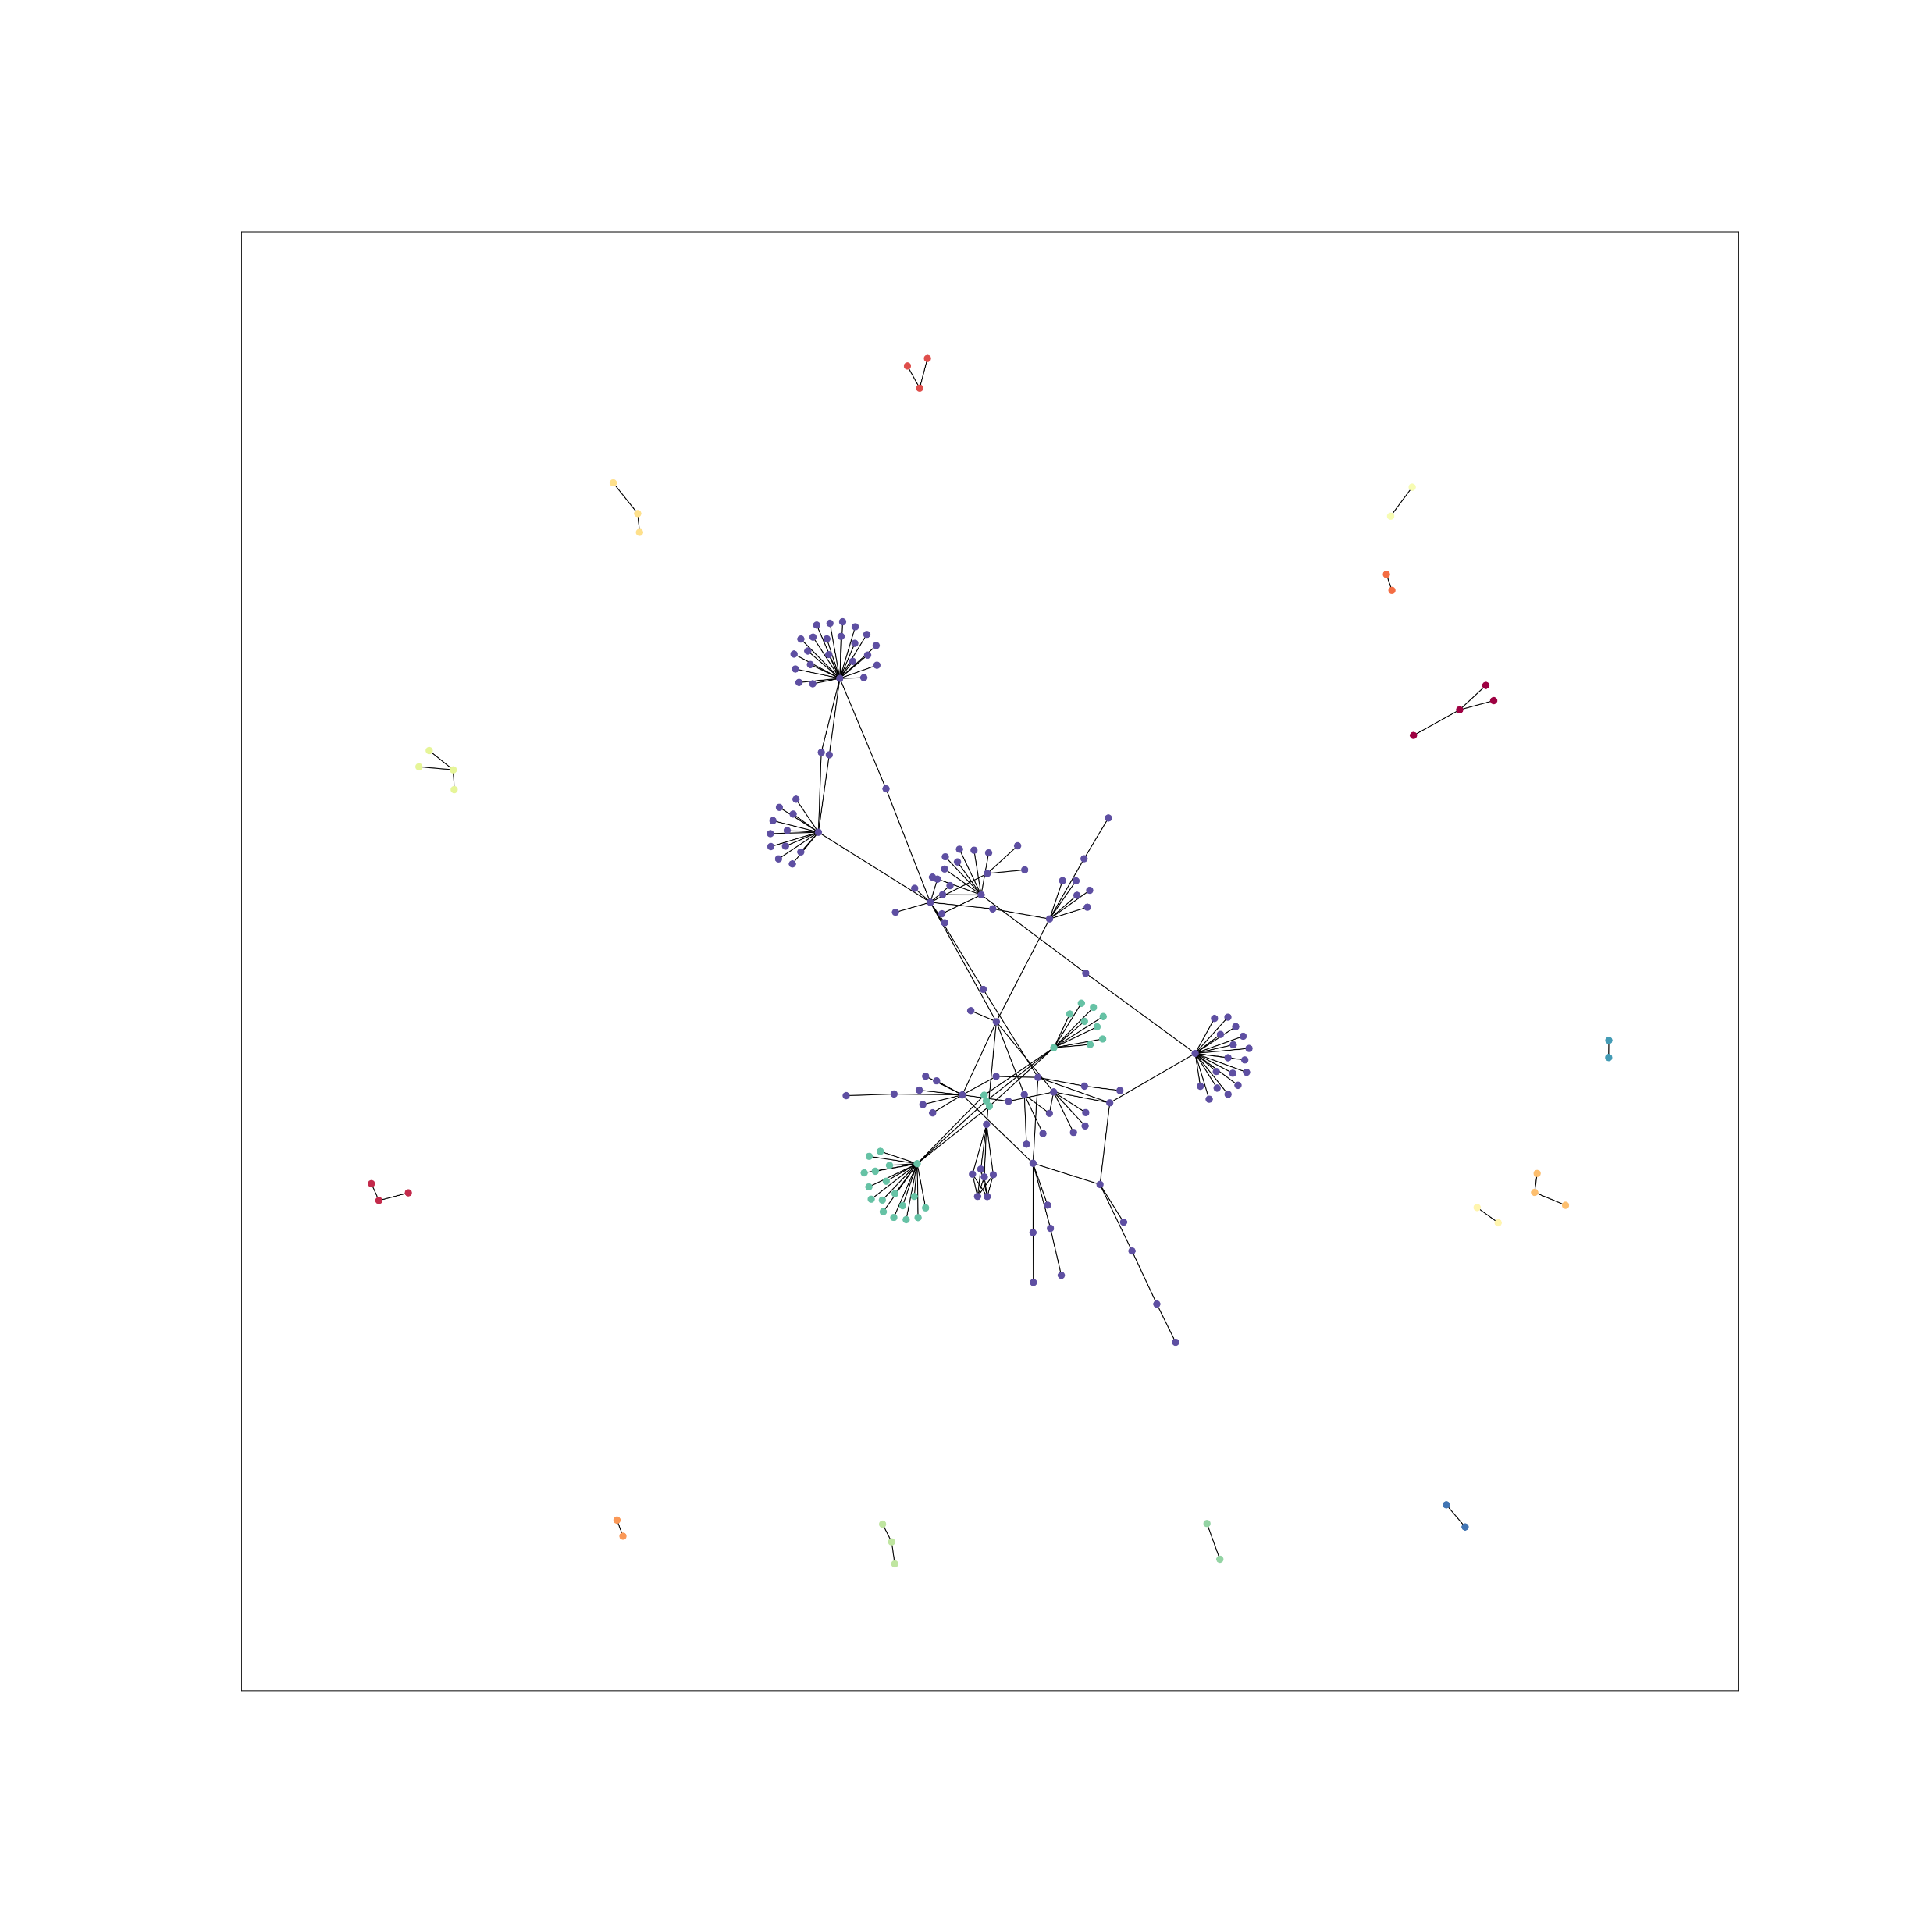
Tissue expression (GTEx)
0.1
0.4
0.7
Notes:
A core major LR network was identified across the resolutions. This contains 95% of LRs for threshold 0.6 and lower. This connectivity is not significantly higher than for other LR lists of the same size. We found that for genes of higher associated risk, the networks were smaller than would be expected by chance – possibly indicating that hyper-connectivity of genes with mendelian disease risk is not compatible with life.

Slide 5
L1
L1
L2
L5
L3
WM
L6
L4
WM
Notes:
We found that the spatial domains which scored highest were overall maintained across thresholds, with cortical layer 6 (spatial domain 7) being the highest scoring. Notably, when assessing the co-localization we identified that glial cell types tended to co-localize with Layer 5/6 neurons in the spots with highest (95th quantile) scores, suggesting that there is architectural relevance for the expression of these genes.

Slide 6
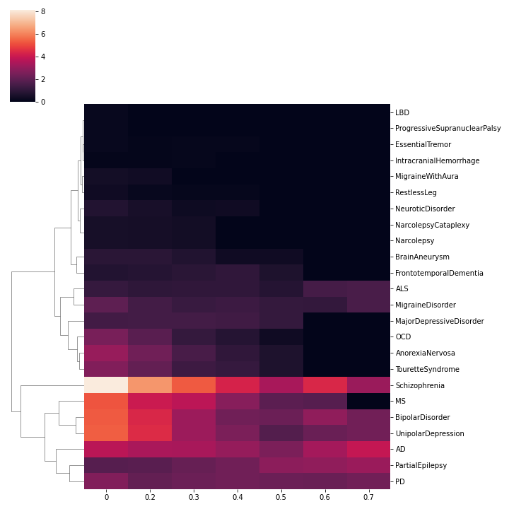
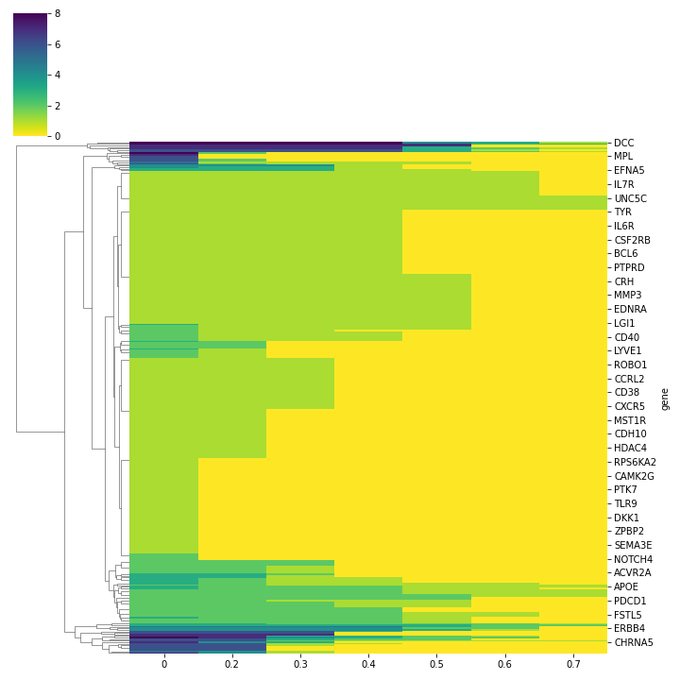
How many genes per disease contribute to core network?
How many diseases does each gene have risk for across thresholds
Notes:
Although Schizophrenia is clearly the dominant disease contributor in low threshold gene selection, several diseases maintain a much stronger representation in the core network with high risk. This includes in particular AD, PD and partial epilepsy. When in the 0.7 threshold, we noted that one gene that was maintained actually had a risk significant for Schizophrenia, Bipolar disorder and major depressive disorder - VRK2. Interestingly, this target also has a relatively high risk (>0.5) for another 4 psychiatric disorders. Having both roles in development and maintenance of the mature neuronal network, this could be a candidate cross-disease target.

Slide 7
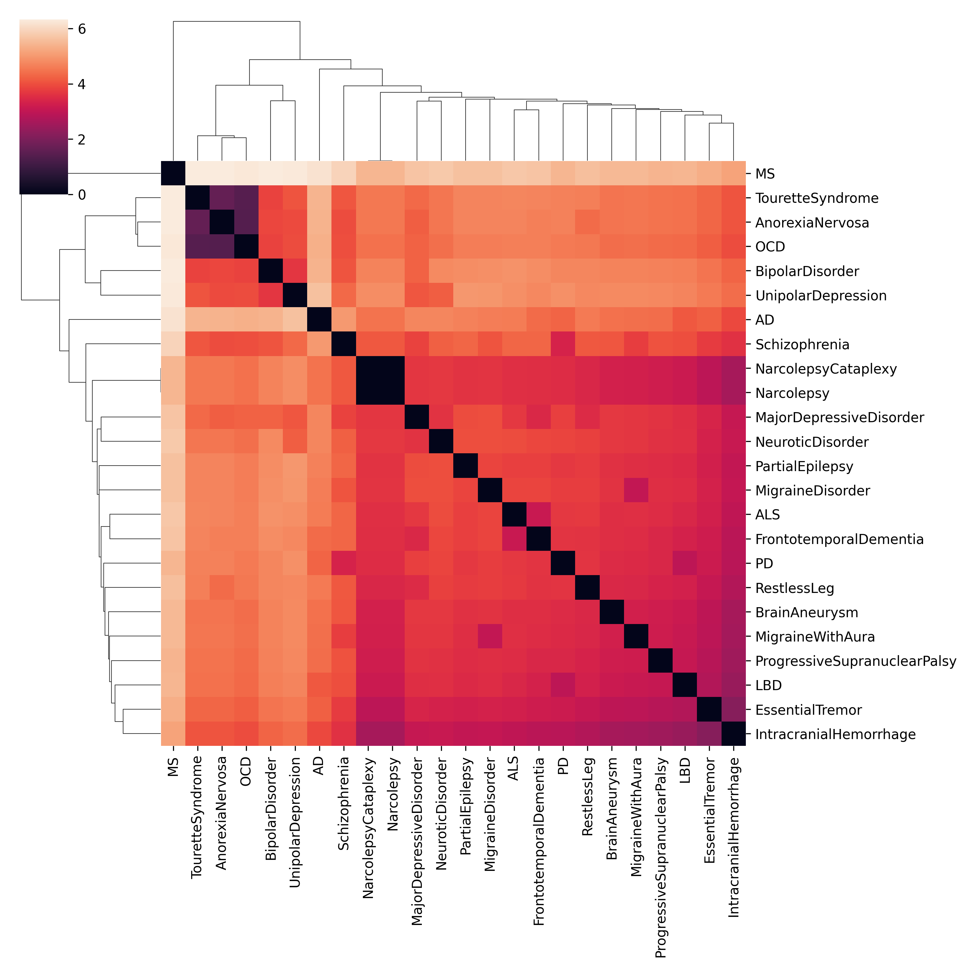
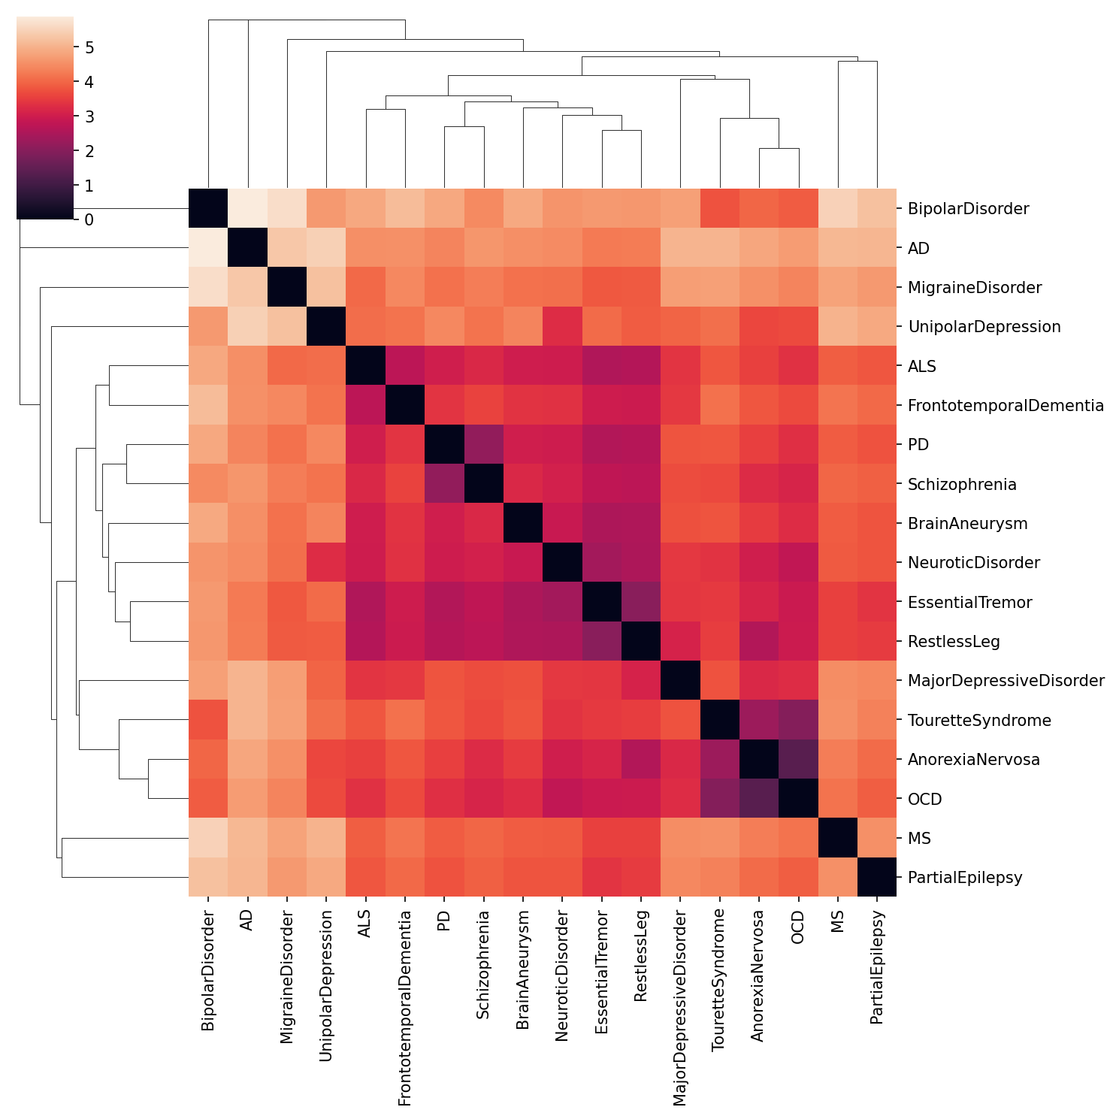

Slide 8
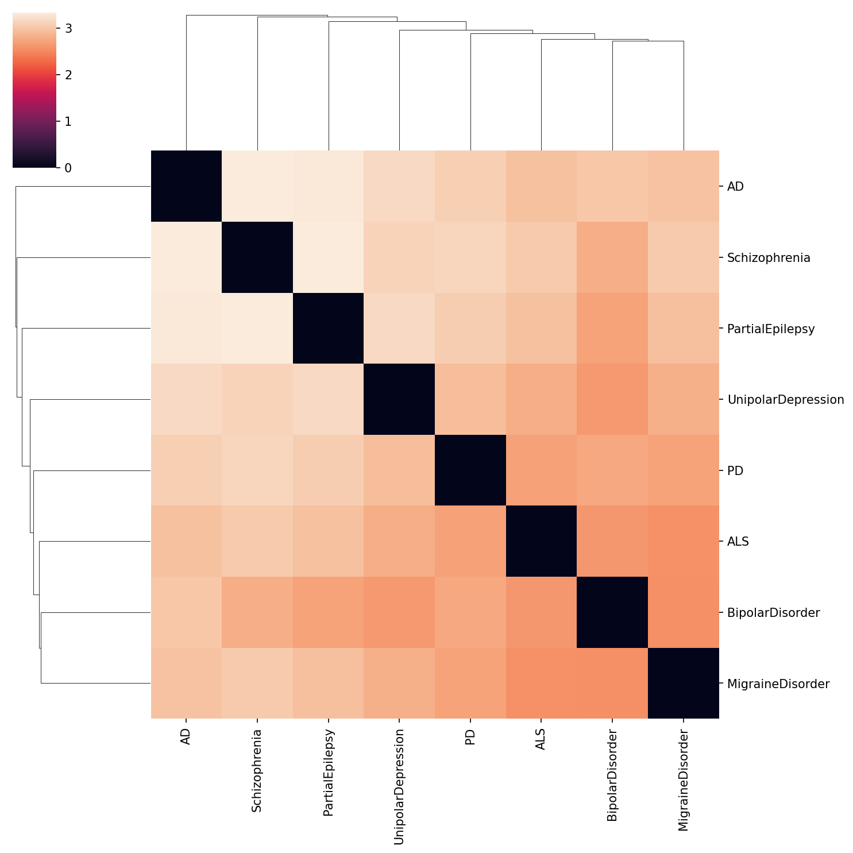

Slide 10
Next steps in this analysis
How conserved are these genes across species?

