Slide 1
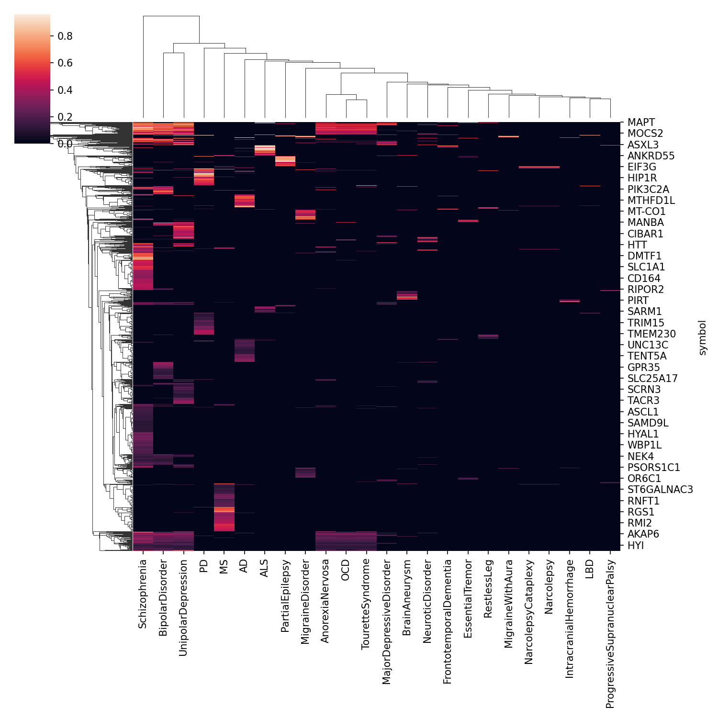
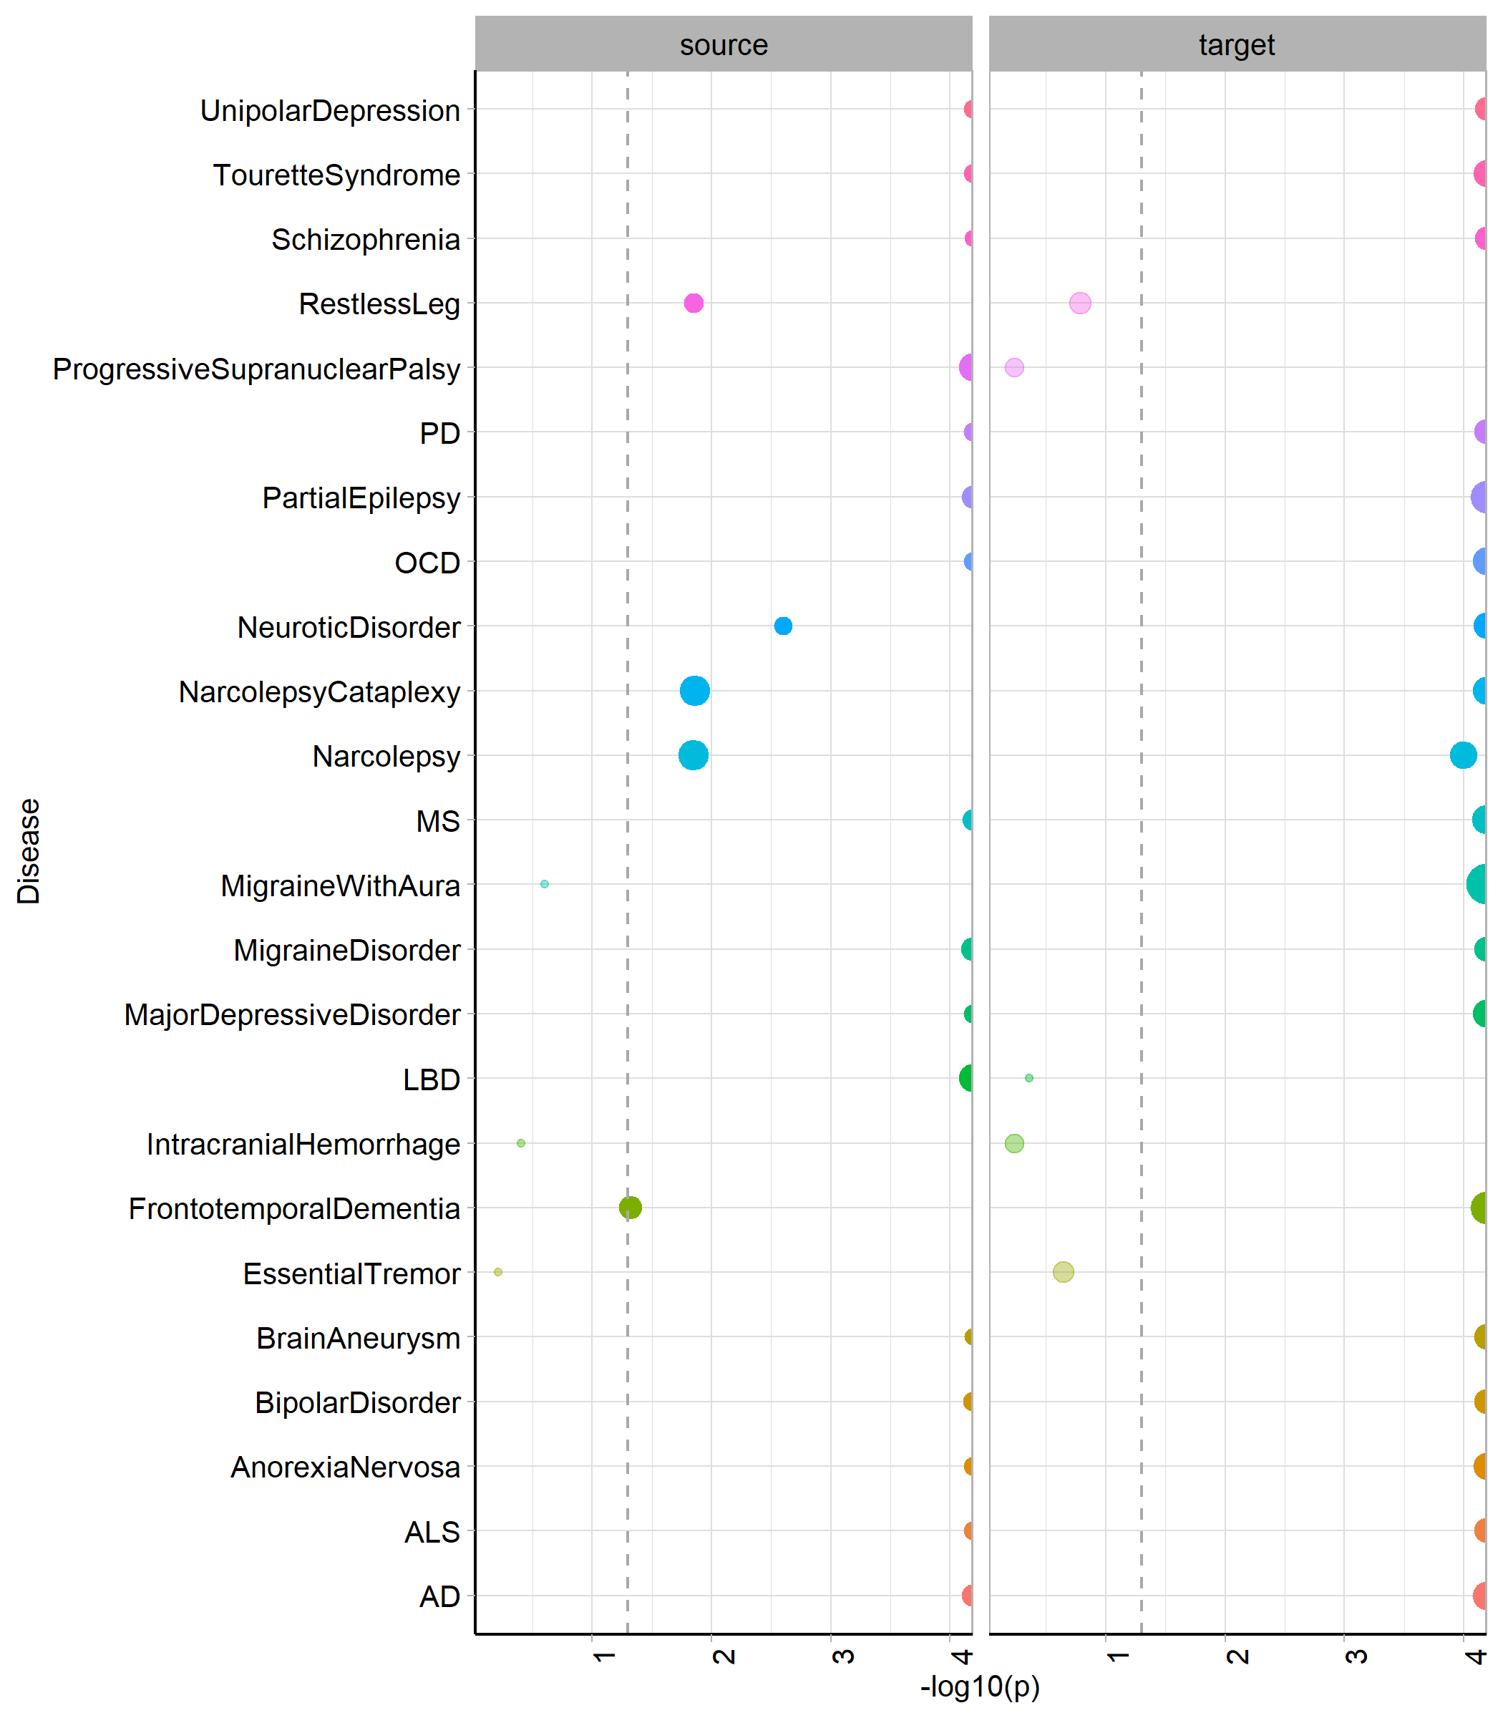
Notes:
Direct genetic risk overlaps do not account for similarity across neurological diseases. The only diseases with an overlapping gene hub are psychiatric diseases. For most diseases, ligand-receptor occurrence among risk genes is significantly higher than would be expected of datasets of this size, suggesting LR roles may underlie similarities across diseases.

Slide 2
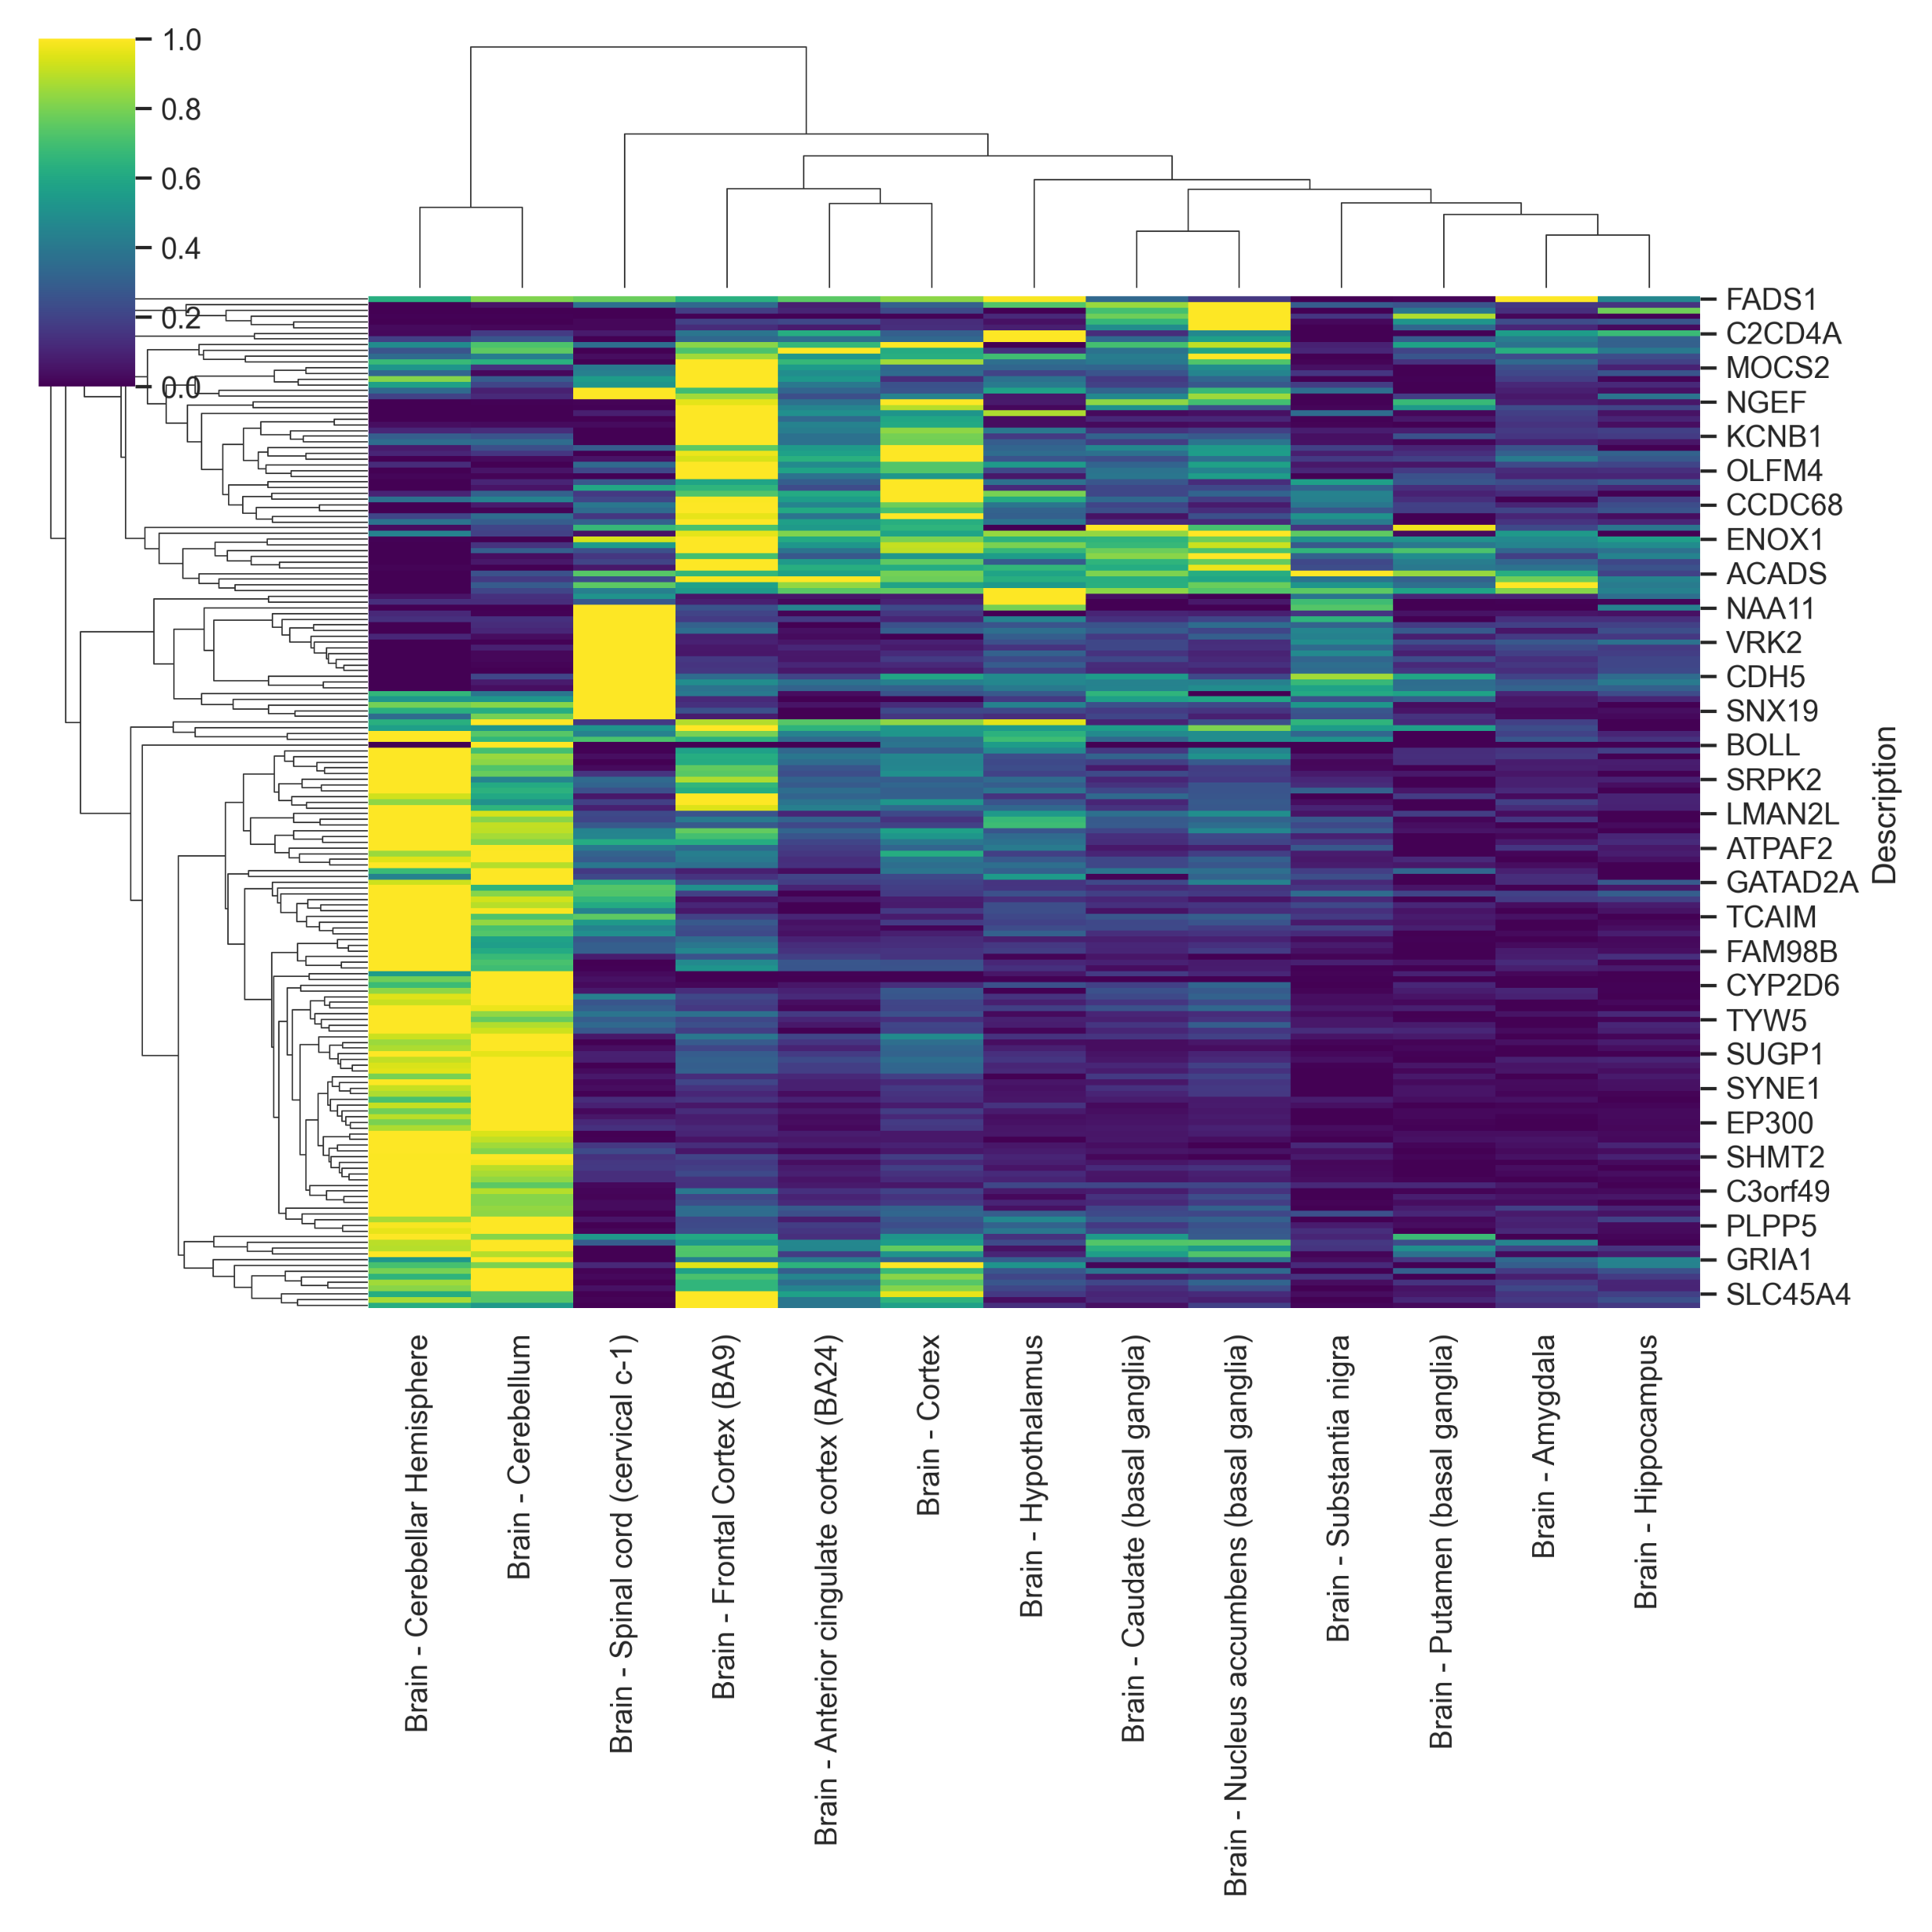
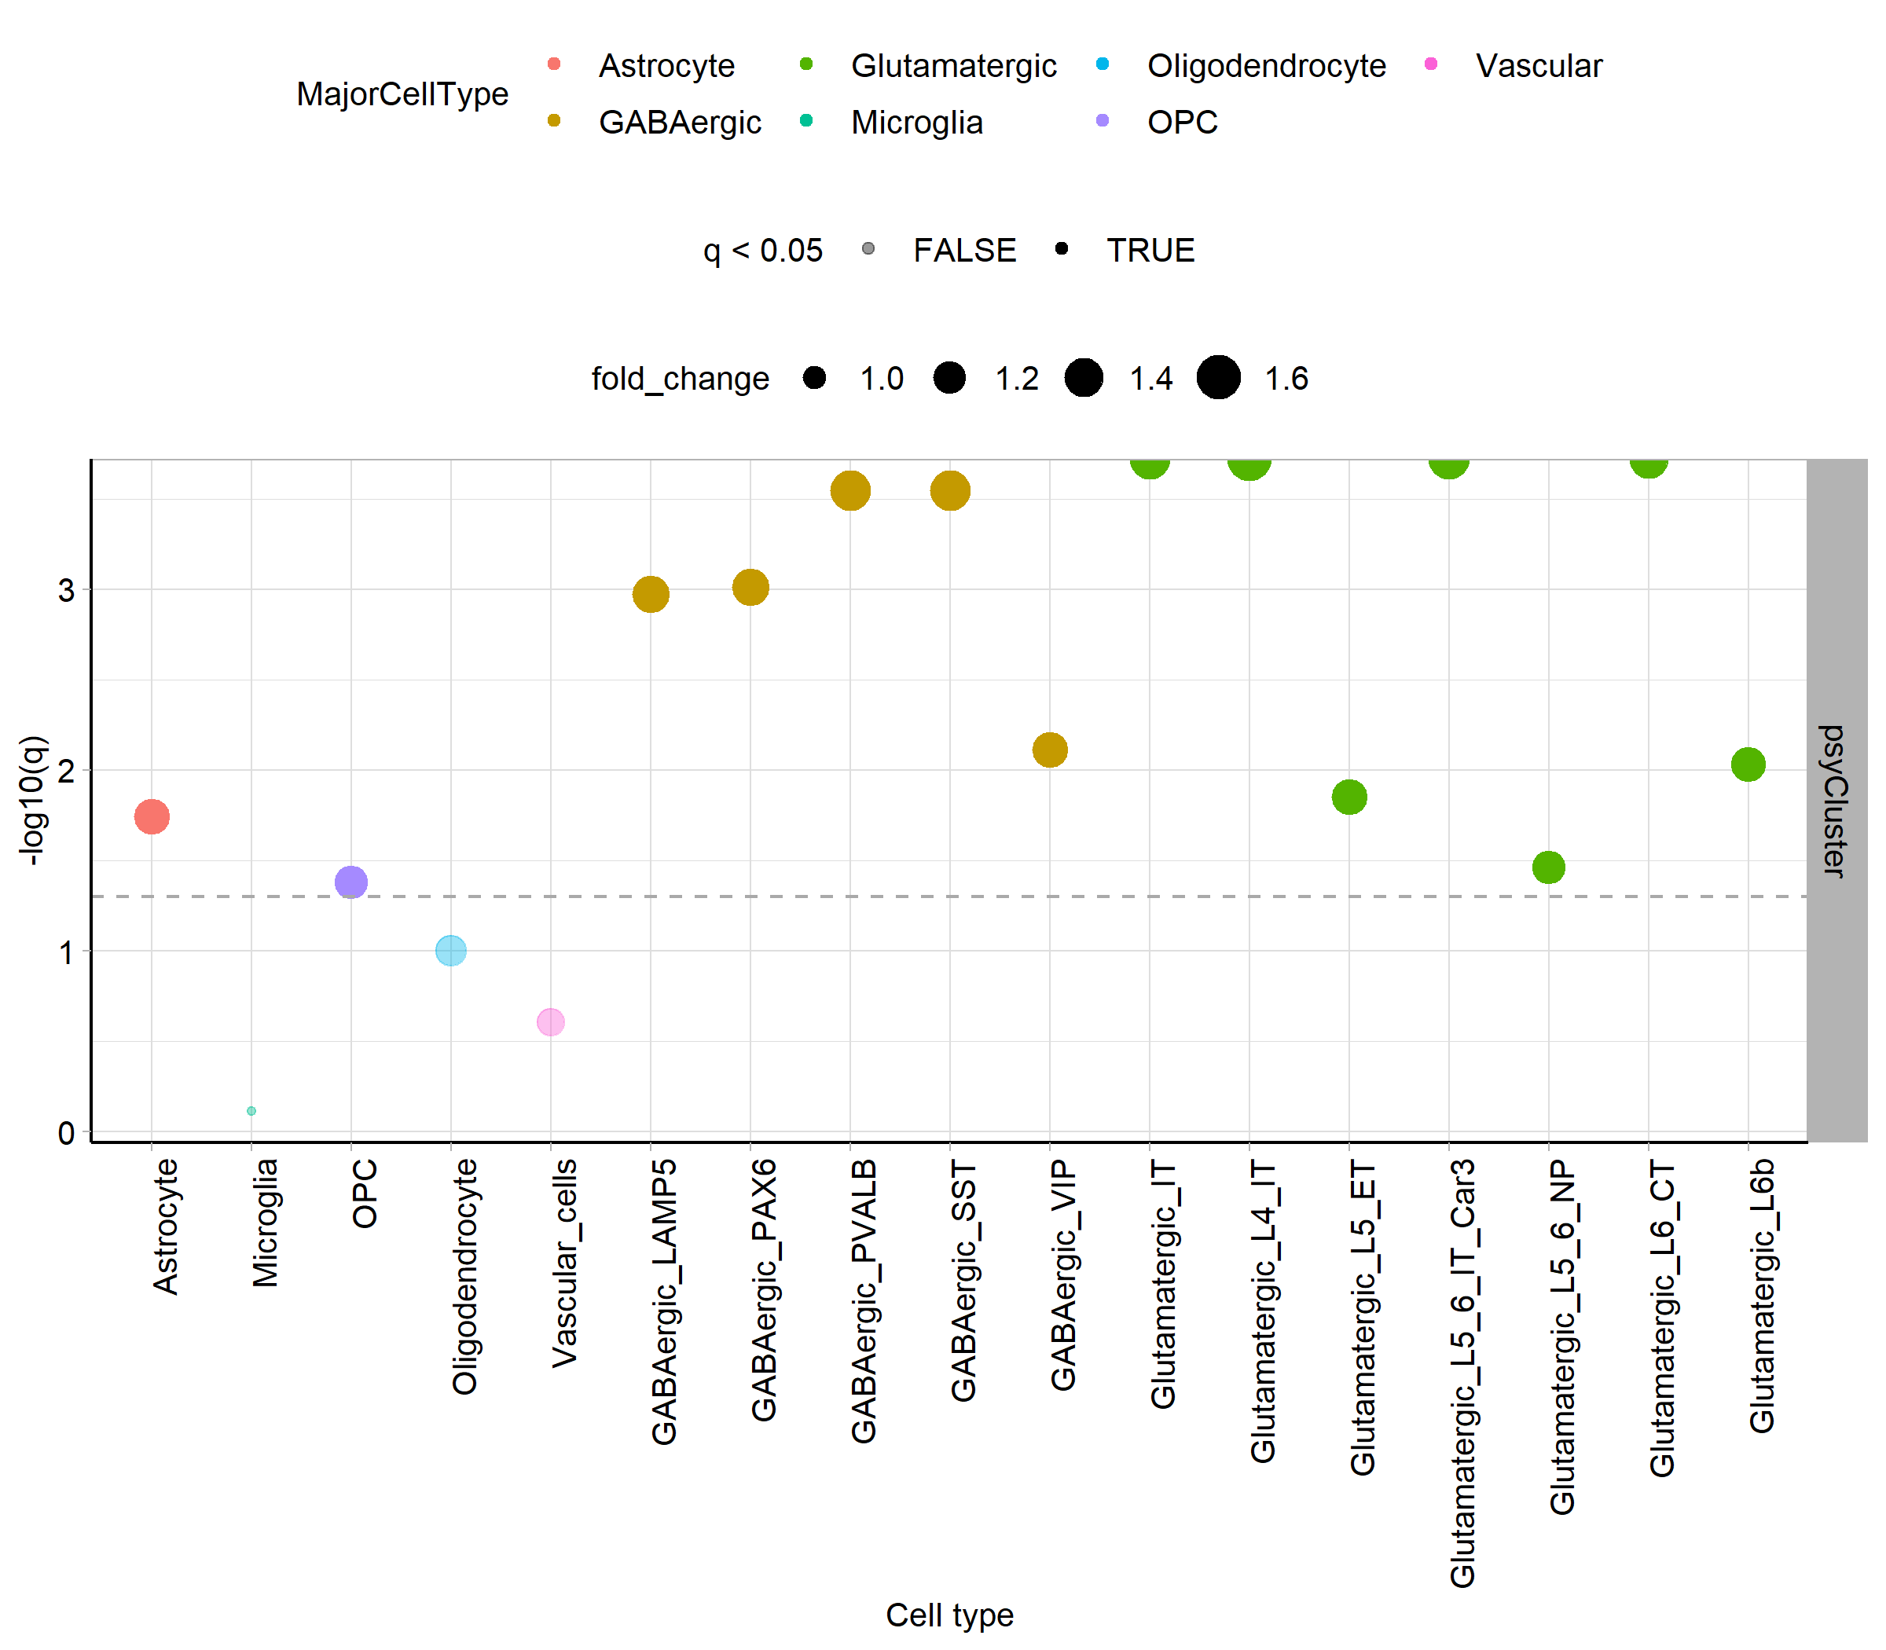
Notes:
The hub of genes associated with psychiatric disorders are predominantly present in neuron rich brain regions, such as the cerebellum. As would be expected, they were enriched to neurons and astrocytes. The spatial domains with highest scores for these genes were neuronal cortical layers, in particular cortical layer 6

Slide 3
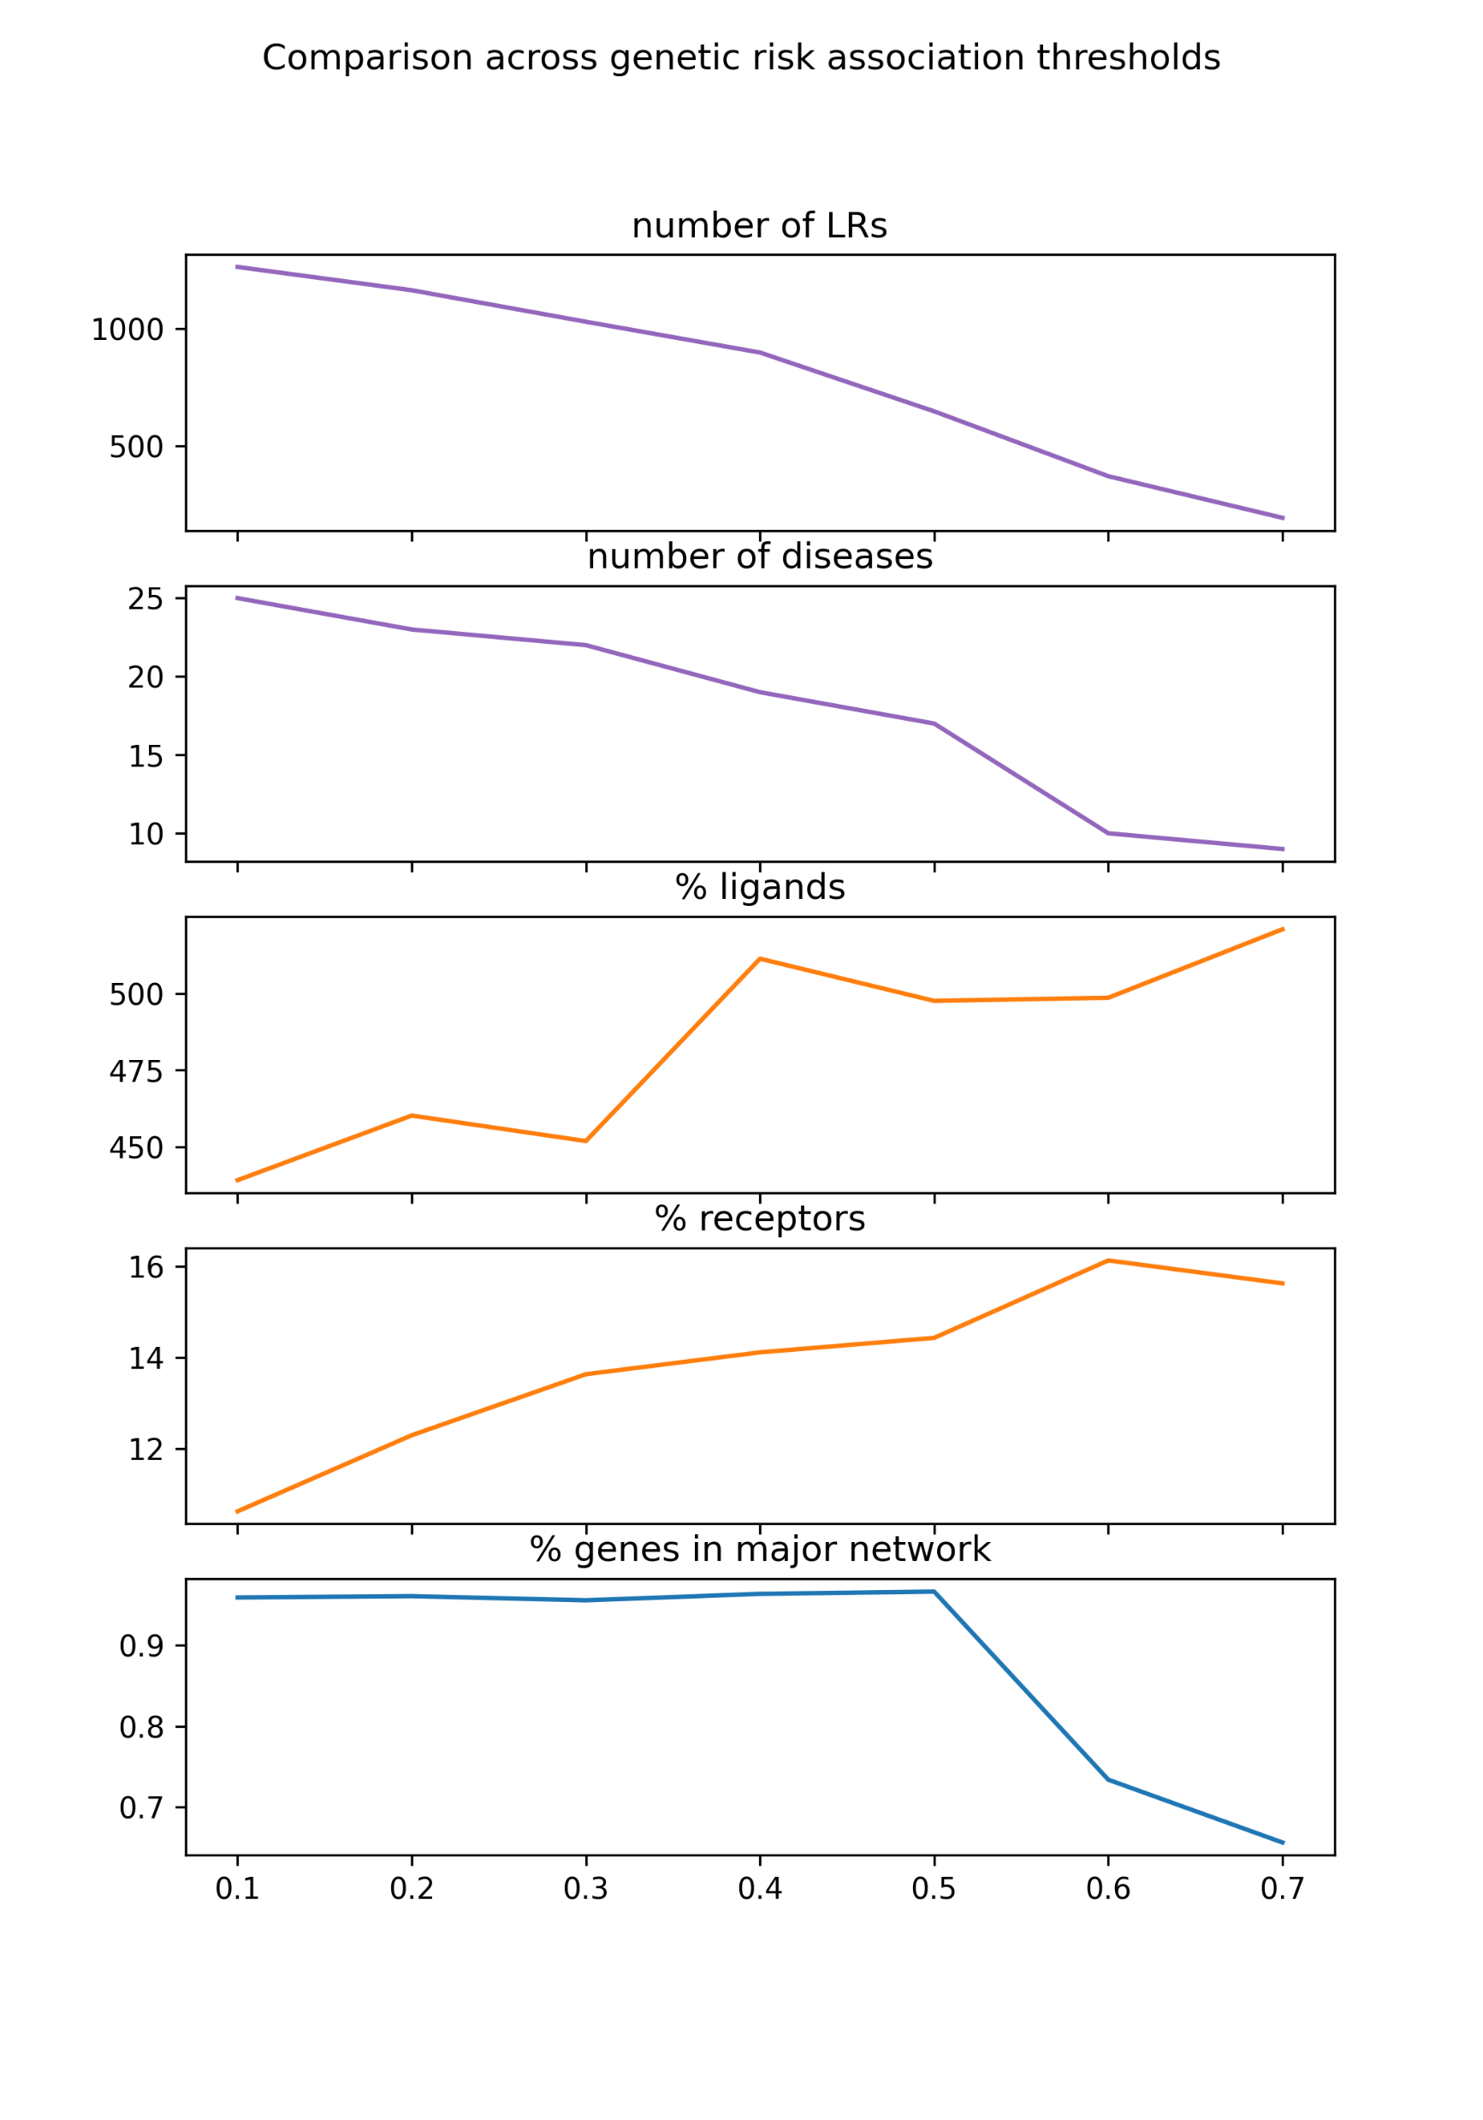
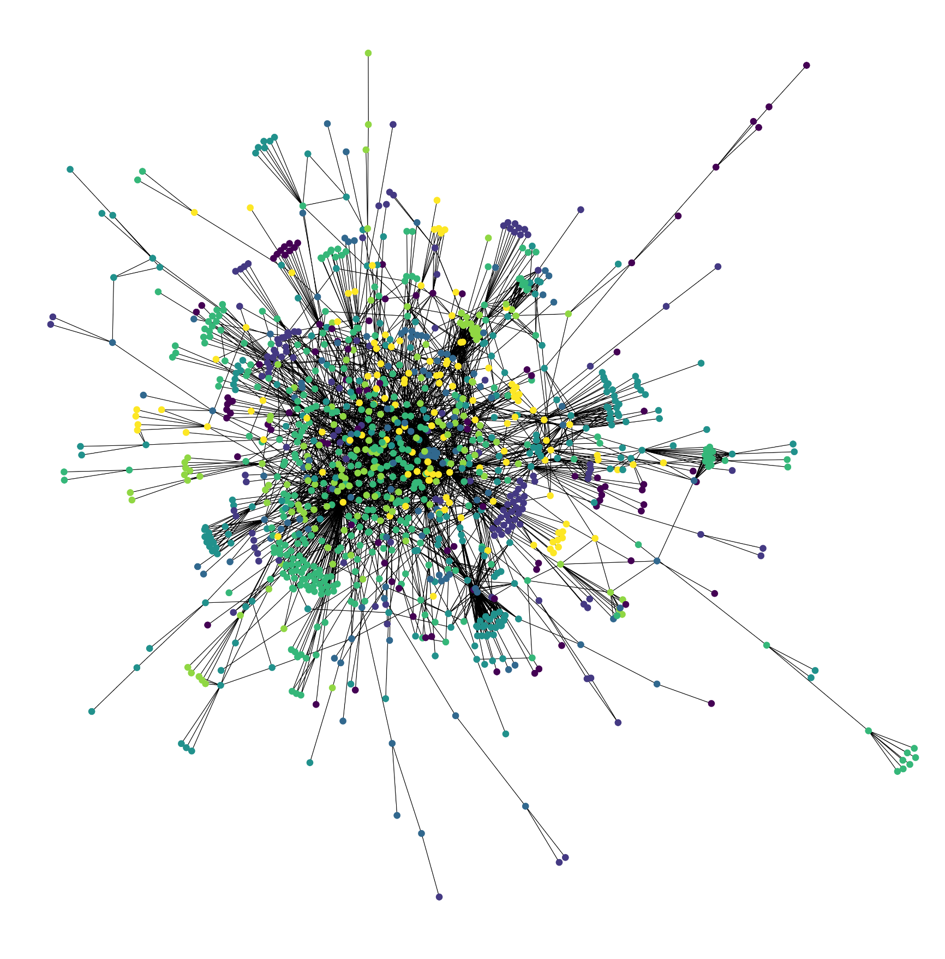
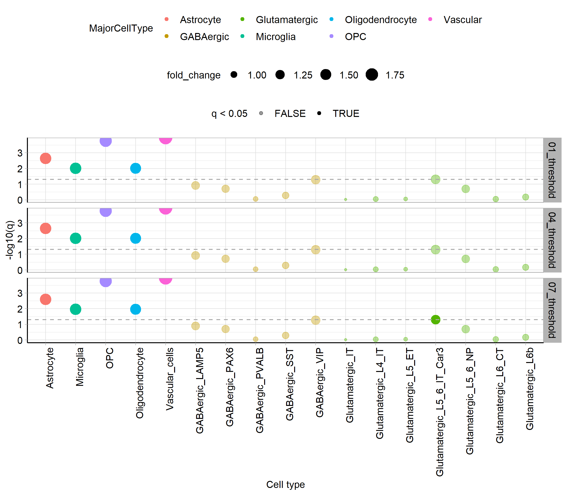
Notes:
We detected changes across the different thresholds and identified that ligand receptor occurrence increases with disease risk (meaning, disease genes are more likely to be ligands or receptors). Notably, the genes with highest risk tend to be expressed in non-neuronal cell types in the brain, such as OPCs, astrocytes, vascular cells and microglia.

Slide 4
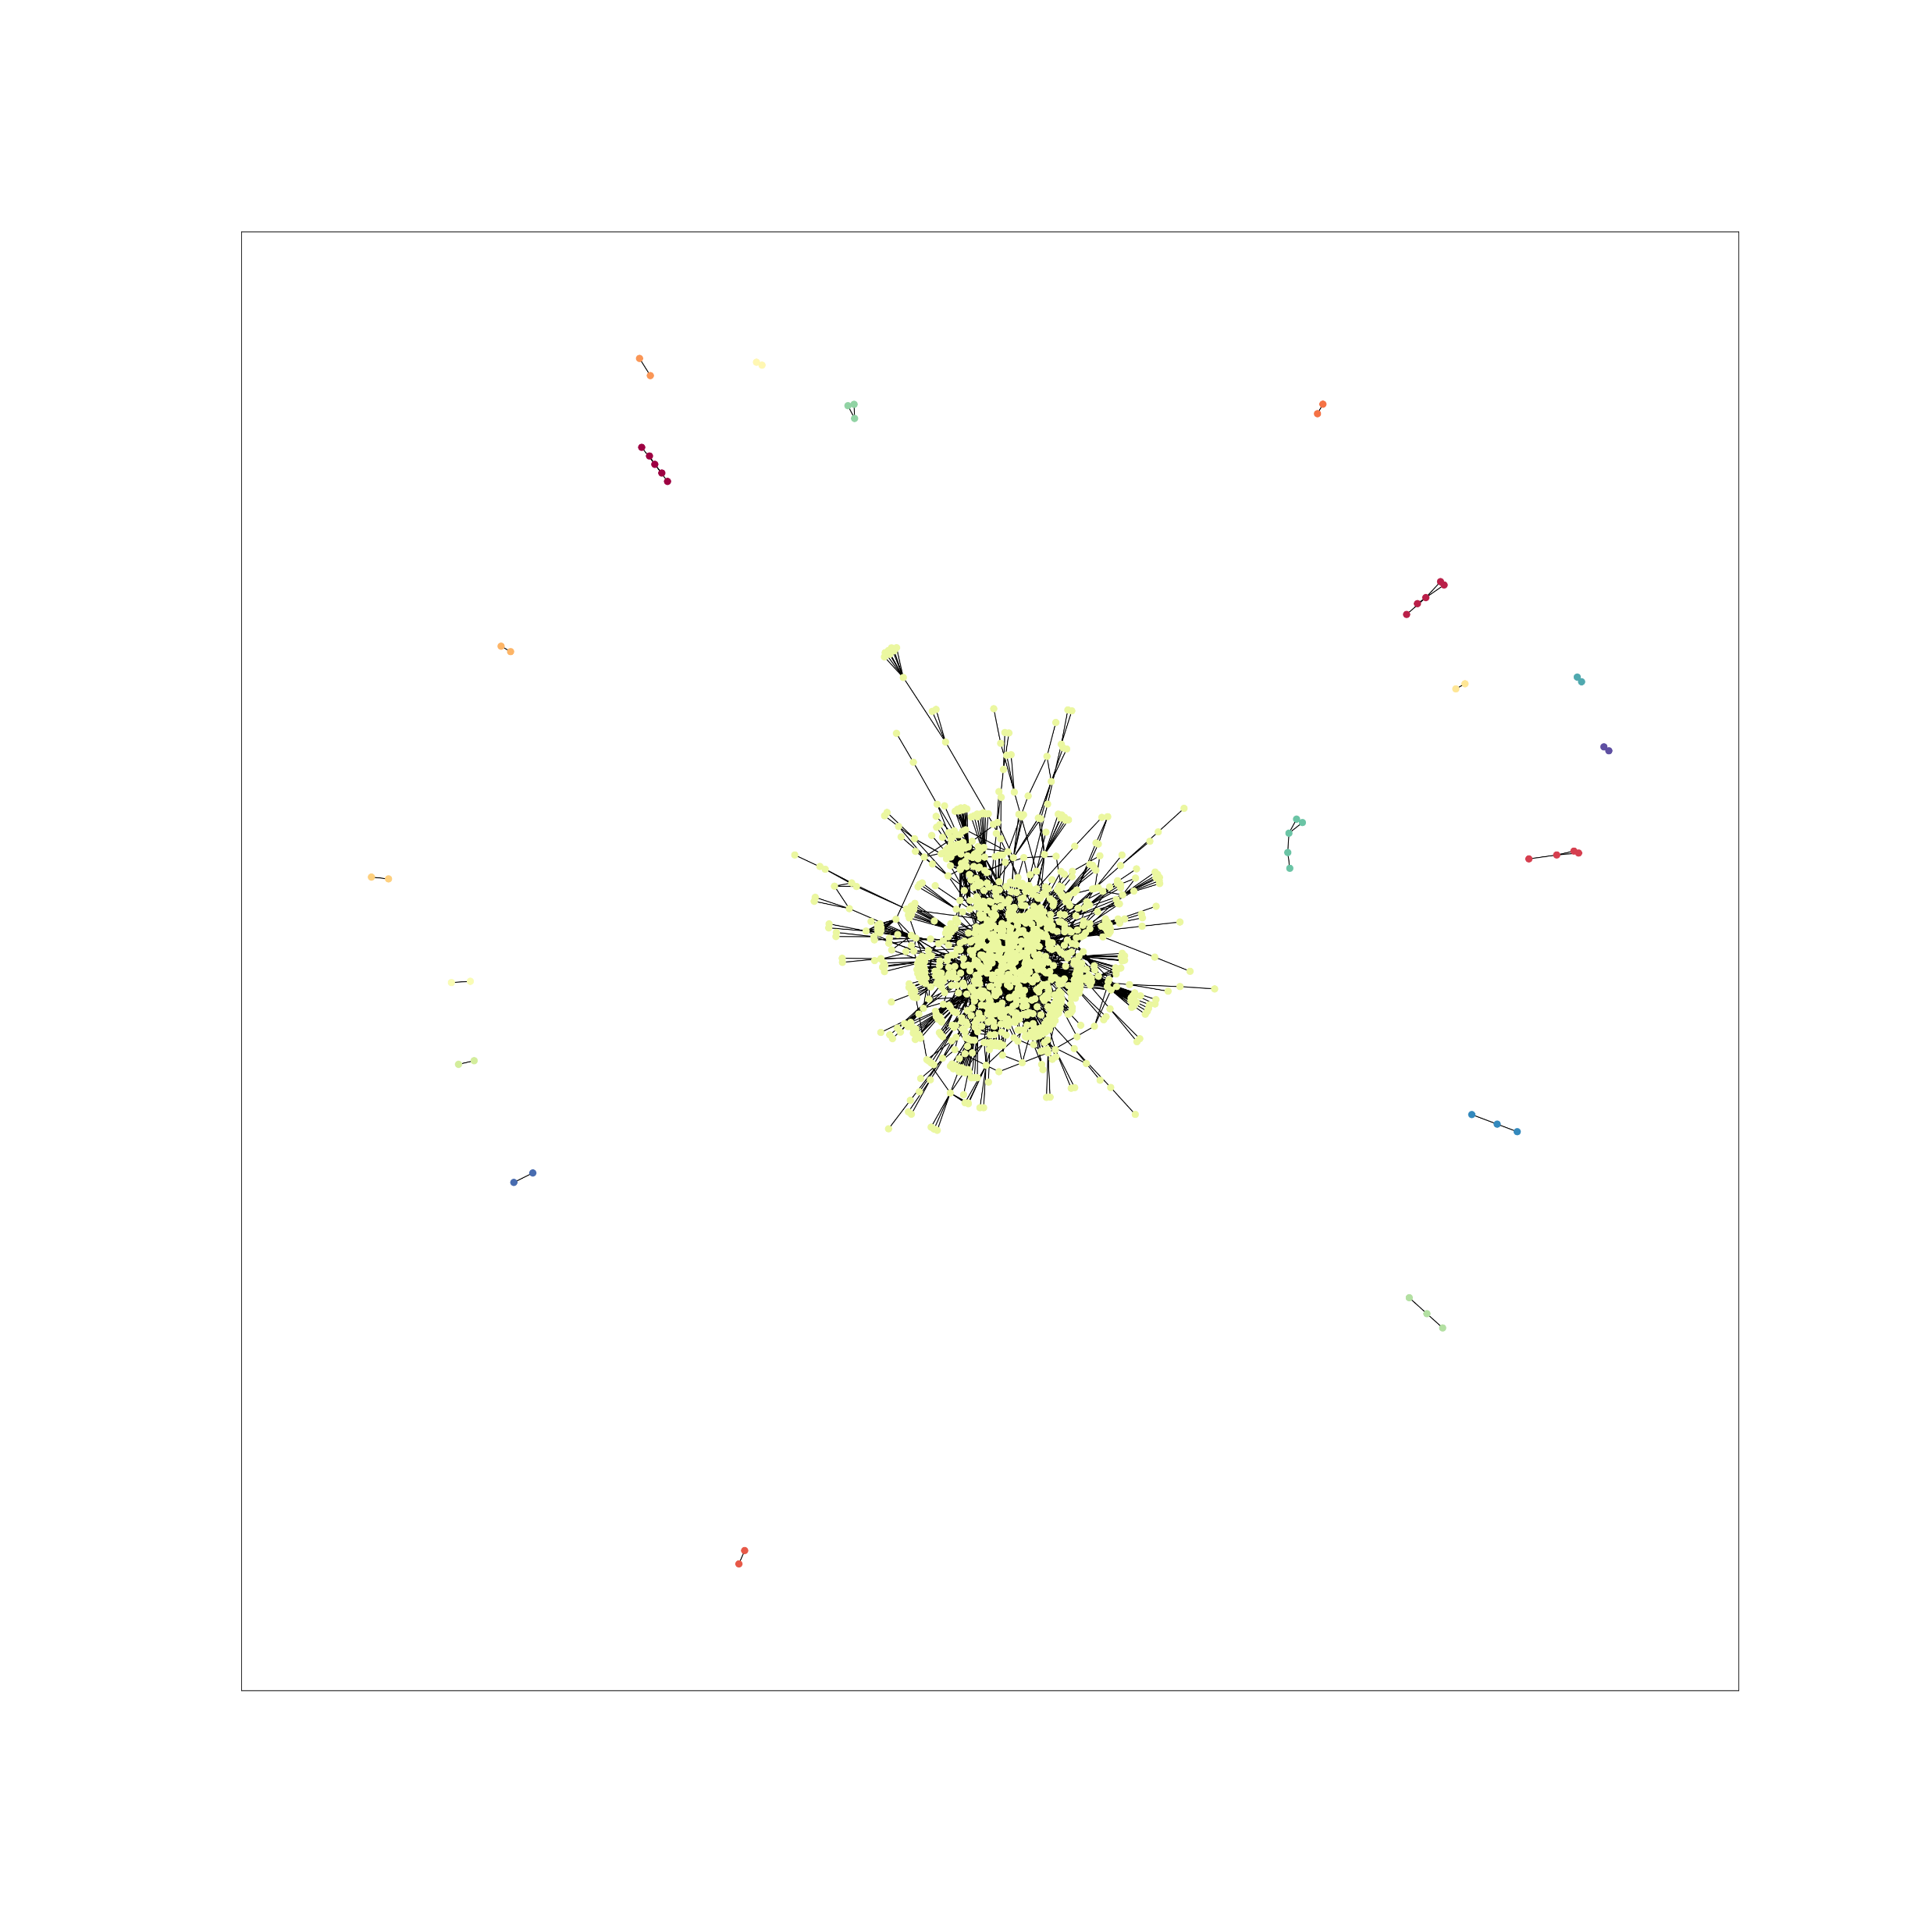
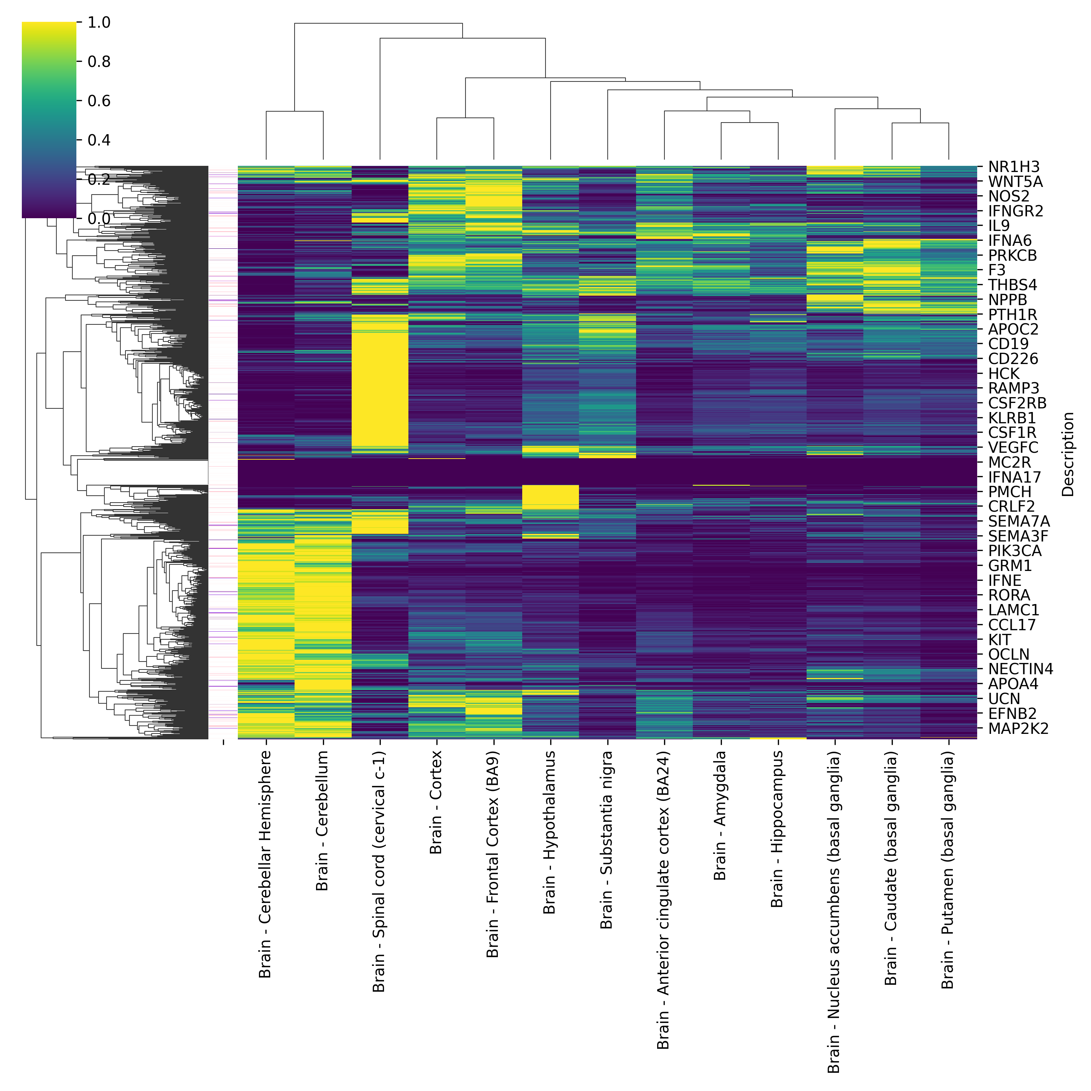
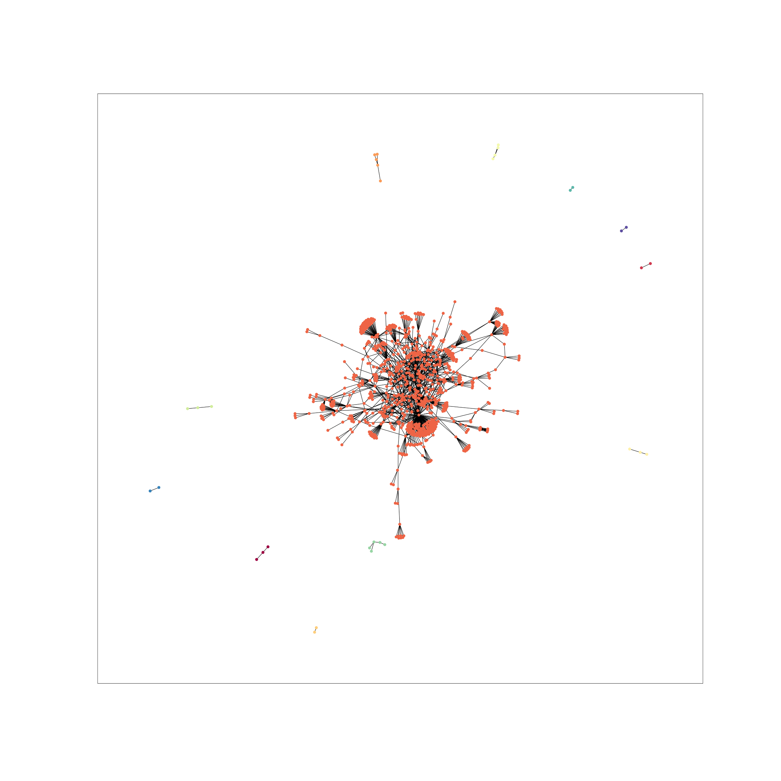
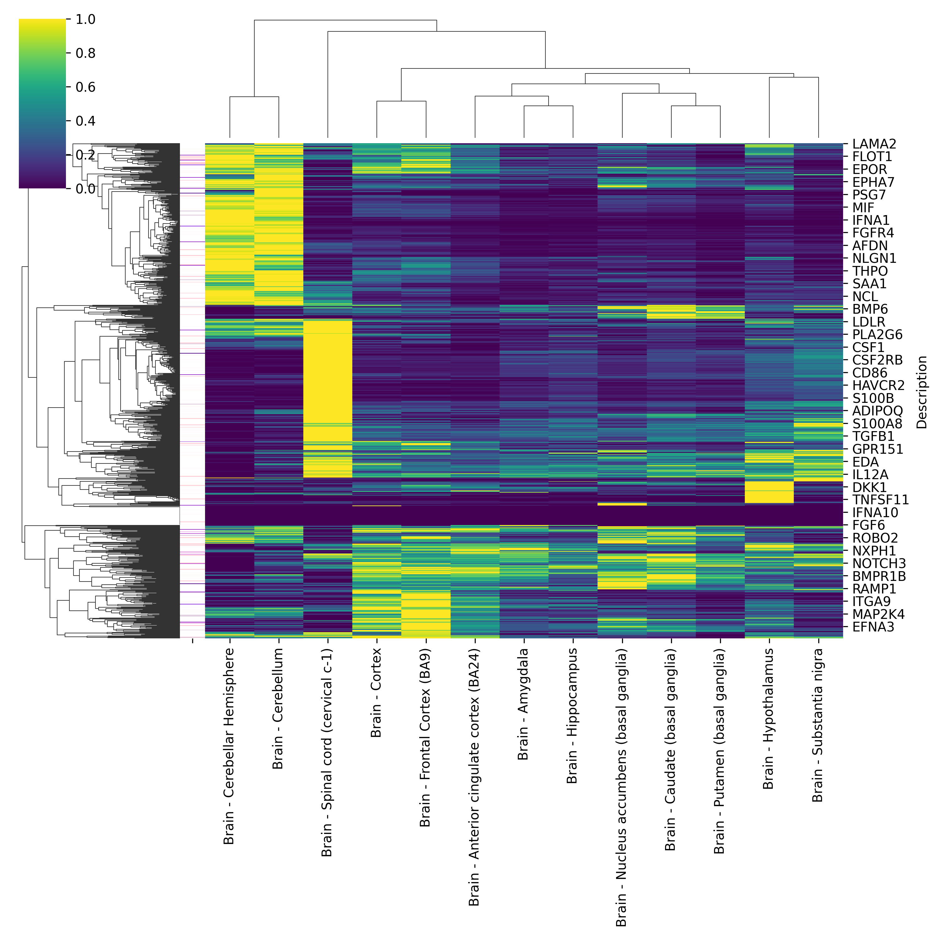
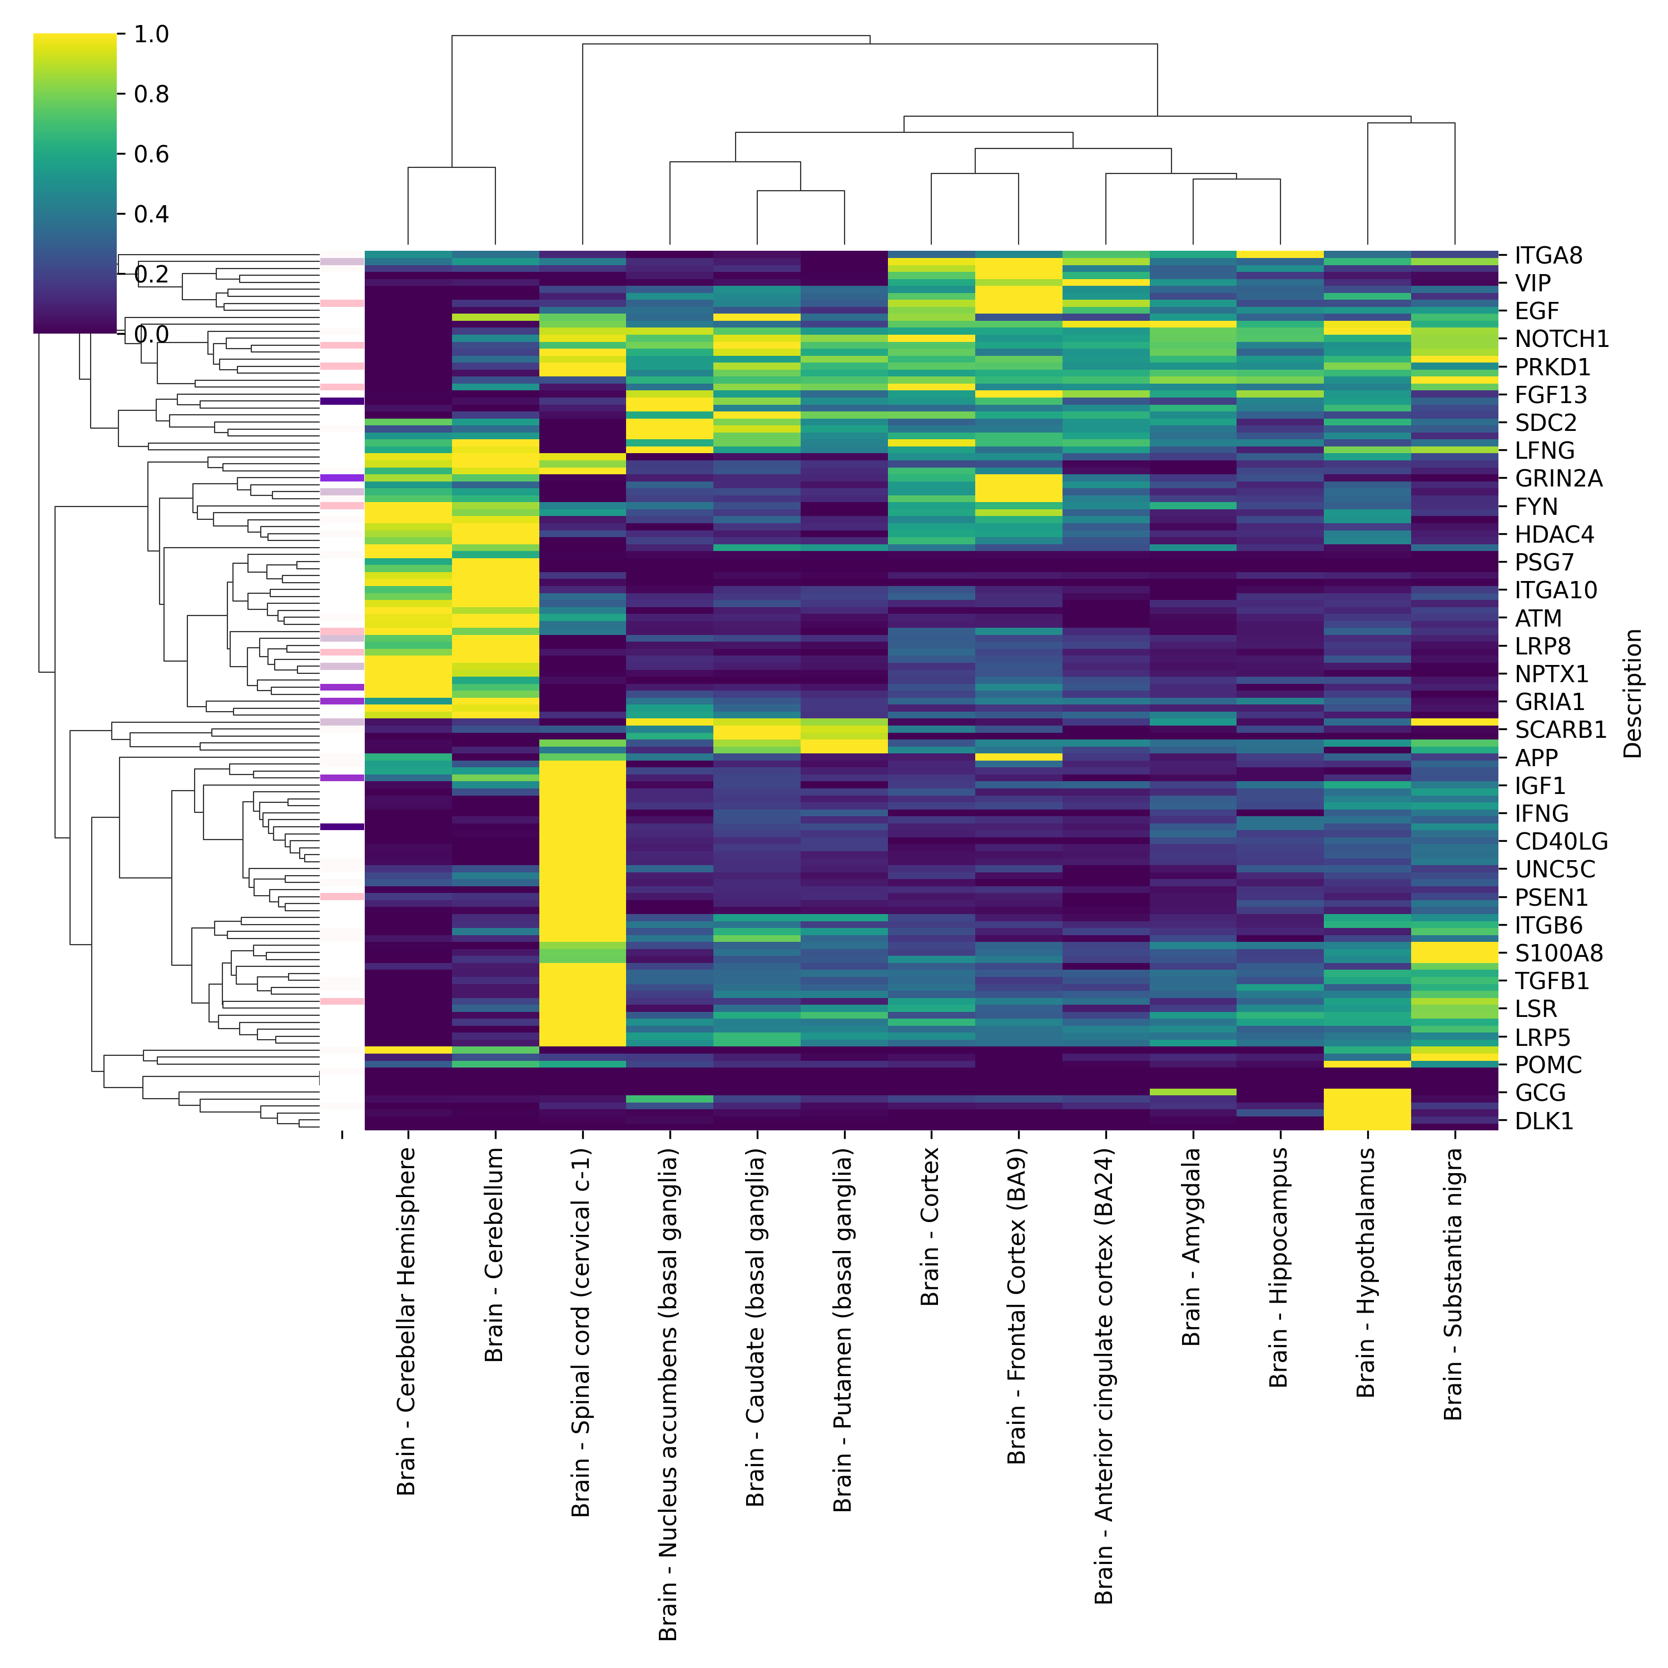
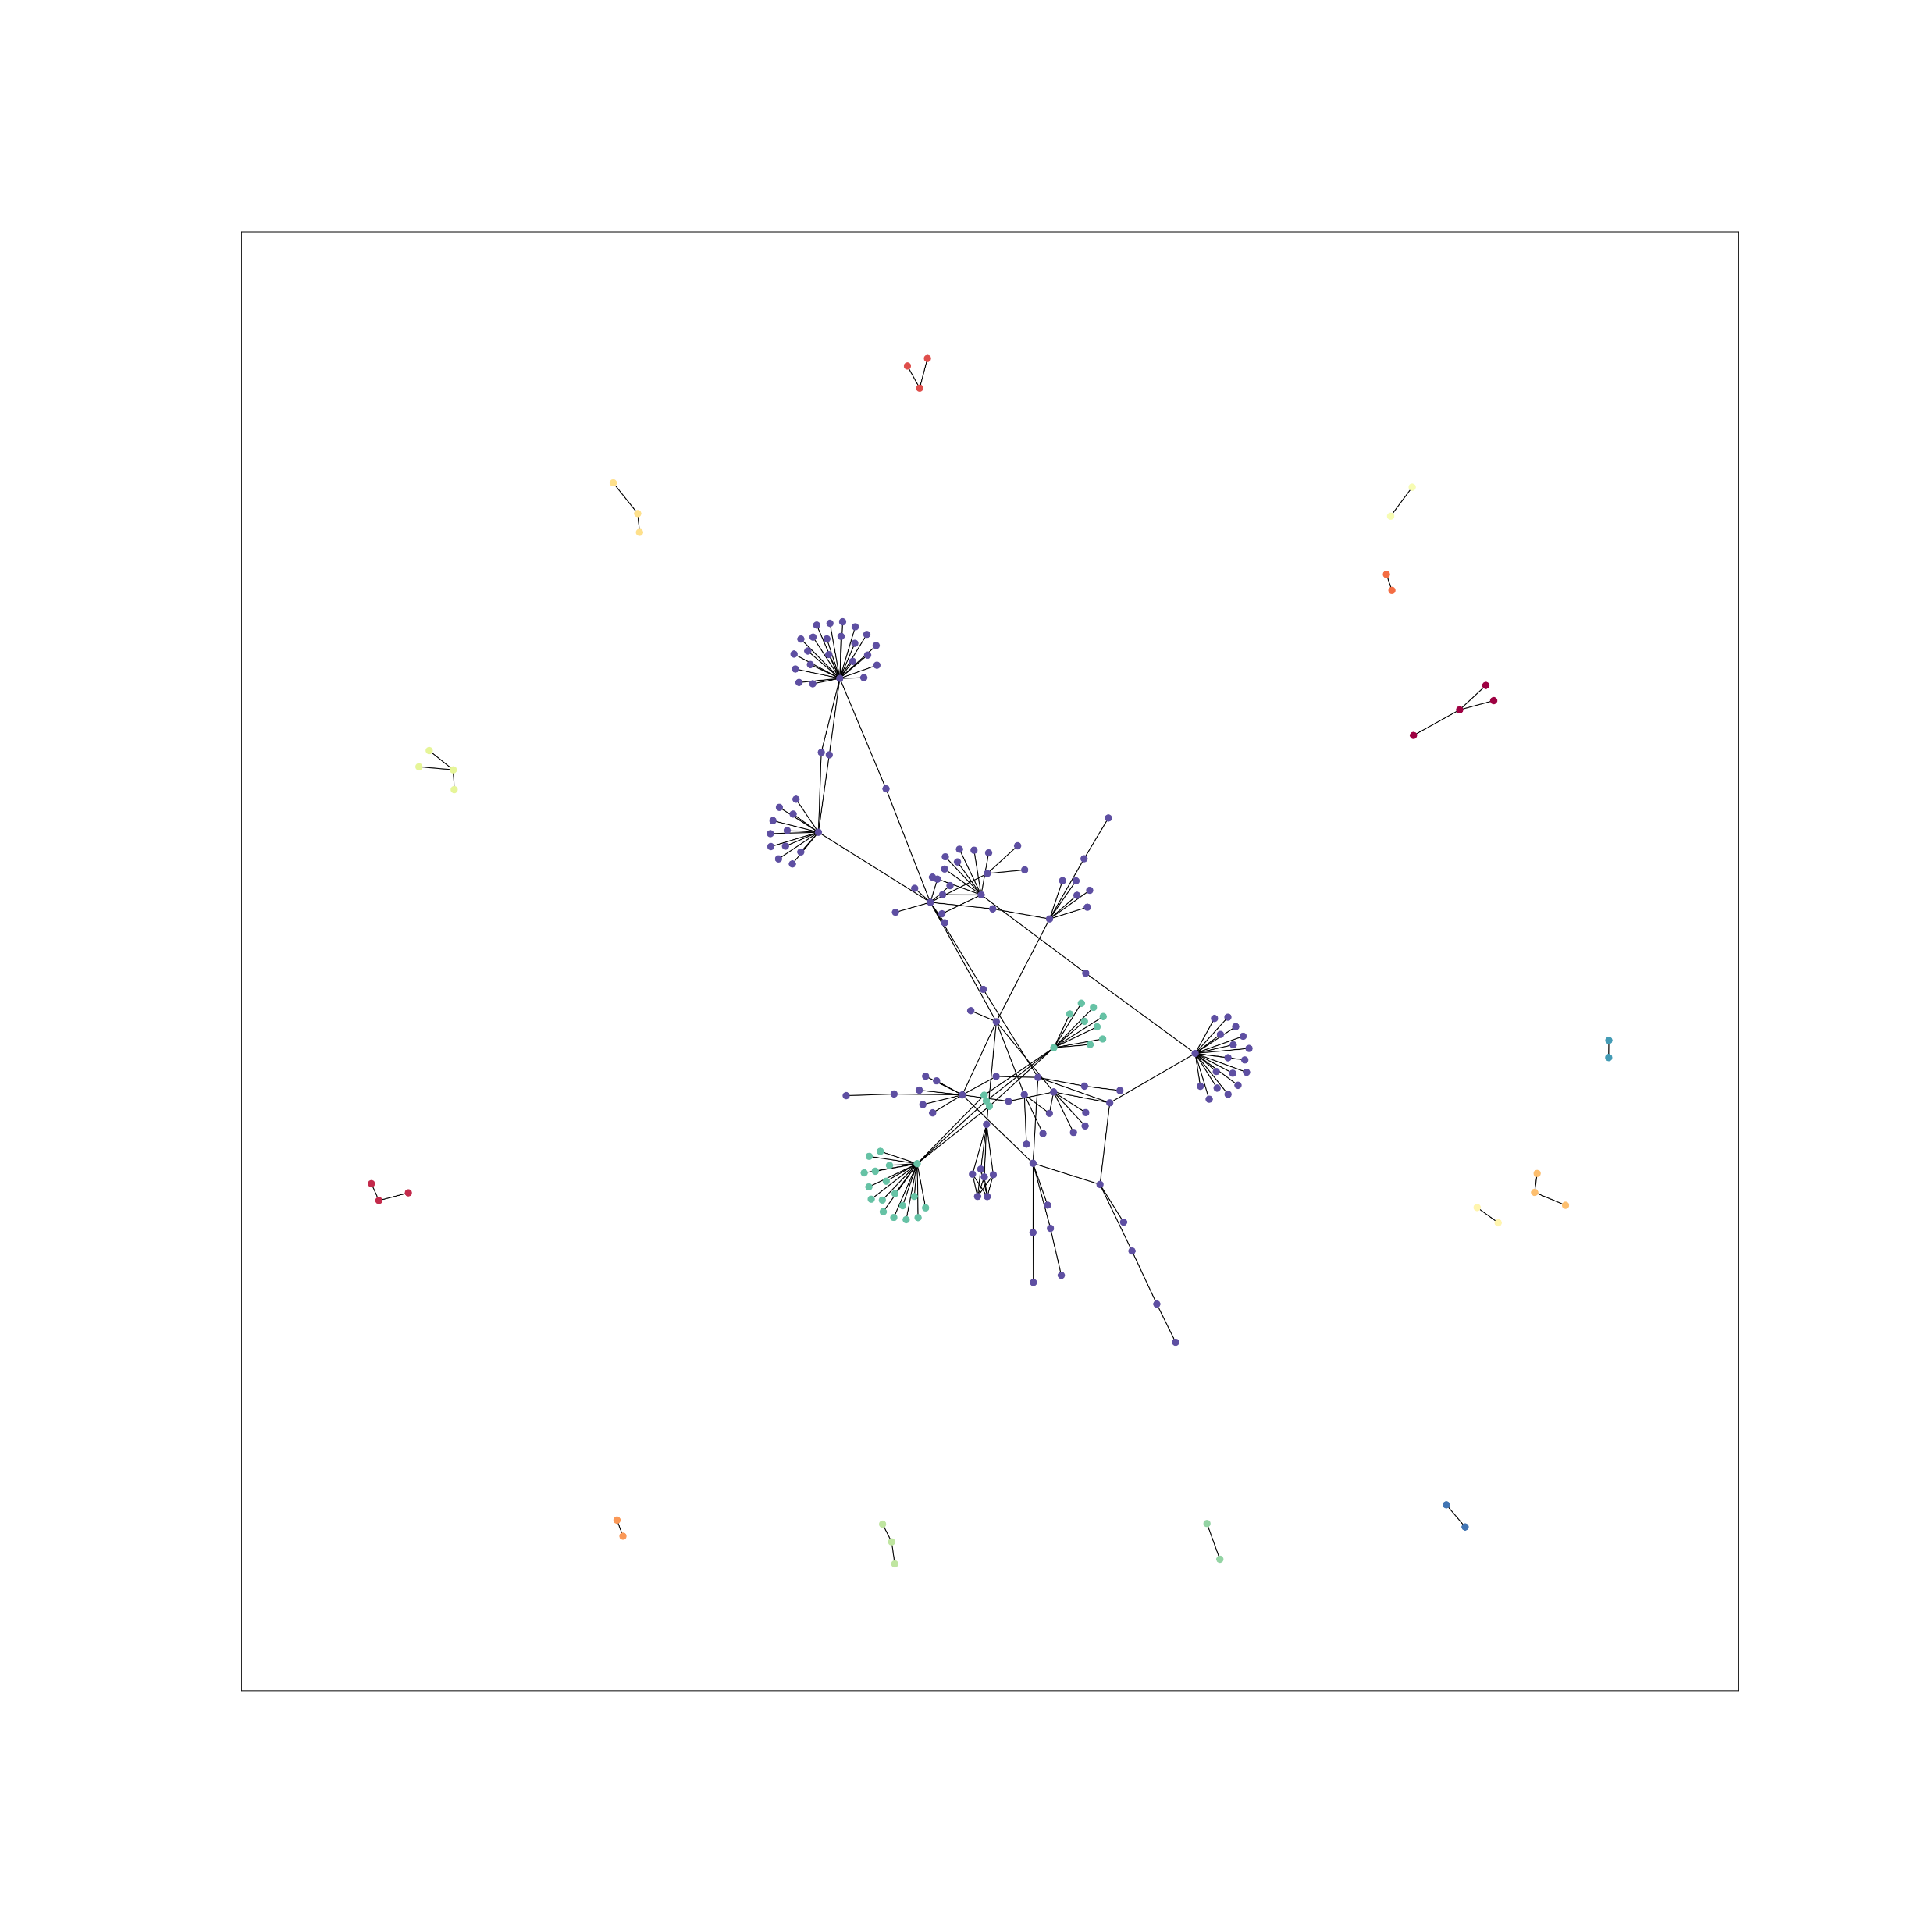
Notes:
A core major LR network was identified across the resolutions. This contains 95% of LRs for threshold 0.6 and lower. This connectivity is not significantly higher than for other LR lists of the same size. We found that for genes of higher associated risk, the networks were smaller than would be expected by chance – possibly indicating that hyper-connectivity of genes with mendelian disease risk is not compatible with life.

Slide 5
L1
L1
L2
L5
L3
WM
L6
L4
WM
Add here co-localization analysis
Notes:
We found that the spatial domains which scored highest were overall maintained across thresholds, with cortical layer 6 (spatial domain 7) being the highest scoring. Notably, when assessing the co-localization we identified that glial cell types tended to co-localize with Layer 5/6 neurons in the spots with highest (95th quantile) scores, suggesting that there is architectural relevance for the expression of these genes.

Slide 6
Next steps in this analysis
Which diseases are represented in the networks across thresholds?
What % of nodes correspond to each disease? (visualize as heatmap?)
How conserved are these genes across species?

