Slide 1
Finding Apartment in Chicago

Slide 2
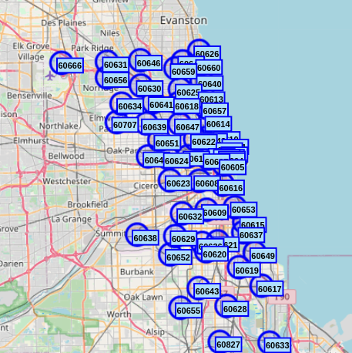
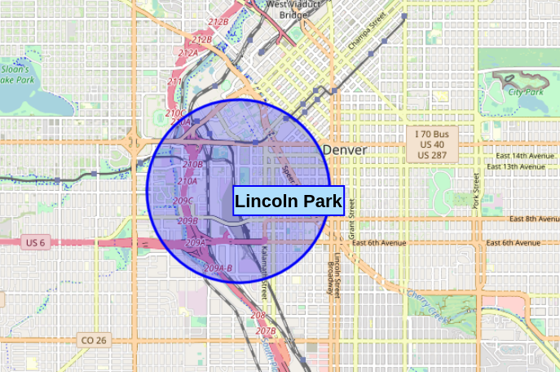
Moving from Denver, Colorado
Billy is moving from Denver to Chicago and wants to find an apartment in a neighborhood similar to his neighborhood in Denver

Slide 3
Data
Data for the project was collected from APIs and downloaded form the internet.
Geo-location coordinates (Latitude & Longitude): Geocoder
Popular venues: Foursquare
Chicago Postal Codes & Population/Postal Code “Chicago Population Counts“ https://data.cityofchicago.org/Health-Human-Services/Chicago-Population-Counts/85cm-7uqa
Chicago Crime 2019 “Crimes – 2019” https://data.cityofchicago.org/Public-Safety/Crimes-2019/w98m-zvie

Slide 4
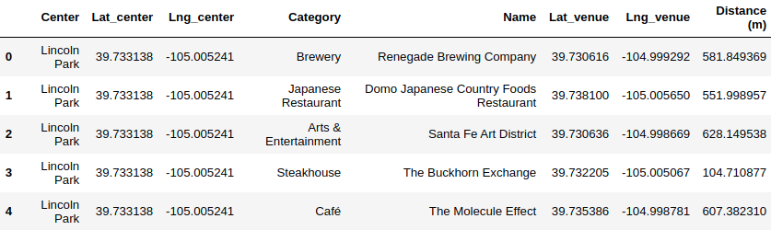
Data Cleaning
Venue dataframe with location name, location coordinates, venue, venue location, and distance from venue to location

Slide 5
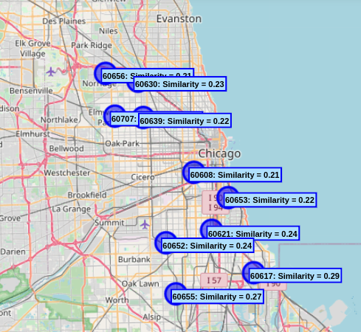
Linear Regression
Create model using Linear Regression, then use model to predict venues around each location in Chicago.

Slide 6
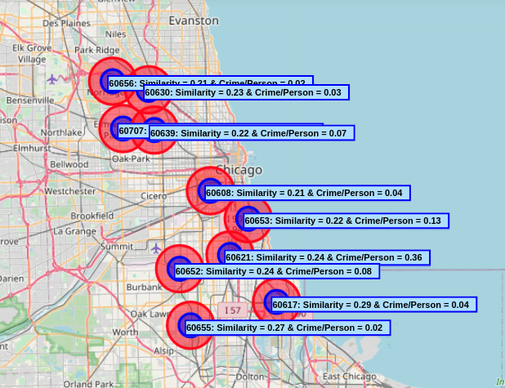
Compare Results
Adding crime/population to find save location for new apartment

Slide 7
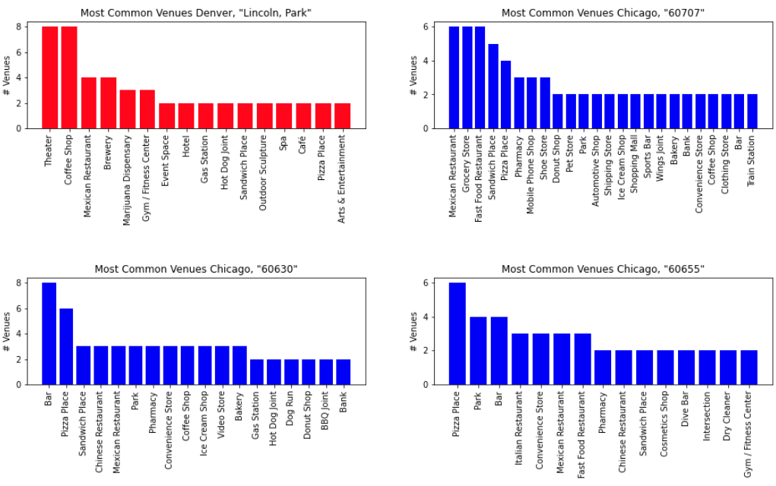
Compare Results
Venues in Denver and 3 top locations in Chicago

Slide 8
Conclusion
In the analysis it is shown that the northwest area of Chicago is the most similar to Lincoln Park, Denver, Colorado. In future analysis could be improved by analyzing the Chicago neighborhood in more detail. For example, the analysis could include traffic, property prices, education, ect. However, for this project I got to see how machine learning can be used to solve a real-world problem.

