Slide 1


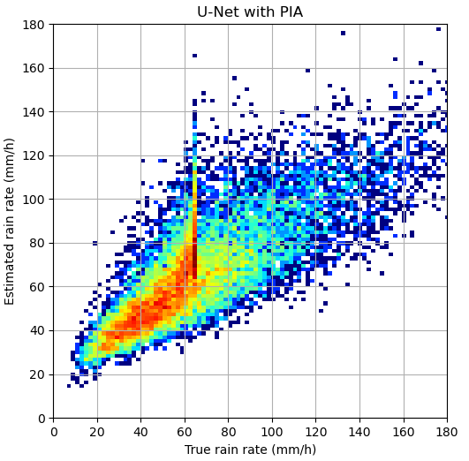
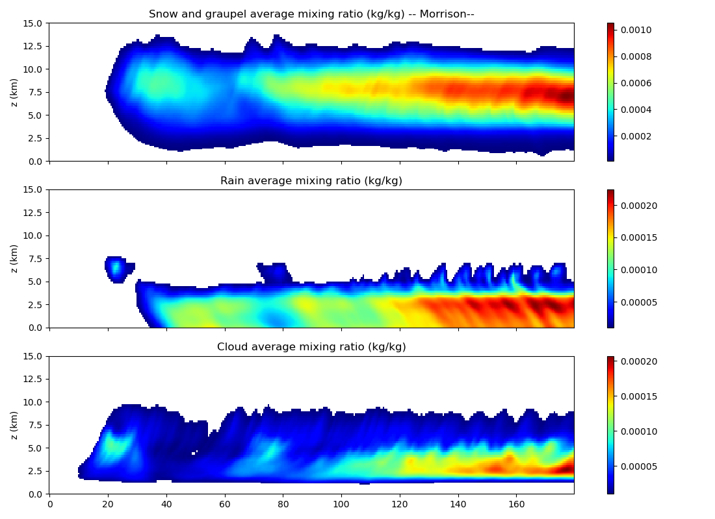
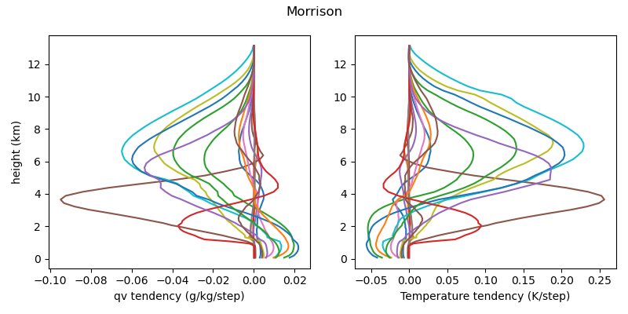
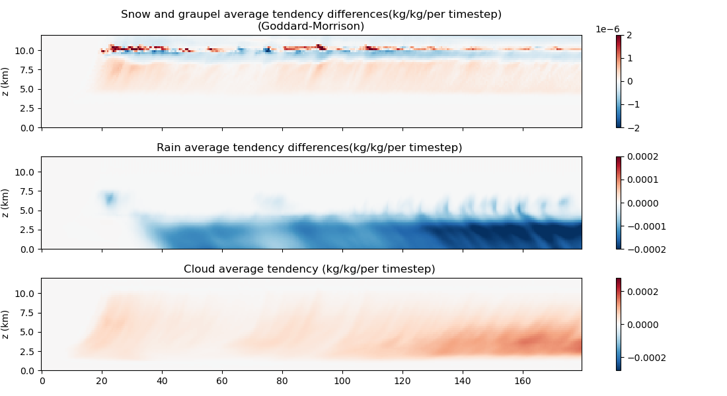
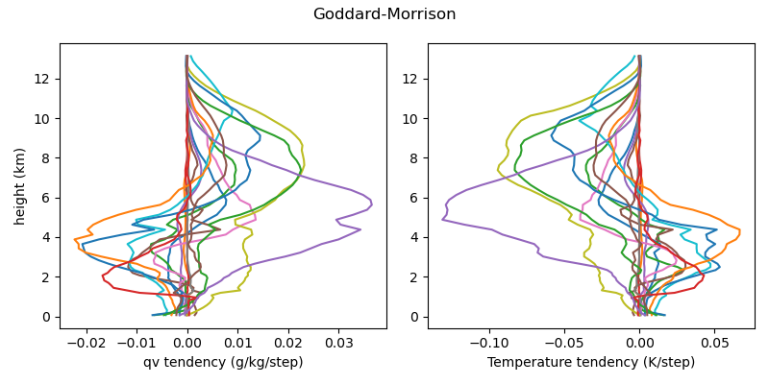
Toward a Framework for Earth System Digital Twins with Machine-Learned Microphysics Parameterizations
Mircea Grecu^{1,2} Xiaowen Li¹ Michael Rilee³, Michael Bauer³ and Kwo-Sen Kuo^{4,2}
Morgan State University, (2) NASA Goddard Space Flight Center, (3) Bayesics, LC, and (4) University of Maryland, College Park
Introduction
Methodology
Results
The accurate representation of of microphysical processes is of paramount importance in the development of Earth System Digital Twins (ESDTs).
Highly complex microphysical parameterizations exist that explicitly account for the interaction among precipitation particles, but they are computationally expensive, which significantly reduce their applicability.
Bulk microphysical schemes are significantly more efficient, but sensitive to a myriad of parameters difficult to optimally tune.
In this study, we investigate a Machine Learning (ML) methodology to develop a hybrid parameterization that will enable a bulk microphysical scheme perform as a more complex one.
Assuming smaller ice particles improves the agreement between simulated and observed Ka-reflectivity in convective cores.
However, the retrieved profiles exhibit artifacts (discontinuities of retrieved properties across the mixed layer) that need to be address.
Observations are clustered based on their similarity in the Euclidean space and generic estimates are derived for the most challenging classes.
The generic estimates do not exhibit artifacts and closely fit the average class observations.
A perturbation methodology is used to derive a large set of profiles, and the associated radar and radiometer observations are calculated.
A ML model based on a U-NET architecture is trained and used to investigate:
The existence of a physical solution consistent with the current PSD and scattering lookup tables;
The impact of NUBF on retrievals;
The sensitivity of retrievals to observations below the FL.
While noisy, results confirm that the estimation problem is ill-posed (susceptible to multiple solutions).
Results are significantly worse when the PIA information is not included.
PIA is currently included through an MLP model that maps the SRT estimates into another radar channel.
Results may be improved through a larger dataset training and possibly other architectures, but the fundamental problem remains as the footprint variability is hard to estimate
Conclusions
Better assumptions regarding the “a priori” ice PSD have been identified and are being implemented into the GPM combined algorithm.
The updates are expected to result in more accurate snowfall estimates (and preliminary results confirm the expectations).
Progress is possible in the estimation of both the solid and liquid precipitation fluxes in convection, but the problem is ill-posed.

