Slide 1
how to give a good talk
michael greenberg
plmw @ popl
2025-01-21 denver, co
Notes:
Click to add Notes

Slide 2
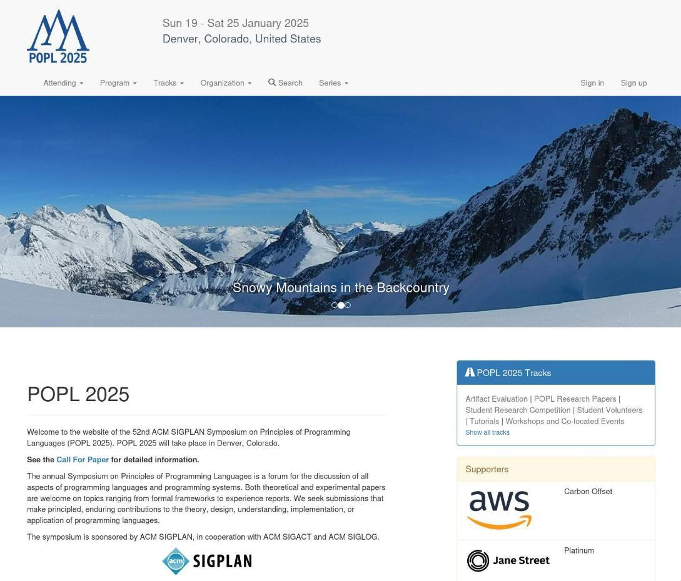
Notes:
welcome to POPL!
who in this room has read a POPL paper?
it is exciting to be at POPL. but I have a weird question. you’ve all been able to read POPL papers already… why do we have talks? the papers are available before the conference

Slide 3
👀
Notes:
why do we have talks at conferences?
can’t people just read the paper?
talks are about capturing attention

Slide 4

too many MCs, not enough mics
exit your show like i exit the turnpike
-- Pras Michél in “How Many Mics”
Notes:
In the words of federal convict and fellow Columbia High School student, Pras...
Giving a talk is an opportunity to get people to care about your work.
People care about things that are _valuable_ to them. How is your work valuable?
Your talk _must_ communicate why it's valuable! If it doesn't, people won't care.

Slide 5
🗣inform📰
🧠educate🧑‍🏫
😂entertain🎭
Notes:
A good talk will:
- Inform (advertise)
- Educate
- Entertain
I'm going to start by discussing what it means to inform, to educate, to entertain.
Along the way, I’ll give a couple of rules that I think good talks (mostly) follow.
I'll conclude by talking a bit about technology and more substantially about value.

Slide 6
🗣inform📰
Notes:
a talk is an advertisement
You have done something.
For people to care about it, they must first know about it.

Slide 7
🌕 🗺≠🌎
Notes:
"Pointing at the moon is not the moon"; "the map is not the territory".
There are two reasons you cannot simply tell people everything about your work.

Slide 8
⌛
Notes:
First, you do not have time. Your conference paper is 20pp, more than 15k words. You have 20min. No.

Slide 9
🤷
Notes:
Second, people do not care. How could they? They do not know what you've done.

Slide 10
rule #1 motivation first
Notes:
so, our first rule.
you must explain very early on what the value proposition is.
why should people pay attention?
what is valuable about your work?

Slide 11
💰👑🎛 ⌚🦺⚖
Notes:
Your work is ultimately motivated by something real in the world.
What are the high-levle motivations of PL work? Efficiency, correctness, expressivity.
- Efficiency reduces costs, in resources (money, power, control) and human time.
- Correctness reduces costs, in resources and human time; correctness improves safety and justice.
- Expressivity reduces costs human time. (Sadly, it often increases costs in resources. But not always!)

Slide 12
🙅 |  | 🙆
🦥 |  | 🐎
⚠ | ➡ | 🦺
🤔 |  | 😄
🆗 |  | 😅
Notes:
- Something seemed impossible, but you can show how to do it.
- Something is hard or inefficient, but you have found a better way.
- Something is error prone, but you know how to detect or avoid those errors.
- Something is complex and poorly understood, but you can explain it plainly.
- Something seems correct, but is actually wrong.

Slide 13
rule #1 motivation first
Notes:
You must begin here. It is a two step process that should be at the front of every single talk:
- problem: What is impossible/hard/error prone/complex/"correct"?
- solution: What is the news? How do we do it/do it better/avoid the issues/understand what's happening/see the problem?

Slide 14
🧠educate🧑‍🏫
Notes:
We're all in academia for the same reason: we're dorks.
People want to learn things. So teach them something!

Slide 15
💡
Notes:
the best work contains an insight.
new way of looking or doing.
how might others profit from it?
you’ve only got 20min, maybe less!
need to focus on key insights, not details

Slide 16
rule #2 teach something portable
Notes:
If you teach something portable, that means people can use it.
It’s valuable.
Your work contains some new knowledge of some kind. Can you teach it to people in a portable way?
Is there an insight about how to build systems, or how things relate? What's possible or impossible?
Is there a problem you solve that you think people have? If not, can they translate the solution to apply elsewhere?
PL is a techniques field, not a problems field.
Since you can't include all of your work, include the bits that you think others are most likely to use themselves.

Slide 17
😂entertain🎭
Notes:
I don't know if you've noticed, but we're not just dorks---we're people. People like to have fun. Did you know your talk can be fun?
most controversial point. but you are competing for attention!
entertainment is a tool you can use for that

Slide 18
🎭
Notes:
A talk is a performance. Like any performance, it can be scripted or improvised. Like any performance, it _must_ be practiced.

Slide 19
😆🥹🫨 ⏱🧑‍🎤
Notes:
Lots of tools to make a good performance: humor, sincerity, excitement, careful planning and pacing, raw charisma.
Some of these might come to you more naturally than others. Use your strengths!

Slide 20
🔁
Notes:
You may not feel very natural at all, in which case there is only one thing to do: practice. Give talks to friendly audiences and get feedback on the presentation; adapt; improve. Give lots and lots and lots of talks.

Slide 21
👤
you
Notes:
Your talks are your public persona.
If you pursue a career as a researcher, you will give a "job talk"---a presentation of your recent work meant to convey who you are, what you have done, what you will do, and what you will be like as a colleague.
You'll want to be able to give a good job talk. Giving lots and lots of talks will make it easier to give a good job talk.

Slide 22
rule #3 every talk is a job talk
Notes:
But also: every talk you give is a job talk---it's the only time most people in the community will see your work. Your talks are "you".

Slide 23
😰
Notes:
This is a very stressful thing to point out, and I am sorry to do it. But it's true.
People are gracious and realistic---nobody expects a student's first talk to be amazing---but the rewards of speaking well are real.

Slide 24
🗣inform📰
🧠educate🧑‍🏫
😂entertain🎭
Notes:
We’ve talked about what a good talk should do.
inform – motivate the value of your work up front
educate – teach something portable (deliver value!)
entertain – cultivate a public person, hold attention
I want to spend a bit of time talking about the technology we use to give talks
and then I’ll dig more into value

Slide 25
🧑‍💻technology🖥
Notes:
You may notice that I have not really talked about the tools we use to give talks: slideshow software, presentation remotes, whatever.

Slide 26
😴
Notes:
It's because I don't care! Slides are pixels on the screen, and how you get them there is your business.
I've given good talks with beamer, keynote, powerpoint, and google slides.
I've given good talks with emacs and with a blackboard and out of a terminal.
This talk was made in LibreOffice Impress.
If you believe in yourself, anything is possible.

Slide 27
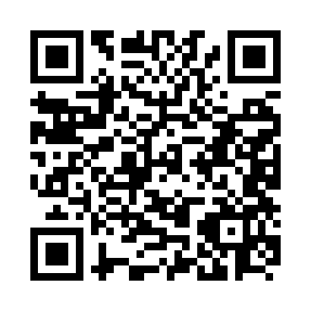
🏗
How to Give a Talk
Neel Krishnaswami
Notes:
There's no shortage of advice on how to structure your narrative. Lots of ways to do it. Check out Neel’s talk.
I can give some guidelines now

Slide 28
💅🖼 📊🫥
Notes:
it’s hard to give real guidelines on slide design.
but:
they should be neat
you should use pictures
you should present results diagrammatically
your slides should make sense on their own, without you there (haha oops)

Slide 29
🙅anti-patterns⛔
📜⌨📸🔣🧑‍⚖
Notes:
do not tell the story of the work
do not write lots of text
do not screenshot your paper’s technical material
do not use new notation
do not show inference rules

Slide 30
🤑value😍
Notes:
so much for technology.
we’ve talked about what a talk needs to do.
and the whole time we’ve circled the idea of “value”
we want to inform the audience that our work is valuable
we want to educate the audience, delivering value
we want to entertain the audience, keeping their valuable attention
let’s talk a bit more about value.

Slide 31
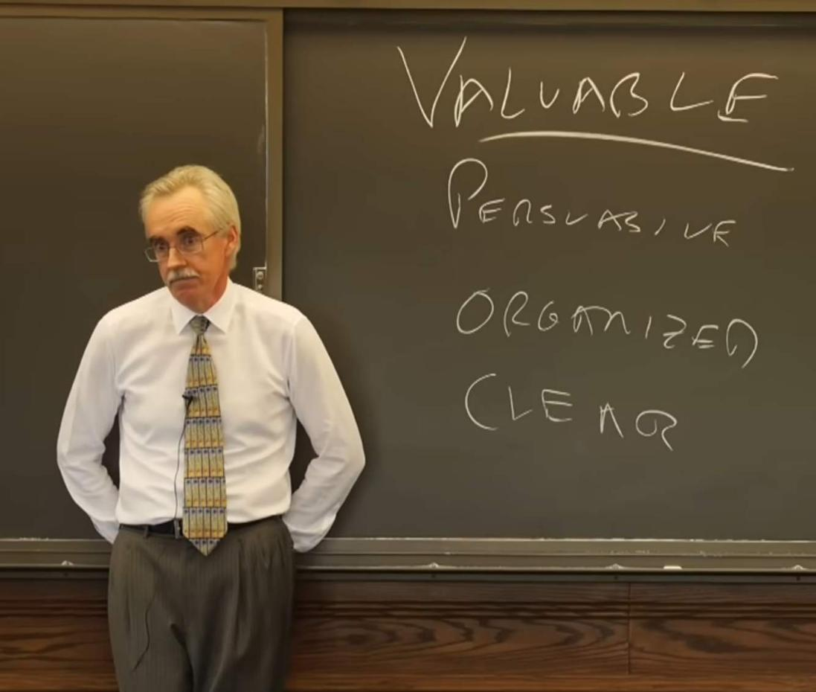
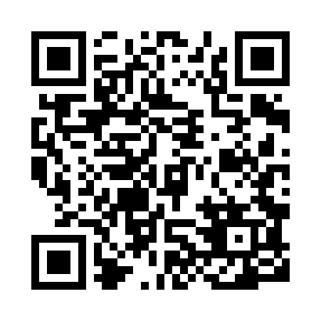
The Craft of Writing Effectively
Larry McEnerney
Notes:
this next bit isn’t really just about talks, but about everything we do.
speaking, writing, choosing what to work on. everything.

Slide 32
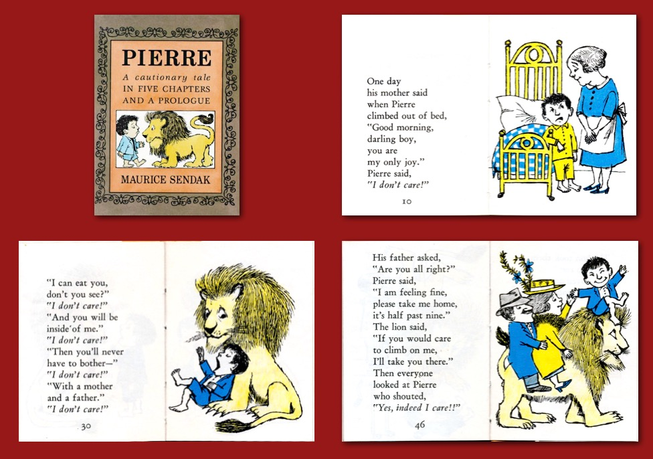
Notes:
Value is not just money.
We assign _value_ to the things we care about.
it is a hard truth that, in general, people do not care.
making people care is hard!
a “good” talk is a valuable talk.
it provides value. the audience values it.
Technical research claims value through its contributions.
Literally: what value is it contributing?
Every technical paper should say this, explicitly.

Slide 33
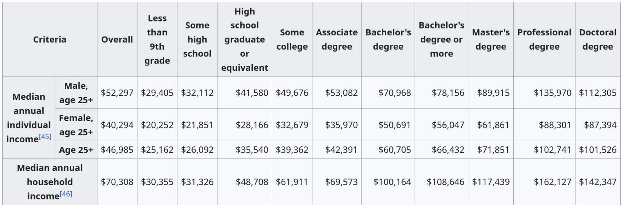
https://en.wikipedia.org/wiki/Household_income_in_the_United_States#Education_and_gender
Notes:
if you’re pursuing a PhD in CS in general and PL in particular, you’re giving up income
your skills are worth more on the market as a SWE IC
jobs requiring the phd do not, in aggregate, pay as much
value is not just money!
you’re here because you value other things
grim, mercenary talk. I would have resented it as a student!
but: we’re all here because we have some shared values. value is constructed by a community

Slide 34
🤔
Notes:
you might be thinking… “is my work valuable? what is my motivation? what have i contributed?”
Different communities have different values.
To address a broader community, you must address broader needs.

Slide 35
💰👑🎛 ⌚🦺⚖
Notes:
Everyone values their time, their safety, justice, scarce resources, power.
The more your work can address these real concerns, the more people will value it.

Slide 36
🛠🆚📃
Notes:
For what it's worth, I hated this kind of thinking as a grad student.
I was interested in theory, and I rejected anything tainted with the reek of application.
There's room for that pure theory, but not a lot. Our community values a clever proof or clear framing of things.
But most people don't.
The value of your work could be that you enjoyed using some particular method. Good for you!
But without clear, broad, real motivations, only a few will share your enthusiasm. Maybe not zero!
But you have to address real concerns to have people value your work.
If you feel stuck with a small audience for your work and that compromise doesn't sound good... you can work on something else?

Slide 37
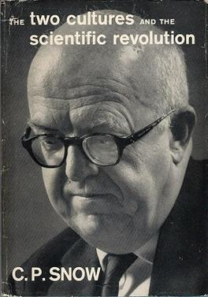
🛠🆚📃
Notes:
These days, I reject the theory/practice distinction.
all of the best work in cs has both.
if you haven’t read this essay, check it out.

Slide 38
🙅 |  | 🙆
🦥 |  | 🐎
⚠ | ➡ | 🦺
🤔 |  | 😄
🆗 |  | 😅
Notes:
Rather than a theory/practice division, I prefer a problem/solution approach.
If you can motivate a problem and show a solution, that’s valuable.
But for someone to think a a technique is valuable, they need context---they need to be in the community already.
If you can, frame things as general problems with general solutions. If you don’t overreach, you’ll do good work.

Slide 39
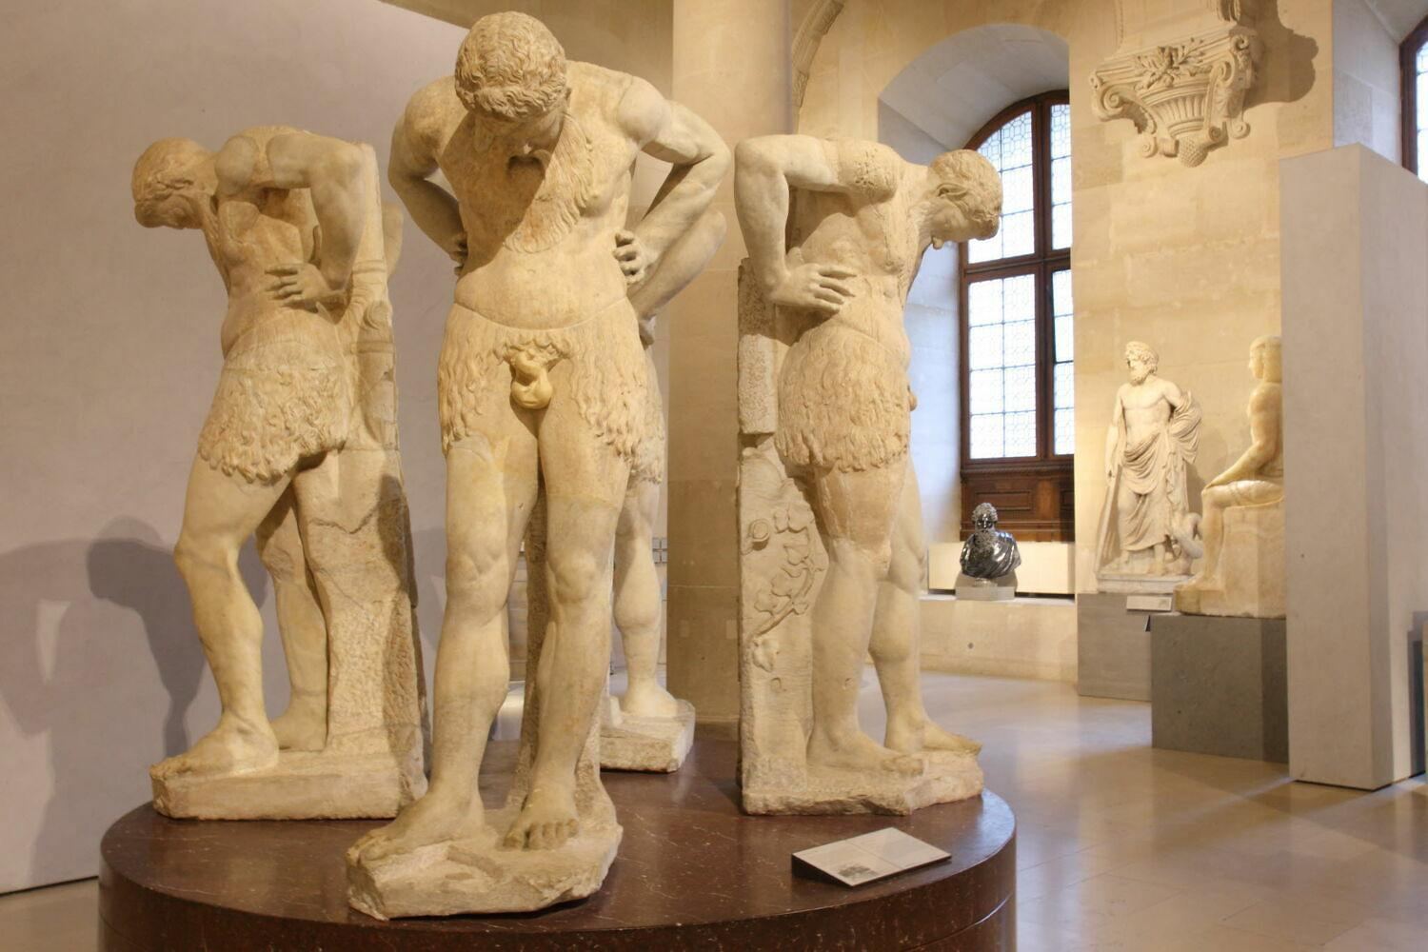
Notes:
PL in particular tends to be technique-focused rather than problem-focused, which is more inward looking.
In the worst case, it is omphaloskepsis---navel-gazing.
If you want your work to affect the world---if you want people to notice what you've done---focus on problems more than techniques. You can learn and master and create the techniques you need along the way.

Slide 40
🤗
rule #1 motivation first
rule #2 teach something portable
rule #3 every talk is a job talk
rule #4 rules are made to be broken
Notes:
I've given a bunch of advice, some of it quite concrete.
I have seen these rules broken very effectively in good talks.
There's really only one rule, and that's to give something valuable to your audience.
They're giving you their time and attention---and our time is our most precious resource.
Thank you for _your_ time and attention; I hope this has been valuable for you.

