Slide 1


Space-Efficient
Manifest Contracts
Michael Greenberg
Princeton University
IBM PL Day 2014-11-18

Slide 2
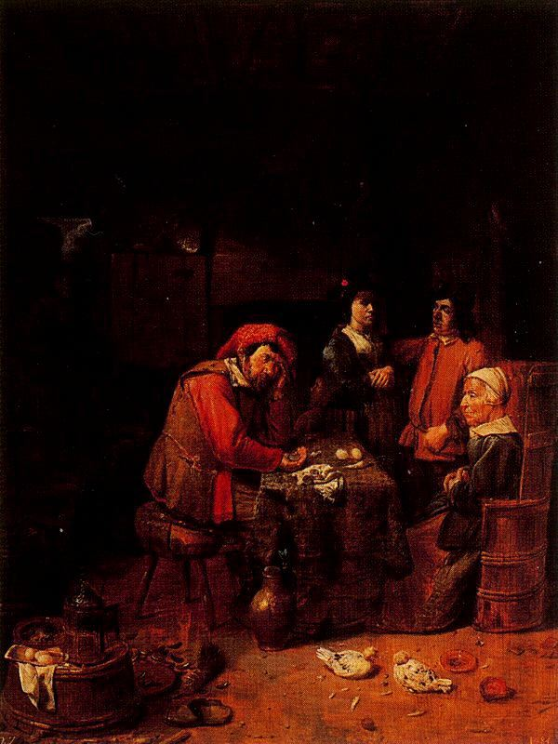
The Wedding Contract
Joos van Craesbeeck
via Wikimedia user:Ribberlin

Slide 3
What are contracts?
Contracts are specifications
  Written in code
  Executable at runtime

Slide 4
assert(x ≥ 0)
sqrt : {x:Float | x ≥ 0} → Float
sqrt : {x:Float | x ≥ 0} → {y:Float | abs(y² – x) < ε}

Slide 5
Higher-order contracts
g : ({x:Int | x≥0}→{x:Int | x≥0}) → {y:Int | y≥0}
You give a function f on Nats, I return a Nat
  If you don’t get a Nat, oops—you blame me
  If f is called with a negative number, oops—you blame me
  If f returns a negative, oops—I blame you
Even-odd rule ---Findler Felleisen 2002

Slide 6
What are contracts?
Contracts are a compromise
  Easy to write
  Easy to check at runtime
  Hard to prove things about

Slide 7

Westward the Course of Empire Takes Its Way
Emanuel Leutze

Slide 8
What are manifest contracts?
Contracts are part of the type system
  Type system keeps track of fancy predicates
  Γ ⊦ v : {x:B | e} implies e[^{v}/_{x}] →* true
  Type system directs when checks happen
T ::= {x:B | e} | T₁→T₂
e ::= x | k | op(e₁,...) | λx:T. e | e₁ e₂ | <T₁ => T₂>^{ℓ} e | blame ℓ

Slide 9
Manifest contracts: checks at base type
<{x:Int | true} => {x:Int | x ≥ 0}>^{ℓ} 2 →* 2
<{x:Int | true} => {x:Int | x ≥ 0}>^{ℓ} -1 →* blame ℓ
<{x:B | e₁}=>{x:B | e₂}>^{ℓ} v ≈ if e₂[^{v}/_{x}] then v else blame ℓ

Slide 10
Manifest contracts: higher-order checks
Defer to a function proxy a/k/a wrapper
<T₁₁→T₁₂ =>T₂₁→T₂₂>^{ℓ} v
… is a value!

Slide 11
Manifest contracts: higher-order checks
A function proxy unwraps contravariantly
(<T₁₁→T₁₂ => T₂₁→T₂₂>^{ℓ} v₁) v₂ →
<T₁₂=>T₂₂>^{ℓ} (v₁ (<T₂₁=>T₁₁>^{ℓ} v₂))
Same blame labels!

Slide 12
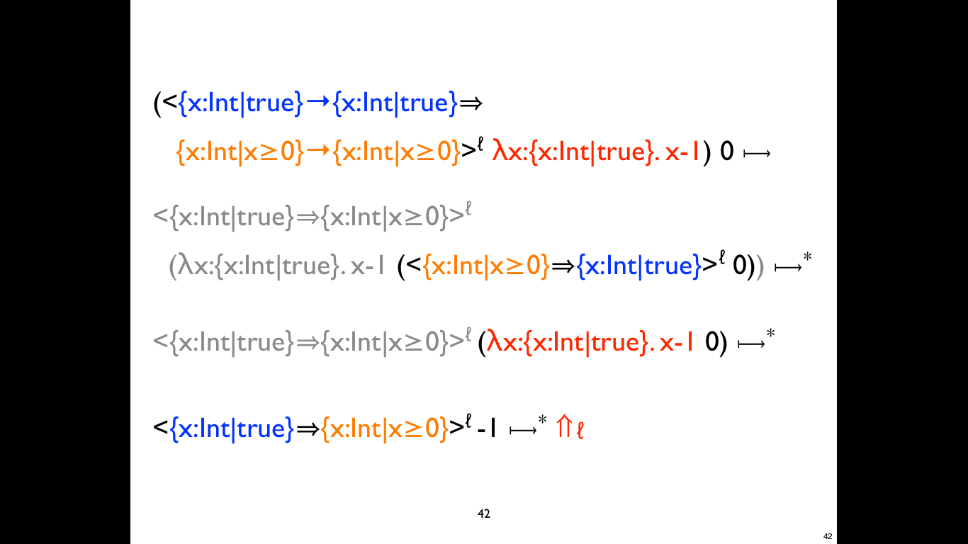

Slide 13
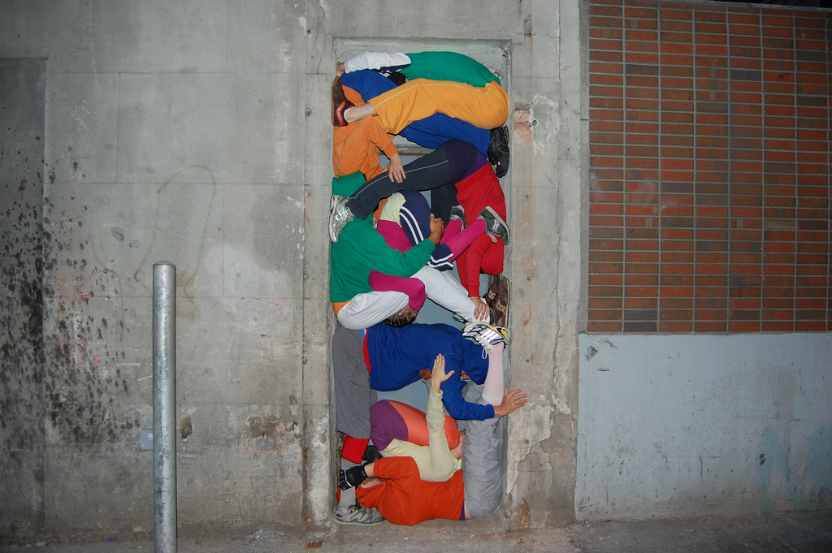
Bodies in Urban Spaces
Willi Dorner / Studio 70

Slide 14
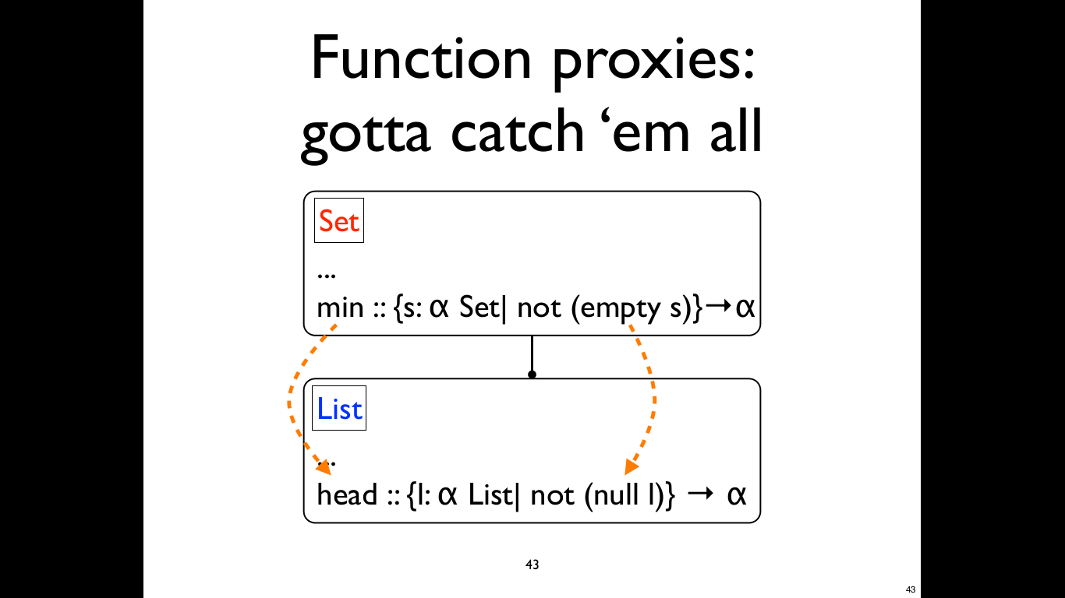

Slide 15
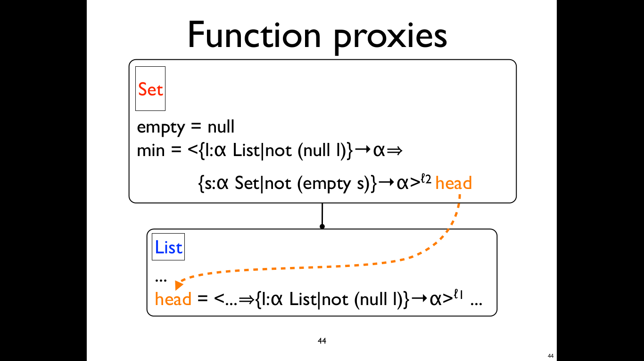

Slide 16
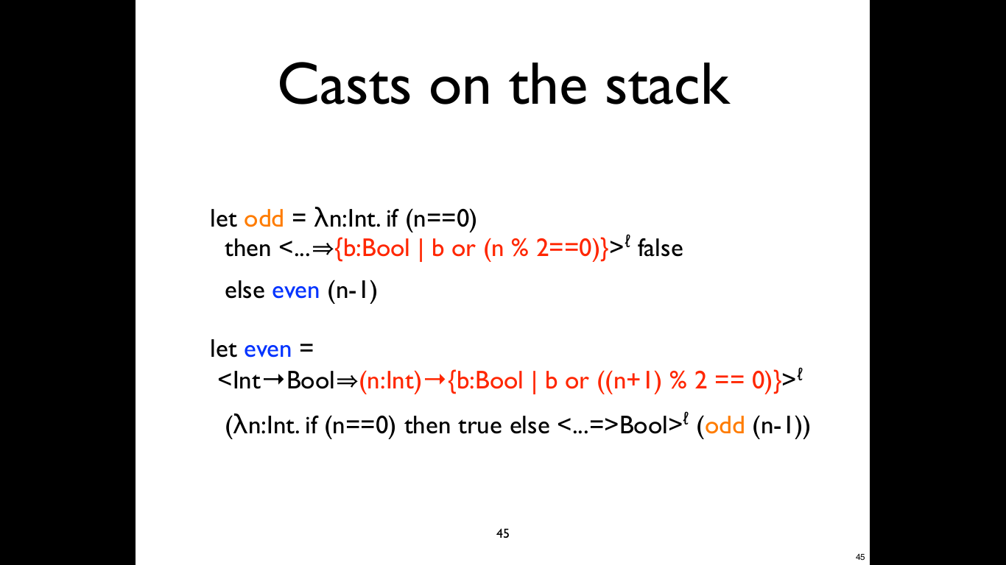

Slide 17
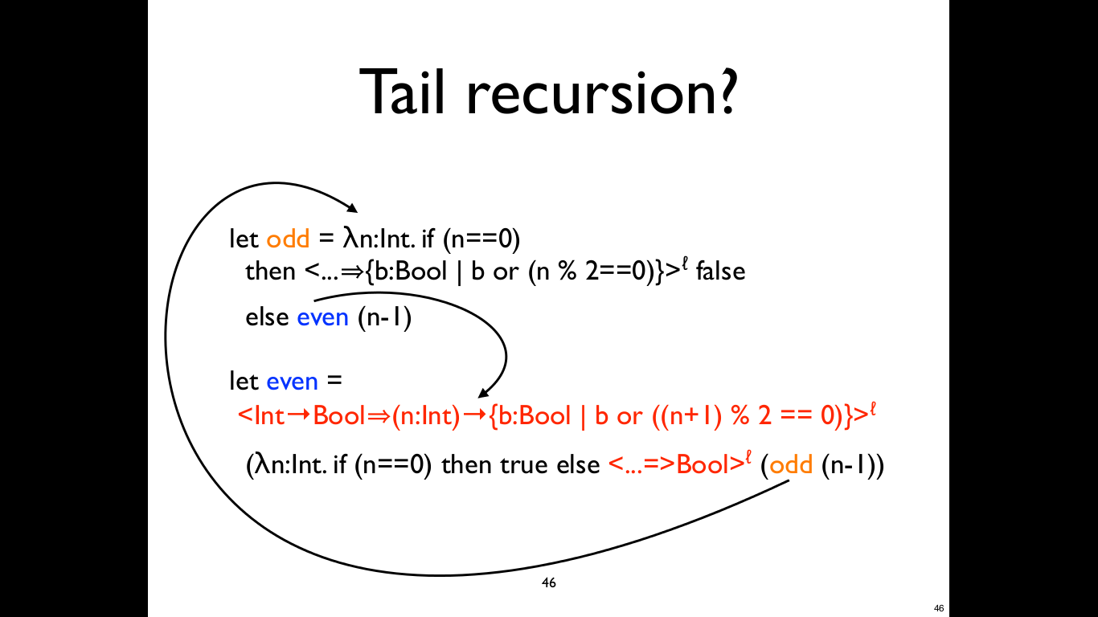

Slide 18
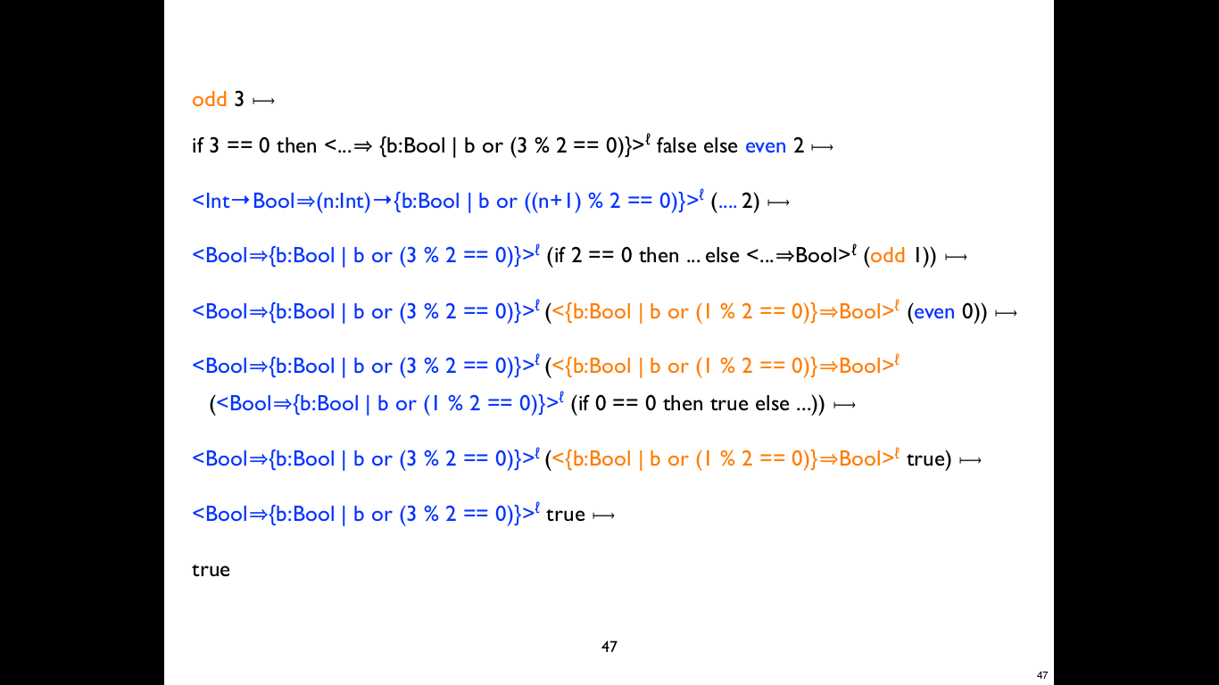

What is to
be done?

Slide 19
Space inefficiency
Stacks and functions proxies accumulate
We need to:
  Merge adjacent casts
  Bound casts' size

Slide 20
Merging adjacent casts
<T₂=>T₃>^{ℓ2} (<T₁=>T₂>^{ℓ1} e) → <T₁=>T₃>^{ℓ?} e
Need to keep track of T₂, both ℓ₁ and ℓ₂
T₂
Let's work it out
at base types!

Slide 21
<{x:B|e₂}=>{x:B|e₃}>^{ℓ2}
(<{x:B|e₁}=>{x:B|e₂}>^{ℓ1} v)
≈
if e₂[^{v}/_{x}] then
if e₃[^{v}/_{x}] then v else blame ℓ₂
else blame ℓ₁

Slide 22
<{x:B|e₂}=>{x:B|e₃}>^{ℓ2}
(<{x:B|e₁}=>{x:B|e₂}>^{ℓ1} v)
→
<{x:B|e₁}=>{x:B|e₃}> v
≈
if e₂[^{v}/_{x}] then
if e₃[^{v}/_{x}] then v else blame ℓ₂
else blame ℓ₁
Need to save e₂, ℓ₂, ℓ₁

Slide 23
<{x:B|e₂}=>{x:B|e₃}>^{ℓ2}
(<{x:B|e₁}=>{x:B|e₂}>^{ℓ1} v)
→
<{x:B|e₁}=>{x:B|e₃}> v
≈
if e₂[^{v}/_{x}] then
if e₃[^{v}/_{x}] then v else blame ℓ₂
else blame ℓ₁
Need to save e₂, ℓ₁, e₃, ℓ₂

Slide 24
<{x:B|e₂}=>{x:B|e₃}>^{ℓ2}
(<{x:B|e₁}=>{x:B|e₂}>^{ℓ1} v)
→
<{x:B|e₁}=>{x:B|e₃}> v
≈
if e₂[^{v}/_{x}] then
if e₃[^{v}/_{x}] then v else blame ℓ₂
else blame ℓ₁
Really need to save
{x:B|e₂}^{ℓ1}, {x:B|e₃}^{ℓ2}

Slide 25
<{x:B|e₂}=>{x:B|e₃}>^{ℓ2}
(<{x:B|e₁}=>{x:B|e₂}>^{ℓ1} v)
→*
<... =>{x:B|e₂}^{ℓ1},{x:B|e₃}^{ℓ2} ...>● v

Slide 26
Space efficiency at higher orders
(<T₁₁→T₁₂ => T₂₁→T₂₂>^{ℓ} v₁) v₂
→
<T₁₂=>T₂₂>^{ℓ}
(v₁ (<T₂₁=>T₁₁>^{ℓ} v₂))

Slide 27
(<T₂₁→T₂₂=>T₃₁→T₃₂>^{ℓ2}
(<T₁₁→T₁₂ => T₂₁→T₂₂>^{ℓ1} v₁)) v₂
→
<T₂₂=>T₃₂>^{ℓ2}
((<T₁₁→T₁₂ => T₂₁→T₂₂>^{ℓ1} v₁)
(<T₃₁=>T₂₁>^{ℓ2} v₂))
→
<T₂₂=>T₃₂>^{ℓ2} (<T₁₂=>T₂₂>^{ℓ1}
(v₁ (<T₂₁=>T₁₁>^{ℓ1} (<T₃₁=>T₂₁>^{ℓ2} v₂)))
Codomain:
older-to-newer
ℓ₁ is older than ℓ₂
Domain:
newer-to-older

Slide 28
Annotating casts with coercions
Solution: Henglein's coercions
c ::= {x:B|e₁}^{ℓ1},...,{x:B|e_{n}}^{ℓn} | c₁⟼c₂
<T₁=>T₂>^{ℓ} e → <T₁ =>^{coerce(T1,T2,ℓ)} T₂>● e
<T₂=>^{c2} T₃>● (<T₁=>^{c1} T₂>● e) →
<T₁=>^{join(c1,c2)} T₃>● e
Almost concatenation
Domains new-to-old
Codomains old-to-new

Slide 29
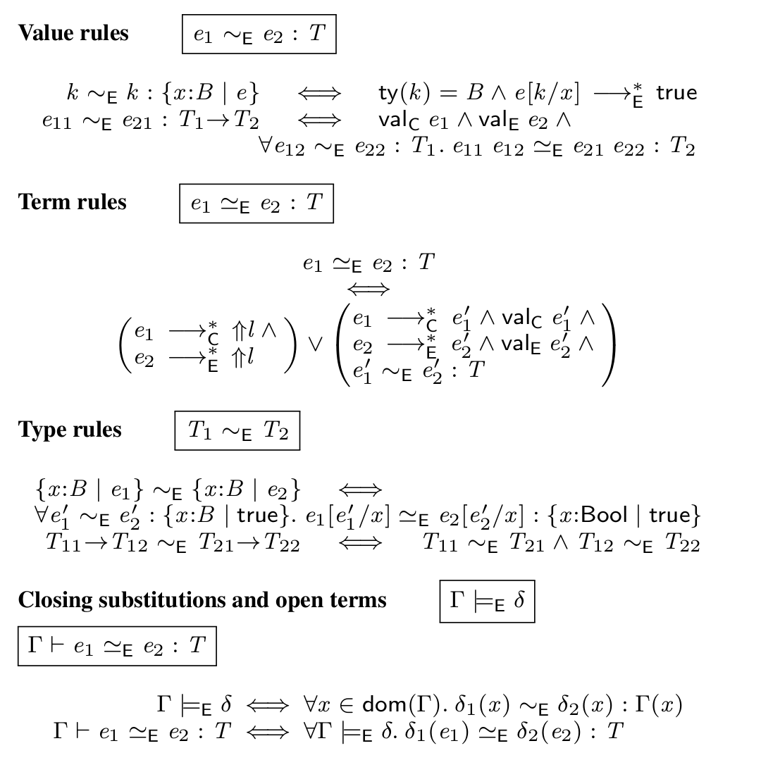
Space efficiency is sound w.r.t classic semantics

Slide 30
Same classic contract behavior
New, space-efficient semantics
    Coercions, cf. Henglein '94
For details, see POPL'15 paper

Slide 31
Bounding the size of casts
Programs have a finite number of types
  In casts, coercions, annotations
Lemma. types(coerce(T₁,T₂,ℓ)) ⊆ types(<T₁=>T₂>^{ℓ})
Theorem. e → e' implies types(e') ⊆ types(e)
Can derive bounds on size + number of casts

