Slide 1
Haplography and hendiadys in the Aramaic of Daniel
Michael Greenberg

Slide 2
Declarative, composable views
Michael Greenberg

Slide 3
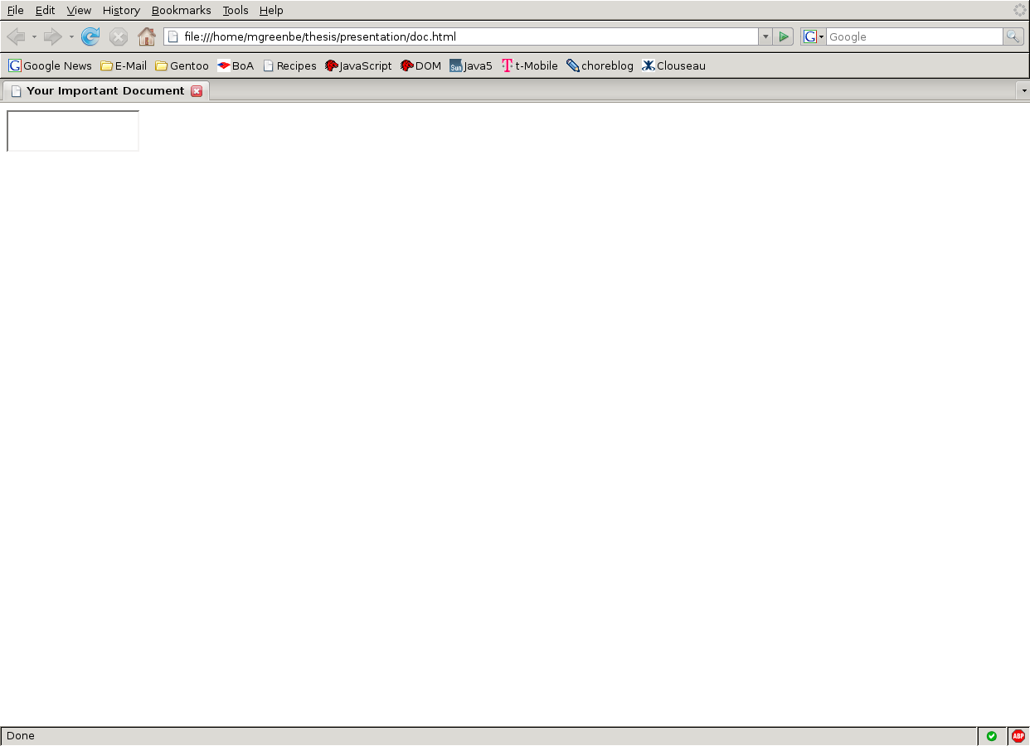

Slide 4
HTML
<html>
<head>
<title>Your Important Document</title>
<script>
// INSERT MAGIC, DISK 1 OF 6
</script>
</head>
<body>
<textarea id="doc" />
</body>
</html>

Slide 5
JavaScript
function make_textarea(id, v, dom_update_callback) {
  var node = make_dom_node('textarea', { 'id': id }, [v]);
  add_event_handler(node, 'change', dom_update_callback);
  add_event_handler(node, 'keypress', dom_update_callback);
  return node;
}
function extract_textarea(id) {
  var node = get_dom_object(id);
  return node.value;
}
...plus about 10-20 lines of DOM manipulation.
...plus about 20-30 lines of AJAX calls.

Slide 6
Flapjax
var d = valFromServer('path.to.doc');
insertDomB(TEXTAREAB({'id':'doc'}, [v]),
'doc');
valToServer(d, 'path.to.doc');

Slide 7
The Data Model
Our data model, d, never gets updated!
The fix:
var d = valFromServer('path.to.doc');
insertDomB(TEXTAREAB({'id':'doc'}, [v]),
'doc');
valToServer(extractValue_b('doc'),
'path.to.doc');

Slide 8
Lenses
Pair of functions
  l.get :: JS → DOM
  l.putback :: DOM * JS → JS
Laws
GETPUT
l.putback(l.get(j), j) = j
PUTGET
l.get(l.putback(d, j)) = d

Slide 9
Examples
focus n
(focus n).get o = o[n]
(focus n).putback v o = o with n = v
plunge n
(plunge n).get v = { n: v }
(plunge n).putback o v = o[n]
l ; k
(l ; k).get j = k.get(l.get(j))
(l ; k).putback d j = l.putback(k.putback(d, l.get(j)), j)

Slide 10
DOM Lenses
span_tag attribs kids
(span_tag attribs kids).get v =
  <span attribs>kids v</span>
(span_tag attribs kids).putback h v = h.lastChild
textarea_tag attribs
(textarea_tag attribs).get v =
  <textarea attribs>v</textarea>
(textarea_tag attribs).putback h v = h.value

Slide 11
DOM Lenses, continued
l = textarea_tag({}) ; span_tag({ 'id': 'doc' }, [])
l.get v =
  <span id=”doc”>
    <textarea>v</textarea>
  </span>
l.putback h v = t.putback(s.putback(h, t.get), v)
  = t.putback(h.firstChild, v)
  = h.firstChild.value

Slide 12
Tree sequencing
l = span_tag({ 'id': 'doc' }, textarea_tag({}))
Works like ;-sequencing, but looks like HTML!

Slide 13
Flapjax with Lenses
var d = valFromServer('path.to.doc');
textarea_tag({ 'id': 'doc' })
.bind_to_b(d, 'doc');
valToServer(d, 'path.to.doc');
Or, with a wrapper:
textarea_tag({ 'id': 'doc' })
.bindToServer('path.to.doc', 'doc');

Slide 14
Contributions
Not Mentioned Here
A declarative, composable language for constructing and deconstructing HTML
Programmers no longer need to work with the DOM directly
Now possible to define generally composable widgets
Combinators for ordered data, order and list_map – a contribution to the theory of lenses
A solution to the “Table of Contents” problem

Slide 15
Future Work
Widgets
  Fancy looking
  Fancy acting
Synchronization policies
Other list combinators
Compilation

