Slide 1
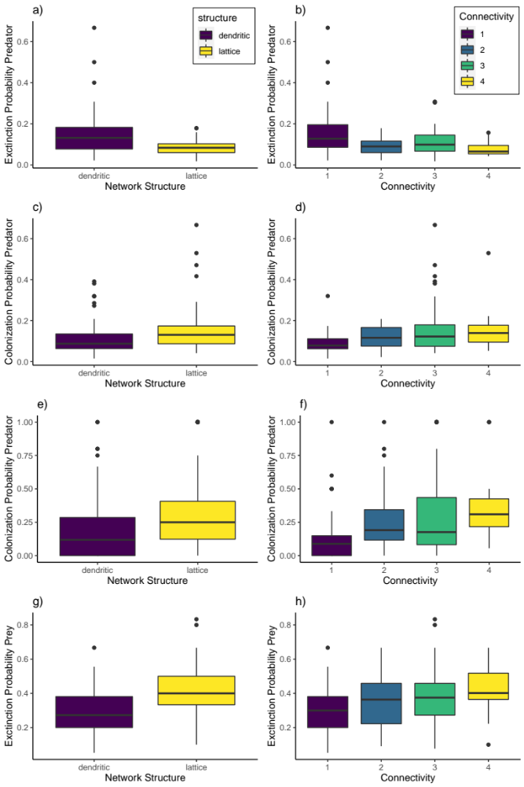
Entire Experiment Phase 2 Phase 3

