Slide 1
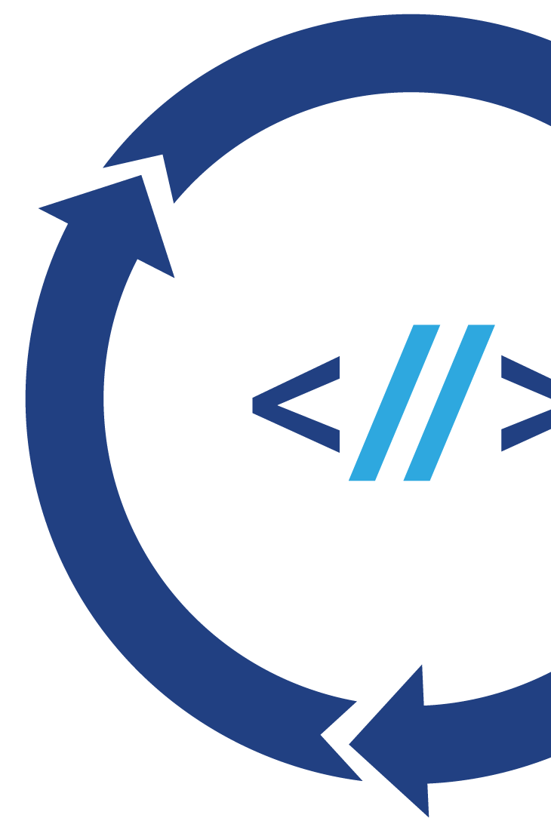
The Release Pipeline Model
Applied to Managing Windows Server and Microsoft Cloud

Slide 2
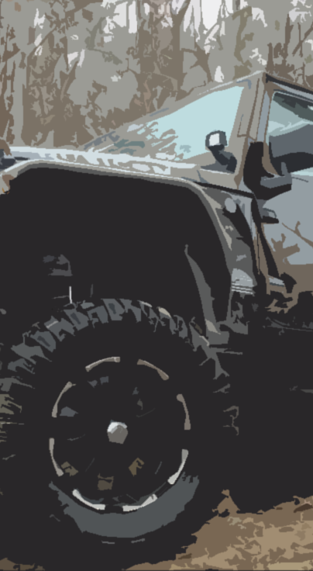
whoami
Michael Greene
Principal Program Manager
Enterprise Cloud Engineering CAT Team
(Customer Feedback, Technical Enablement)
CAT PM for PowerShell & DevOps
12 yrs at Microsoft
3 yrs BPOSD/O365D Ops
@migreene
Mgreenegit

Slide 3
Shift
Requirements for a scientific revolution
First, the new candidate must seem to resolve some outstanding and generally recognized problem that can be met in no other way.
Second, the new paradigm must promise to preserve a relatively large part of the concrete problem-solving ability that has accrued to science through its predecessors.
(Kuhn n.d.)

Slide 4
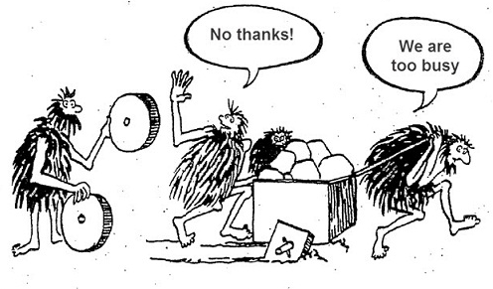
Landscape
  how do we include Windows Server?
  that’s a little more on the dev side, than IT Pro.
patterns & practices
Whitepaper (#releasepipeline)
http://aka.ms/thereleasepipelinemodel

Slide 5
Configuration as Code
Lots of API's
Complex scenarios should be property:value
Living documentation
PowerShell DSC is the PLATFORM that all solutions can use to deploy and manage Windows Server
Azure Resource Manager is also Configuration as Code
Nothing replaces knowledge about the systems you intend to manage

Slide 6
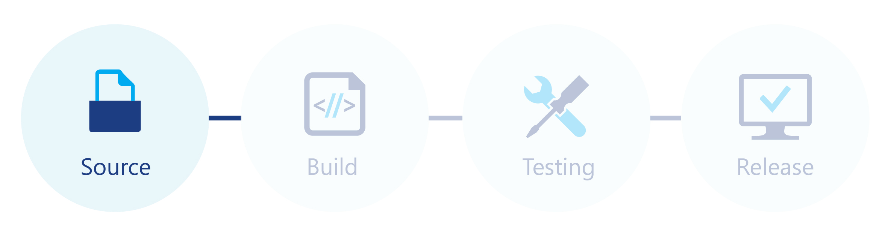
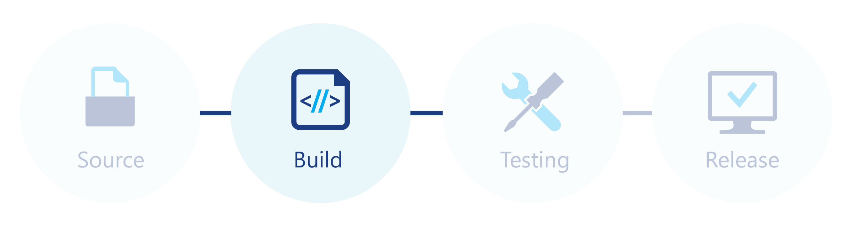
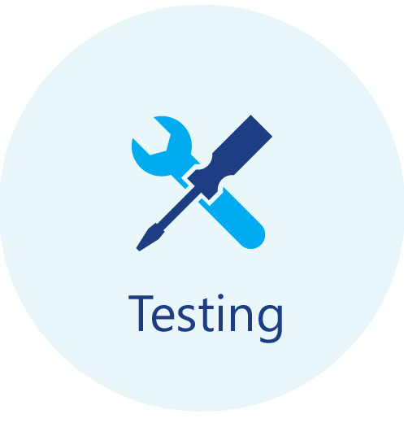
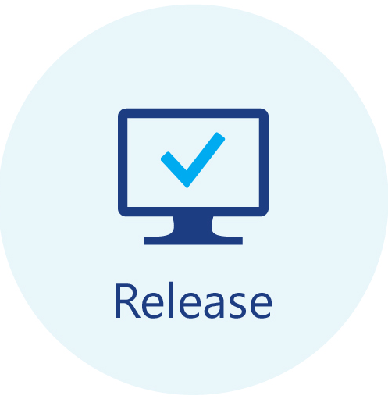
The Release Pipeline

Slide 7
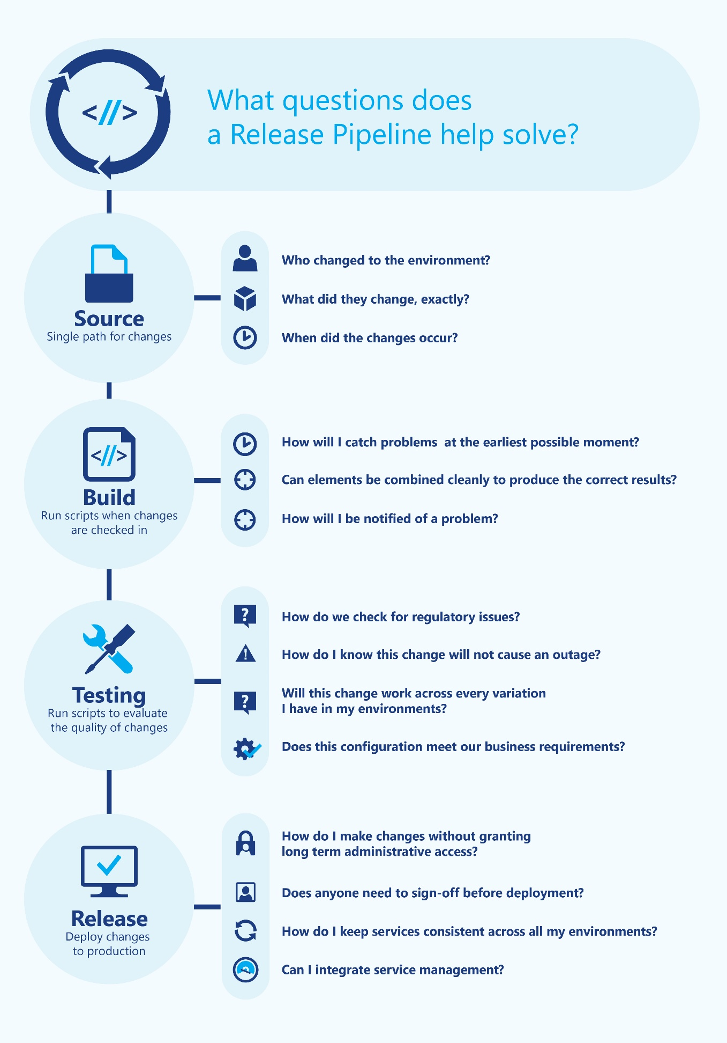
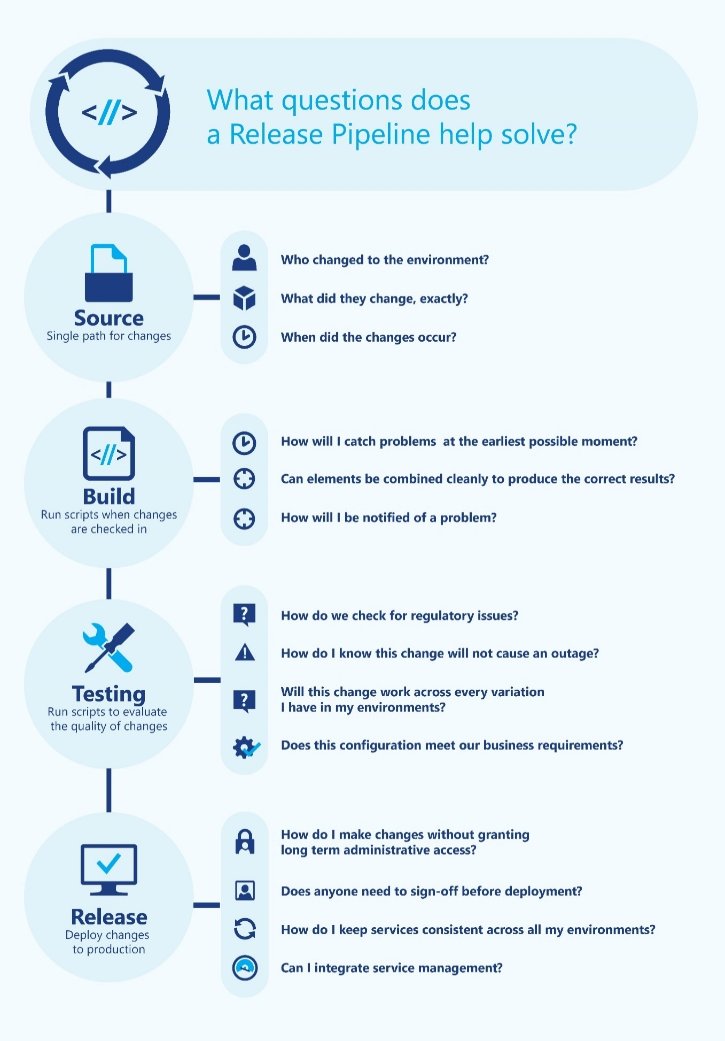
What problems does this solve?

Slide 9
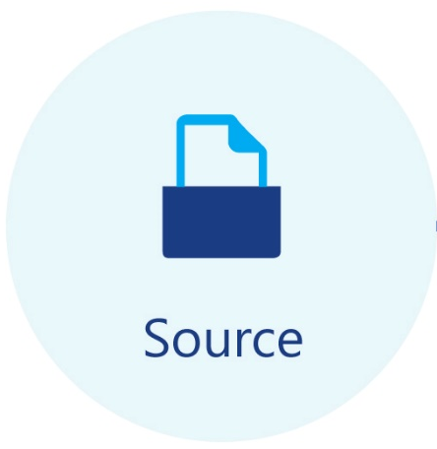
What we did before
Prototype in VM
Submit change form
Present to CAB
Argue that the change is worthwhile
Conflict oversight by committee
Update docs

Slide 10
What we do now
Document everything in configuration as code
  Including automated deployment and testing
Clone latest to workstation
Make change
Run tests locally
Push to Source
  Who, What, When, Why (comments)
Merge with Master, resolve conflicts if needed

Slide 11
Show
What is it like to manage a change?

Slide 12
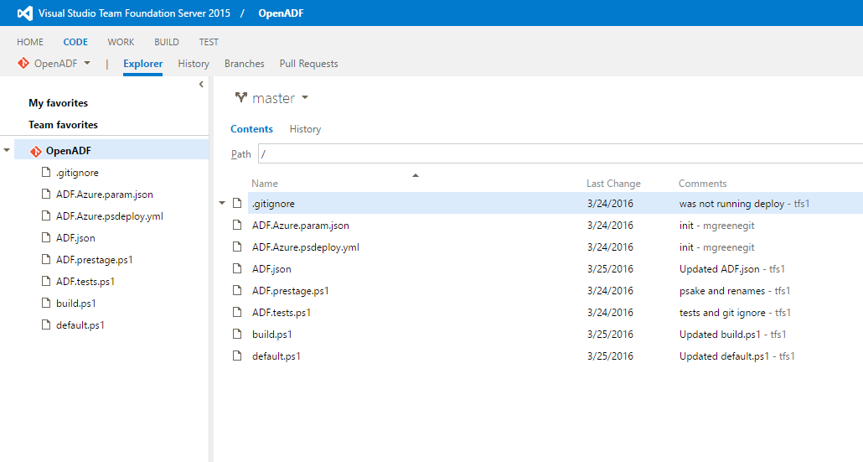

Slide 13
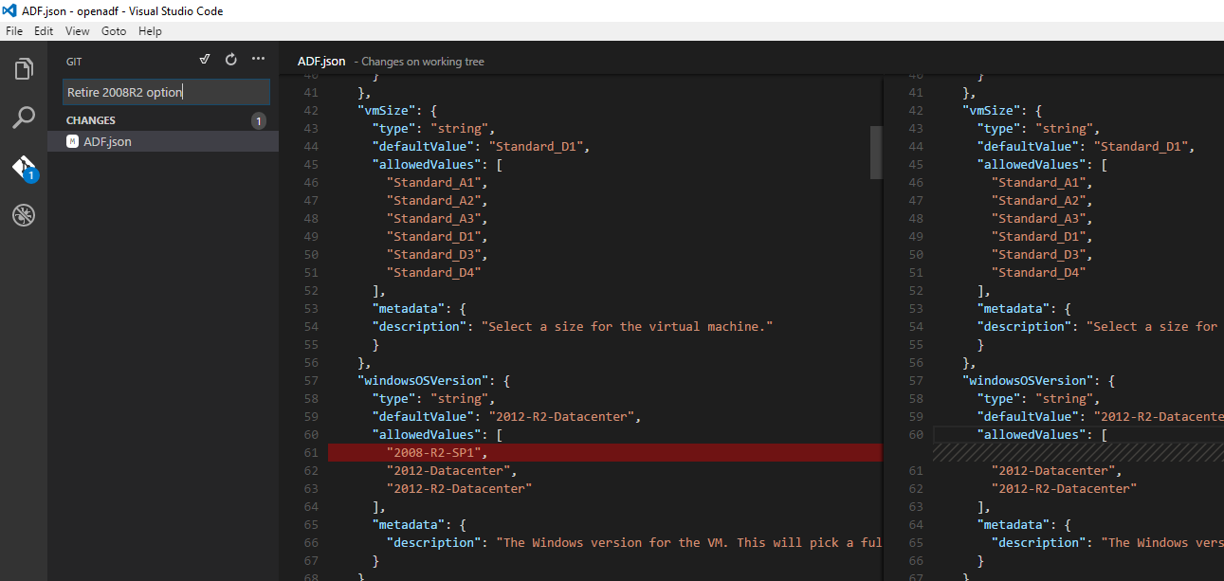

Slide 14
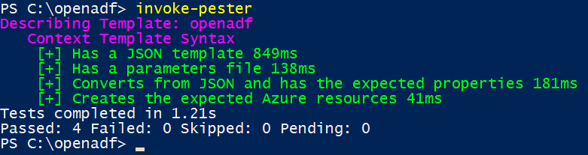
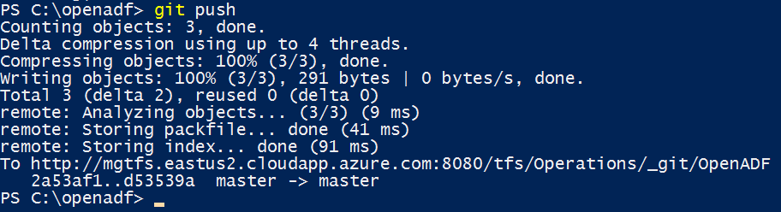

Slide 15
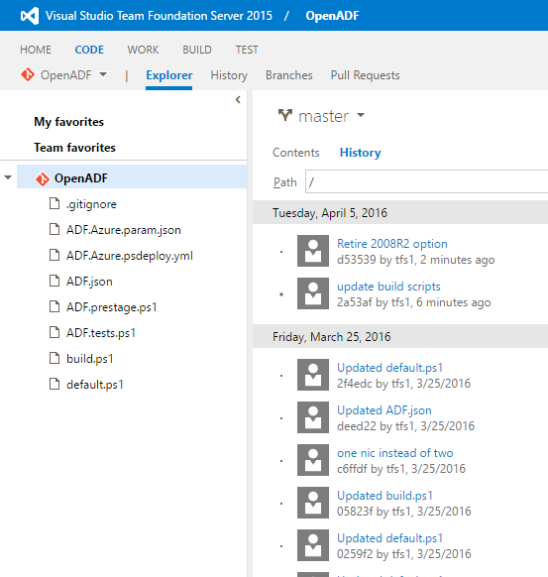
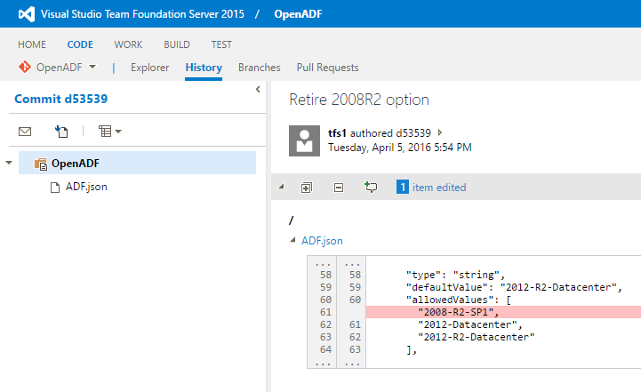

Slide 17
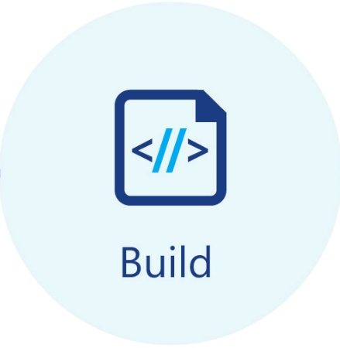
What we did before
Remote in on Saturday
Make sure servers are listed in RDCMan
Connect to servers and make changes
Reboot in order
Say a prayer / squeeze rabbit’s foot / perform tribal dance
Check that services still work correctly

Slide 18
What we do now
Trigger Build service
  Webhook/agent, schedule, manual
Run scripts stored in Source
Validate quality
Perform work
Capture output
* opportunity to implement Just Enough Administration
http://aka.ms/JEA

Slide 19
Show
Trigger build
Verify thing happened
View reports

Slide 20
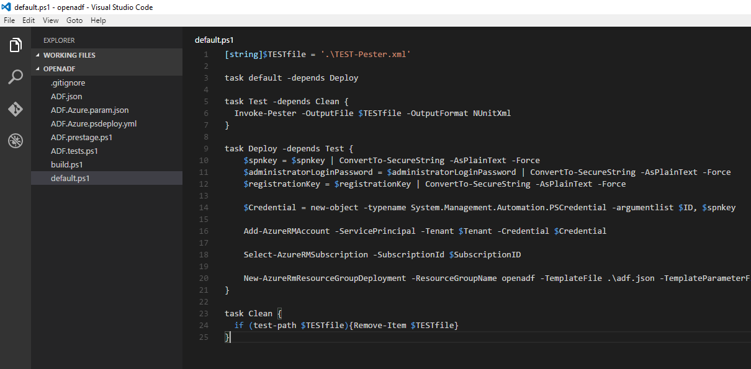

Slide 21
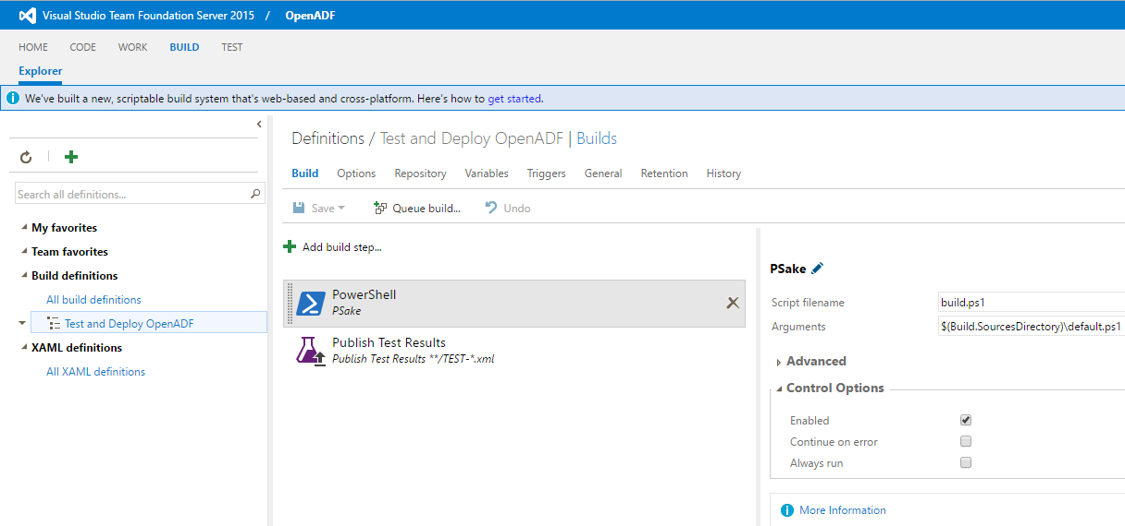

Slide 22
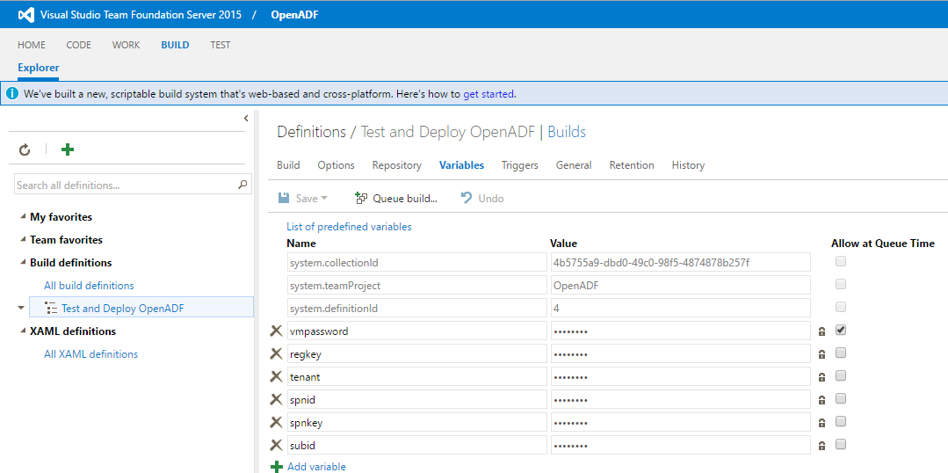

Slide 23
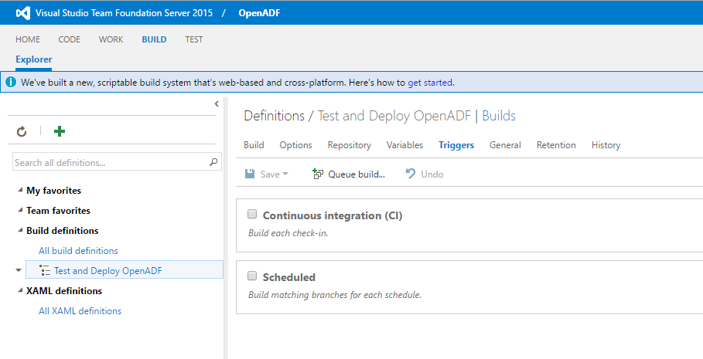

Slide 24
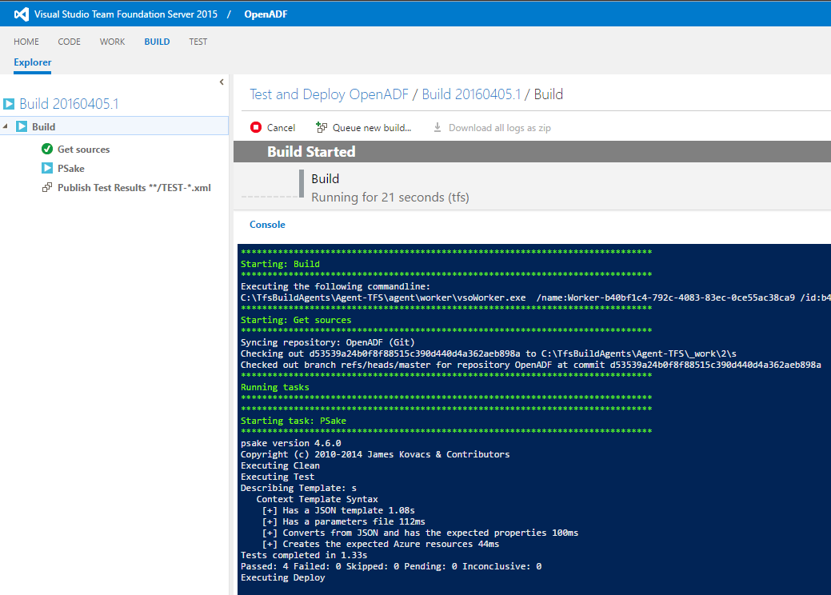

Slide 25
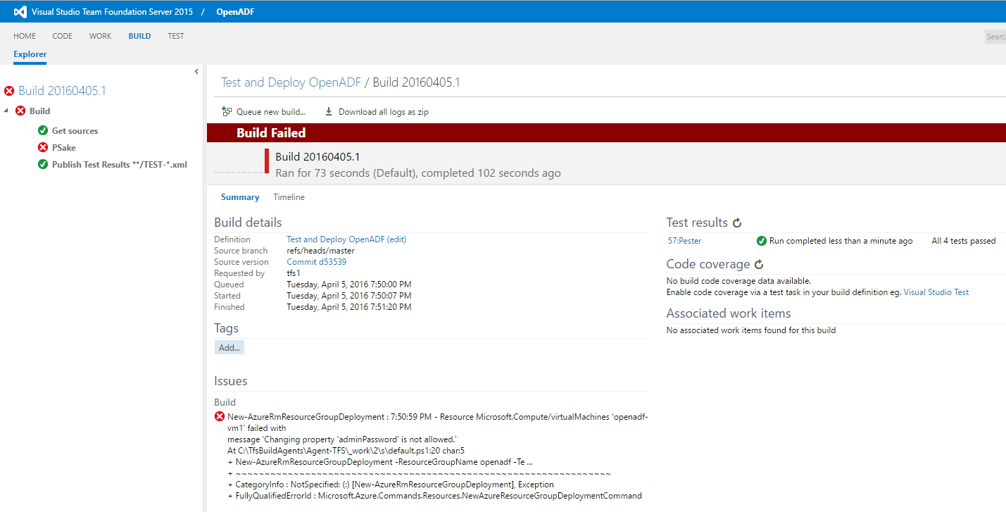

Slide 26
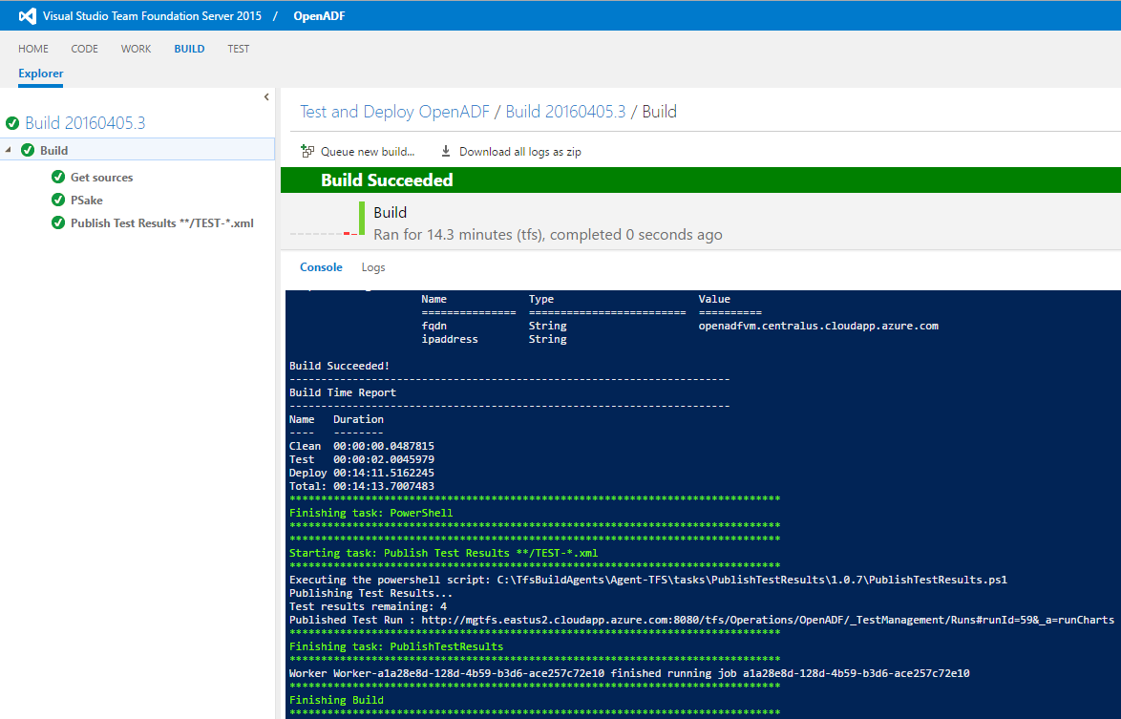

Slide 27
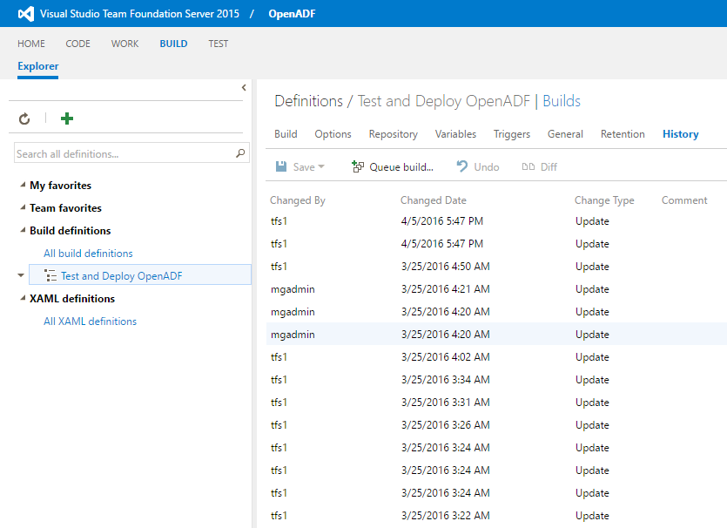

Slide 29

What we did before
Create VM
Install OS
Install app/service
Implement change
  Manual, test OU, run script
Try app/service to make sure it still works

Slide 30
What we do now
Build runs Scripts from Source
Linting - Script Analyzer
  Must meet guidelines set by organization
Unit Tests – Pester
  Functionally should work as expected
Integration Tests – Pester / Kitchen
  Should work across matrix of diverse combinations
Operational Validation – Pester / OVF
  Service should do what it is supposed to do
TDD
If nothing else,
LEARN THIS

Slide 31
Show
Test-Kitchen
Reports form Unit tests
Reports from validation tests

Slide 32
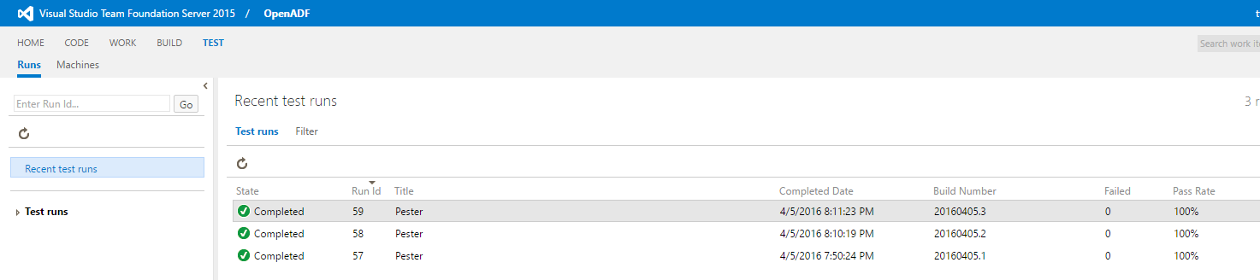

Slide 33
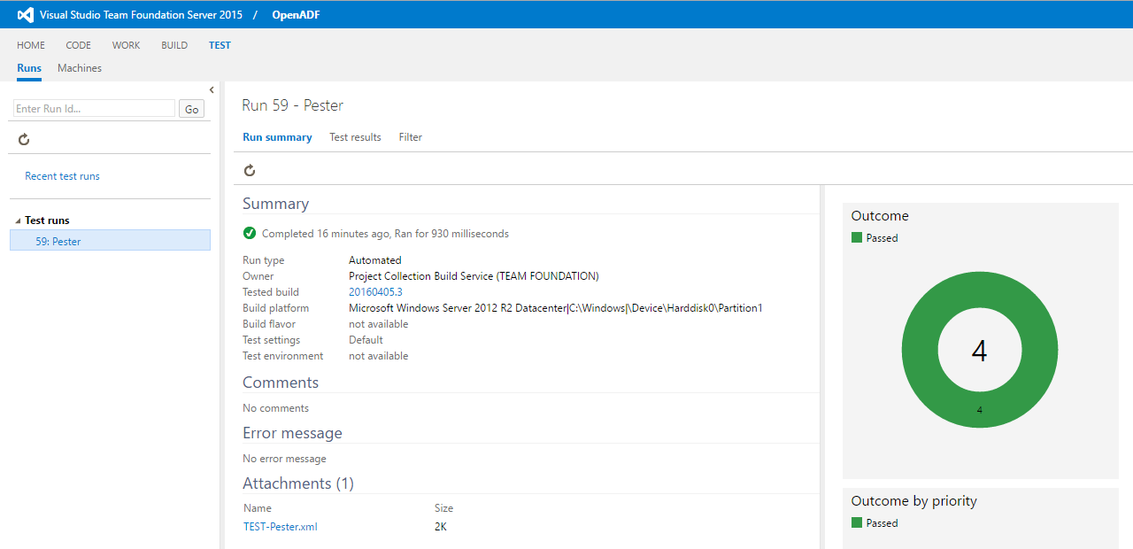

Slide 34
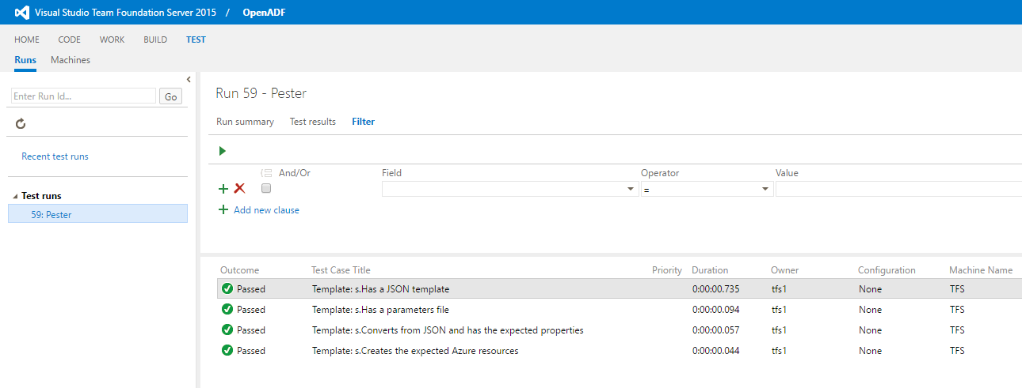

Slide 35
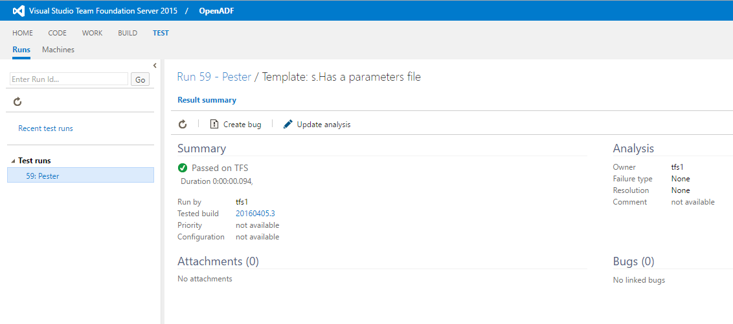

Slide 37
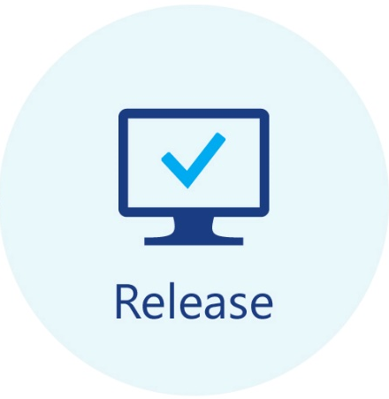
What we did before
Request/create VM
Request/manage environmental changes
Install OS
Install app/service (or defer to app/service owner)
Onboard to patching, anti-malware, backup, monitoring
Validate app/service is working
Go Live

Slide 38
What we do now
Build runs scripts from Source
Potentially automatically releases when Tests pass
Deploy artifacts to environment
Simplify complex work through automation
Promote through stages
  QA, Prod, Green/Blue

Slide 39
Show
PSDeploy ARM

Slide 40
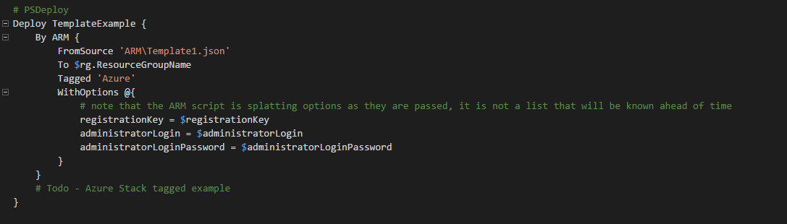

Slide 41
Community projects
Pester
pSake
psDeploy
Operational Validation Framework
your_project_here

Slide 42

Architect the transition
Don't cutover overnight
Old and new tools can be integrated
Keep options open

Slide 43
Make it contagious
apply this model to:
OS images
app packages
containers

Slide 44
Make change visible
If change is happening fluidly, everyone needs to know
Your peers are not going to go check reports, the way they check Facebook
Notify all stakeholders in the way they collaborate

Slide 45
Finally
Everyone must be onboard for long term success

