Slide 1
Configuration Sharing
Michael Greene
@migreene

Slide 2
PowerShell Desired State Configuration
Declare server state
Force multiplied by community contribution
Construct release pipelines that test before releasing to production

Slide 3


Configuration and Continuous Deployment
Intent | Environment Configuration (Dev -> Test -> Production) | $WebConfigEnv = @{ ComputerName = $VMServerNames Name = “FourthCoffee” } …
 | Structural Configuration | WindowsFeature IIS { Name = "Web-Server" Ensure = "Present" } …
Make It So | Idempotent Automation | foreach -parallel ($featureName in $Name) { $feature = Get-WindowsFeature -Name $featureName if(($Ensure -eq "Present") -and (!$feature.Installed)) { Install-WindowsFeature -Name $featureName } …. } …

Slide 4
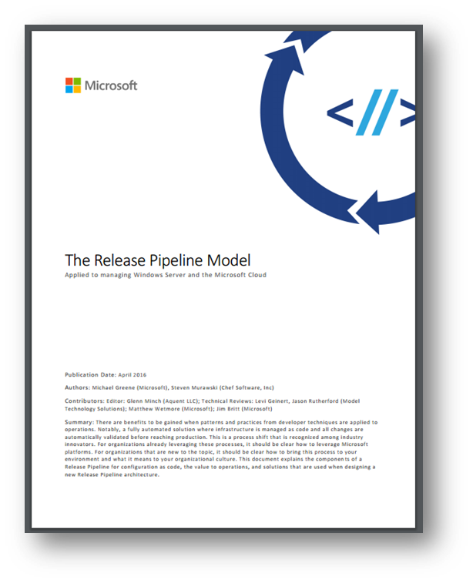
white paper
http://aka.ms/thereleasepipelinemodel

Slide 5
PowerShell Desired State Configuration Community
GitHub
PowerShell Gallery
Azure Automation DSC

Slide 6
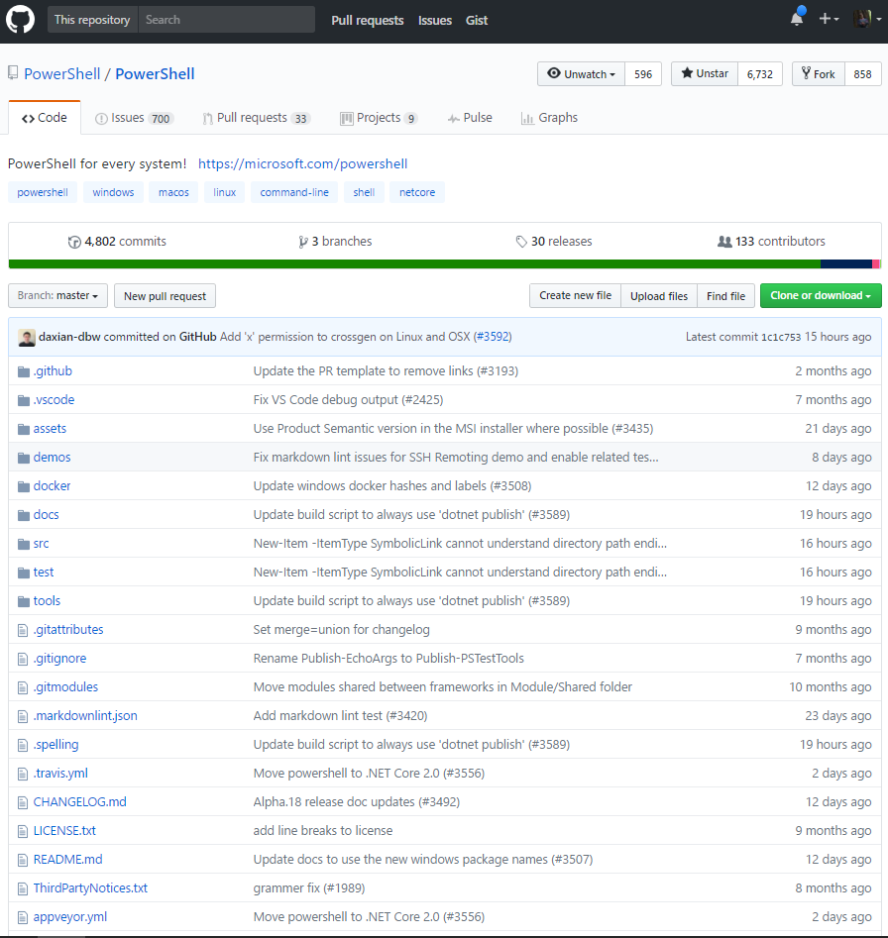
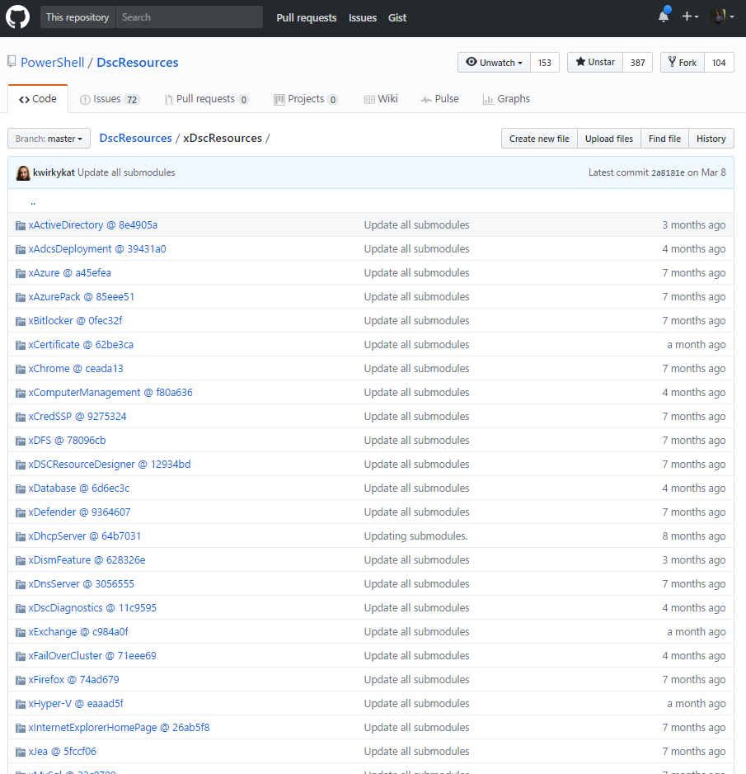
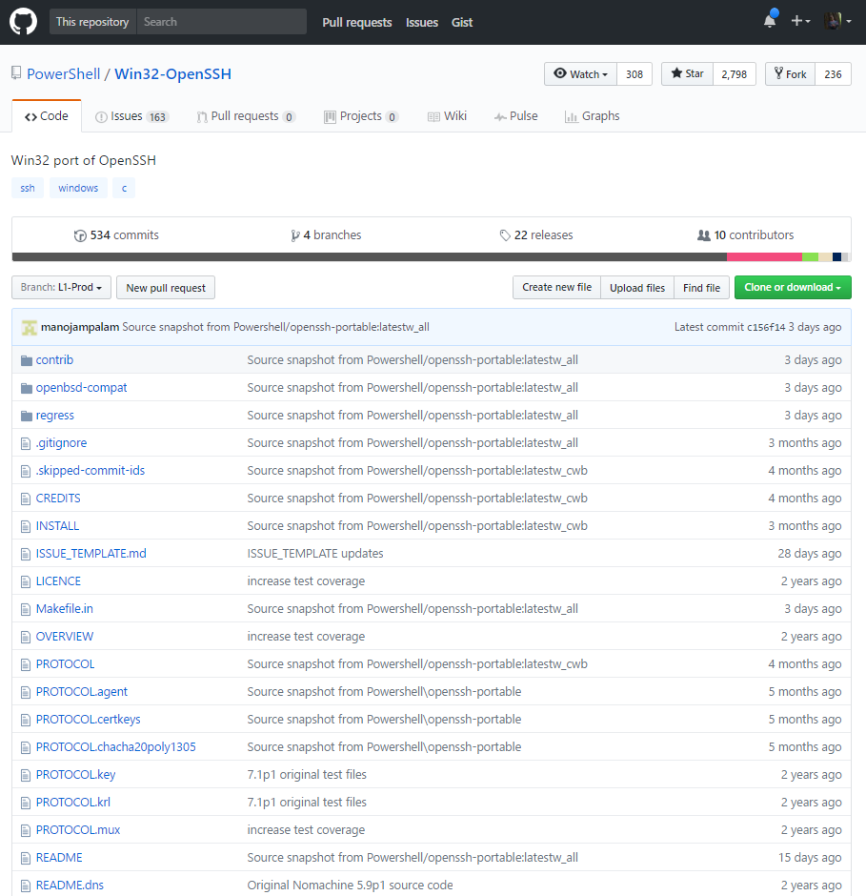
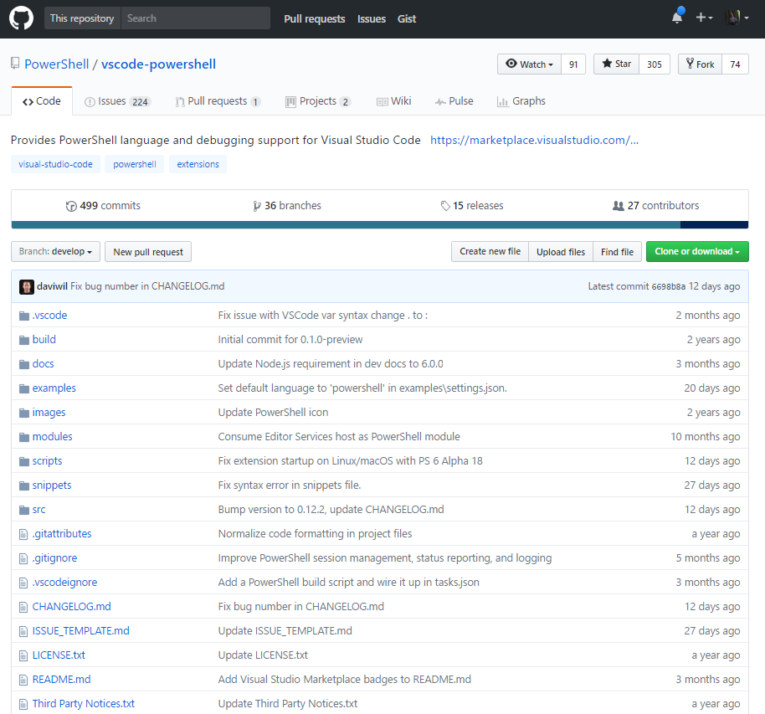
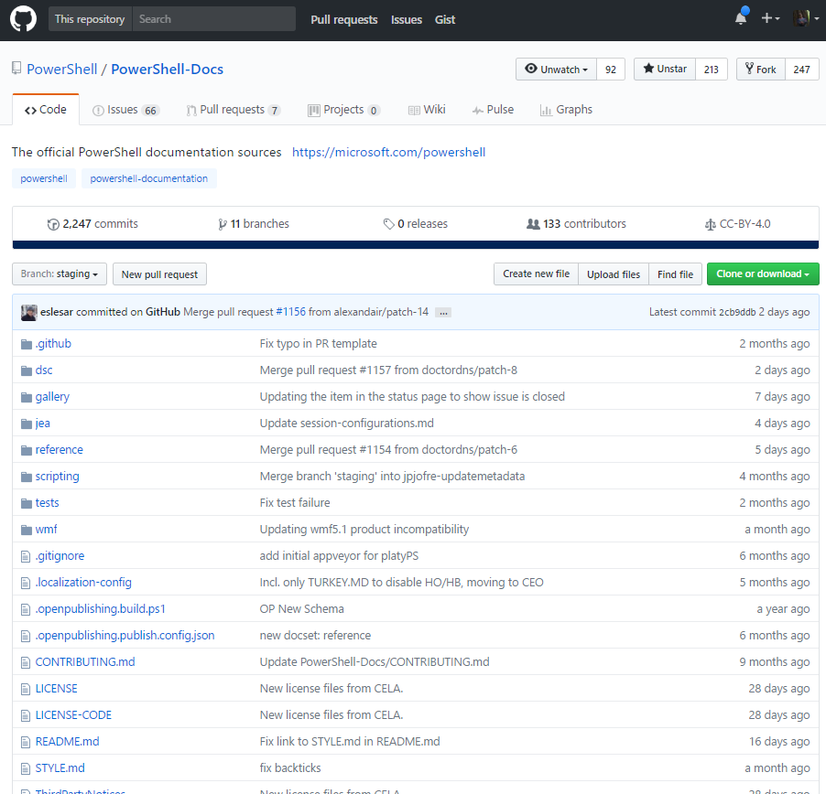
PowerShell on GitHub
Vscode Ext
DSC Resources
Win32-OpenSSH
Docs
PowerShell

Slide 7
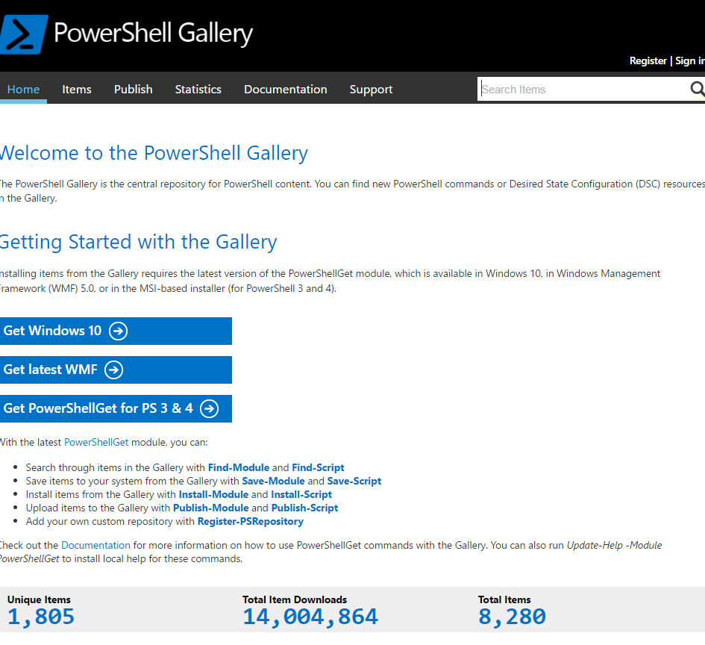
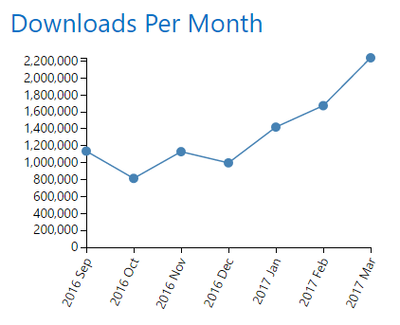
PowerShell Gallery Contributions
2000+ modules/scripts
766 DSC Resources
181 DSC Modules
~1400 authors

Slide 8
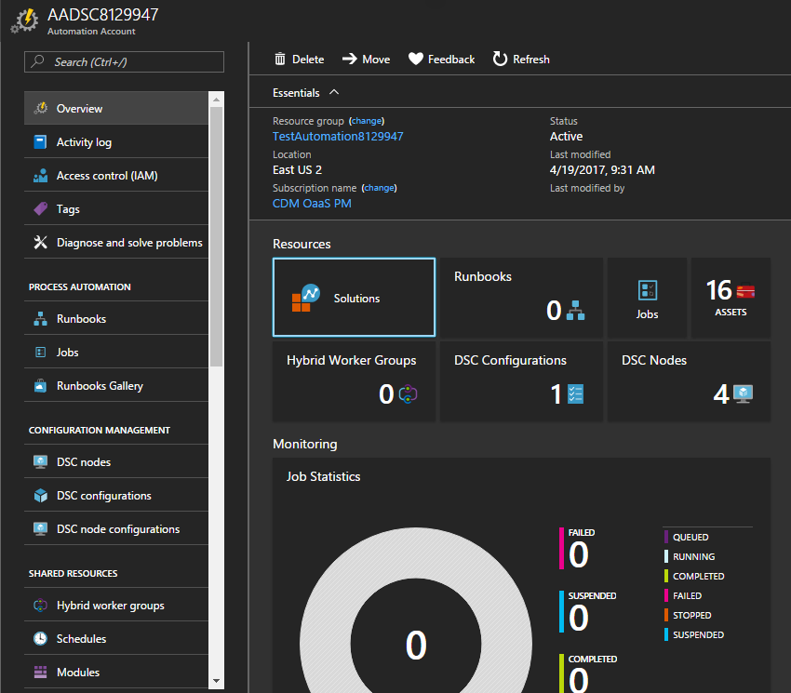
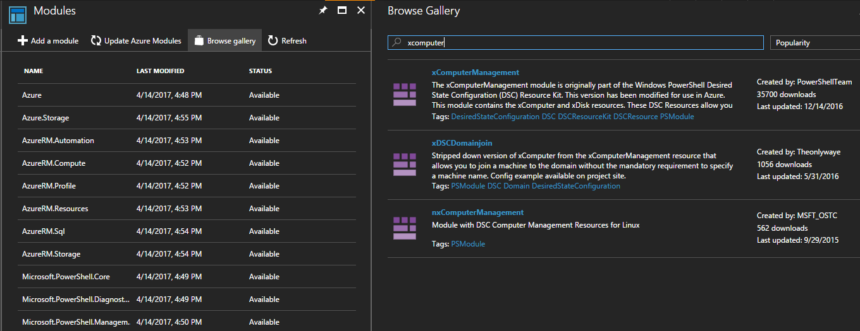
Community integration in Azure
Search for and import modules directly from the Gallery

Slide 9
Server
Configurations

Slide 10
Why
Simplify process of authoring
Simplify cloud hosted testing
Get script from gallery
Review assets
Make changes as needed
Run Automation
Define configuration
Load requirements into cloud services
Provision cloud VM’s
Validate configuration

Slide 11
Automate patch validation
What if, once a month, on the second Tuesday, you could automatically test whether any issues exist with the latest patches for every app in your catalog?

Slide 12
Automate change validation
What if you could test a new security policy change and whether it breaks any of the apps in your catalog?

Slide 13
Automate new OS releases
What if you could validate which of your applications have problems with a new OS version?

Slide 14
Without having to buy more servers

Slide 15
Server
Configuration
Sharing

Slide 16
Lessons learned
Configurations can be in scripts or modules
however, no tooling expects modules, so stick with scripts
Best to include one configuration per script, with name matching
Include scripting within Configuration scripts to be very efficient
Pair with a content module to deliver documentation, tests, etc

Slide 17
Methods of authoring configurations
Sample
Monolithic
Composite Resources

Slide 18
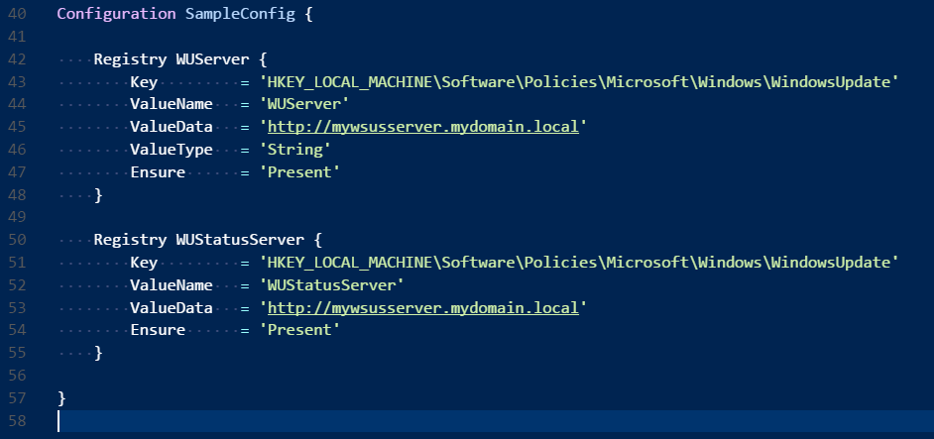
Sample example
Just a script file with a configuration
Use New-ScriptFileInfo to generate header painlessly

Slide 19
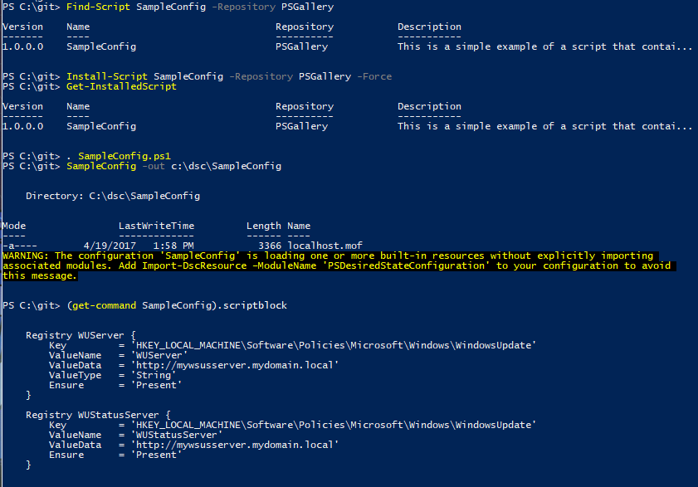
Sample practical

Slide 20
Monolithic explained
PS1 file for configuration
Module for tests, docs, manifest
Required module automatically installs
PowerShellGet
loads
RequiredModule
Module
Config
(installing script always installs the module)

Slide 21
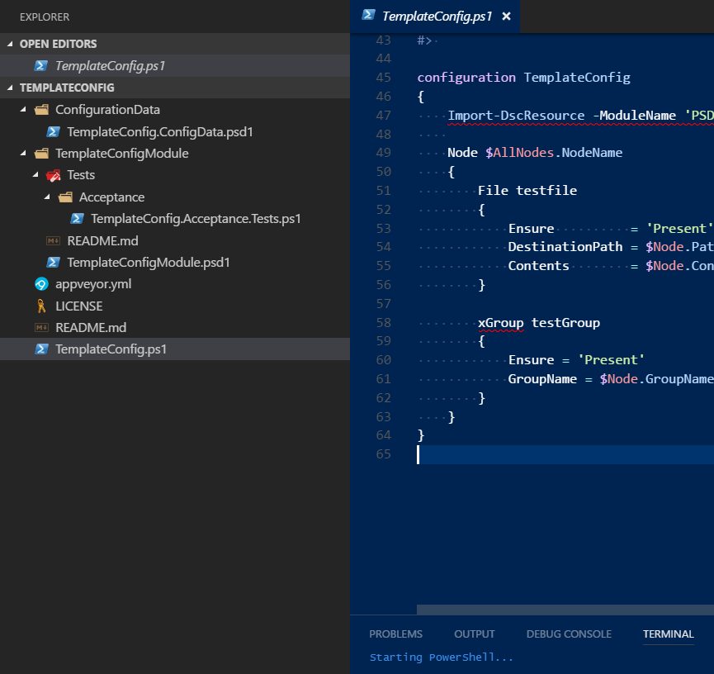
Monolithic example
Configuration / Environmental Data
Module
Tests
Manifest
README.md
Script
Other:
Build file
License
Documentation

Slide 22
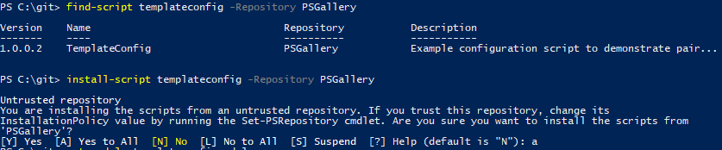
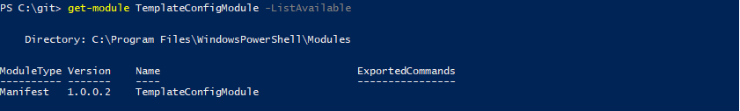
Monolithic practical

Slide 23
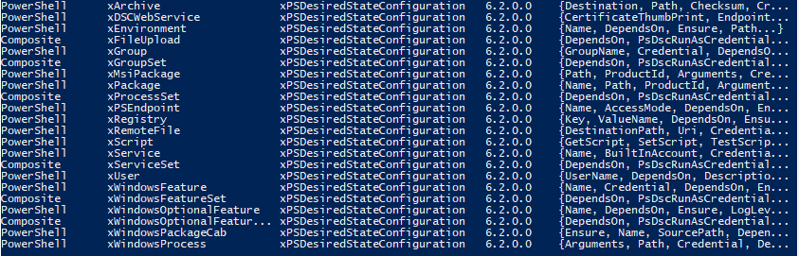
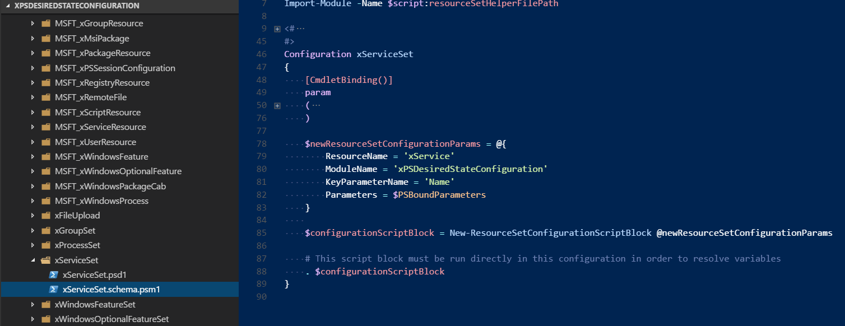
Composite explained
Configuration packaged as a Resource

Slide 24
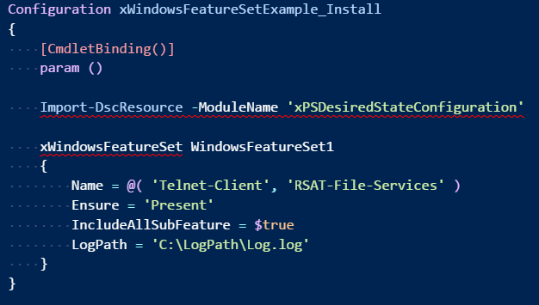
Composite examples

Slide 25
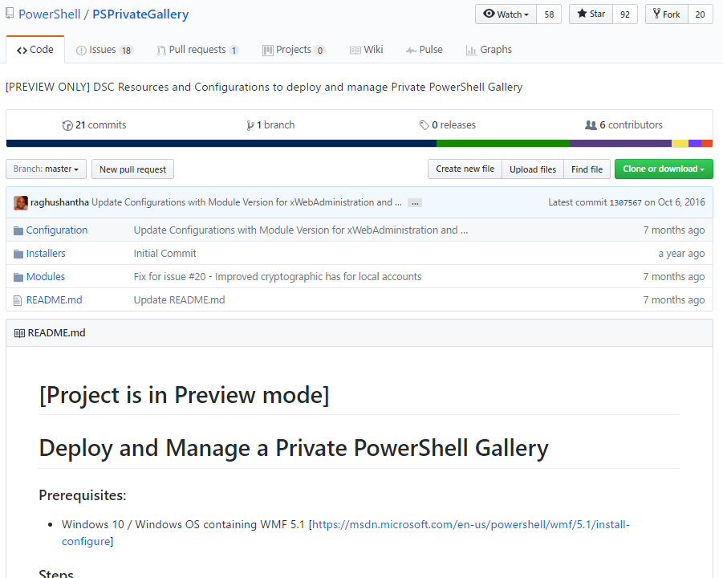
Hosting a private gallery
Any NuGet feed/service
File share
Privately hosted “Gallery” template

Slide 26
Authoring shared Configurations
Focus scripts on being readable rather than highly-efficient use of characters and lines
Take advantage of tools like PSScriptAnalyzer and VSCode
Identify requirements, where the Configurations are expected to work, and provide tests
Community has identified a quality baseline
https://github.com/PowerShell/DscResources/blob/master/HighQualityModuleGuidelines.md
Michael Lombardi has created an excellent guide to documentation
http://michaeltlombardi.gitlab.io/needful-docs/

Slide 27
New Community Repos
  DSCConfigurations
  http://github.com/powershell/dscconfigurations
  Submodules
  DSCConfiguration.Tests
  TemplateConfig

Slide 28
Automated testing
DSCConfigurations.Tests
  Designed for AppVeyor
  Eliminate as much manual work as possible
    (build scripts, linting, unit tests, Azure provisioning)
  REQUIRES Azure Subscription
Based on release pipeline concepts
Pester, Azure Automation DSC, Azure Virtual Machines
Supply OS metadata in PSPrivateData
Deletes Resource Group on completion

Slide 29
Potential to integrate with Community Tool Chain
This test-automation project has been focused on hosting
Opportunity to integrate familiar provisioning toolsets
  Test Kitchen
  Vagrant
  Terraform

Slide 30
DEMO

Slide 31
Real world problem solved
Tested xGroup in template with all supported versions of Windows Server
Uncovered issue with Get-ComputerInfo on Server 2008R2
Filing documentation bug and Issue for xPSDesiredStateConfiguration
https://github.com/PowerShell/xPSDesiredStateConfiguration/issues/339
https://msdn.microsoft.com/en-us/powershell/reference/5.1/microsoft.powershell.management/get-computerinfo
https://github.com/PowerShell/PowerShell-Docs/issues/1162

Slide 32
Future work
Potentially integrate with Kitchen for flexibility in Testing on many platforms
  Note - this process to this point has been focused on hosting the test environment. The complexity of the test matrix consists of:
  ForEach ($WindowsOSVersion in $Configuration.WindowsOSVersion) {
Integrate with Azure Test Labs to accelerate test time
Integrate Acceptance test examples from Demo_CI repo
Test scenarios with Hybrid Runbook Worker validating tagged Configuration scripts from private gallery environments
Documentation
Publish lots of configurations
Publish complex multi-node scenarios

Slide 33
More Information
Microsoft.com/PowerShell
GitHub.com/PowerShell/DSCConfigurations
Blog post
http://blogs.msdn.com/powershell

