Slide 1
Deploying for Day 100
Michael Greene
@migreene

Slide 2

Cloud deployment transformation
app owner:
operations/security:
storage
networking
virtual
machine
we have some questions

Slide 3
Assertion
at least some of these VM’s will run for more than 1 month

Slide 4
Challenges
these nodes will still need to be updated
diagnostic logs and information will still be critical post-mortem data
some part of the service will need a backup/recovery plan
organizations will still need to comply with policy

Slide 5
Hypothesis
Operators can enable application owners to deploy sustainable services using modern practices.

Slide 6
Sometimes cattle are a little bit pet-like
Immutable servers
  True North
  Doesn’t eliminate the need for operational practice
Incremental delivery
  Service existing application sets
  Adopt practices from immutable strategies where possible

Slide 7
Define: deployment
Provision
  Instantiate the environment
Deploy
  Enable the resources that are sustained by the environment
Configure
  Deliver the desired state of the resources
Install
  Add external code

Slide 8
Map tools to definitions
Provision
  ARM, Cloudformation, Terraform
Deploy
  OS/Container Image or Service content
Configure
  DSC, Ansible, Chef, Puppet, etc
Install
  NuGet, MSI, EXE, etc

Slide 9
Sustainable service roles (>30 days)
Provision
Deploy
Configure and Maintain
Install
Update
Monitor
Backup

Slide 10
deployment template content
Cursory view of Azure-Quickstart-Templates repo
  16 contain “Microsoft.OperationalInsights”
  10 contain “Microsoft.Automation”
  2 contain “Microsoft.Backup”
Opportunity for innovative contribution
  Think beyond deployment
  Composable embedded templates in application templates
  Refer to http://aka.ms/arm-omsall

Slide 11
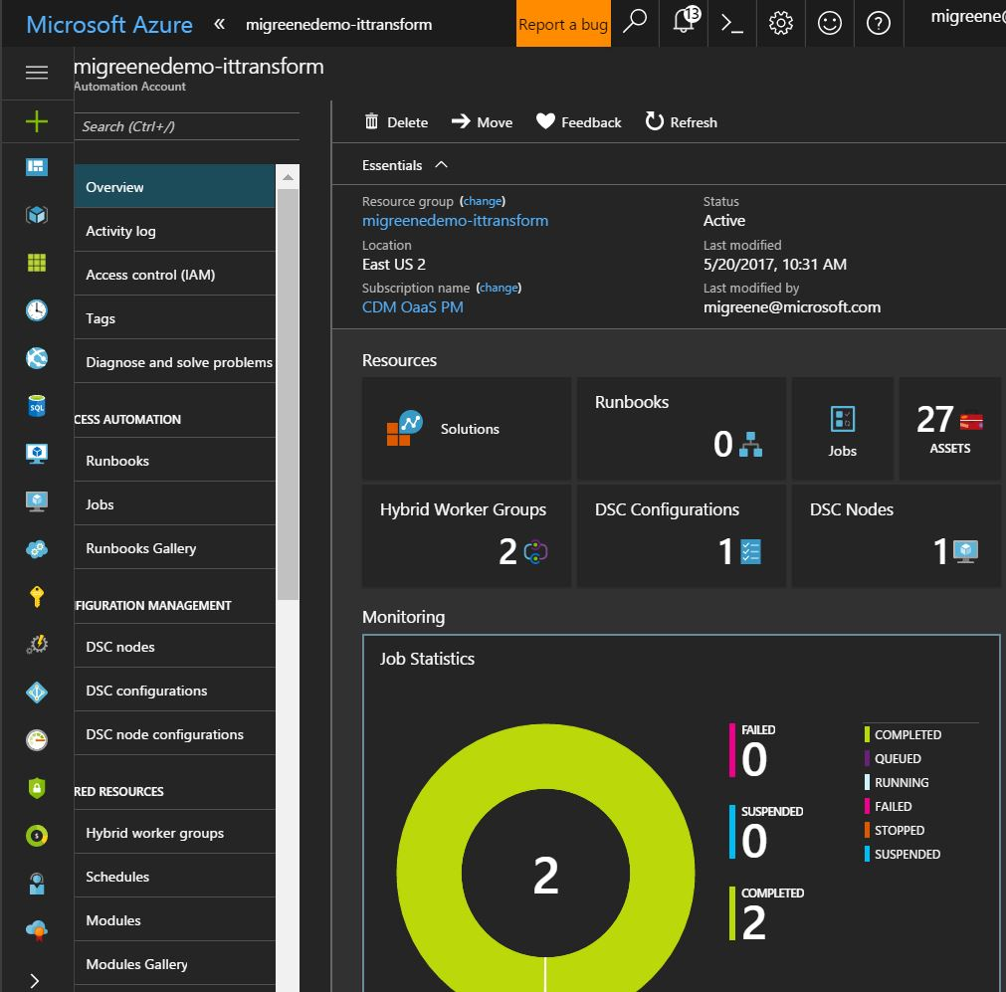
Operations Management
Automation
Motivation:
  Central Management of Distributed Task Execution (Runbooks)
  Configuration Management
  State Reporting
Design influences:
  Consider common account across application resource groups

Slide 12
ARM sample – Automation Resource type
{
"type": "Microsoft.Automation/automationAccounts",
"name": "[parameters('omsAutomationAccountName')]",
"apiversion": "2015-10-31",
"location": "[parameters('omsAutomationRegion')]",
"comments": "Automation account for OMS",
"properties": {
"sku": {
"name": "free"
}
},

Slide 13
ARM sample – Automation resource: variables
{
"name": "[variables(‘variableName')]",
"type": "variables",
"apiVersion": "2015-10-31",
"dependsOn": [
"[concat('Microsoft.Automation/automationAccounts/',parameters('omsAutomationAccountName'))]"
],
"tags": { },
"properties": {
"description": “name foo",
"value": “value bar“
-or-
"description": “name foo",
"userName": "[parameters(‘username’)]”,
"password": "[parameters(‘password')]"
}
},

Slide 14
ARM sample – Automation resource: modules
{
"name": "[variables('psModules’).Module.name]",
"type": "Modules",
"apiVersion": "2015-10-31",
"tags": { },
"dependsOn": [
"[concat('Microsoft.Automation/automationAccounts/', parameters('omsAutomationAccountName'))]"
],
"properties": {
"contentLink": {
"uri": "[variables('Modules’).Module.url]"
}
}
},

Slide 15
ARM sample – Automation resource: runbooks
{
"name": "[variables('runbooks’).Runbook.name]",
“type": "runbooks",
"apiVersion": "2015-10-31",
"dependsOn": [
“[concat('Microsoft.Automation/automationAccounts/', parameters('omsAutomationAccountName'))]",
"[concat('Microsoft.Automation/automationAccounts/', parameters('omsAutomationAccountName'), '/variables/’, variables(‘variableName'))]",
"[concat('Microsoft.Automation/automationAccounts/', parameters('omsAutomationAccountName'), ‘/modules/', variables('Modules’).Module.name)]", ],
"tags": { },
"properties": {
“runbookType": "[variables('runbooks’).Runbook.type]",
"logProgress": "false",
"logVerbose": "false",
"description": "[variables('runbooks’).Runbook.description]",
"publishContentLink": {
"uri": "[variables('runbooks’).Runbook.uri]",
"version": "[variables('runbooks’).Runbook.version]"
}
}

Slide 16
ARM sample – Automation resource: configuration
{
"name": "[variables(‘configurations’).Configuration.name]",
"type": "Configurations",
"apiVersion": "2015-10-31",
"tags": {},
"dependsOn": [
“[concat('Microsoft.Automation/automationAccounts/', parameters('omsAutomationAccountName'))]",
"[concat('Microsoft.Automation/automationAccounts/', parameters('omsAutomationAccountName'), '/variables/’, variables(‘variableName'))]",
"[concat('Microsoft.Automation/automationAccounts/', parameters('omsAutomationAccountName'), ‘/modules/', variables('Modules’).Module.name)]", ],
"properties": {
"logVerbose": "false",
"description": "[variables(configurations).Configuration.description]",
"state": "Published",
"overwrite": "[variables('configurations’). Configuration.overwrite]",
“source": {
"type": "uri",
“value": "[variables('configurations’). Configuration.uri]"
}
}
},

Slide 17
ARM sample – Automation resource: compilation
{
"name": "[variables(‘configurations’).Configuration.compilationjob]",
"type": "Compilationjobs",
"apiVersion": "2015-10-31",
“tags": {},
"dependsOn": [
“[concat('Microsoft.Automation/automationAccounts/', parameters('omsAutomationAccountName'))]",
"[concat('Microsoft.Automation/automationAccounts/', parameters('omsAutomationAccountName'), '/variables/’, variables(‘variableName'))]",
"[concat('Microsoft.Automation/automationAccounts/', parameters('omsAutomationAccountName'), ‘/modules/', variables('Modules’).Module.name)]",
"[concat('Microsoft.Automation/automationAccounts/', parameters('omsAutomationAccountName'), ‘/configurations/', variables(‘Configurations’).Configuration.name)]",
],
"properties": {
"configuration": {
"name": "[variables('configurations’). Configuration.name]"
}
}

Slide 18
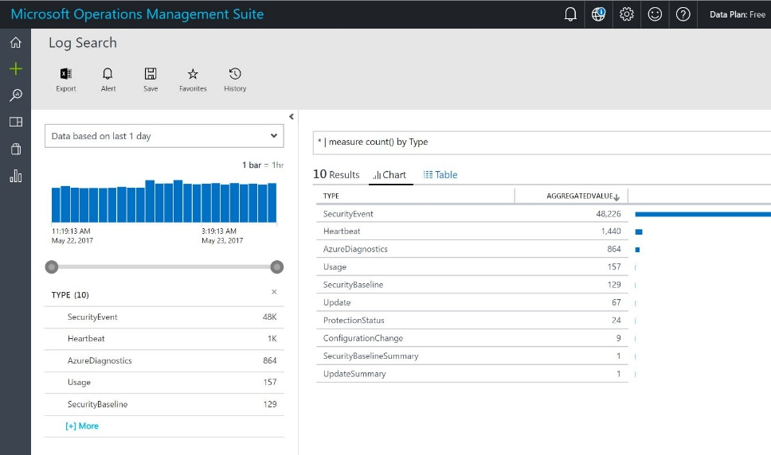
Operations Management
Log Analytics (OMS Workspace)
Motivation:
  Collect information from guest nodes
  Monitoring / Alerting
  Reporting / Dashboard
  Solutions
Design influences:
  Consider common account across application resource groups

Slide 19
ARM sample – OMS Workspace Resource type
{
"type": "Microsoft.OperationalInsights/workspaces",
"name": "[parameters('omsWorkspaceName')]",
"apiVersion": "2015-11-01-preview",
"location": "[parameters('omsWorkspaceRegion')]",
"comments": "Log Analytics workspace",
"properties": {
"sku": {
"name": “free"
}
},

Slide 20
ARM sample – Workspace resource: datasource
{
"name": "AzureActivityLog",
"type": "datasources",
"apiVersion": "2015-11-01-preview",
"dependsOn": [
"[concat('Microsoft.OperationalInsights/workspaces/', parameters('omsWorkspaceName'))]"
],
"kind": "AzureActivityLog",
"properties": {
"linkedResourceId": "[concat(subscription().id, '/providers/Microsoft.Insights/eventTypes/management')]"
}
},

Slide 21
ARM sample – Workspace resource: savedsearches
{
"name": "[concat(parameters('omsWorkspaceName'), '/', 'SoftwareUpdateFailed1')]",
"type": "Microsoft.OperationalInsights/workspaces/savedSearches",
"apiVersion": "2015-11-01-preview",
"dependsOn": [
"[concat('Microsoft.OperationalInsights/workspaces/’, parameters('omsWorkspaceName'))]"
],
"tags": {},
"properties": {
"ETag": "*",
"query": "Type=Event EventID=20 Source=\"Microsoft-Windows-WindowsUpdateClient\" EventLog=\"System\" TimeGenerated>NOW-24HOURS | Measure Count() By Computer",
"displayName": "A Software Update Installation Failed",
"category": "Software Updates"
}
},

Slide 22
ARM sample – Solution Resource type
{
"type": "Microsoft.OperationsManagement/solutions",
"name": "[concat(variables('batch1').solutions[copyIndex()].Name)]",
"apiVersion": "2015-11-01-preview",
"location": "[parameters('omsWorkspaceRegion')]",
"dependsOn": [
"[concat('Microsoft.OperationalInsights/workspaces/', parameters('omsWorkspaceName'))]"
],
"copy": {
"name": "solutionCopy",
"count": "[length(variables('batch1').solutions)]"
},
"properties": {
"workspaceResourceId": "[resourceId('Microsoft.OperationalInsights/workspaces', parameters('omsWorkspaceName'))]"
},
"plan": {
"name": "[variables('batch1').solutions[copyIndex()].name]",
"product": "[concat('OMSGallery/', variables('batch1').solutions[copyIndex()].marketplaceName)]",
"promotionCode": "",
"publisher": "Microsoft"
}
}

Slide 23
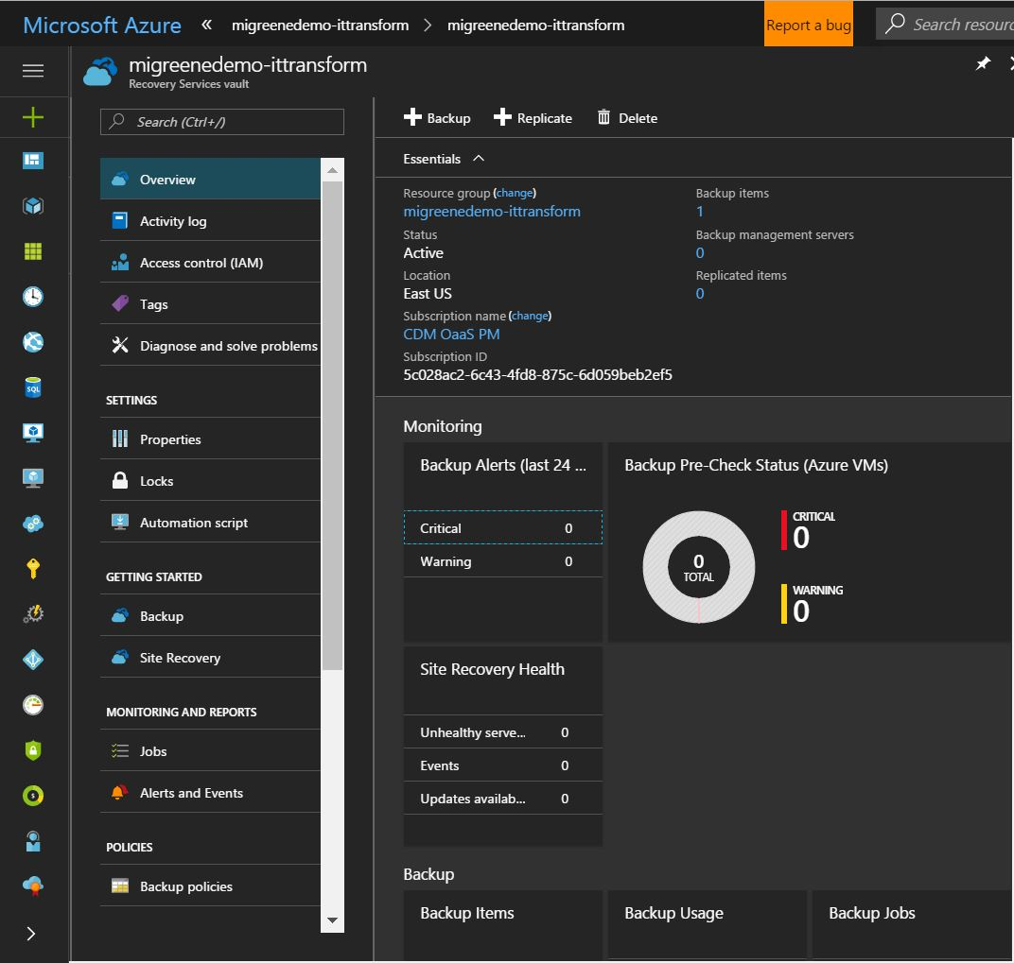
Operations Management
Recovery Services
Motivation:
  Backup guest VM
  File level recovery (preview)
Design influences:
  Leverages multiple OMS services
  Consider common account across application resource groups

Slide 24
ARM sample – Recovery Services Resource type
{
"type": "Microsoft.RecoveryServices/vaults",
"name": "[parameters('omsRecoveryVaultName')]",
"apiVersion": "2016-06-01",
"location": "[parameters('omsRecoveryVaultRegion')]",
"comments": "ASR Recovery Vault for OMS",
"sku": {
"name": "RS0",
"tier": "Standard"
},

Slide 25
ARM sample – Recovery Services resource: vault
{
"type": "Microsoft.Backup/BackupVault",
"apiVersion": "2015-03-15",
"name": "[parameters('vaultName')]",
"location": "[resourceGroup().location]",
"properties": {
"sku": {
"name": "[parameters('skuName')]"
}
}
}

Slide 26
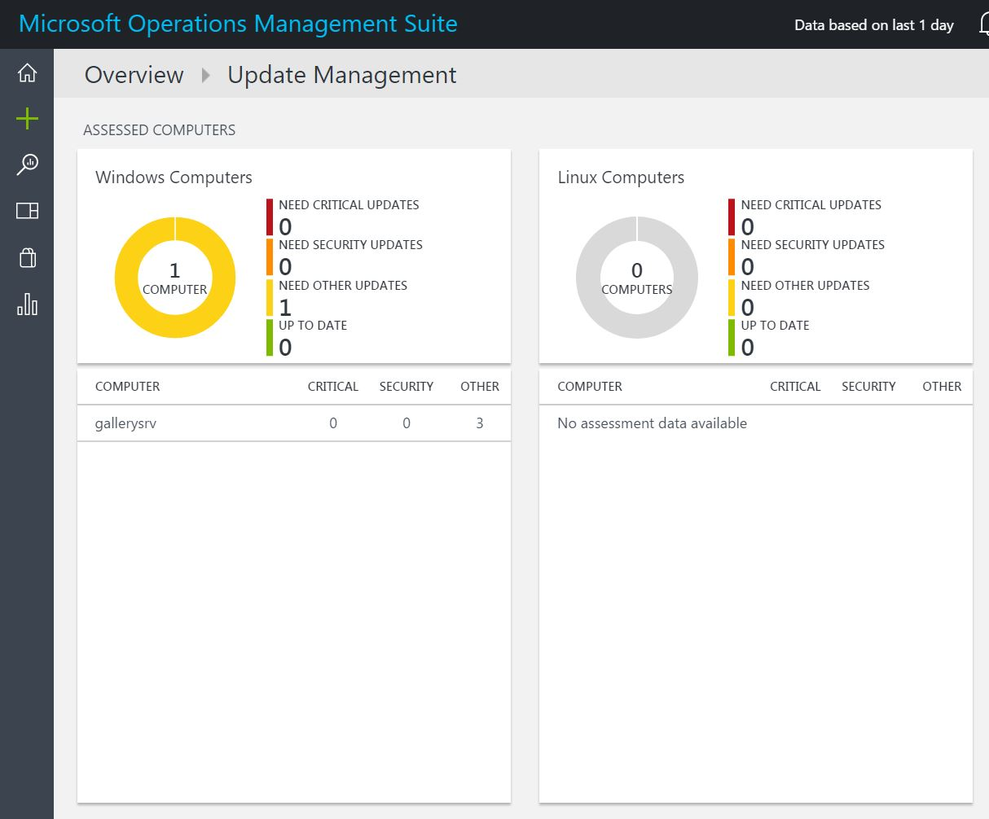
Operations Management
Update (OMS Workspace)
Motivation:
  Keep guest OS up to date with security and other updates
  Cross platform
Design influences:
  Leverages multiple OMS services
  Consider common account across application resource groups

Slide 27
ARM sample – OMS Workspace solutions
Delivered as component of OMS Workspace
"variables": {
"batch1": {
"solutions": [
{
"name": "[concat('Updates', '(', parameters('omsWorkspaceName'), ')')]",
"marketplaceName": "Updates"
},

Slide 28
Embedded templates
Concept:
  ARM templates can be nested for re-use
  Operations teams publish best practices and maintain the Release Pipeline
  Simplify for application owners by publishing, or automatically including embedded templates
{
"type": "Microsoft.Resources/deployments",
"apiVersion": "2016-02-01",
"name": "omsWorkspace",
“dependsOn": [
"[concat('Microsoft.Resources/deployments/', 'omsRecoveryServices')]"
],
"properties": {
"mode": "Incremental",
"templateLink": {
"uri": "[variables('nestedTemplates').omsWorkspace]",
"contentVersion": "1.0.0.0"
},
"parameters": {
"omsWorkspaceName": {
"value": "[parameters('omsWorkspaceName')]"
},
"omsWorkspaceRegion": {
"value": "[parameters('omsWorkspaceRegion')]"
}
}
},

Slide 29
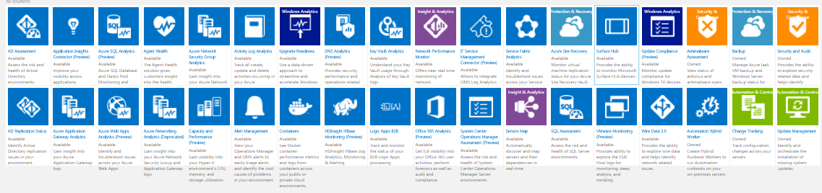
Additional Operational Services
Too many for this presentation
But, recommend Change Tracking, Malware Assessment, and Service Map
Then, application specific such as AD, SQL, and VMWare

Slide 30
DEMO
Operator User Experience
Explore Azure Portal
WITHOUT LOGGING IN TO A VM:
  What is it like to view diagnostic data?
  What is it like to deliver updates?
  What is it like to run scripts?
  What is it like to verify state?
What additional solutions should I consider?

Slide 31
References
Release Pipeline whitepaper
  http://aka.ms/thereleasepipelinemodel
OMS-All Azure community template
  http://aka.ms/arm-omsall
Twitter: @migreene

Slide 32
Questions?
Please use Events XD (EventBoard)
to fill out a session evaluation.
Thank you!

