Slide 1
Boise Python Developers Meetup
IPython Notebook Basics?
Mike Grindle
mgca208@summitxo.com

Slide 2
What is an IPython Notebook?
Web browser based interactive environment
Code cells, Rich text, Graphics, Multimedia
Generate output or convert to PDF, HTML
Share as a static web page
Flexible, controlled Parallel Processing
Interactive multi-user collaboration

Slide 3
What Do You Need?
Packages:
  python – v2 or v3
  ipython
Sources:
  Your distro repository
  https://pypi.python.org/pypi/ipython
  https://github.com/ipython/ipython

Slide 4
Let's Get Started
Open a terminal session
  Enter: ipython notebook
  You need to kill process when done!
What do you get?
  Command entry history

Slide 5
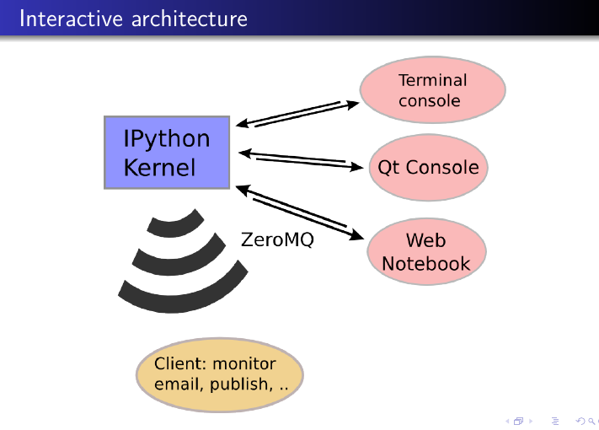
Behind the Pretty Picture

Slide 6
IPython “Magic”
Notebook uses IPython Magic
Line Magic and Cell Magic
  Run system commands
  Start/run other languages
  Connect to web services
  Collaborate with other users
Notebook: basic-steps.ipynb

Slide 7
Let's See Some Examples
Rich Output
Text
Graphics
Multimedia
Notebook: rich-output.ipynb

Slide 8
Embed Other Interpreters
Run other languages within
A Notebook
Notebook: other-languages.ipynb

Slide 9
Embed Other Programs Results
Octave – Matlab compatible
R – statistical package
Notebook: octave-magic.ipynb
trapezoid-rule.ipynb

Slide 10
Links:
IPython Notebook Introduction – homepage:
http://ipython.org/ipython-doc/stable/notebook/index.html
http://ipython.org/notebook.html
IPython Official Repository (GitHub):
https://github.com/ipython/ipython
Good overview of early capabilities:
https://www.youtube.com/watch?v=26wgEsg9Mcc
Python Docs with Notebook:
http://nbviewer.ipython.org/github/ipython/ipython/blob/master/examples/Index.ipynb
Gallery of Interesting IPython Notebooks:
https://github.com/ipython/ipython/wiki/A-gallery-of-interesting-IPython-Notebooks
Using Ipython Notebook on Parallel Cluster:
http://web.mit.edu/STAR/cluster/docs/latest/plugins/ipython.html
http://www.astro.washington.edu/users/vanderplas/Astr599/notebooks/21_IPythonParallel

