Slide 1

Traffic management system
Project undertaken towards fulfilment of CSE499 Capstone Project under the guidance of Dr. Asnath Victy Phamila Y
Dayanidhi Krishna | 14BCE1119
T.R. Shreyas | 14BCE1245
M.G. Ritwik | 14BCE1249

Slide 2
Contents
Abstract
Review 1 – A brief recap
Architecture
Hardware Design
International Standards
Image Processing Implementation
Hardware Implementation
Goals/Objectives for Final Review

Slide 3
ABSTRACT
A dynamic traffic management system is proposed in response to the challenges posed by the traditional approach. The challenge of identifying the density of traffic on each lane is first tackled following which an integrated system is developed which schedules each lane's traffic on the basis of an alternative algorithm driven by traffic density.

Slide 4
Review 1 – A Brief recap
Motivation for taking up this project/Project Statement
01
Literature Review
02
Project Design
03
Image Processing Implementation
04

Slide 5


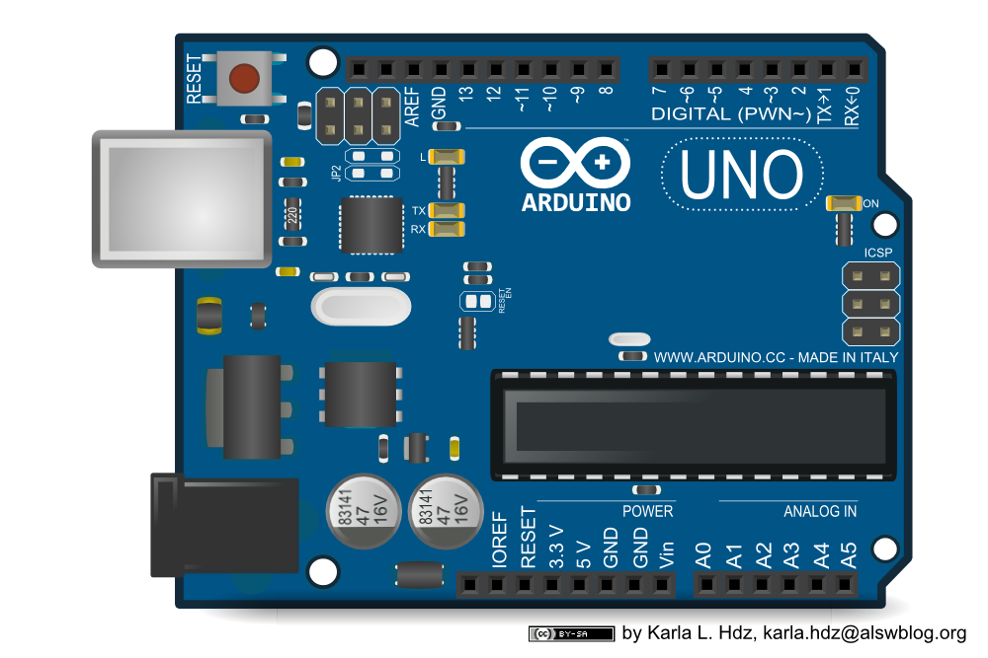
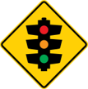
HARDWARE DESIGN
Density
Evaluation
Signal Change
Acquisition
Video Feed from Camera
Server/
Buffer DB
Aurdino
Traffic

Slide 6
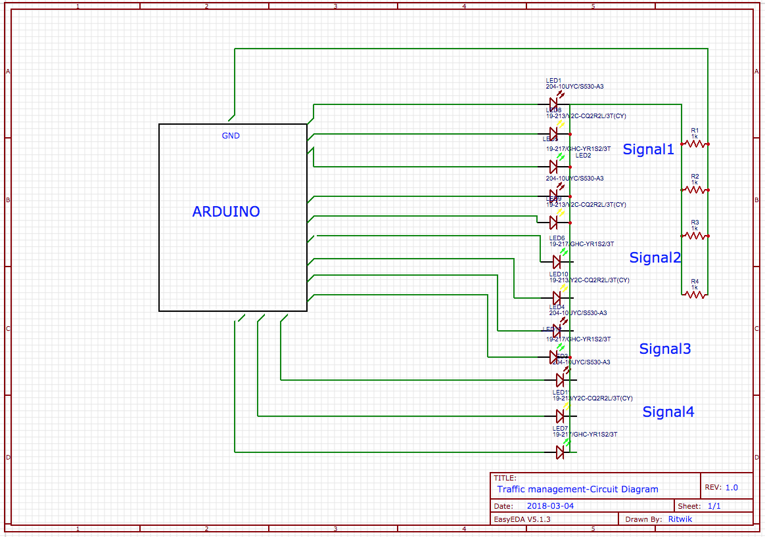
Circuit diagram

Slide 7
Interaction between the various modules
Density after video analysis using MATLAB
Transmission of CSV formatted density values of each lane to Arduino
Alteration of time quantum of active lane and selection of next lane on the basis of latest density value
Signaling Algorithm to trigger corresponding ports to on/off applicable Traffic Lights

Slide 8
International Standards and Codes
ISO 39001 & ISO 39002 are only internationally recognized standards for traffic management
Mandates the need for mutual exclusion between signals at different traffic lights to prevent clashing active states, i.e. a Conflict Monitor Unit.
Specific to used Arduino Board
USB utilized for communication with server
Maximum current of 500mA
Voltage between 7V to 12V for safe predictable outcomes

Slide 9
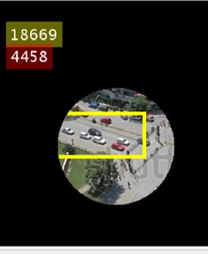
Image Processing
maskedImageTemp = maskedImage .* 255;
%to display the number of pixels on the image
y= maskedImageTemp(:,:,1)>0 & maskedImageTemp(:,:,2)>0 & maskedImageTemp(:,:,3)>0;
numPixelstotal = sum(y(:))
position = [30 30];
box_color = {'yellow'};
maskedImage = insertText(maskedImage,position,numPixelstotal,'FontSize',20,'BoxColor',box_color,'BoxOpacity',0.4,'TextColor','white');
z= maskedImageTemp(:,:,1)>165 & maskedImageTemp(:,:,1)<185 & maskedImageTemp(:,:,2)>165 & maskedImageTemp(:,:,2)<185 & maskedImageTemp(:,:,3)>165 & maskedImageTemp(:,:,3)<185;
numPixels = sum(z(:))
position = [30 60];
box_color = {'red'};
maskedImage = insertText(maskedImage,position,numPixels,'FontSize',20,'BoxColor',box_color,'BoxOpacity',0.4,'TextColor','white');

Slide 10
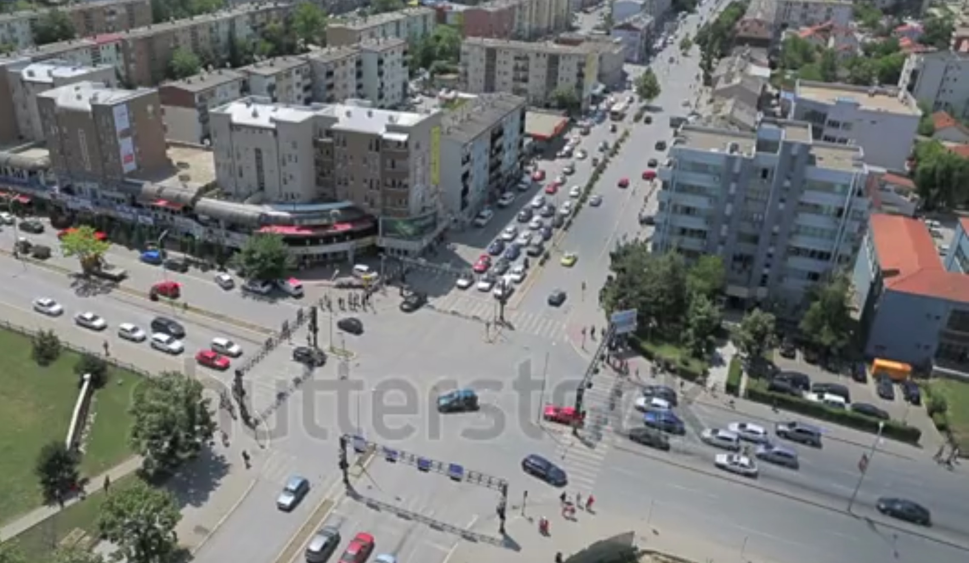
Video Acquisition & Frame Extraction
fontSize=20;
varx=0;
foregroundDetector = vision.ForegroundDetector('NumGaussians', 3, 'NumTrainingFrames', 50);
videoReader = vision.VideoFileReader('footage.mp4');
for i = 1:150
% read the next video frame
frame = step(videoReader);
foreground = step(foregroundDetector, frame);
end
figure; imshow(frame);
title('Video Frame');
figure; imshow(foreground); title('Foreground');

Slide 11
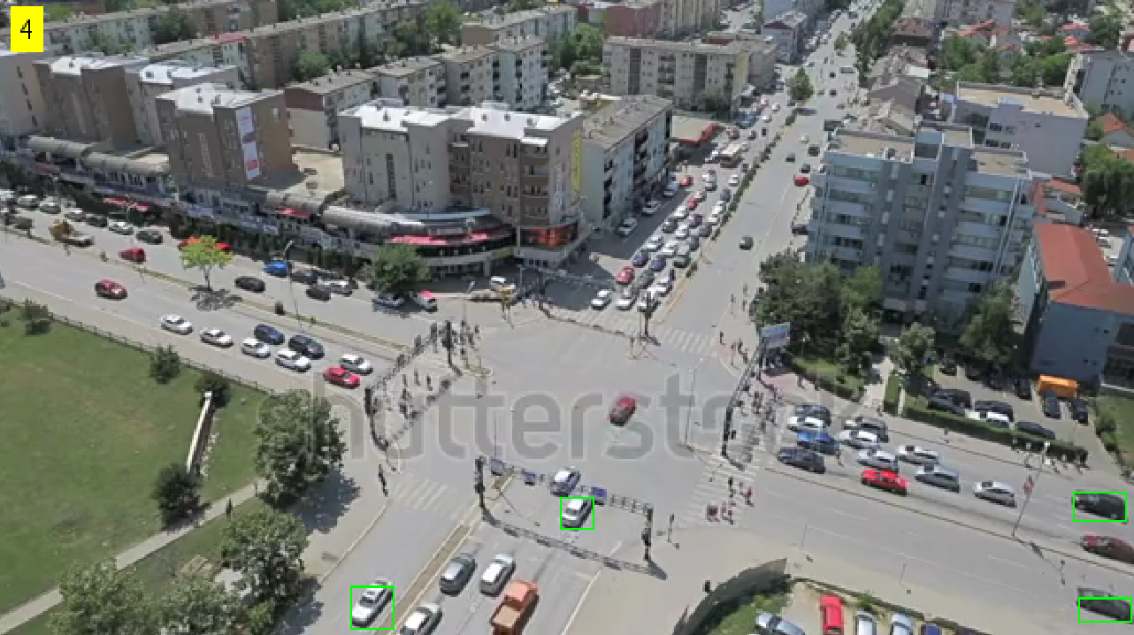
Blob analysis
se = strel('square', 3);
filteredForeground = imopen(foreground, se);
%figure; %imshow(filteredForeground); %title('Clean Foreground');
blobAnalysis = vision.BlobAnalysis('BoundingBoxOutputPort', true, 'AreaOutputPort', false, 'CentroidOutputPort', false,'MinimumBlobArea', 150);
bbox = step(blobAnalysis, filteredForeground);
result = insertShape(frame, 'Rectangle', bbox, 'Color', 'green');
numCars = size(bbox, 1);
result = insertText(result, [10 10], numCars, 'BoxOpacity', 1,'FontSize', 14);

Slide 12
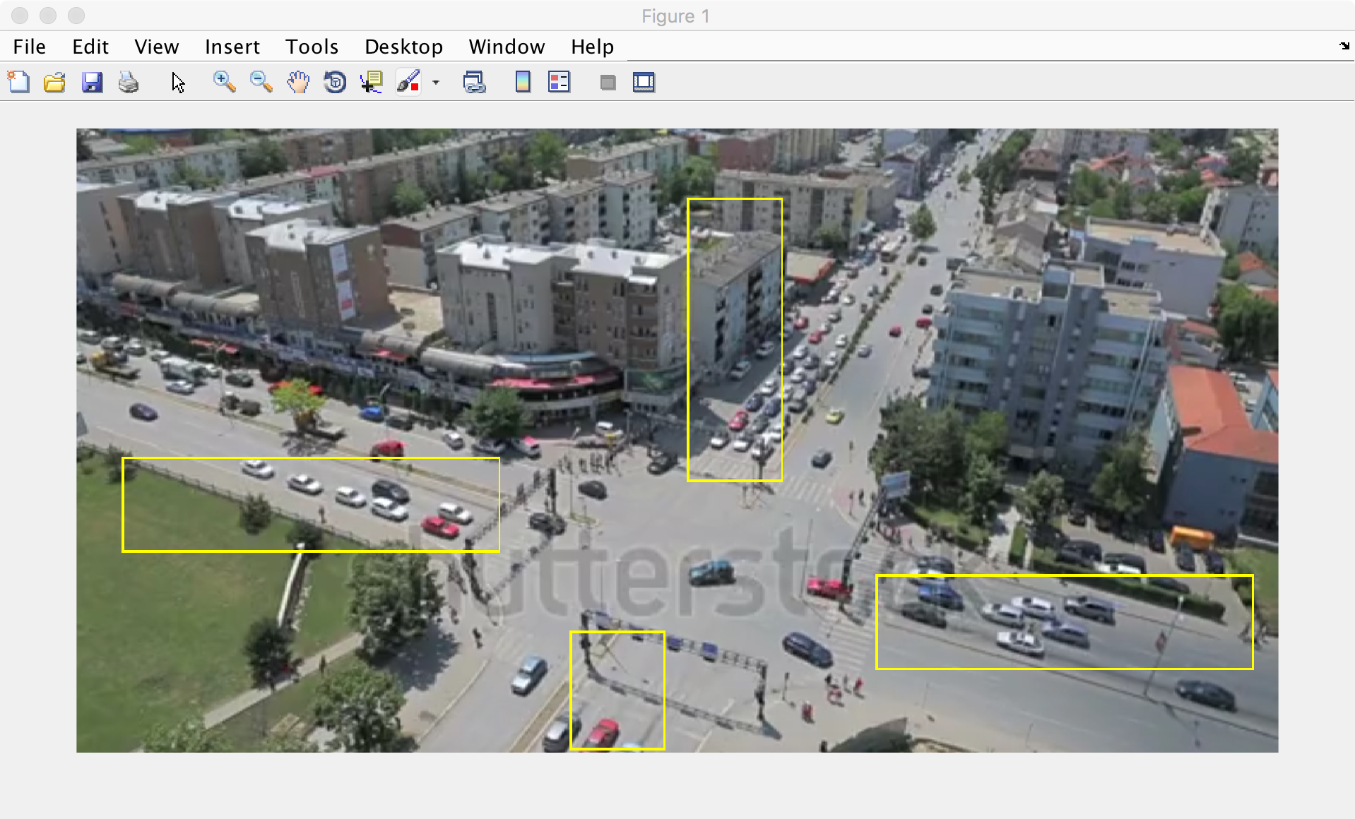
Setting Region of Interest
result = insertShape(result,'rectangle',[50 155 170 60],'LineWidth',5);
result = insertShape(result,'rectangle',[400 200 170 60],'LineWidth',5);
result = insertShape(result,'rectangle',[310 40 45 130],'LineWidth',5);
result = insertShape(result,'rectangle',[245 265 60 65],'LineWidth',5);

Slide 13
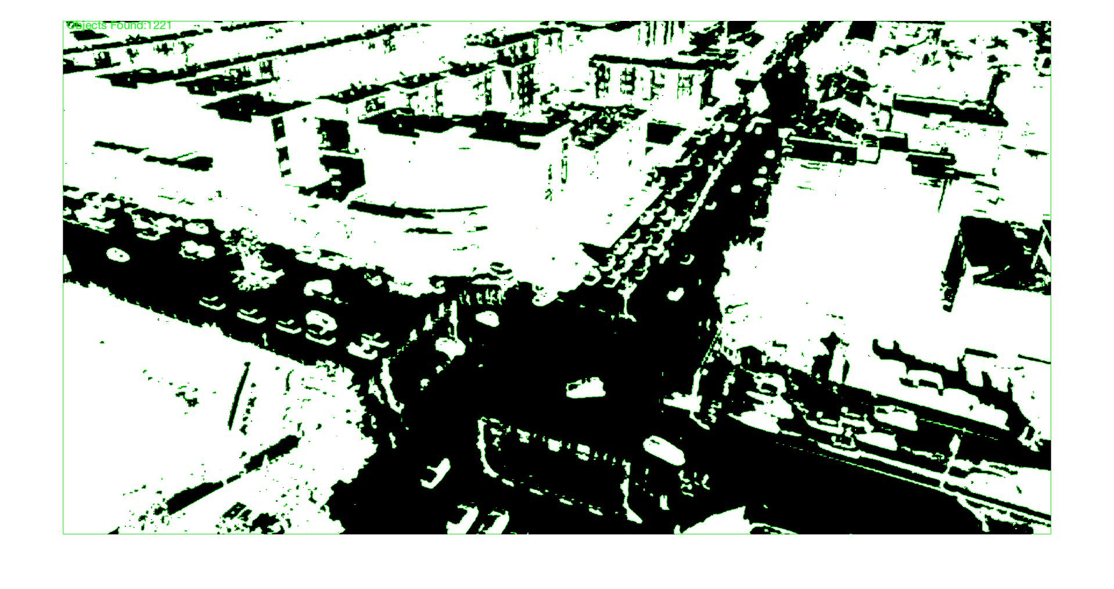
Stationery pixel detection
img1=imread('screenShot.jpg');
imshow(img1)
img1=rgb2gray(img1);
imshow(img1)
img2=im2bw(img1,graythresh(img1));
imshow(img2)
img2=~img2;
imshow(img2)
B = bwboundaries(img2);
imshow(img2)
text(10,10,strcat('\color{green}Objects Found:',num2str(length(B))))
hold on
for k = 1:length(B)
boundary = B{k};
plot(boundary(:,2), boundary(:,1), 'g', 'LineWidth', 0.2)
end

Slide 14
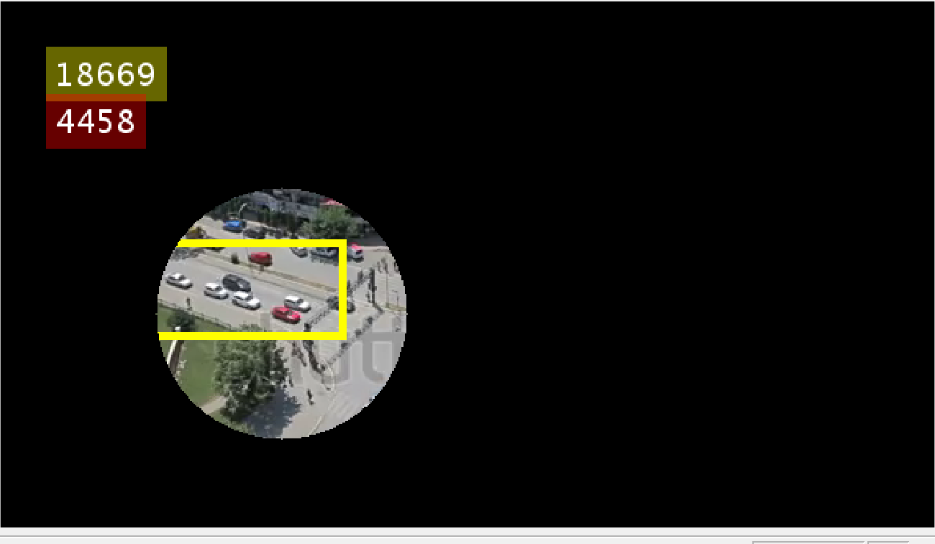
Grey Pixel Counting
maskedImageTemp = maskedImage .* 255;
%to display the number of pixels on the image
y= maskedImageTemp(:,:,1)>0 & maskedImageTemp(:,:,2)>0 & maskedImageTemp(:,:,3)>0;
numPixelstotal = sum(y(:))
position = [30 30];
box_color = {'yellow'};
maskedImage = insertText(maskedImage,position,numPixelstotal,'FontSize',20,'BoxColor',box_color,'BoxOpacity',0.4,'TextColor','white');
z= maskedImageTemp(:,:,1)>165 & maskedImageTemp(:,:,1)<185 & maskedImageTemp(:,:,2)>165 & maskedImageTemp(:,:,2)<185 & maskedImageTemp(:,:,3)>165 & maskedImageTemp(:,:,3)<185;
numPixels = sum(z(:))
position = [30 60];
box_color = {'red'};
maskedImage = insertText(maskedImage,position,numPixels,'FontSize',20,'BoxColor',box_color,'BoxOpacity',0.4,'TextColor','white');

Slide 15
Hardware Implementation – 1
int red1 = 1, yellow1 = 2, green1 = 3, red2 = 4, yellow2 = 5, green2 = 6, red3 = 7, yellow3 = 8, green3 = 9, red4 = 10, yellow4 = 11, green4 = 12;
int sort_desc(const void *cmp1, const void *cmp2)
{
// Need to cast the void * to int *
int a = *((int *)cmp1);
int b = *((int *)cmp2);
// The comparison
return a > b ? -1 : (a < b ? 1 : 0);
// A simpler, probably faster way:
//return b - a;
}

Slide 16
Hardware Implementation - 2
void setup() { pinMode (red1, OUTPUT); pinMode (yellow1, OUTPUT); pinMode (green1, OUTPUT); pinMode (red2, OUTPUT); pinMode (yellow2, OUTPUT); pinMode (green2, OUTPUT); pinMode (red3, OUTPUT); pinMode (yellow3, OUTPUT); pinMode (green3, OUTPUT); pinMode (red4, OUTPUT); pinMode (yellow4, OUTPUT); pinMode (green4, OUTPUT);
// The array int lt[6] = {35, 15, 80, 2, 40, 110}; // Number of items in the array int lt_length = sizeof(lt) / sizeof(lt[0]); // qsort - last parameter is a function pointer to the sort function qsort(lt, lt_length, sizeof(lt[0]), sort_desc); // lt is now sorted }

Slide 17
Hardware implementation - 3
digitalWrite(yellow1, LOW);
digitalWrite(yellow2, LOW);
digitalWrite(red1, HIGH);
digitalWrite(green2, HIGH);
delay(4000);
}
void loop(){
digitalWrite(green1, HIGH);
digitalWrite(red2, HIGH);
digitalWrite(red3, HIGH);
digitalWrite(red4, HIGH);
delay(4000);
digitalWrite(green1, LOW);
digitalWrite(red2, LOW);
digitalWrite(yellow1, HIGH);
digitalWrite(yellow2, HIGH);
delay(1000);

Slide 18
Traffic control and coordination
The normal function of traffic lights requires more than slight control and coordination to ensure that traffic and pedestrians move as smoothly, and safely as possible. A variety of different control systems are used to accomplish this, ranging from simple clockwork mechanisms to sophisticated computerized control and coordination systems that self-adjust to minimize delay to people using the road.
Phases and stages- Traffic controllers use the concept of phases, which are directions of movement grouped together. For instance, a simple T-junction may have three vehicle movement phases, one for each arm of the junction. There may be additional phases for other movements such as pedestrians, cyclists, bus lanes or tramways. A stage is a group of non-conflicting phases which move at the same time.

Slide 19
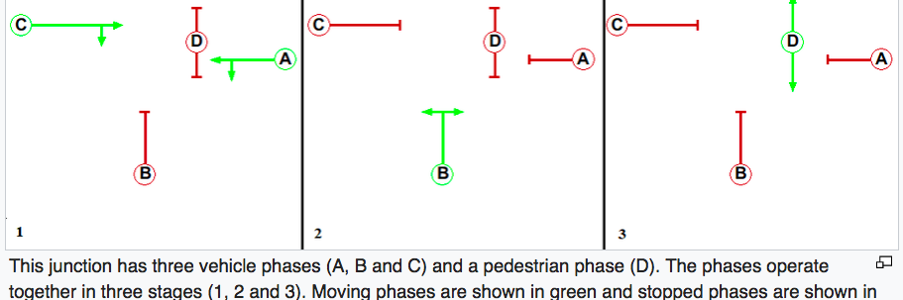
Traffic control and coordination(contd.)

Slide 20
Traffic control and coordination(contd.)
FIXED TIME CONTROL - Simple and primitive, synchronized switching.
COORDINATED TIME CONTROL - Attempts are often made to place traffic signals on a coordinated system so that drivers encounter a green wave, a long string of green lights (the technical term is progression). The distinction between coordinated signals and synchronized signals is very important. Synchronized signals all change at the same time and are only used in special instances or in older systems. Coordinated (progressed) systems are controlled from a master controller and are set up so lights "cascade" (progress) in sequence so platoons of vehicles can proceed through a continuous series of green lights. In some countries this "green band" system is used to limit speeds in certain areas. Lights are timed in such a way that motorists can drive through without stopping if their speed is lower than a given limit, mostly 50 km/h (30 mph) in urban areas.
ADAPTIVE CONTROL-In modern coordinated signal systems, it is possible for drivers to travel long distances without encountering a red light. Traffic lights are sometimes centrally controlled by monitors or by computers to allow them to be coordinated in real time to deal with changing traffic patterns. Video cameras, or sensors buried in the pavement can be used to monitor traffic patterns across a city.

Slide 21
Goals and Objectives for Final Review
Scheduling Algorithm
Integrate all three components (Image Processing, Signaling & Scheduling)
Incorporate integration and scheduling algorithm into Research Paper
Submit Paper for review and publication
Finalize Specifications of product for project

