Slide 1

ATMS 597 Weather and Climate Data Science Project 3 Group 2
Divyansh Chug, Max Grover, David Lafferty
Location: Mumbai, India
Season: JJA

Slide 2

Find Extreme Precipitation Days
Downloaded Data
Calculate Averages and Anomalies
Pull in NCEP/NCAR Reanalysis data
Plot Final Results
Create plots for:
Selected Mumbai, India
Calculated Cumulative Distribution Function
Long term averages
Daily data
Subset daily data for extreme days
Calculate mean of long term and extreme days
Calculate Anomalies
Extreme – Long Term
Surface level
Total Column WV
Pressure levels
250 hPa
500 hPa
850 hPa
List of Extreme Days (>95th Percentile)
NetCDF files

Slide 3
Global Precipitation Climatology Project cumulative distribution function

Slide 4
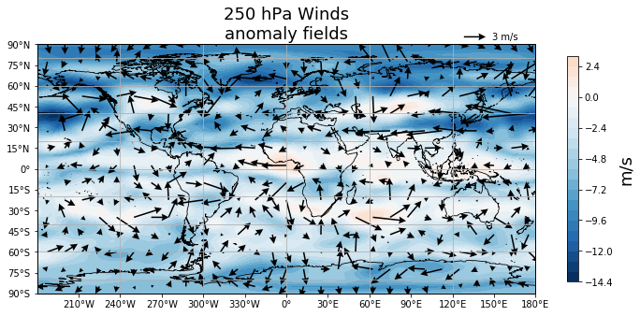
NCEP Reanalysis Anomalies 250 hPa wind vectors and wind speed

Slide 5
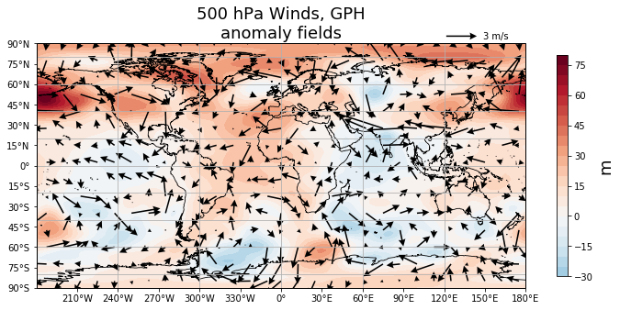
NCEP Reanalysis Anomalies 500 hPa wind vectors and geopotential height

Slide 6
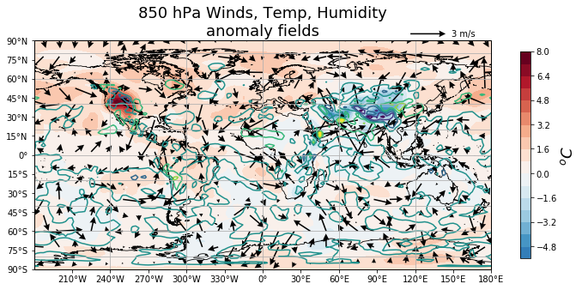
NCEP Reanalysis Anomalies
850 hPa temperature, specific humidity, and winds

Slide 7
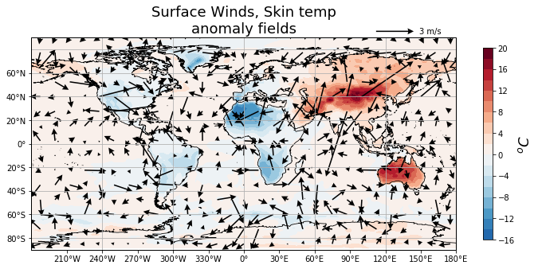
NCEP Reanalysis Anomalies
skin temperature and surface wind vectors

Slide 8
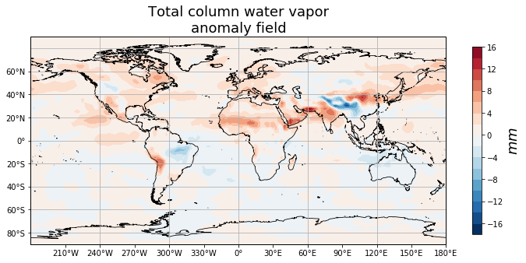
NCEP Reanalysis Anomalies
total atmospheric column water vapor

Slide 9



Acknowledgments

