Slide 1
You may already be using AOP
Matthew D. Groves
PostSharp MVP

Slide 2
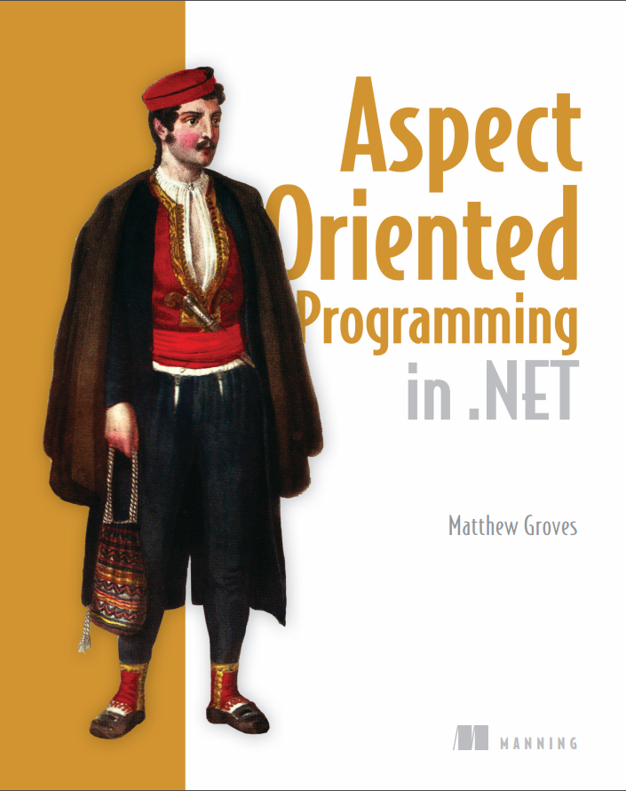
Notes:
Thanks Britt,
When I started speaking about AOP to user groups and conferences, I would often get asked to recommend a book. There are some good books out there, but they are either Java focused or very academically focused. So I thought that an AOP book with a .NET and real-world aspect focus would be a good idea.
I’m working on a book, it’s almost done. You can read it in ‘early preview’ now. Manning has provided a discount code for you to purchase this book, and I’ll be sharing that at the end of the session.
Today’s session is a very basic introduction to AOP. I’m going to introduce you to it via some of the tools available with ASP.NET that you might already be familiar with.

Slide 3

AOP sounds complicated…
Aspect-Oriented Programming
Pointcuts
Advice
Join points
Scattering
Tangling
Weaving
Post-compile IL manipulation
Runtime proxy generation
Cross-cutting concerns
http://www.flickr.com/photos/tripphotogallery/4059486159/

Slide 4
…but it’s not!
Instead of writing the same pattern manually over and over again…
…AOP lets you write it once and automatically apply it.

Slide 5
Aspect-oriented programming
class BusinessModule1 {
… core data members
… logging members
public Method1() {
… log start
… core operation
… log end
}
public Method2() {
… log start
… core operation
… log end
}
}
class BusinessModule2 {
… core data members
… logging members
public Method1() {
… log start
… core operation
… log end
}
public Method2() {
… log start
… core operation
… log end
}
}
*diagram by Xiaoran Wang of programcreek.com
Notes:
Business logic AND logging
Tangling: how do we split out the logging code to encapsulate it?
Scattering: how do we re-use the encapsulate code?

Slide 6
Aspect-oriented programming
class BusinessModule1 {
… core data members
public Method1() {
… core operation
}
}
class LogAspect {
… logging members
public BeginMethod() {
… log start
}
public EndMethod() {
… log end
}
}
AOP tool
class BusinessModule1 {
… core data members
… logging members
public Method1() {
… log start
… core operation
… log end
}
}
*diagram by Xiaoran Wang of programcreek.com
Notes:
Aspect-oriented programming introduce the idea of “weaving”
So you take the logging out of the business modules
Put logging into it’s own class, called an “aspect”
Tell the AOP tool which modules that the logging aspect should be applied to
The AOP tool will “weave” them together (possibly right after compiling, possibly at runtime)
The “generated” code still looks and runs basically like it did before
But the code you maintain and work with is nicely separated

Slide 7
Let’s do some coding
ASP.NET has some AOP features built in
HttpModule (requests)
ASP.NET MVC ActionFilter (actions)
PostSharp
OnMethodBoundaryAspect (methods)

Slide 8
Next week…
“Call This Instead: Intercepting Methods”
What interception means
How to write a method interception PostSharp aspect
A practical example of a data transaction aspect
PostSharp 3 RTM available now
Notes:
Go to postsharp.net download page

Slide 9
Use code 13psaop for 40% off http://manning.com/groves
http://about.me/mgroves
Notes:
Use the promo code for 40% off the book (it’s an early preview now called a MEAP)
Questions, comments, feedback, you can contact me via email or twitter by first going to about.me/mgroves

