Slide 1
Call This Instead: Intercepting Methods
Matthew D. Groves
PostSharp MVP

Slide 2
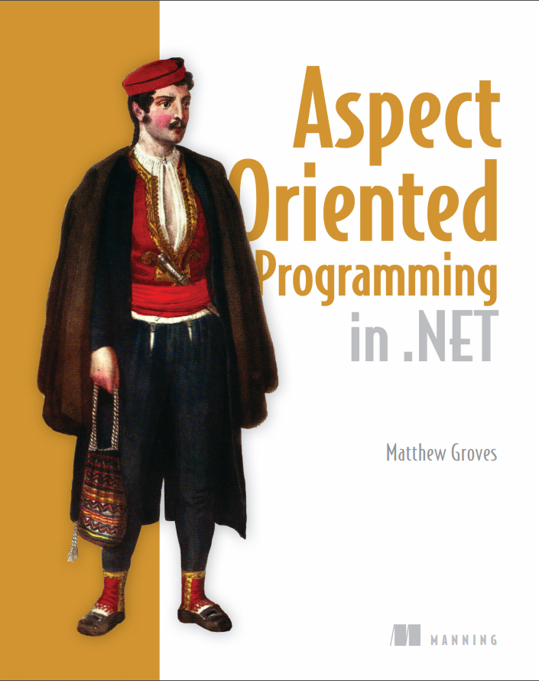
Notes:
Thanks Britt,
As I said last week, I’m working on a book, it’s almost done. You can read it in ‘early preview’ now. It is not just about PostSharp, but there is a lot of PostSharp in it. Manning has provided a discount I’ll be sharing that at the end of the session.
Today’s session is an introduction to Method Interception with PostSharp. We’ll look at what method interception means, how to write a method interception aspect with PostSharp, and we’ll create a practical aspect to help us with data transactions

Slide 3
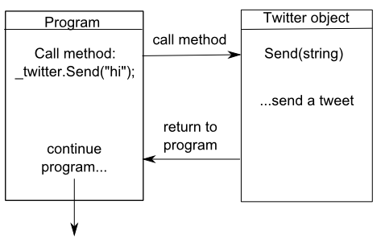
Normal program flow
Notes:
Before we talk about interception, let’s talk about normal program flow.
My program makes a method call on an object. Program flow switches to running the code in that method
When the method finishes, program flow goes back to the calling code (sometimes there’s a return value)
In this example, I’m calling a “Send” method on a twitter object. The twitter objects “send” method executes and then the program resumes.

Slide 4
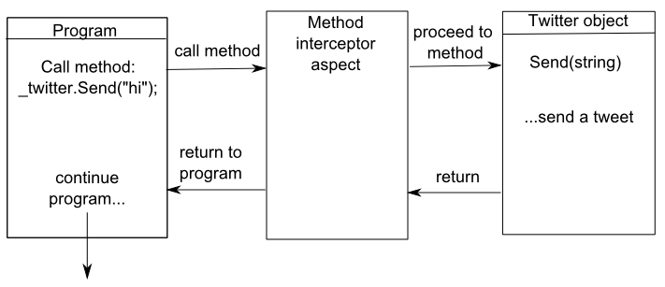
Program flow with interception
Notes:
Let’s suppose we put a middle-man in between the program and the twitter object.
This middle man allows you to add behavior between the program and the twitter object. It is “intercepting” calls to the Send method, and runs instead of the Send method.

Slide 5
Inside the interceptor…
Add behavior
Execute code before/after/instead of the method
Get the method’s context
Type, instance, arguments, return value, etc
Change the method’s context
Arguments, return value
Control flow of program
Proceed to the method (or not)

Slide 6
Let’s do some coding
PostSharp
How to write a MethodInterceptionAspect
Data transaction aspect
Data transaction
Begin/Commit/Rollback
.NET’s TransactionScope
Minimal
Notes:
We’ll write a simple MethodInterceptionAspect just to see how it works.
Then we’ll write a more practical aspect to help with data transactions.
Data transactions involve begin/commit/rollback: some data operations require multiple steps, but we want them to behave as if they were atomic (all or nothing)
.NET has a TransactionScope object that makes it easy to do transactions, assuming your underlying database supports it
When I say “minimal”, I mean that we could add more features like retry, retry only with specific exceptions, retry with logging, etc.
I don’t think we can cover a full example in the allotted time, but if you are interested, there is a data transaction example in the book that is more in-depth

Slide 7
Next week…
“Before and After: Boundary Aspects”
What are the four method boundaries?
Writing a PostSharp method boundary aspect
A practical caching aspect
Notes:
Go to postsharp.net download page

Slide 8
Use code 13psaop for 40% off http://manning.com/groves
http://about.me/mgroves
Notes:
Use the promo code for 40% off the book (it’s an early preview now called a MEAP)
Questions, comments, feedback, you can contact me via email or twitter by first going to about.me/mgroves

