Slide 1
Under the Hood of a Post-Compiler
Matthew D. Groves
PostSharp MVP

Slide 2
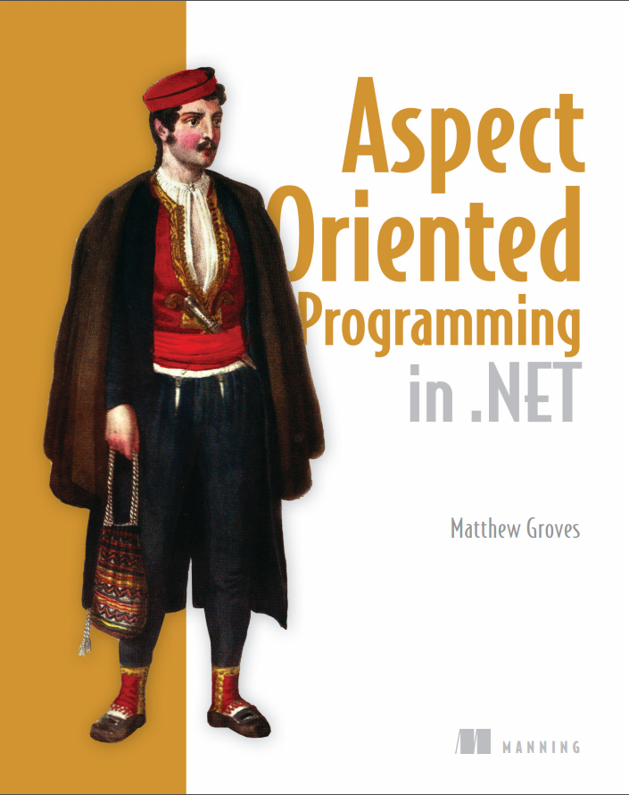
Notes:
Thanks Britt,
Thanks everyone for being here for week 3. I’m working on a book, which is in ‘early preview’ now. It is not just about PostSharp, but there is a lot of PostSharp in it. Manning has provided a discount I’ll be sharing that at the end of the session.

Slide 3
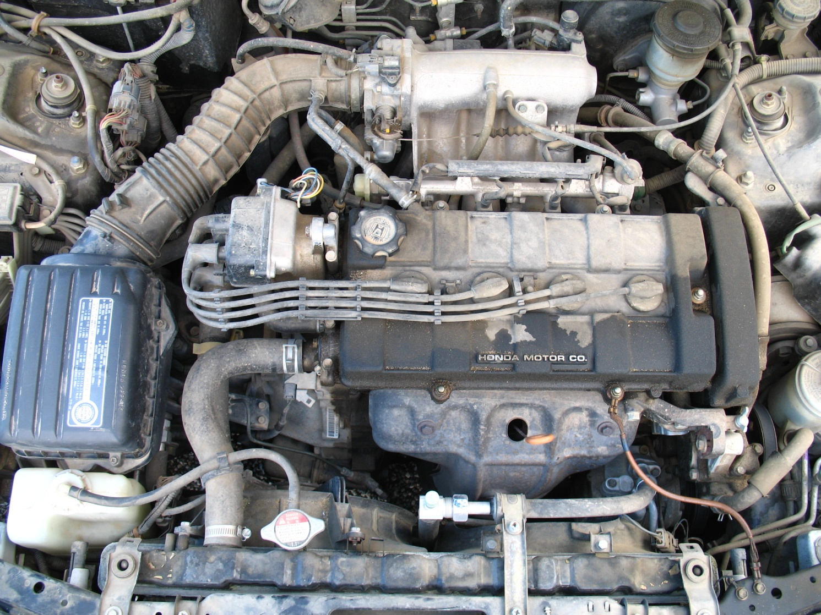
widget
fusion reactor
thing-a-ma-jig
doohickey
doodad
knick-knack
canooder
valve
http://www.flickr.com/photos/befuddledsenses/2903185831/
Notes:
Before we look under the hood of PostSharp, let’s look under the hood of a car
I am not a mechanic
I watch Top Gear but I skip over the technical parts to get to the funny stuff
I would imagine most drivers are like me: they have no idea what’s going on
but they can still operate a vehicle without knowing the firing order of their sparkplugs
However, I believe that drivers who are more educated about how their engine, transmission, exhaust system work
Are in a better position to make decisions about owning, repairing, maintainence, etc
You don’t have to know how to rebuild an engine, but understanding what pistons and cylinders are can be helpful
So that’s what we’re going to do with Postsharp

Slide 4
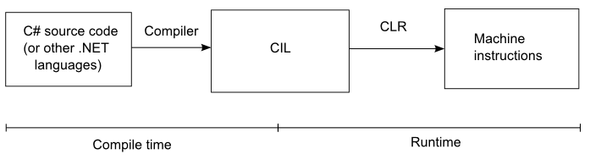
Notes:
This is a simplification of the process of writing and executing a program in .NET
You start by writing some C# (or other languages)
You then run a compiler that turns that C# into CIL (also known as MSIL, IL, byte code, etc).
When executing this CIL assembly, it is translated to actual machine instructions by the CLR via “just-in-time” compilation
So notice that I’ve put “CIL” as the end result of the “compile time” step, and the beginning of the “runtime” step

Slide 5
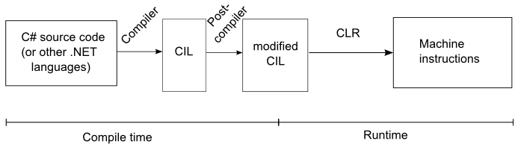
Notes:
Now let’s introduce PostSharp. PostSharp has two main components: one of them is a library that you can use while writing and compiling C# code, just like any other library. This is what we’ve looked at in previous webinars: the base classes and other API objects that we use to write aspects.
The other main component is the PostSharp post-compiler. The post compiler is a program that executes right after the normal C# compiler. It will look at the compiled CIL and change it, using the aspects and attributes you used as instructions. The end result is a modified assembly.
This modified assembly is what gets run on the CLR and compiled into machine instructions. So notice that the “old” CIL assembly is entirely within the the “compile-time” step now. Only the modified assembly straddles the middle.

Slide 6
The Babelfish Game
It was many and many a year ago,
In a kingdom by the sea,
That a maiden there lived whom you may know
By the name of Annabel Lee.
यह एक साल पहले, समुद्र, कि जिसे आप Annabel ली के नाम से पता कर सकते हैं एक युवती वहाँ रहता द्वारा एक राज्य में कई और कई था।
It was a year ago, the sea,
That you may know by the name of Annabel Lee
Is a young woman lived there in a State
By many and many.
Notes:
Here is one stanza of a poem by Edgar Allen Poe
Translated to Hindi by Babelfish
And then translated back to English, again with Babelfish
I have no idea how good the Hindi translation is
But I know the English one isn’t exactly the same as where I started
The English was “compiled” into Hindi and then “decompiled” back into English.

Slide 7
The Decompiler Game
Write C#
Compile the C# into CIL
Decompile the CIL into C#
Notes:
We should expect to see the same C# as we created
Well, in reality, you probably won’t. There are a lot of decompilers and they all make different assumptions and decisions when decompiling into
C#.
But for the most part, they look similar.
And this is good, because I’m not very good at reading CIL. I’ve tried: it’s tough.

Slide 8
The Decompiler Game
Write C#
Compile the C# into CIL
Post-compiler modifies the CIL
Decompile the modified CIL
See what the post-compiler did (in C#)
Notes:
To see what PostSharp actually did to my code, I could just look at the CIL.
There are tools to do that, you can see the exact CIL opcodes.
But, like I said, CIL may as well be Hindi to me. It would take me forever to figure out what the CIL is doing.
So instead, I’ll use a decompiler to translate back to C#, and this can show us what PostSharp is actually doing!

Slide 9
Decompilers
ILSpy (free, open source)
JetBrains dotPeek (free)
Telerik’s JustDecompile (free)
Red Gate’s Reflector (trial available)
Others
ILSpy and dotPeek available on Chocolately NuGet (http://chocolatey.org)
Notes:
There are several decompilers out there
They are all pretty good
Today I’m using Reflector, since it seems to give the most complete picture when using PostSharp
In the book, I use ILSpy, because it’s been around a while, it’s free, and it’s easy to install with Chocolatey NuGet

Slide 10
{ Code }

Slide 11
Next week…
“Unit testing and thin aspects”
The implications of IL manipulation and unit testing
Writing a “thin” aspect that can be unit-tested
Gael Fraiteur will also join to talk about the PostSharp philosophy of unit-testing aspects
Notes:
Go to postsharp.net download page

Slide 12
Use code 13psaop for 40% off http://manning.com/groves
http://about.me/mgroves
Notes:
Use the promo code for 40% off the book (it’s an early preview now called a MEAP)
Questions, comments, feedback, you can contact me via email or twitter by first going to about.me/mgroves

