Slide 1
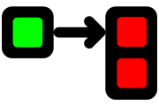
Queueing
Is
Easy
Convention
Matthew D. Groves
Heuristic Solutions
Configuration

Slide 2

Queueing is Intimidating
Notes:
I got into Rabbit because I had a problem that I need solved, not because it was a cool toy I wanted to play with.
Queueing systems are powerful tools with lots of different ways you can do things.
But It was intimidating to me. If there are a million ways to do it, chances are I would pick the wrong one.
But I found that it doesn’t have to be. If you feel the same way now, then I want to show you that it’s easier than I thought.

Slide 3
Matthew D. Groves
I’ve been writing code since I was 8
Software Developer with Heuristic Solutions
I mainly work with .NET, but I also dabble in JS, PHP, mobile, etc
BS, MBA, PostSharp MVP, Microsoft MVP
“I am not an expert, but I am an enthusiast!” – Alan Stevens
Notes:
Heuristic Solutions is based in the D.C. area; has mostly remote staff. A lot of us are in Columbus, Ohio. If you are near Columbus, Ohio and you’re in this room, ask me about Heuristic Solutions, I’d love to talk to you about it. We mainly work on a SaaS product with complex domain and code base. And I plan to actually show you our product today, as it relates to Queueing.

Slide 4
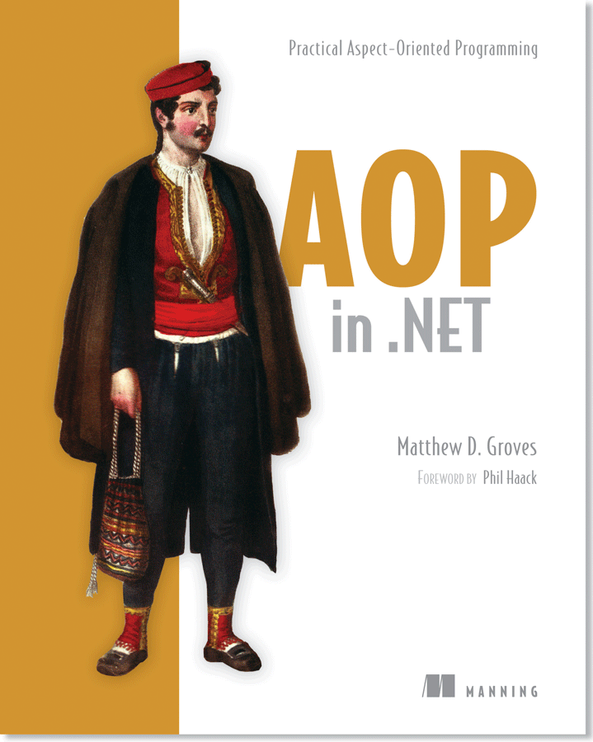
http://manning.com/groves
Notes:
I wrote a book on AOP; it’s only tangentially related to what I’m talking about today but you should buy it anyway

Slide 5
Agenda
Queueing review
RabbitMQ on .NET demo
Queueing patterns
EasyNetQ basics
EasyNetQ code demo
Real application
Notes:
Here’s what I’m covering today
I’m not going to show you how to install RabbitMQ today
I have a video series on YouTube, and those videos will cover that, I’ll give you the link on the last slide
It’s super easy on windows and linux, come talk to me afterwards I’d be happy to help

Slide 6
Queueing
Main program
(UI, business logic, DB, hard work)
Queue
[a][b][c][d]…
Processor
(hard work)
Processor
(hard work)
Processor
(hard work)
Notes:
Let’s assume that we have a “main program”, let’s say a web app. It does all kinds of stuff: renders a UI, does business logic, makes DB queries, etc. Picture Amazon.com for instance.
It also has some tasks that are difficult, slow, or maybe there’s a large quantity of them. These tasks are on the main progress process, which means they affect the user experience. But those tasks don’t necessary need to happen there. They could be run on some other process, or some other machine. When you place an order, Amazon has to do a lot of work: notifications to sellers, notification to warehouses, updating databases, retrieving funds etc. These don’t all need to happen immediately. Amazon can just tell you “okay we got your order” and ideally move that work off of the web server to some other process on some other machine.
But we can’t just push it directly to the machine, it might already be busy. So we put the relevant information into a temporary holding area. This is the queue.

Slide 7
Code:
RabbitMQ on .NET
Notes:
I’m going to show you a Hello World using RabbitMQ on .NET

Slide 8
EasyNetQ
Notes:
We get a lot of power, but we may have to do a lot of work.
Instead, we could use EasyNetQ.
This is a .NET specific library, so both the producer(s) and consumer(s) need to be in .NET to use this.
It’s an opinionated library, so we lose some control of RabbitMq.
We lose some flexibility, but we gain some powerful patterns of producing and consuming.

Slide 9
In EasyNetQ, messages are objects
Notes:
Messages are plain old objects. You give an object to EasyNetQ, it creates the channels, routing, queues, serializes the messages.
You pull a message off the queue as an object, it finds the right routing, queue, and does the deserialization.

Slide 10
EasyNetQ Patterns:
Send & Receive
Publish & Subscribe
Request & Response
Notes:
Here are three patterns that EasyNetQ handles for us.

Slide 11
EasyNetQ - Send and Receive
Send Message [A]
Receive Message [A]
Queue
[A][B][A][B]…
[A][A][A][A]…
Send Message [B]
Receive Message [B]
Receive Message [B]
Receive Message [B]
Notes:
You put a message A on the queue (send)
You take a message A off the queue (receive)
The queue is durable, so it will persist in the queue after it is sent.
With this pattern, you can put any number of message types on the same queue. Receivers who subscribe to the queue will process the message types separately.
You don’t have to put everything on the same queue, but you can.

Slide 12
EasyNetQ – Publish and Subscribe
Publish Message [A]
Queues
[A] Queue for X
[A] Queue for Y
[A] Queue for Z
Subscribe to [A]
Do Task X
Subscribe to [A]
Do Task Y
Subscribe to [A]
Do Task Z
Subscribe to [A]
Do Task X
Subscribe to [A]
Do Task X
Notes:
You publish a message
Anyone who is subscribing will receive the message.
You can have multiple subscribers for 2 different reasons:
Scaling (more processes, the more messages you can process)
Doing multiple things with the same message (notify the seller, process the payment, notify the warehouse)

Slide 13
EasyNetQ – Request and Response
Requester
Has [A]
Wants [B]
Request
Queue
[A]
Response
Queue
[B]
Responder Expects [A],
Returns [B]
Notes:
You can use EasyNetQ to send a message as a request, and then wait for the response.
It’s like a remote method call.
You can do it as a blocking call or as an asynchronous call.
This is pretty cool, but I’m not going to demo it today unless we have time. Talk to me afterwards if this is something you’re interested in.

Slide 14
EasyNetQ Code:
Send & Receive
Publish & Subscribe
Request & Response
Notes:
I’m not going to cover #3, but I do have code samples for it if you are interested in checking it out on your own.

Slide 15
EmpiriCall
Which features are/are not being used?
Which customers are using which features?
Which users are using which features?
Notes:
At last CodeMash, I was inspired to create an open source project, EmpiriCall. It’s still a work in progress.
At Heuristics, we mainly work on a product called LearningBuilder. It’s a large, complex, highly configurable system with a lot of features.
I wanted to answer some questions about LearningBuilder.
Which features are being used?
Which features are not being used (or barely being used)?
Which users are using which features?
Which customers are using which features?
I could guess, talk to customers, talk to the BAs, sales, etc. And that’s important. But I also want to be able to look at the actual usage, and have empirical answers to those questions. This data can help inform decisions for testing, refactoring, sales, pricing.

Slide 16
EmpiriCall
Learning Plan
(feature 1)
Learning Plan creation
Learning Plan view
Reflective Practice Exercises
Workflow
Admin
(feature 2)
Create new Workflow
Add Automation to Workflow
Add Behavior to Workflow
Notes:
I’m sure I’m not the first to think of this, and maybe I’m wrong, but here goes.
My central conceit is that there are features, and there are MVC actions. A feature consists of a bundle of MVC actions. I can track MVC action details, therefore, I can track features. (if I map them correctly).
You might think a logging framework or Google Analytics could do this, and maybe they can, but I don’t think those tools have this in mind. They also can’t report on what’s NOT being used very well.
I’m going to record every single MVC action and the user who is doing the action. I’m going to parse my MVC app to get a list of all the possible actions. I can also tie those actions to a “feature”, which is just an arbitrary string.
An architect can see “hey, no one has used this action in 6 months, why not? Can we drop it?”
A BA can see “Hey, this customer is using feature X a lot during a certain month? Why? Is there something missing?”
Sales can see “Hey, only customer X is using feature Y, maybe we should sell it as a separate module.”
A UX Designer can see “Hey, no one is using feature Z, maybe because it’s not discoverable enough”

Slide 17
Demo:
EmpiriCall on LearningBuilder
Notes:
That’s my vision, anyway. Let me show it to you in action, on LearningBuilder.
I said that I was recording every MVC action. If I’m making an extra database trip for every single action, that’s adding a lot of work to the main project; a lot of extra DB traffic. But I can just record the data into a message, push it off to a queue, and have some other process put it into the reporting database. So the main project is barely doing any extra work—all the work is on the queue, the processors, and a separate reporting database.

Slide 18
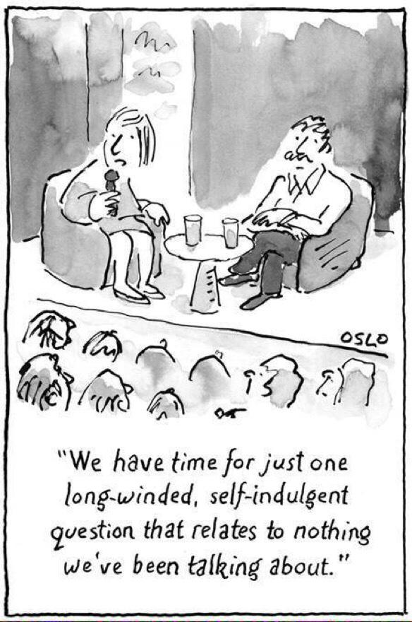
Code and Slides:
github.com/mgroves
Contact Me:
mgroves.com
Buy My Book:
manning.com/groves
Videos:
http://tinyurl.com/mgrovesrabbit

