Slide 1
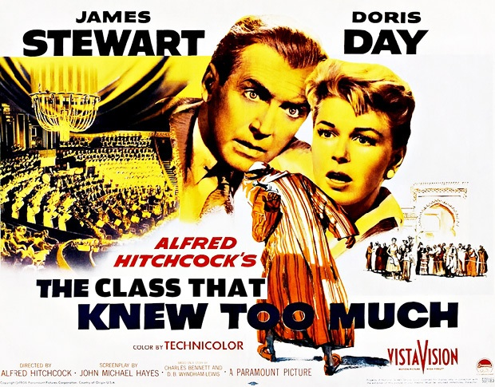
{ Matthew D .Groves }

Slide 2
{ A little about me }
I’ve been writing code since I was 8
I mainly work with .NET, but I also work with PHP and other OSS
BS, MBA, PostSharp MVP, “professor”
“I am not an expert, but I am an enthusiast!” – Alan Stevens
Notes:
Please ask tough questions and challenge me, give me feedback and help me improve

Slide 3
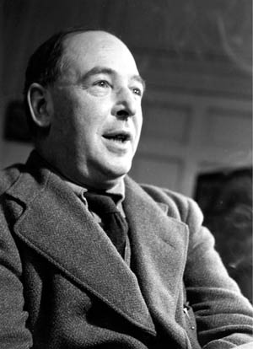
“I write for the unlearned about things in which I am unlearned myself”
– C.S. Lewis

Slide 4
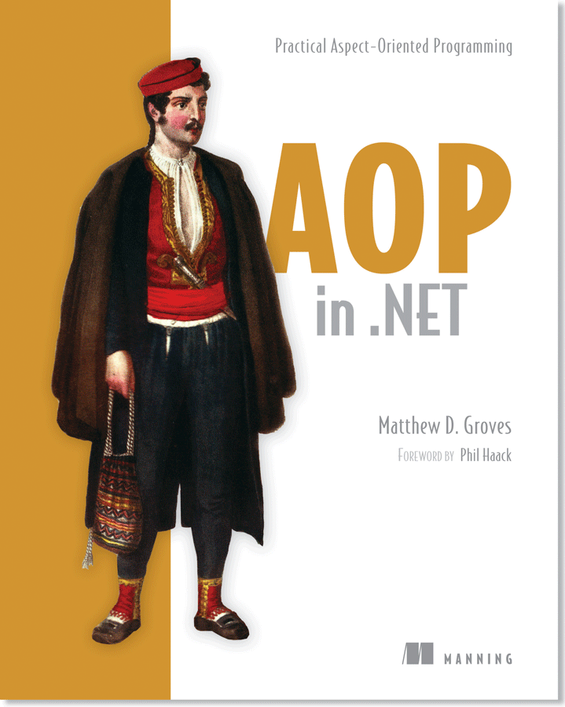
http://crosscuttingconcerns.com http://manning.com/groves
Notes:
Currently writing this book
We’ll talk a little about AOP today.

Slide 5
{ Single Responsibility Principle }
Notes:
A class should have only one responsibility.
A class should have one, and only one, reason to change.
A class shouldn’t handle both UI and database access, for a simple example.
There should be 1 class for UI, 1 class for database access, and possibly even another class to communicate between the two to keep them loosely coupled.

Slide 6
{ What’s the big deal? }
Notes:
Complexity
Tight coupling
Bugs
Harder to test

Slide 7
{ Identify classes that violate SRP }
Notes:
“code smells”, heuristics, rules of thumb
They AREN’T hard and fast rules that are always right, but they often indicate that something is wrong

Slide 8

Long methods…
Notes:
A long method is often an indication that too much is being done.
It may indicate that the *method* should at least be broken up.
It may also indicate that the *class* should be broken up.

Slide 9
…are long
Notes:
This is why people hate on regions: they don’t fix smelly code, they simply hide it.
Long methods may start as a nugget of small, clean code.
Eventually they get surrounded by cross-cutting concerns like logging, defensive programming, caching, try/catch/exception handling, etc

Slide 10

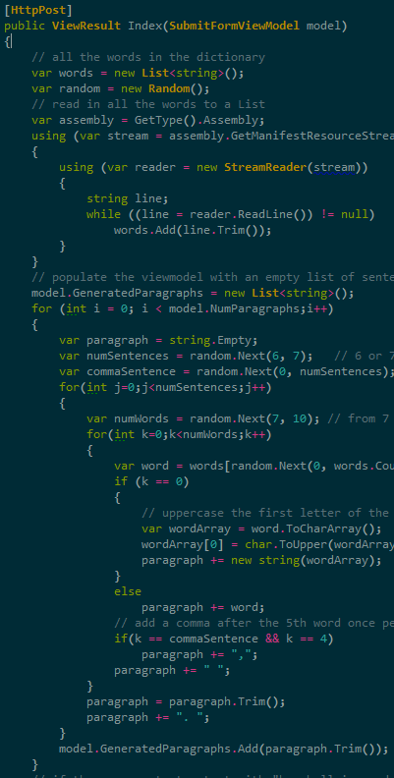
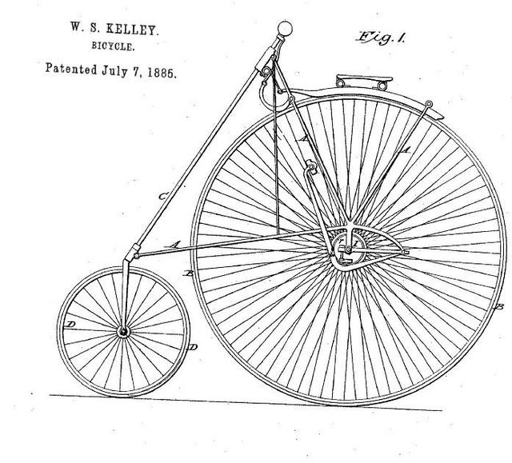
“Sawtooth” code
Notes:
Long methods often contain sawtooth code
Cyclomatic complexity – think of all the possible “routes” you can take through this code, the more “routes”, the more complex it is

Slide 11

Use “and”?
NO “AND THEN”!

Slide 12
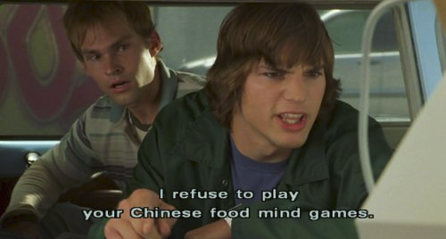
Notes:
Describe what the class does (briefly). Out loud if you have to.
Do you have to use multiple sentences or the word “and” or “or”? Then it’s possible that your class is doing TWO things instead of a single thing.
“NO and-then! I refuse to play your Chinese food mind games.”

Slide 13



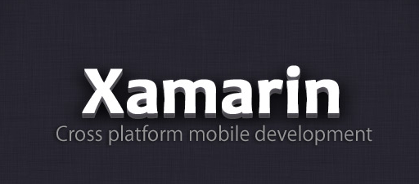
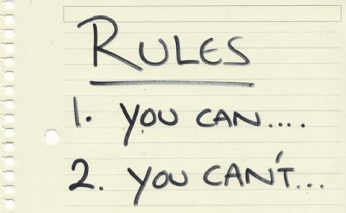
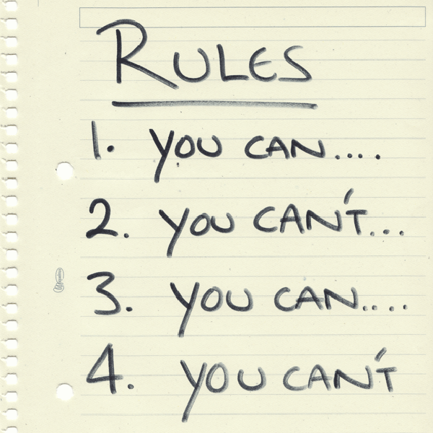
Would a class have to change if…
Notes:
If I changed from SQL server to Raven DB, what classes would have to change or be replaced?
If I changed from ASP.NET to one of the Xamarin products, what classes would have to change or be replaced?
When the business rules change, what classes would have to change or be replaced?
If a single class says “yes” to more than one of these questions, then it knows too much!

Slide 14

It knows too much!
Notes:
That class knows too much!

Slide 15
{ How to refactor}
Notes:
With those “code smells” and heuristics we can start to see what classes need refactored.
If you have a large code base, prioritize, to tackle the worst ones first.
Smaller classes, for instance, can violate single responsibility, but because they’re small, they are probably easier to deal with than large classes that violate single responsibility.

Slide 16
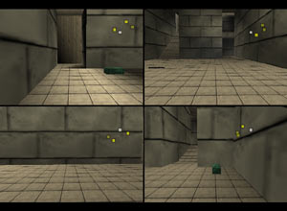
Split into multiple classes
Notes:
Well you can’t say you didn’t see this coming.
If a class is too big, split it into multiple classes.
Easier said than done, right?
One thing I had to get over: more classes can often mean more simplicity.
“well it’s only 1 class, so it’s less complex than 5 classes”
Short term speed vs long term maintenance
Maybe start by writing unit tests for the entire class. Make sure the functionality is still behaving as expected and the tests are passing.
Then, as you start to pull it apart, if your tests still pass then you’ve succeeded.
Now split your unit tests up, each isolating one of the classes (by mocking/faking the other).

Slide 17
{ Code }

Slide 18
Aspect-oriented programming
class BusinessModule1 {
… core data members
… logging members
public Method1() {
… log start
… core operation
… log end
}
public Method2() {
… log start
… core operation
… log end
}
}
class BusinessModule2 {
… core data members
… logging members
public Method1() {
… log start
… core operation
… log end
}
public Method2() {
… log start
… core operation
… log end
}
}
tangling
scattering
logging
logging
*diagram by Xiaoran Wang of programcreek.com
Notes:
Business logic AND logging
Tangling: how do we split out the logging code to encapsulate it?
Scattering: how do we re-use the encapsulate code?

Slide 19
Aspect-oriented programming
class BusinessModule1 {
… core data members
public Method1() {
… core operation
}
}
class LogAspect {
… logging members
public BeginMethod() {
… log start
}
public EndMethod() {
… log end
}
}
“weaving”
class BusinessModule1 {
… core data members
… logging members
public Method1() {
… log start
… core operation
… log end
}
}
*diagram by Xiaoran Wang of programcreek.com
Notes:
Aspect-oriented programming introduce the idea of “weaving”
So you take the logging out of the business modules
Put logging into it’s own class, called an “aspect”
Tell the AOP tool which modules that the logging aspect should be applied to
The AOP tool will “weave” them together (possibly right after compiling, possibly at runtime)
The “generated” code still looks and runs basically like it did before
But the code you maintain and work with is nicely separated

Slide 20
{ Code }

Slide 21
Small functions
f(x)
f(h(i(j(x))))
Notes:
One big function becomes a lot of little functions.
Maybe now you can start to cluster: functions F,H,I should stay, function J should go in its own class.

Slide 22
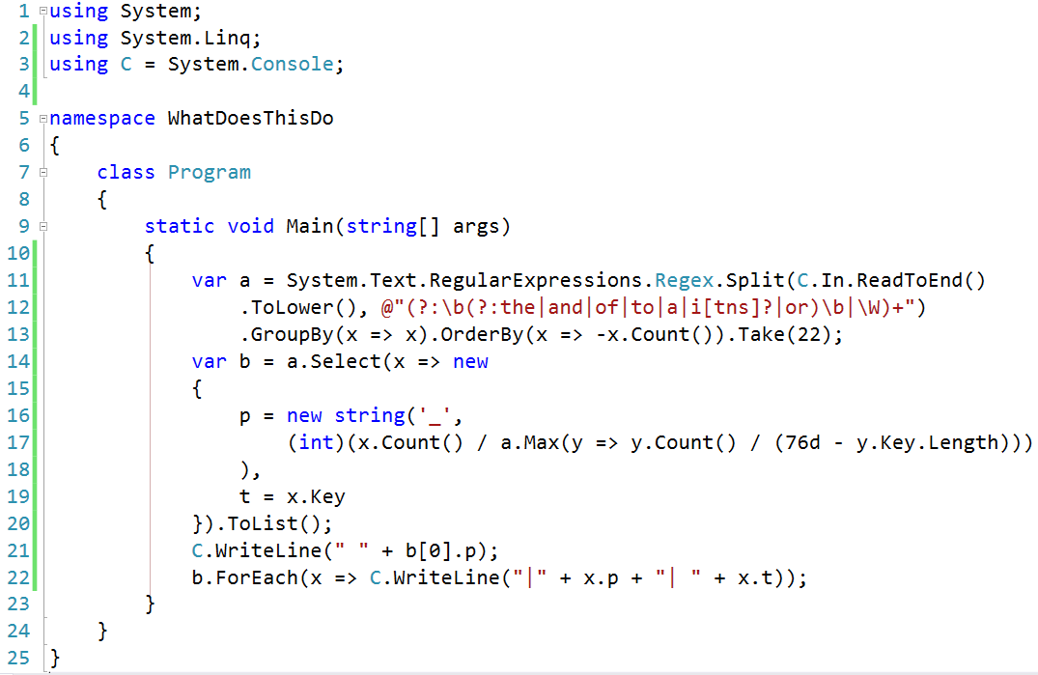
Descriptive names

Slide 23
{ Code }

Slide 24
{ Is it okay to violate SRP? }
Notes:
MVC controllers? Keep them thin
Active Record, combining data and behavior? Separate data and behavior
Small apps, one-offs, prototypes, spikes: YAGNI
Public APIs (may *appear* to do multiple things to the users)
Obfuscation
Minification
Fun stuff like code golf

Slide 25
AOP in .NET http://manning.com/groves 42% off code: 12mp25
Contact me:
http://crosscuttingconcerns.com
http://about.me/mgroves

