Slide 1
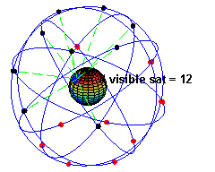
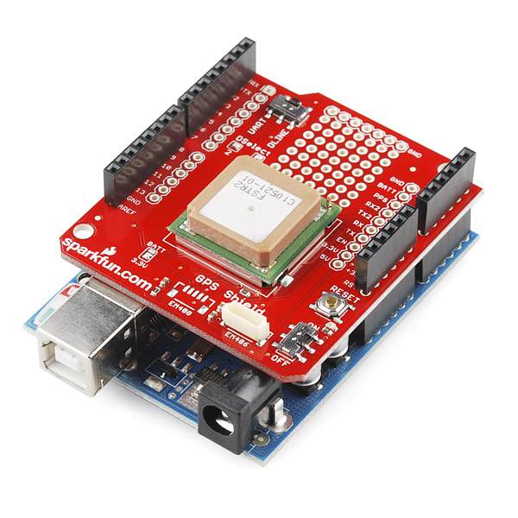
GPS - Global Positioning System
Mike Grusin
Engineer
Sparkfun Electronics
mike.grusin@sparkfun.com

Slide 2
It's GPS time! Grab the software...
Download from the class GPS directory
OR go to http://github.com/mgrusin/GPS_class
Click “download ZIP” (or clone if you already use Git)
Unzip to a convenient location
You'll also need this hardware:
  Arduino
  USB cable
  GPS Shield
  EM-506 module
  Serial LCD display
  Battery pack w 4xAA

Slide 3
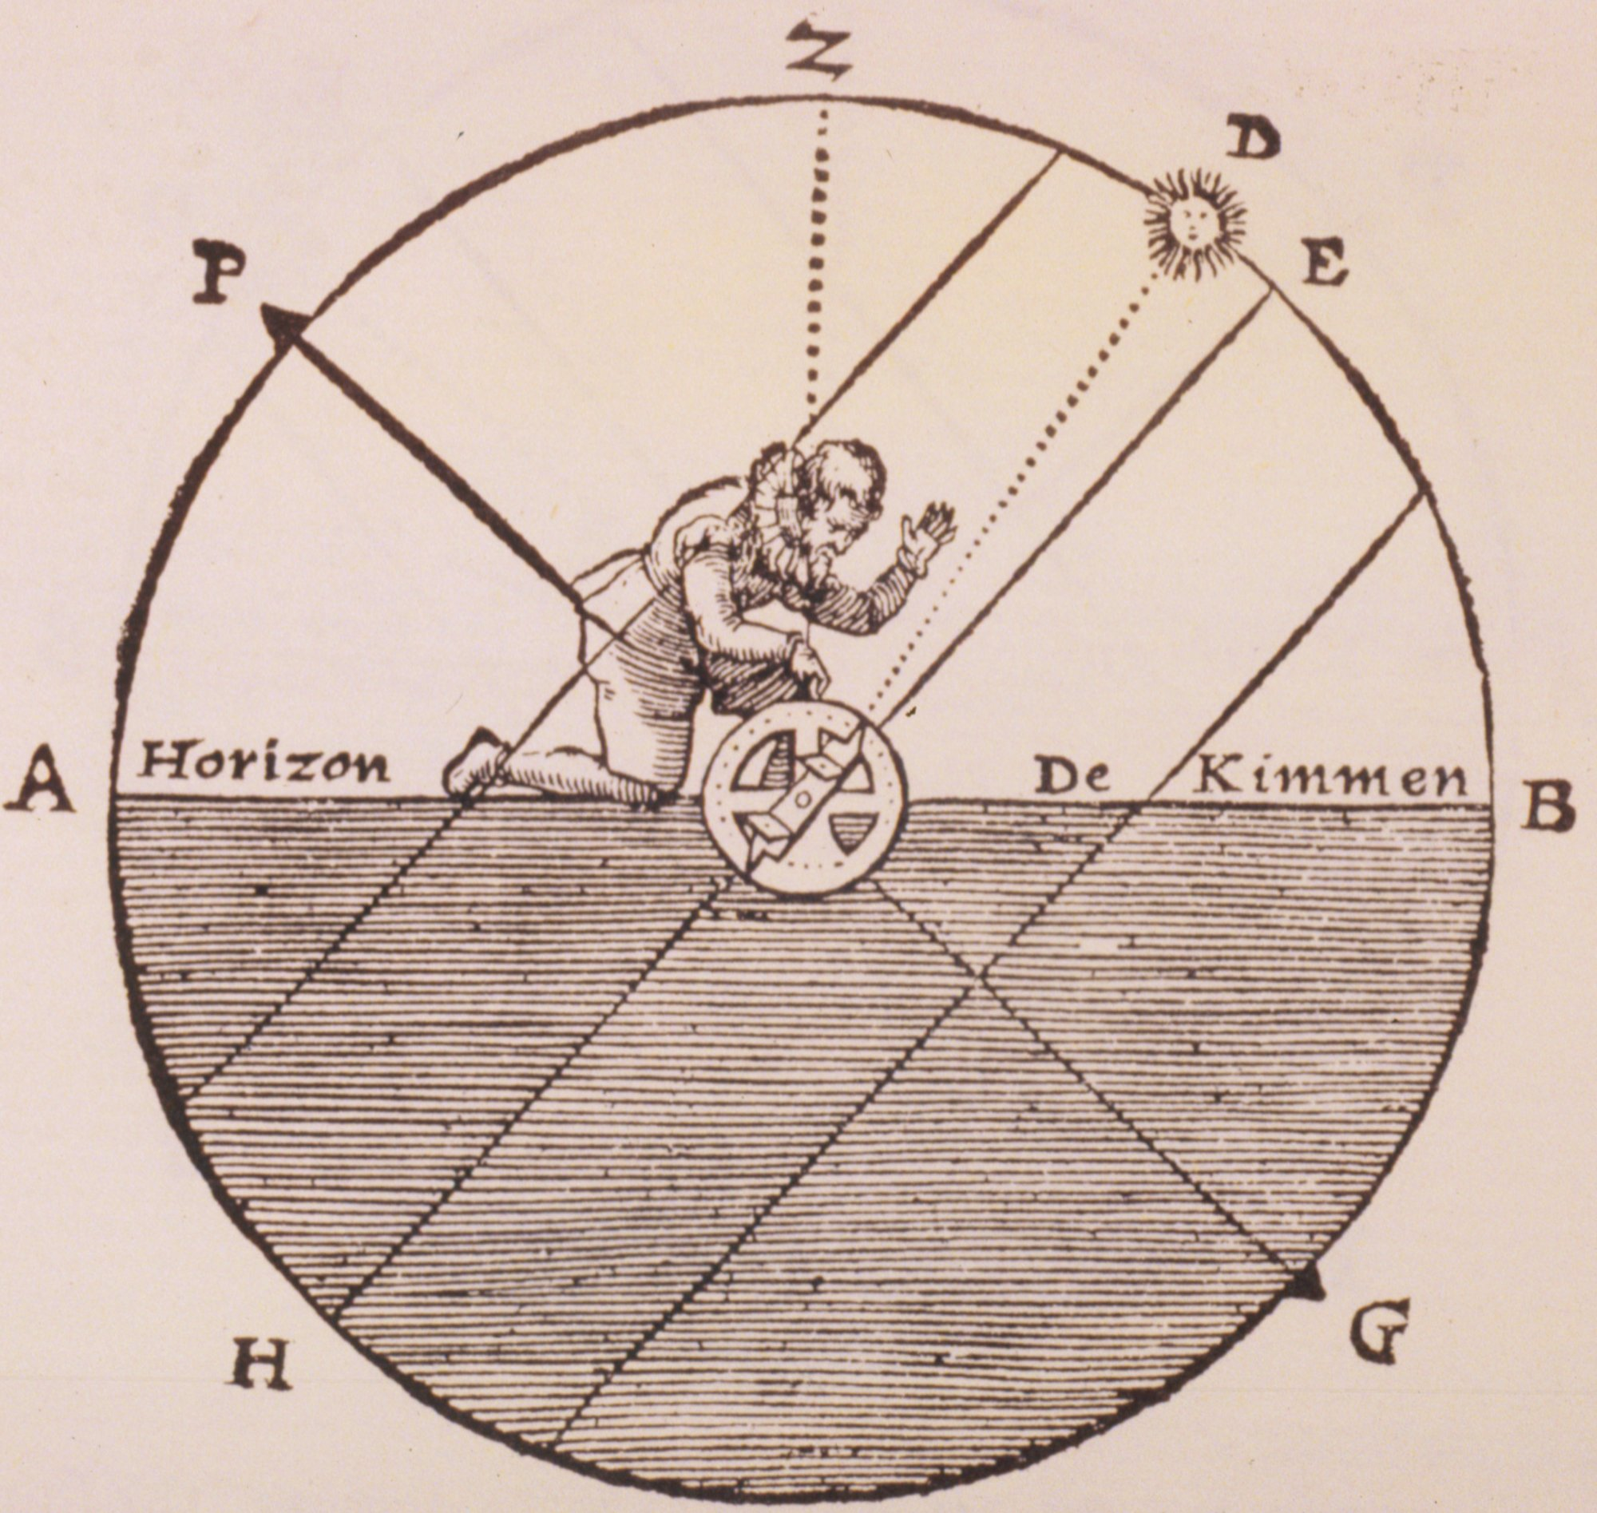
Before GPS: the history of “where am I?”
It's useful to think about how people determined their location
in the past
  All sensors, including GPS, have limitations
  Using more than one method can improve your odds of success!

Slide 4
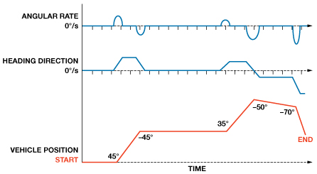
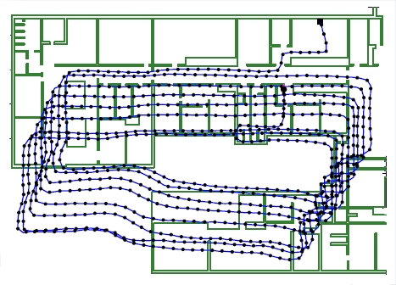
Before GPS: the history of “where am I?”
“Dead Reckoning”
  Keep track of how far you've gone (distance) and the angle you're traveling (azimuth)
    Distance sensors:
      Odometry (count wheel rotations)
      Optical flow detectors
      (e.g. computer mice)
    Angle sensors:
      Potentiometer on “steering wheel”
      Magnetometer / compass
      Gyro / IMU
      (Intertial Measurement Unit)
  Small errors will add up the longer you do this
    Filtering is important (and complex)

Slide 5
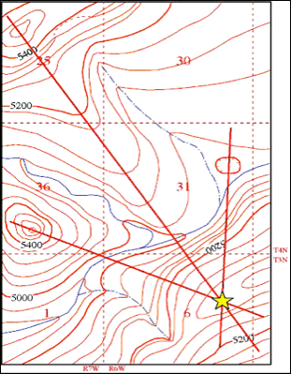
Before GPS: the history of “where am I?”
Triangulation
  Measure the bearing angle (azimuth) from your (unknown) position to fixed landmarks with known positions
  Plot reciprocal angle from landmarks
  Your location is where the lines cross!
  Works well, but requires known fixed landmarks and a way to accurately measure bearing angles to them (compass), or the angle between them (protractor or sextant)
  GPS uses a variant of this method!

Slide 6
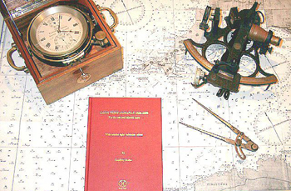
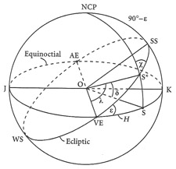
Before GPS: the history of “where am I?”
Celestial navigation
  A variant of triangulation
  A sextant measures precise angle (altitude) between a celestial object and the horizon
  By knowing the exact time and consulting tables, you can determine your location (to ¼ mile if skilled)
  You need the exact time (this was very difficult with mechanical clocks!) and a clear view of the sky
  Still used as a backup (salt water and electronics don't mix)

Slide 7
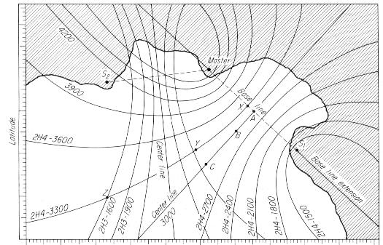
Before GPS: the history of “where am I?”
LORAN (Long Range Navigation)
  Developed in the 40s for military and eventually civilian navigation
  Used phase-linked fixed radio transmitters
  The phase difference between two transmitters locates you on a hyperbolic line
  Adding a third transmitter puts you at the intersection of two hyperbolic lines
  Accuracy of 0.1 to 0.25 miles
  Transmitters turned off and system decommissioned in 2010 due to ubiquity, higher accuracy, and lower cost of GPS

Slide 8
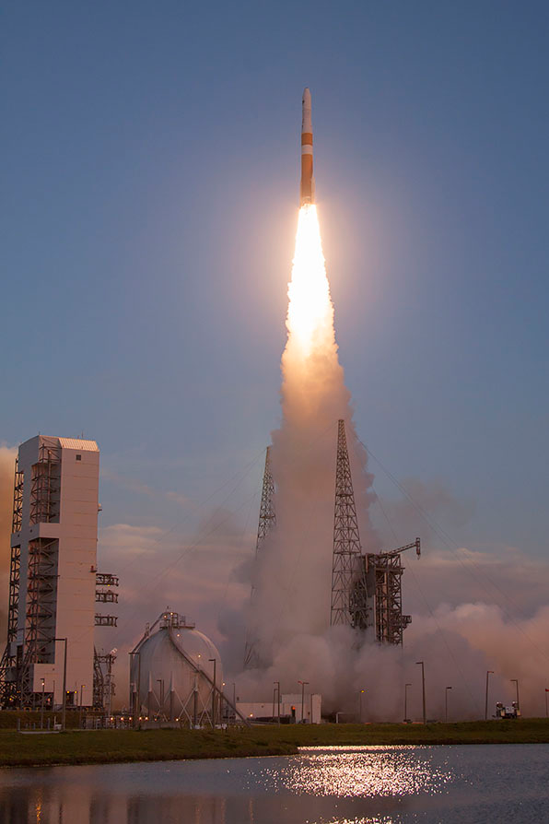
GPS
Evolution of earlier military satellite experiments and navigation systems (1960s and 1970s)
Requires 24 satellites for continuous global operation
  First launch in 1989, fully operational in 1994
  Launches continue today for upgrades and maintenance
Run by USAF 50th Space Wing, based in Colorado Springs
“One of the most beneficial and humanitarian results of military and aerospace technology”
Other countries have their own systems:
Russia (GLONASS), EU (Galileo), China, India

Slide 9
How does it work? (the simplified version)
The GPS constellation
  Consists of at least 24 active satellites (plus spares and upgrades)
  Satellites are in 6 orbital planes
  (at least 4 active satellites per plane)
  12500 miles up, 12-hour orbit
  The orbital geometry ensures that (depending on the local terrain) you can see at least four satellites from any point, and often more (8 to 10)

Slide 10
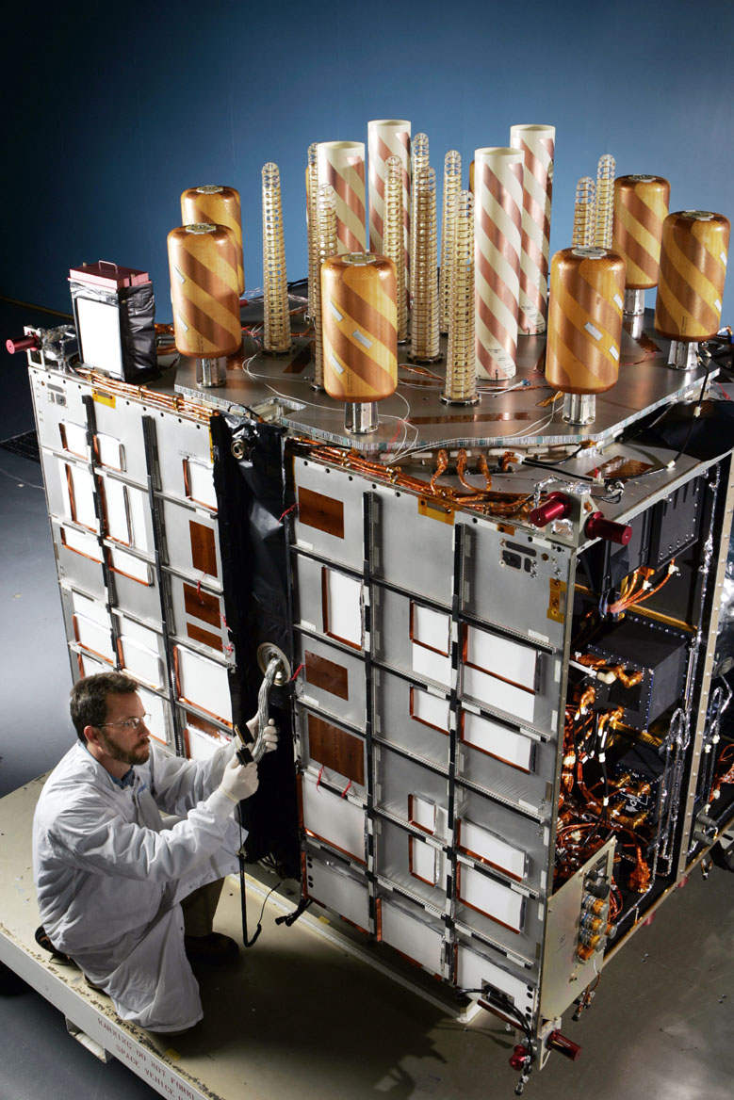
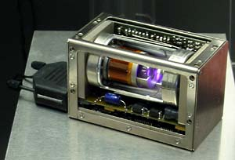
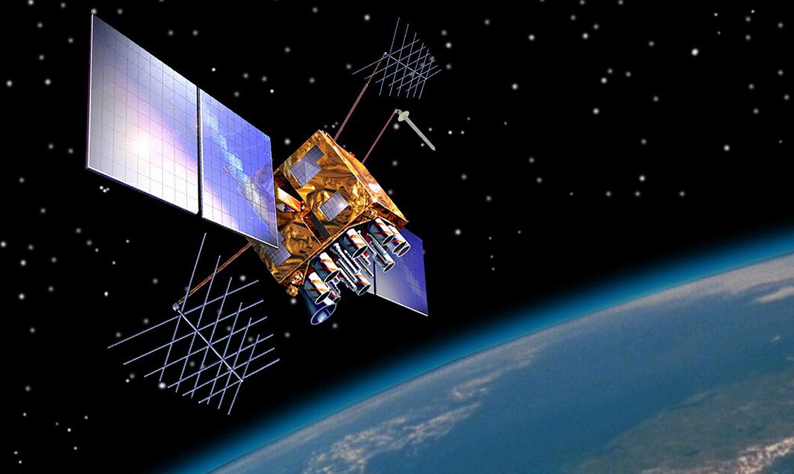
Atomic clocks
Each GPS satellite contains
four(!) Rubidium atomic clocks
  For redundancy and testing against each other
  Accurate to better than 1ns
  (1 billionth of a second)
  The clocks are designed to tick slightly slow to remove relativistic effects from the satellite's velocity
Note that even the cheapest GPS receiver gives you access to extremely accurate time!

Slide 11
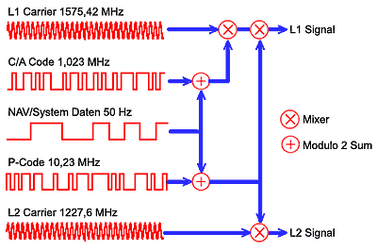
How does it work? (the simplified version)
Your receiver listens to a cacophony of signals to figure out where it is
  All active satellites constantly transmit precisely-timed signal patterns
    Frequencies: 1228MHz and 1575MHz
    Very low power: 50W
  Data contains fixed sequences
  unique to each satellite, plus (all)
  satellite orbits (ephemerides) and
  the atomic time
  Complete data is 1500 bits, and takes
  30 seconds / frame
    Low rate, but bit timing is
    extremely precise
  Note that all satellites transmit
  simultaneously on the same frequencies
  – everything gets mashed together!

Slide 12
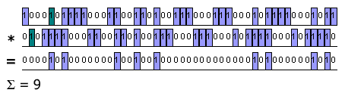
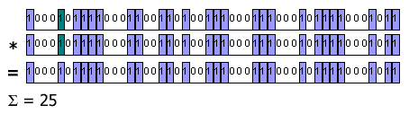
What are “Channels?”
GPS receivers are advertised as having x “channels” (up to 60!)
Why so many “channels” with only 24 active satellites?
These are not receivers (there are only two frequencies, so you would need at most two receivers)
These “channels” (called “correlators”) do the mathematically-intensive job of trying to match the key patterns (different for each satellite) against the mashed-up signal being received (all the visible satellites mixed together)
When a channel finds a match, the satellite data can be extracted and used to create or improve the current fix.
Multiple correlators greatly speed up the initial fix, as they can all work in parallel to identify the satellites in-view.

Slide 13
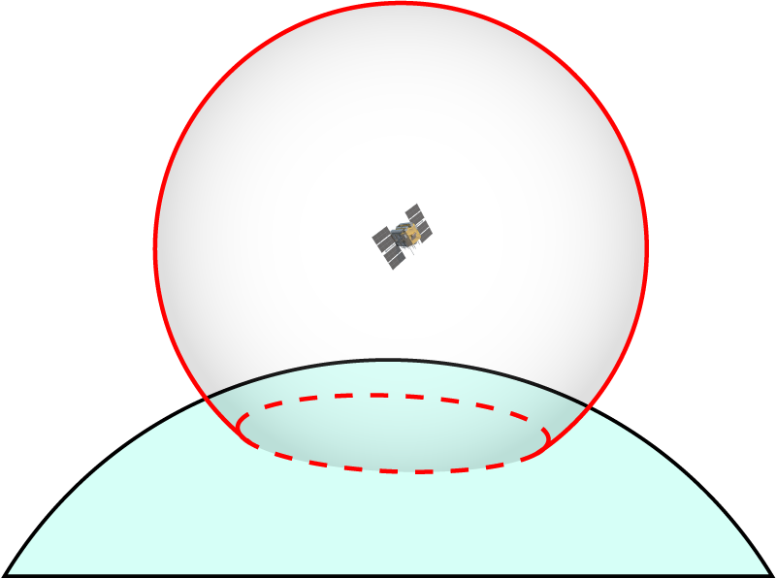
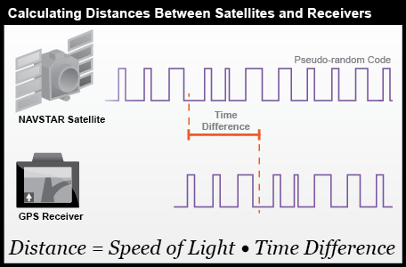
How does it work? (the simplified version)
When a satellite is found, the atomic clock time on the satellite (sent along with the data) is compared to the (possibly inaccurate) clock time in the GPS receiver, to guess the range (“pseudorange”) to the satellite.
Calculating the range to a single satellite puts your position somewhere on the surface of a sphere centered on that satellite.

Slide 14
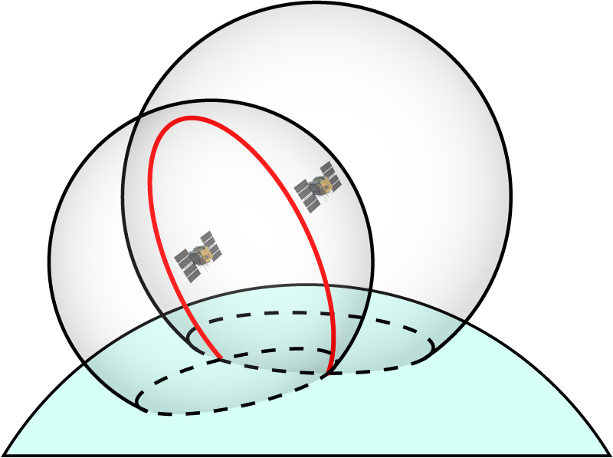
How does it work? (the simplified version)
When you have the range to two satellites, your position will be somewhere on the circle where the two spheres intersect

Slide 15
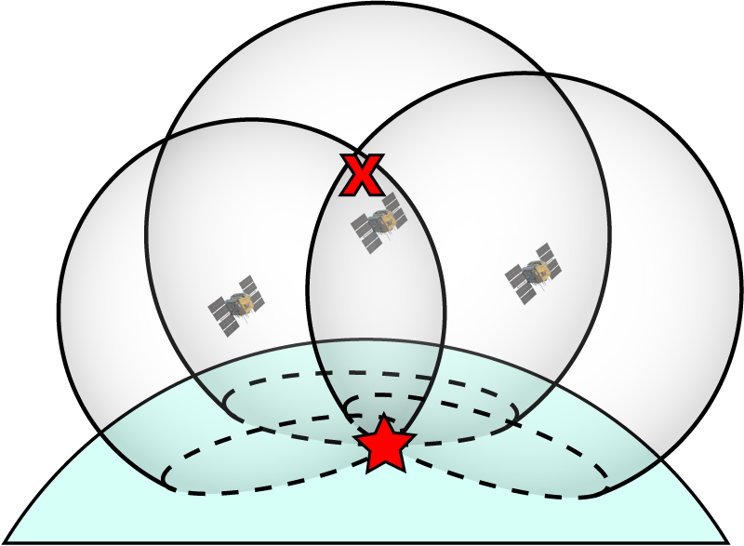
How does it work? (the simplified version)
When you have the range to three satellites, your position will be at one of two points where the three spheres intersect
GPS modules assume you're near the surface of the earth; one of these points will usually be far off in space and can be discarded

Slide 16
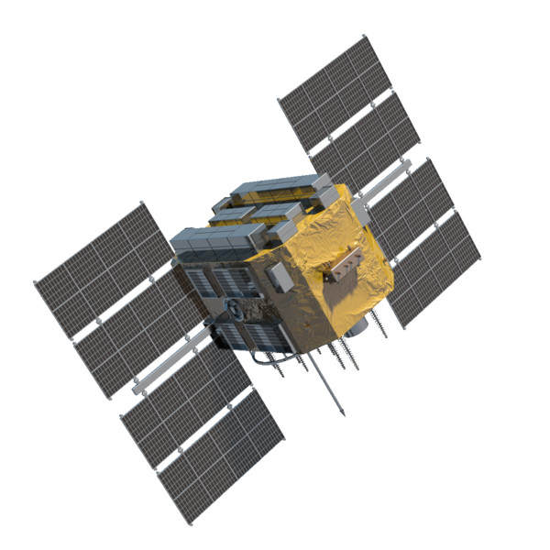
How does it work? (the simplified version)
When you have four (or more) satellites, you will not only improve the accuracy of the fix, but you can solve for the precise time at the GPS receiver.
This is why and how the receiver does not need an (expensive!) atomic clock to function.

Slide 17
More history: SA (Selective Availability)
SA was a military-imposed feature designed into the first-generation of GPS satellites which purposely added random errors to the signal
Degraded civilian GPS receivers to 100m accuracy
The military used special receivers and a daily key to remove those errors
SA was turned off during the entirety of the Gulf War (1990), because troops were buying civilian GPS receivers due to a shortage of military receivers
Following the war, the US government was increasingly pressured to turn off SA
to enhance valuable civilian uses of GPS (especially within the FAA)
Permanently turned off in 2000
The military claims to have “methods” to deny GPS to hostile forces (while friendly use is unaffected)
Newest replacement satellites do not have the capability to add SA errors,
so it's not coming back :)

Slide 18
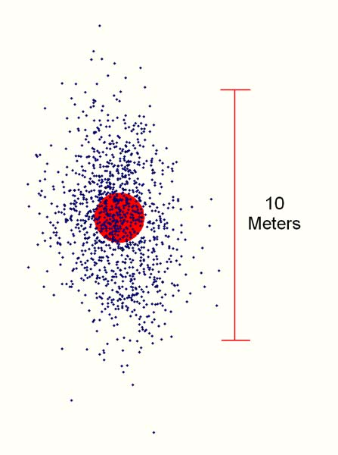
Accuracy and error sources
How accurate is GPS?
  When viewing GPS output on a map, you will see the fix wander around
  the true location
  Error sources:
    Ionospheric effects ± 5 meters
    Satellite orbits determination ± 2.5 meter
    Atomic clock errors ± 2 meter
    Multipath effects ± 1 meter
    Tropospheric effects ± 0.5 meter
    Calculation rounding errors ± 1 meter
  Worst case: ± 12 meters (~40 feet radius)
  The GPS receiver can give you metrics (HDOP and CEP)

Slide 19
Improving accuracy
Use GPS outdoors with a clear view of the sky
  Signals may or may not penetrate building construction, but will be degraded in all cases
Avoid trees, rain
  GPS frequencies are absorbed by water
Avoid “multipath” situations
  Urban (or rock) canyons cause signals to bounce, causing phase issues
Use a good antenna
  If its directional, keep it pointed up (or it will make things worse!)
You can also throw money at the problem...

Slide 20
Improving accuracy
You can get specialized GPS receivers that are accurate to several cm,
but they are expensive ($1000+). They use tricks to improve on the raw
accuracy of GPS
  DGPS (Differential GPS)
    Uses two GPS receivers, one at a known fixed location, and another one (which can be moving) where you want a precise position (AVC robot, etc.)
    The fixed receiver measures the error (it's fixed, so any difference is error)
    The fixed receiver transmits the errors to the moving unit. If they're fairly close, they should be seeing roughly the same ionospheric effects
    Unfortunately this does NOT work by just putting two GPS units near each other (many people have tried). They must always be using the same set of satellites, which isn't guaranteed.
    The EM-506 on your shield can receive DGPS data on the second serial port, if you have access to a commercial DGPS transmitter to send that data

Slide 21
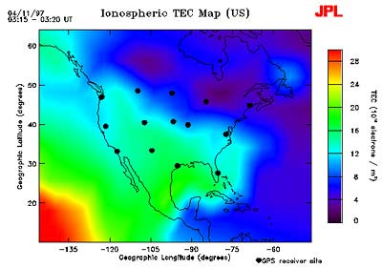
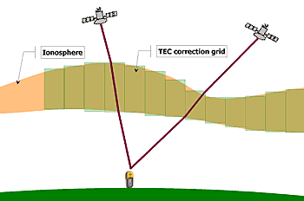
Improving accuracy
There is also infrastructure to compensate for atmospheric effects, some which cost money and some which are free.
WAAS (Wide-Area Augmentation System)
  Less accurate than DGPS, but doesn't require additional hardware
      FAA measures fluctuations in the ionosphere
      FAA sends correction data to a geostationary satellite, which broadcasts that data on GPS frequencies as a special “fixed” GPS satellite
      WAAS-equipped GPS receivers can use this data to correct for ionospheric effects
  Can improve accuracy to ± 2 meters (under ideal conditions)
  Free to use, and available on several Sparkfun GPS products including your EM-506

Slide 22
Improving start-up time
All GPS receivers need time to get the initial fix (“cold start”)
  All the correlator channels search for satellites until they find a match
  Once one satellite is found, it will provide data that speeds up the search
Under ideal conditions, this will take about a minute, but it could be many minutes (or never) if you're indoors or in another poor-reception area.
Many GPS receivers (not the EM-506) allow you to connect a back-up power source to keep the GPS receiver's internal clock running while it's turned off (“warm start”)
  This can be an extra connection to your power source, separate battery (coin cell), super-capacitor, etc.
    The EM-506 has a large built-in capacitor which works great for 10s of minutes
    For other receivers, the GPS Shield has a footprint on the bottom for a coin cell holder
  Power draw is very low (microamps)
By leaving the clock running, when the rest of the GPS unit powers up, it can immediately predict which satellites are in view, and quickly look for just those.
Warm start performance will degrade the longer it's been asleep and the further
it's moved from the last known location, but in general this is very effective.

Slide 23
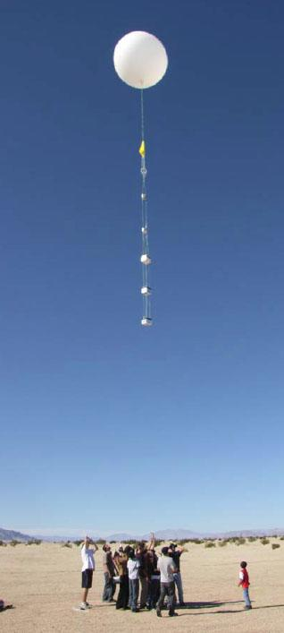
ITAR restrictions
To prevent their use in weapons, all consumer GPS units sold in the US have built-in restrictions to the maximum speed and altitude at which they'll operate
  No higher than 60,000' altitude
  No faster than 1000 knots speed (1150 mph)
All consumer GPS modules are programmed to refuse to operate if one or both of those limits is exceeded
“One or both” becomes important if you want to use GPS on a high-altitude balloon (to 130,000' or more), which only violates one of those limits (altitude).
Different manufacturers will interpret this rule in different ways (and this isn't often in the datasheets). Check Sparkfun user comments and Google for real-world experiences for prospective modules.

Slide 24

Getting to know your GPS
You are now the proud owner of a GPS Shield and an EM-506 GPS module
The EM-506 sends data via standard (asynchronous) serial port (4800 baud)
The Shield has a switch that routes the EM-506's serial port to either:
  Pins 0 and 1 (RX and TX, also used to program the Arduino)
  Pins 2 and 3 (for use with the SoftwareSerial library)
Your Arduino has only one hardware serial port. SoftwareSerial lets
you create additional “soft” serial ports, which can be very useful
For this class, we'll use SoftwareSerial
  Set the “UART/DLINE” switch to “DLINE”
  Remember that serial data will be sent to pins 2 and 3!
Red LED on EM-506:
  Off: powered off
  On (steady): looking for satellites
  On (blinking): has computed a position fix (>= 4 satellites)

Slide 25
Talking to your GPS
Almost all GPS receivers output a data fomat specified by (and generally called) NMEA (National Marine Electronics Association)
This is human-readable ASCII (text) data, sent on a standard serial port, usually at 4800bps (you can change the speed)
Data is sent as comma-separated values
in single lines, or “sentences”
There are about a half-dozen common sentences that have various useful GPS data in them
Example:
$GPRMC,161229.487,A,3723.2475,N,12158.3416,W,0.13,309.62,120598,,*10
What does it mean?

Slide 26
Talking to your GPS
$GPRMC,161229.487,A,3723.2475,N,12158.3416,W,0.13,309.62,120598,,*10
Message: $GP From GPS receiver
Sentence: RMC “Recommended Minimum” data
UTC Time: 161229.487 hhmmss.sss
Status: A A=valid or V=not valid
Latitude: 3723.2475 ddmm.mmmm
N/S: N N=north or S=south
Longitude: 12158.3416 dddmm.mmmm
E/W: W E=east or W=west
Speed: 0.13 knots
Course: 309.62 degrees true
Date 120598 ddmmyy
Mag Var: NA degrees E=east or W=west
Checksum: *10 Lets you check for errors
<CR><LF>: End of message

Slide 27
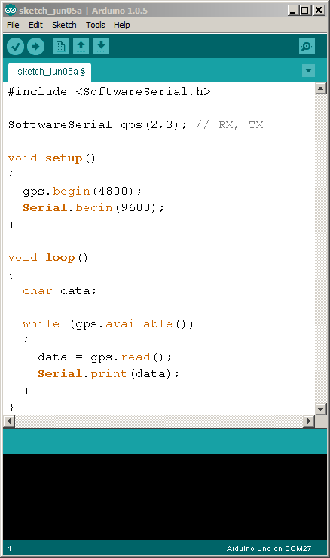
Let's try it!
Write and upload
this sketch
  Or load “PassThrough”
Open the serial
monitor and set it
to 9600 baud
You should see
NMEA data in the
serial monitor
window

Slide 28
NMEA “sentences”
You'll see that each line starts with a '$' and a sentence designator “GPXXX”
Each sentence has a different set of data (some is duplicated)
  Google “NMEA sentence” to learn what all the fields are
What you see is the default set of sentences for this GPS module
You can send commands to the GPS module to turn sentence types on and off, and control the rate at which they appear
  For example, you can ask it to send “RMC” sentences once per second, and the “satellites in view” sentence once every 10 seconds (or not at all).
  See the EM-506 datasheet for info

Slide 29
Interpreting live data
There are any number of GPS viewing programs (free and $)
that can read standard NMEA output
  Download and install the “GPS Viewer / Configuration Software” available from the Venus GPS product page at Sparkfun.com
    Note that this software is for a different GPS module (Venus)
    so it can't configure anything, but it will display the NMEA data
  Set the correct COM port and baud rate (9600 for the passthrough)
  Click the “Connect” icon next to the baudrate
  The software will graphically display the position, satellites in view, etc. (but it does not have access to actual geographic data)

Slide 30
Saving / Logging raw data
If you save the NMEA output of your GPS, you'll have a timestamped record
of everything it does
  Run the previous PassThrough sketch
  Start Coolterm (or the terminal software of your choice) and tell it to talk to your Arduino's serial port at 9600 baud
  Tell Coolterm to save the streaming NMEA data to a text file
  Go somewhere interesting with your Laptop and GPS receiver
  When you're done, tell Coolterm to stop saving the data
You can now load that data into any software that reads NMEA, e.g. Google Earth:
  Find a website that translates NMEA sentences into Google Earth .kml files
    http://www.h-schmidt.net/NMEA/
    Many others out there, Google “NMEA to kml”
  Give the site your saved NMEA file
  Load the output .kml file into Google Earth!

Slide 31
LIVE data to Google Earth
Jeff Branson, everybody!

Slide 32
Using GPS data in your sketches
All the data you need is buried somewhere in one of the NMEA sentences
You could write a sketch that digs through the data and extracts the values you need...
But as is common with Arduino, someone has done the hard work for you!
Use the TinyGPS or TinyGPSPlus libraries by Mikal Hart
  We'll use TinyGPSPlus as it's newer and easier to use
http://arduiniana.org/libraries/tinygpsplus
All you need to do is:
  Blindly pass NMEA sentence data to the library
  The library will parse the data and extract the useful information
  The library provides easy-to-use functions to give you that data
Let's try it!

Slide 33
Install TinyGPSPlus
Go to http://arduiniana.org/libraries/tinygpsplus/
Click download, choose the latest, click “source code (zip)”, save.
Extract the zip file and view the contents
Rename e.g. “TinyGPSPlus-0.94b” to “TinyGPSPlus”
  Arduino doesn't like punctuation except for “_” in filenames
Drag “TinyGPSPlus” to your “Arduino/libraries” folder
Restart the Arduino IDE

Slide 34
Let's try it out!
In the Arduino IDE, open:
File/
Examples/
TinyGPSPlus/
DeviceExample
Change this line:
static const int RXPin = 4, TXPin = 3;
to match the GPS Shield connections:
static const int RXPin = 2, TXPin = 3;
Upload the sketch, and open the serial monitor to 115200 baud
You can run any of the examples as long as you
change the above line in each sketch

Slide 35
Treasure Hunt
The TinyGPSPlus library has functions that can tell you how far away and what direction you are from another location.
Let's use that to make a portable treasure hunting device, and go outside and find some treasure!

Slide 36
Treasure Hunt
Connect your serial LCD to your Arduino + GPS Shield
  Black wire to GND
  Red wire to 5V
  Yellow wire to pin 5
Load the TreasureHunt sketch
Take one Treasure Coordinate Slip from the HAT OF DESTINY
Edit the sketch to replace TARGET_LAT and TARGET_LON
(defined at the top of the sketch) with your treasure coordinates (be sure to double check the numbers for accuracy!)
Upload the sketch...

Slide 37
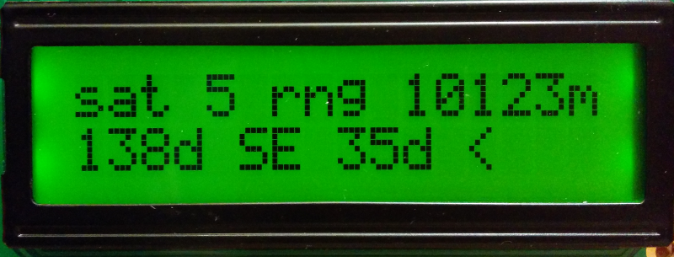
Treasure Hunt
The TreasureHunt sketch opens two SoftwareSerial ports, one for the GPS (pins 2 and 3) and one for the LCD (pins 4 and 5)
It uses the TinyGPSPlus library to compute the distance and bearing from the GPS location to your treasure location, and display useful data on the LCD. Once you have a GPS lock (flashing red light on the EM-506), you should see something like this:

Slide 38
Treasure Hunt
Number of satellites the GPS receiver can see (the more the better)
Range in meters from the current position to the target position
Absolute (compass) bearing from the current position to the target
Relative bearing from your current direction to the target (must be moving to work!)

Slide 39
Absolute vs. Relative course
Absolute course
(no movement required)
Relative course
(requires movement!)
NORTH
target
Target is
45 degrees
to the left of the
current course
target
Targest is
northeast
(315 degrees)
of your
current location
Current course
45 degrees
you
you

Slide 40
GPS course determination
GPS units can determine your course and speed, but these numbers are only valid if you're moving
  Course and speed are determined by looking at the difference between the current position and several previous positions.
  If you're moving, this works well. But if you're not moving, the natural meandering of the GPS location error will give you “windmilling” course and speed information.
  If you stop, you won't know what direction you're facing, which can be problematic for robots
  Some GPS units include an actual magnetic compass to provide heading information even if you're standing still
    You can also incorporate a separate compass into your projects
  Some GPS units have a “pinning” function that will freeze the location if no movement is suspected

Slide 41
Treasure Hunt
Make sure your GPS LED is blinking (has a position fix) and information is displayed on the LCD
If everything is working, disconnect the USB cable, and connect your 4 x AA battery pack
If everything is STILL working, go outside and find your treasure!

Slide 42
Thanks for spending time with us!
More information
  http://learn.sparkfun.com
  http://www.kowoma.de/en/gps/
  mike.grusin@sparkfun.com

Slide 43
Treasure hunt!
40.064367, -105.210019 main sparkfun sign
40.064594, -105.209897 east front sign
40.064596, -105.210328 west parking sign
40.065326, -105.210346 back parking light pole
40.065324, -105.209903 back parking light pole
40.065132, -105.209670 back parking light pole
40.064975, -105.209425 back parking light pole
40.064908, -105.209527 weird pond pole
40.065082, -105.210384 tree at corner of building
40.065090, -105.209854 tree at corner of building
40.064664, -105.209868 tree at corner of building
40.064669, -105.210390 tree at corner of building

