Slide 1

Kick-Off Tokenised Money Workshop
Michael Salmony
Frankfurt
27th May 2026

Slide 2
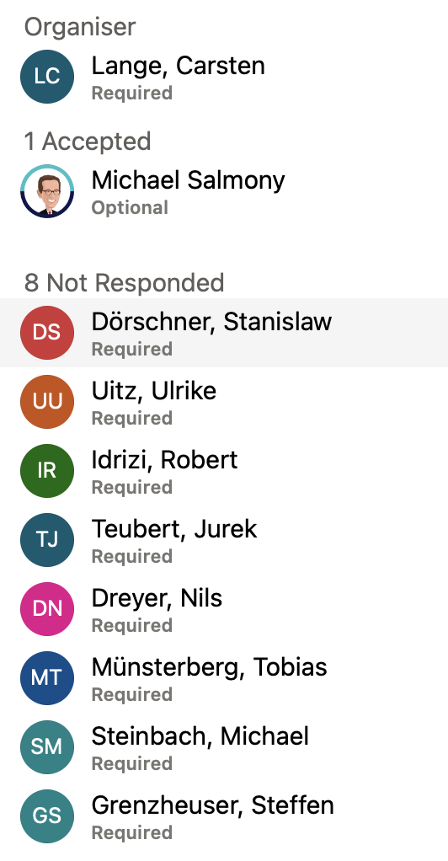
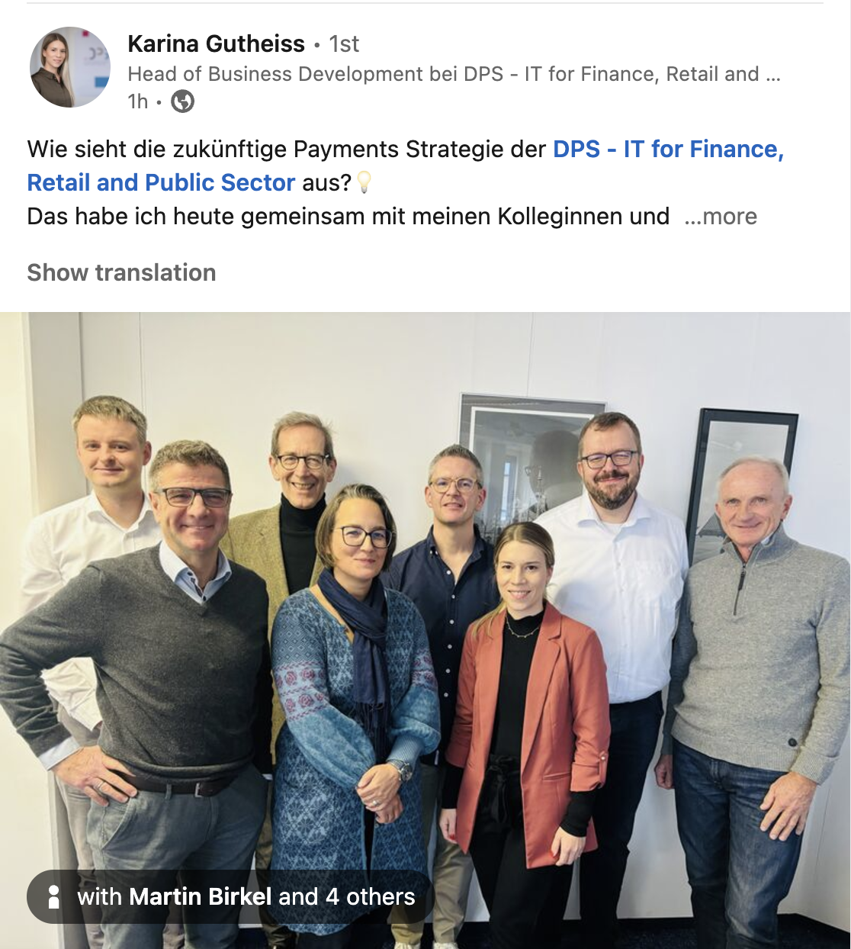
2024 ⇢ heute

Slide 3
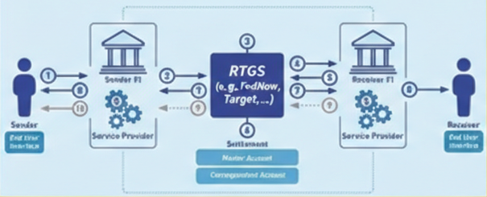



Tokenisation of Money - a good idea
Removing the separation of messaging and money transfer: “Immediate Settlement Finality”
Today
account- to-account
“Digital Bearer Instrument”
Money
Tokenised
phone- to-phone

Slide 4
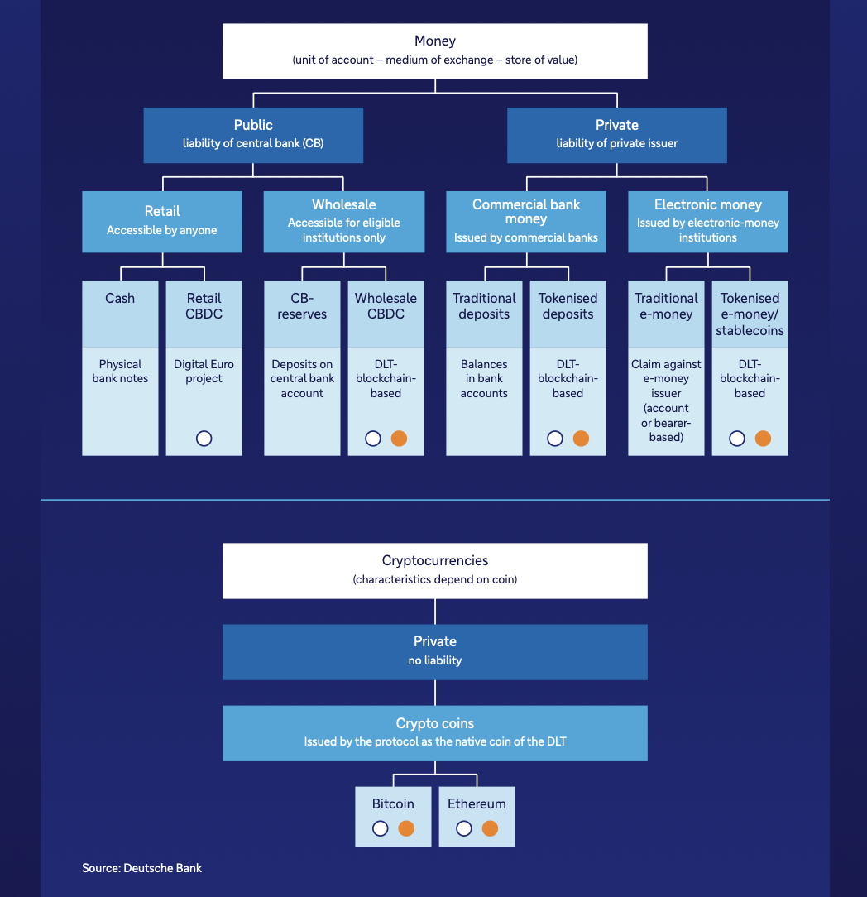
The Money Format Wars
 | Crypto | Stablecoin | Electronic Money | Commercial Bank Money | Central Bank Money
Form | Bitcoin and 10,000 more | Tether (USDT, USA₮), Circle (USDC), … | PayPal (400M), paytm (300M), Alipay/WeChatPay (1bn), GrabPay, MercadoPago, M-Pesa, Starbucks, Telco minutes, WoW gold … wallets | Account at Deutsche, BBVA, … | Reserves – for commercial banks Cash (>1000 years)/Coins (>2000 years) - for everybody
Liability | None | True, regulated stablecoins: on commercial banks, treasuries, …. | On non-bank company | On commercial bank | On central bank
Backing | None | 1:1 fiat, Gold, … (hence “stable”) Beware fake “Stable”coins – see Terra, Luna |  | Insured up to 100k€ (EU) Beyond that: counterparty risk also: some settlement risk | Sovereign/Nation State i.e. free of counterparty risk The ultimate settlement asset
Regulated |  | MiCA (EU) GENIUS (US), etc | Yes – with promise to redeem 1:1 in fiat | Yes | Yes
Acct/Token | Tokenised Stored in Crypto-Wallets |  | E-Wallet Money not lent out, pays no interest | Account | Account
Networks | typ. DLT, enhanced: Lightning |  | Own FinTech network | SWIFT, VISA/MC, SEPA, Instant, … | RTGS, TARGET with finality of settlement
Digital | 100% digital Where the hype was | 100% digital Where the digital attention is globally | 100% digital - used by millions/ billions of users and businesses Where the digital action was globally | By far the dominant form of digital money (20x bigger than central bank money) CBMT, Tokenised Deposit, Deposit Token | Reserves are 100% digital Cash is 100% non-digital rCBDC (digital cash) being explored wCBDC (inter-CB) being explored
Source: after Citi https://www.youtube.com/watch?v=ZfOPZD98H00&ab_channel=MobeyForum

Slide 5
Stablecoins
The new Form Factor of Money

Slide 6
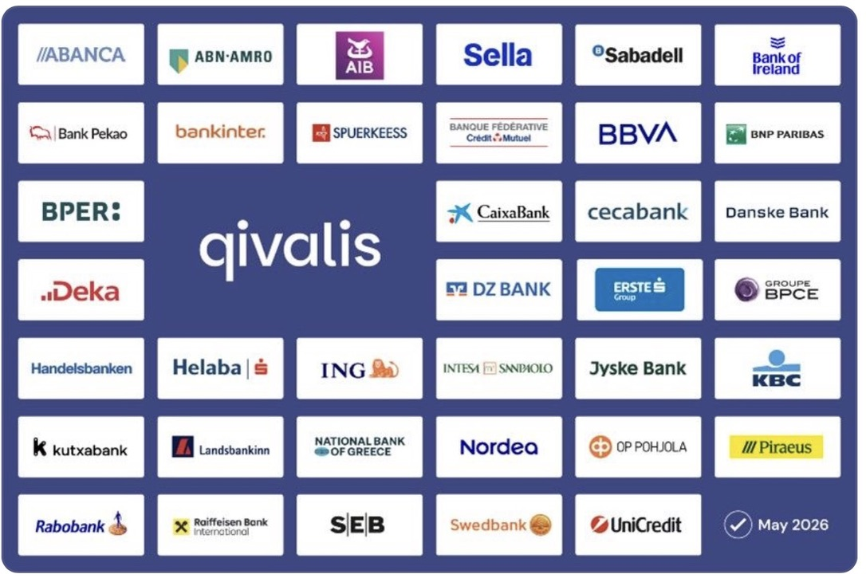
Qivalis – EU Bank Consortium for Stablecoins
Status 1H26 – 37 banks in 15 countries
Euro stablecoin
MiCAR compliant
EMI license being sought from DNB
Planned launch 2H2026
"We're not competing with payments in Europe because payments in Europe work."
Goal: settle tokenised securities in tokenised Euros (Europe has 36 CSDs, 13 central counterparties, no single sovereign bond market, every MS has its own government debt, its own market conventions. (cf US: one treasury market, DTCC, settlement system - FedWIRE)

Slide 7
Summary
Tokenised Assets becoming reality
Many forms of Tokenised Money emerging (Stablecoins, Bank Tokens, CBDC, tMMF, …)
Market – especially in Europe – needs help to scale
Large impacts on banks, networks, providers expected
Develop a Tokenisation Strategy !

Slide 8


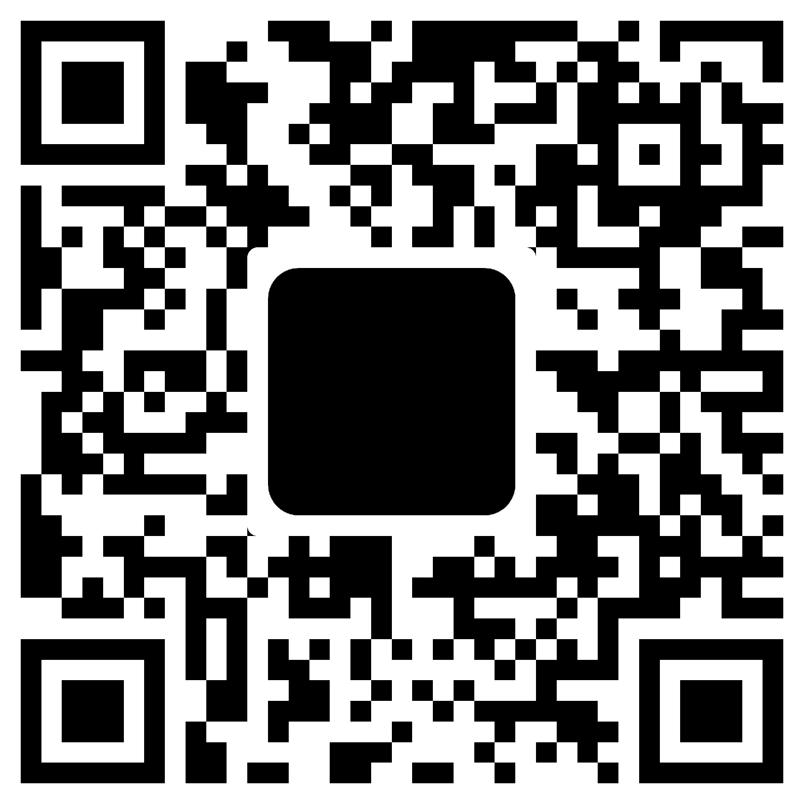
Dr Michael Salmony FRSA
salmony@payments-innovation.com
/in/salmony/
+49 172 6867163
Payments Innovation Consulting is a dedicated consultancy on innovation and digitisation in payments. Confidential information to be used by the recipient only. This document, or any part of it, may not be reproduced, copied, circulated and/or distributed nor quoted without prior written approval from Payments Innovation Consulting.
© Payments Innovation Consulting

