Slide 1

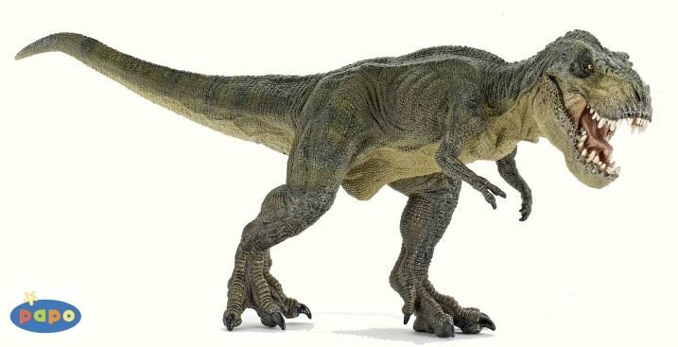

Dynogrid
Particle in Cell Code with Adaptive Grid and Dynamic Load Balancing
Tuesday, April 14th, 2015
Mark Sholte
Scott Luedtke
Max Porter
Joel Iventosch

