Slide 1

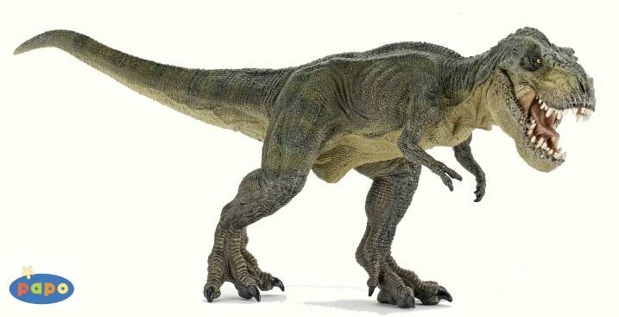

Dynogrid
Particle in Cell Code with Adaptive 3D Grid and Dynamic Load Balancing
Tuesday, April 14th, 2015
Mark Sholte
Scott Luedtke
Max Porter
Joel Iventosch

Slide 2

Preliminary Simulation

Slide 3
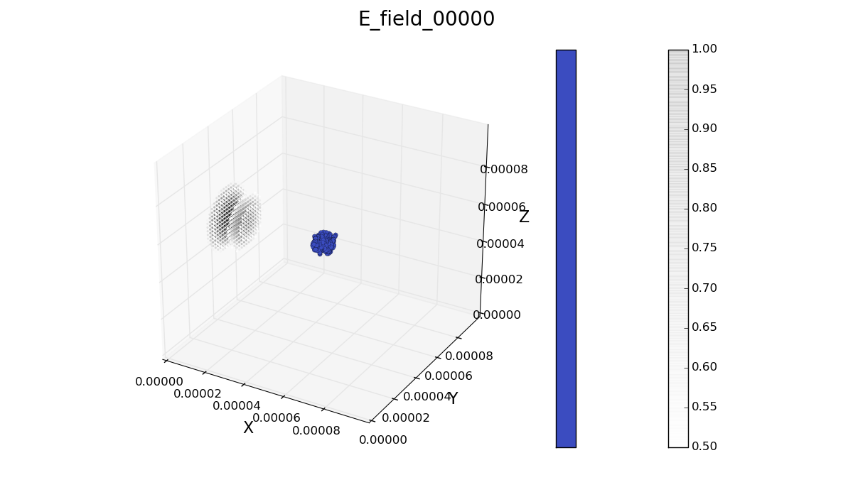
Initial

Slide 4
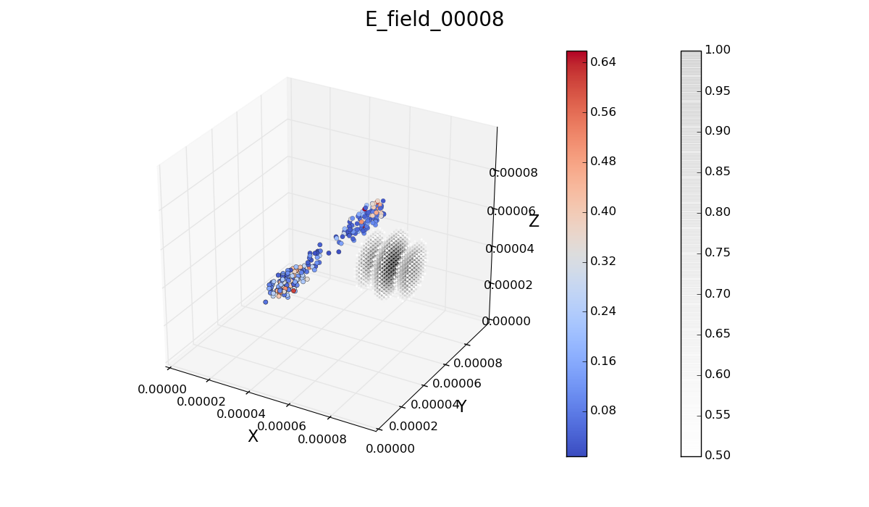
Final

Slide 5
Problem Definition (Theory)
Ultimate problem is achieving optimal load balancing
Since distributed memory (due to problem size), only communicating with nearest neighbors is reasonable
Takes p^{1/3} iterations for information to disseminate (p^{1/3} = # procs in one dimension in 3D)

Slide 6
Problem Definition (Specifics)
Start with a 3-dimensional grid
If D is the finest resolution per dimension, a static grid would have D³ grid points
In real world, D ≈ 1,000,000 ; This is unmanageable
A dynamic grid only requires D resolution in small portion of the grid
For us: D ≈ 100 (D³ ≈ 1,000,000), but only in ≈1/1,000 of the grid
However: dynamic grid makes load balancing very tricky
Problem: Load balancing
How to balance: Grid points? Particles? Both?
Answer: Get weighted calculation of current grid + particle load, Broadcast All2All load sizes, each grid point decides to either Give some load or Take some load
How to most efficiently communicate load exchanges between processors at each time step?
Answer: Give or Take only with neighbors (doing this well is the tricky part)

Slide 7
Complexity Estimates
N = number of grid points
M = number of particles
Sequential case:
Complexity = O(N+M)
Parallel case:
Complexity = O((N+M)/p + (L+M/p^{2/3}b) + (L log p + (n L + p^{2/3}/b) p^{1/3}))
Second group of terms = swapping particles between processors as the particles move
Third group of terms = Load balancing, i.e. intelligently Give or Take grid points

Slide 8
High-level Pseudocode

Slide 9
Goals
Fully distributed memory
MPI communication
Build octrees for adaptive grid, may use Morton ids if deemed useful
Possibly add more accurate physics – there is lots of flexibility here, depending on the time available
Get reasonably close to embarrassingly parallel

