Slide 1
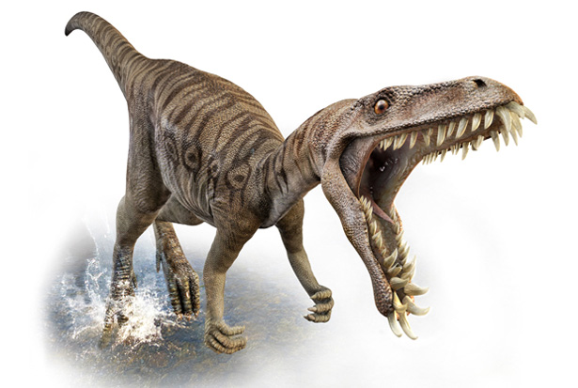
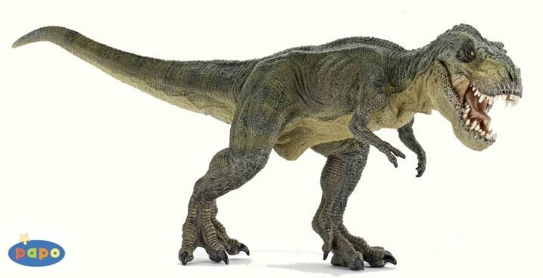
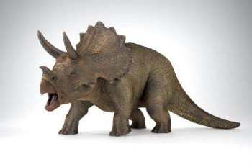
Dynogrid
Particle in Cell Code with Adaptive 3D Grid and Dynamic Load Balancing
Tuesday, April 14th, 2015
Mark Sholte
Scott Luedtke
Max Porter
Joel Iventosch

Slide 2
Problem Definition (The Math)
In theory, embarrassingly parallel is the goal – but a very difficult one

Slide 3
Problem Definition (Example)
Start with a grid of maximum dimensions DxDxD
A static grid would have D³ grid points
A dynamic grid has a(D³)+b((D/10)³)+c((D/100)³)… grid points, where a=% volume where highest resolution is required, b=% volume where second highest resolution is required, etc.
In our case a≈1/1000, b<1 so we have O(D³/1000) grid points (far less than O(D³)), but in a concentrated area
Summary: Most of our grid points are in a highly concentrated moving area, so updating grid values (while also updating particles) requires an intelligent load balancing algorithm
Problem: Load balancing
How to balance: Grid points? Particles? Both?
Answer: Get weighted calculation of current grid + particle load, Broadcast All2All load sizes, each grid point decides to either Give some load or Take some load
Bigger problem: Communication
How to most efficiently communicate load exchanges between processors at each time step?
Answer: Give or Take only with neighbors (doing this well is the tricky part)

Slide 4
? Problem Definition (Example)
[Pictures: 3 versions of simulation output:
1. Boxes drawn to show processor division with static grid and no load balancing
2. Boxes drawn to show processor division with dynamic grid and load balancing around both particles and grid points (before collision)
3. Boxes drawn to show processor division (after collision)

Slide 5
Complexity Estimates
N = number of grid points
M = number of particles
Sequential case:
Complexity = O(N+M)
Parallel case:
Complexity = O((N+M)/p + (l+M/√(p)b) +
Second term = swapping particles between processors as they move
Third term = Load balancing, i.e. intelligently Give or Take grid points

Slide 6
High-level Pseudocode

Slide 7
Goals
Fully distributed memory
MPI communication
Build octtrees for adaptive grid, may use Morton ids if deemed useful
Possibly add more accurate physics – there is lots of flexibility here, depending on the time available

