Slide 1
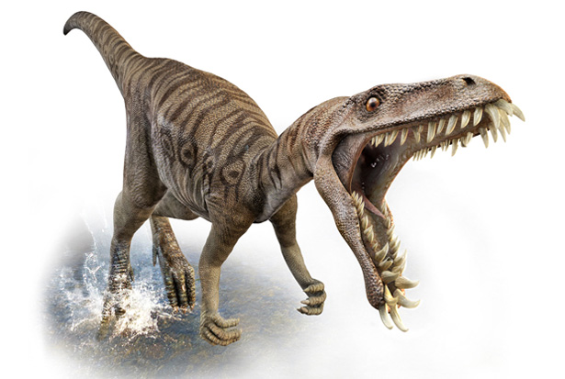
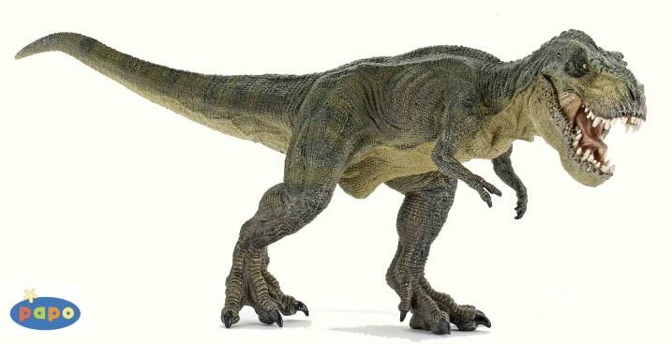

Dynogrid
Particle in Cell Code with Adaptive 3D Grid and Dynamic Load Balancing
Tuesday, April 14th, 2015
Mark Sholte
Scott Luedtke
Max Porter
Joel Iventosch

Slide 2
Problem Definition (Theory)
Ultimate problem is the communication costs of load balancing
Since distributed memory, only communicating with nearest neighbors is reasonable
Takes p^{1/3} iterations for information to disseminate (p^{1/3} = # procs in one dimension in 3D)

Slide 3
Problem Definition (Specifics)
Start with a grid of maximum dimensions DxDxD
A static grid would have D³ grid points
A dynamic grid has a(D³)+b((D/10)³)+c((D/100)³)… grid points, where a=% volume where highest resolution is required, b=% volume where second highest resolution is required, etc.
In our case a≈1/1000, b<1 so we have O(D³/1000) grid points (far less than O(D³)), but in a concentrated area
Summary: Most of our grid points are in a highly concentrated moving area, so updating grid values (while also updating particles) requires an intelligent load balancing algorithm
Problem: Load balancing
How to balance: Grid points? Particles? Both?
Answer: Get weighted calculation of current grid + particle load, Broadcast All2All load sizes, each grid point decides to either Give some load or Take some load
Bigger problem: Communication
How to most efficiently communicate load exchanges between processors at each time step?
Answer: Give or Take only with neighbors (doing this well is the tricky part)

Slide 4
Complexity Estimates
N = number of grid points
M = number of particles
Sequential case:
Complexity = O(N+M)
Parallel case:
Complexity = O((N+M)/p + (l+M/(p^{2/3})b) +
Second term = swapping particles between processors as they move
Third term = Load balancing, i.e. intelligently Give or Take grid points

Slide 5
High-level Pseudocode

Slide 6
Goals
Fully distributed memory
MPI communication
Build octtrees for adaptive grid, may use Morton ids if deemed useful
Possibly add more accurate physics – there is lots of flexibility here, depending on the time available
Get reasonably close to embarrassingly parallel

