Slide 1
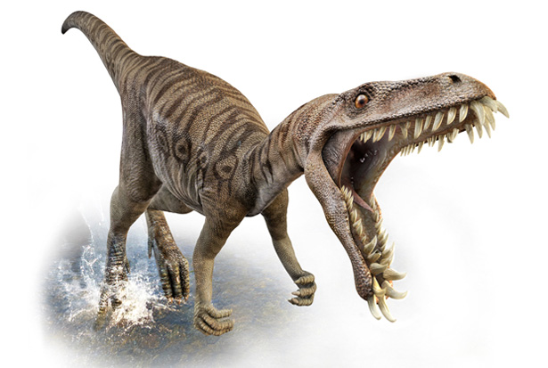
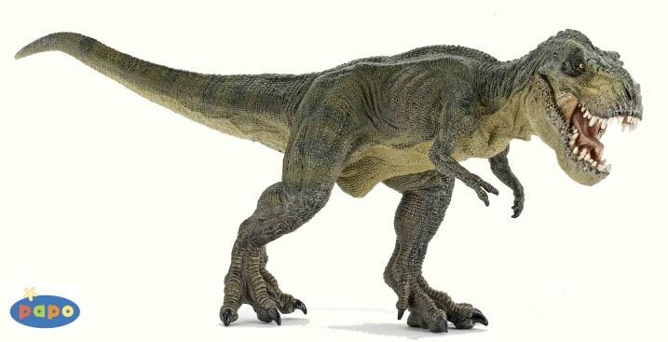

Dynogrid
Particle in Cell Code with Adaptive Grid and Dynamic Load Balancing
Tuesday, April 14th, 2015
Mark Sholte
Scott Luedtke
Max Porter
Joel Iventosch

Slide 2
Problem Definition (The Math)

Slide 3
Problem Definition (Example)
[Pictures: 3 versions of simulation output:
1. Boxes drawn to show processor division with static grid and no load balancing
2. Boxes drawn to show processor division with dynamic grid and load balancing around both particles and grid points (before collision)
3. Boxes drawn to show processor division (after collision)

Slide 4
Complexity Estimates
G = number of grid points
N = number of particles
Sequential case:
Complexity = O(G+N)
Parallel case:
Worst case: O(G/p+N) or O(G+N/p)
[Should never happen]
Best case: O((G+N)/p)
[Will rarely happen – embarrassingly parallel]

