Slide 1

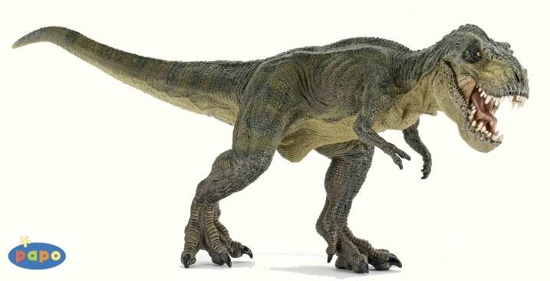

Dynogrid
Particle in Cell Code with Adaptive 3D Grid and Dynamic Load Balancing
Tuesday, April 14th, 2015
Mark Sholte
Scott Luedtke
Max Porter
Joel Iventosch

Slide 2

Preliminary Simulation

Slide 3
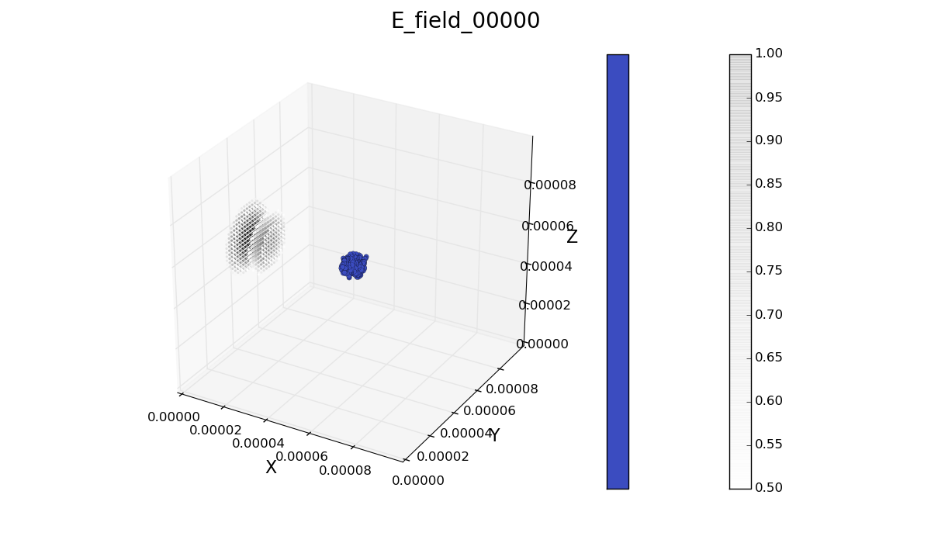
Initial

Slide 4
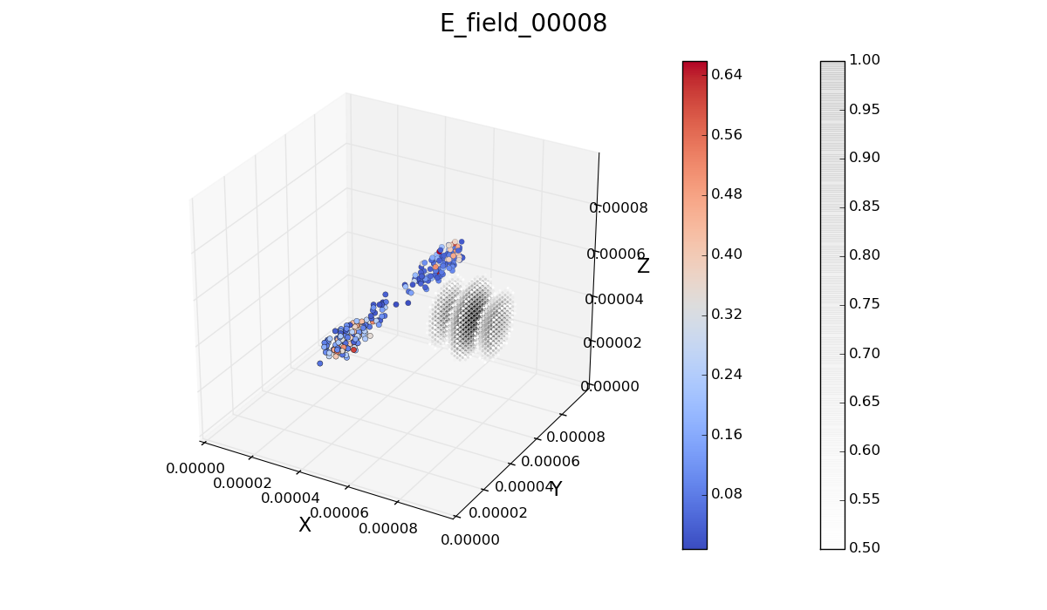
Final

Slide 5
Problem Definition (Theory)
Ultimate problem is achieving optimal load balancing
Since distributed memory (due to problem size), only communicating with nearest neighbors is reasonable
Takes p^{1/3} iterations for information to disseminate (p^{1/3} = # procs in one dimension in 3D)

Slide 6
Problem Definition (Specifics)
Start with a 3-dimensional grid
If D=Finest grid dimension needed…
Static grid: D³ grid points
Dynamic: D³ x (small factor) grid points
However: dynamic grid makes load balancing very tricky
Problem: Load balancing
Distributed memory
Balancing both grid points (dynamic) and particles (moving)
Need small All2All comm, lots of (intelligent) neighbor comm

Slide 7
Complexity Estimates
N = number of grid points
M = number of particles
Sequential case:
Complexity = O(N+M)
Parallel case:
Complexity = O((N+M)/p + (L+M/p^{2/3}b) + (L log p + (n L + p^{2/3}/b) p^{1/3}))
Second group of terms = swapping particles between processors as the particles move
Third group of terms = Load balancing, i.e. intelligently Give or Take grid points

Slide 8
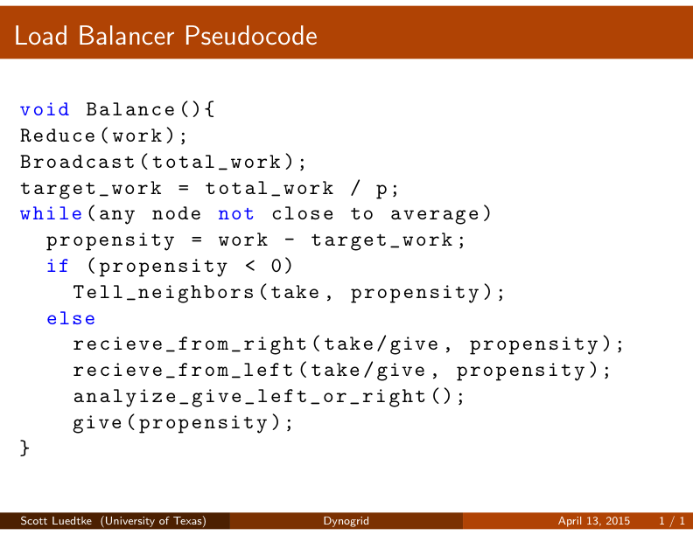
High-level Pseudocode

Slide 9
Goals
Achieve optimum load balancing
Optimize load balancer
Build MPI communication routines
Implement adaptive grid
Possibly add more accurate physics – there is lots of flexibility here, depending on the time available

